Slide 1
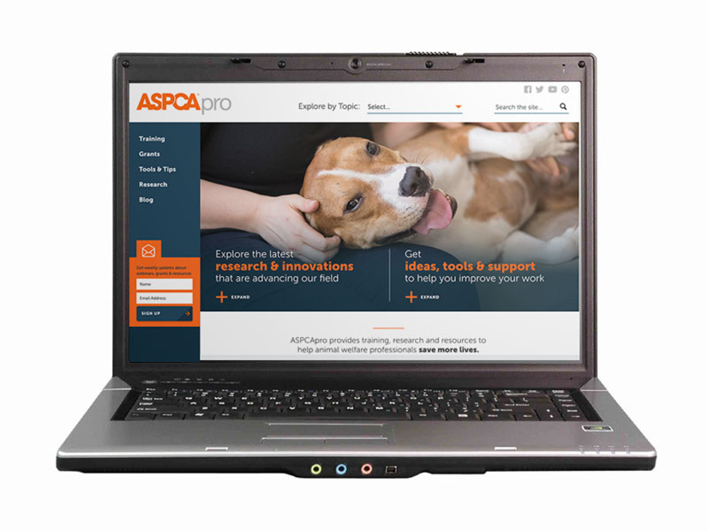
Determining National Emergency Veterinary Response Capabilities
Enjoy the music!
The webinar will begin at its scheduled time.
Join the webinar using built-in computer audio or dial
669-900-6833 or 646-558-8656
Webinar ID: 616-661-922

Slide 2
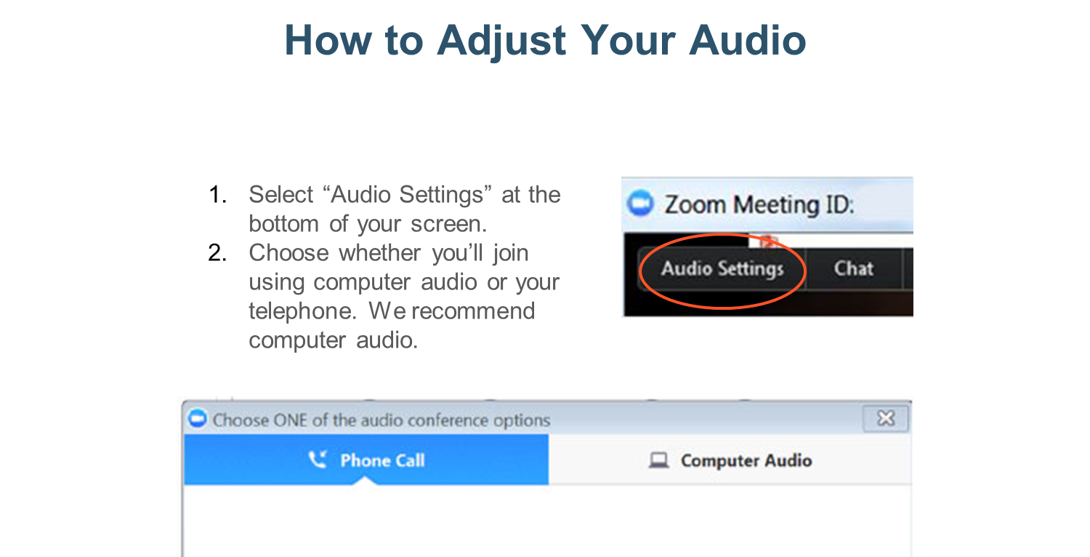

Slide 3
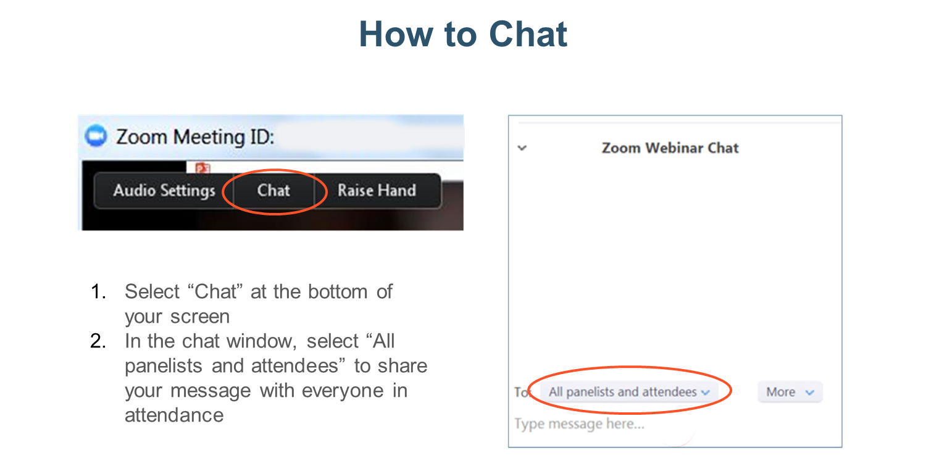

Slide 4
Determining National Emergency Veterinary Response Capabilities
Dr. Dick Green
ASPCA Senior Director, Disaster Response
Notes:
You have to look at the whole dog and the context in order to accurately interpret what’s going on
4

Slide 5
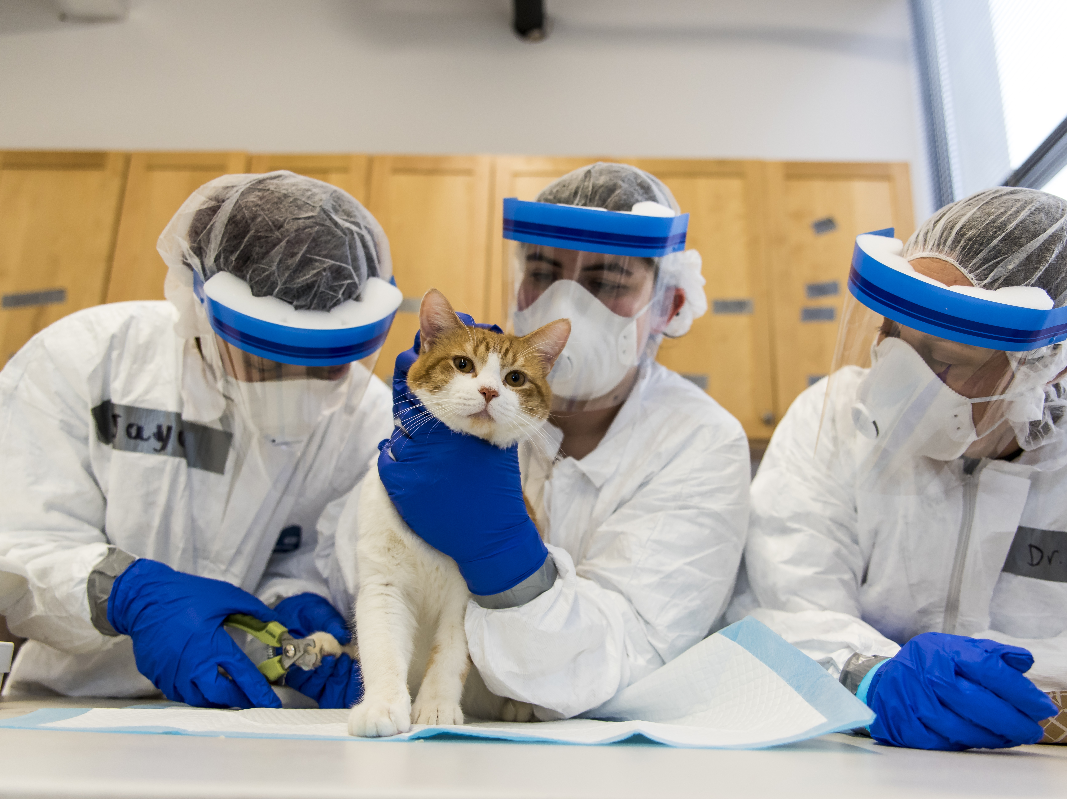
Determining National Emergency Veterinary Response Capabilities
Dick Green, EdD
Sr. Director Disaster Response

Slide 6
Emergency Veterinary Resources
Fed/National
NGOs
State
VRC
State VMA
Local
Individuals
Clinics
VMA
Agriculture
Mutual Aid
EMAC
NVRT

Slide 8
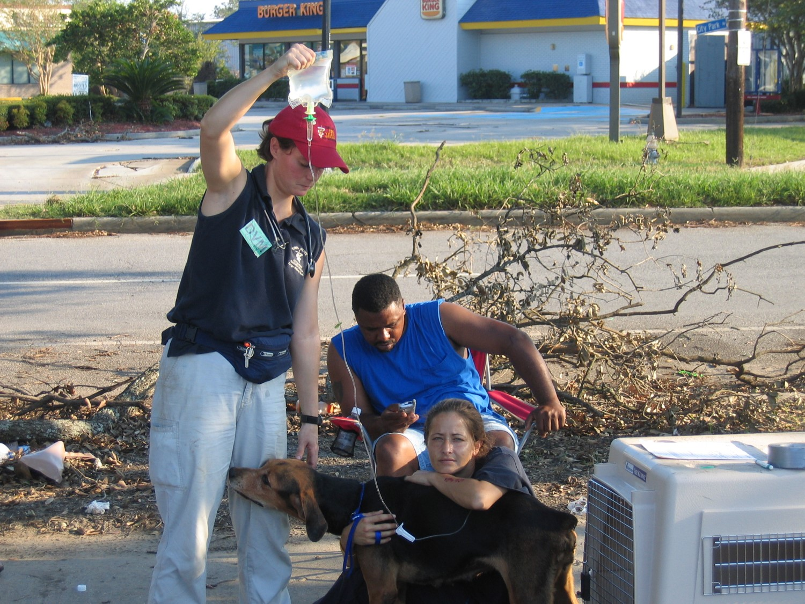
Animals in Disasters
Large human impact results in large animal impact
Hurricanes, wildfires, tornadoes, floods
Local capacity is typically overwhelmed
Impacted clinics
Lack of a County Animal Response Team (CART)
Lack of a Veterinary Reserve Corp (VRC)

Slide 9
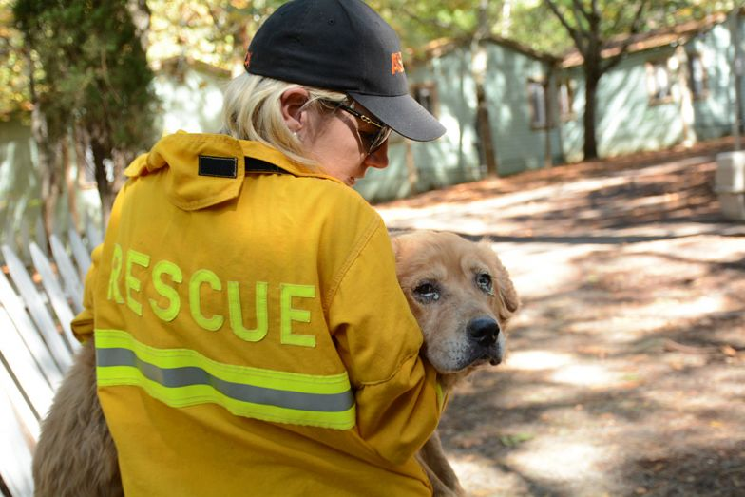
Determining National Animal Response Capabilities
National Capabilities for Animal Response in Emergencies (NCARE Study)
Washington State CARE Study
NYS CARE Study

Slide 10
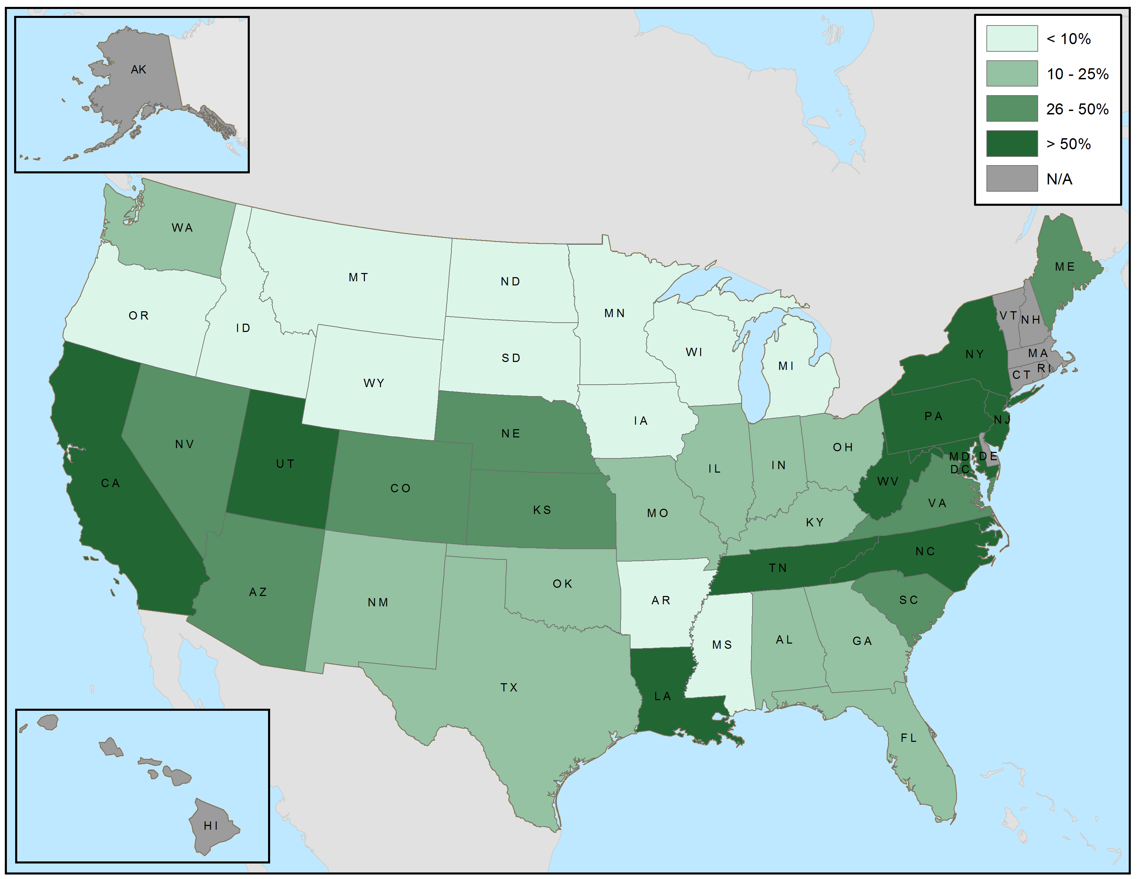
Percentage of counties with a CART
Notes:
Grey – fewer than 4 counties responded
OR New England states, not organized at county level

Slide 11
Small County Resources by FEMA Region
 |  | FEMA Region
 | Total N=561 | II N=16 | III N=48 | IV N=125 | V N=75 | VI N =93 | VII N=88 | VIII N =57 | IX N=17 | X N=42
Has CART or similar county organization, % (95% CI) | 23 (20-27) | 69 (41-89) | 50 (35-65) | 27 (20-36) | 13 (7-23) | 15 (8-24) | 23 (14-33) | 16 (7-28) | 41 (18-67) | 2 (0-13)
Has cache of small animal supplies, % (95% CI)** | 41 (37-46) | 87 (60-98) | 73 (57-85) | 50 (40-60) | 49 (36-61) | 22 (14-31) | 27 (18-38) | 24 (13-37) | 94 (70-100) | 29 (15-46)
Has cache of large animal supplies, % (95% CI)** | 9 (7-12) | 20 (4-48) | 12 (4-25) | 7 (3-14) | 9 (3-18) | 4 (1-11) | 8 (3-16) | 17 (8-29) | 33 (11-62) | 0 (0-10)
Plans to allow pets and their owners to shelter together, % (95% CI)** | 50 (46-54) | 67 (38-88) | 57 (42-72) | 42 (32-52) | 44 (32-57) | 47 (37-58) | 71 (60-81) | 36 (24-50) | 65 (38-86) | 41 (24-59)

Slide 12
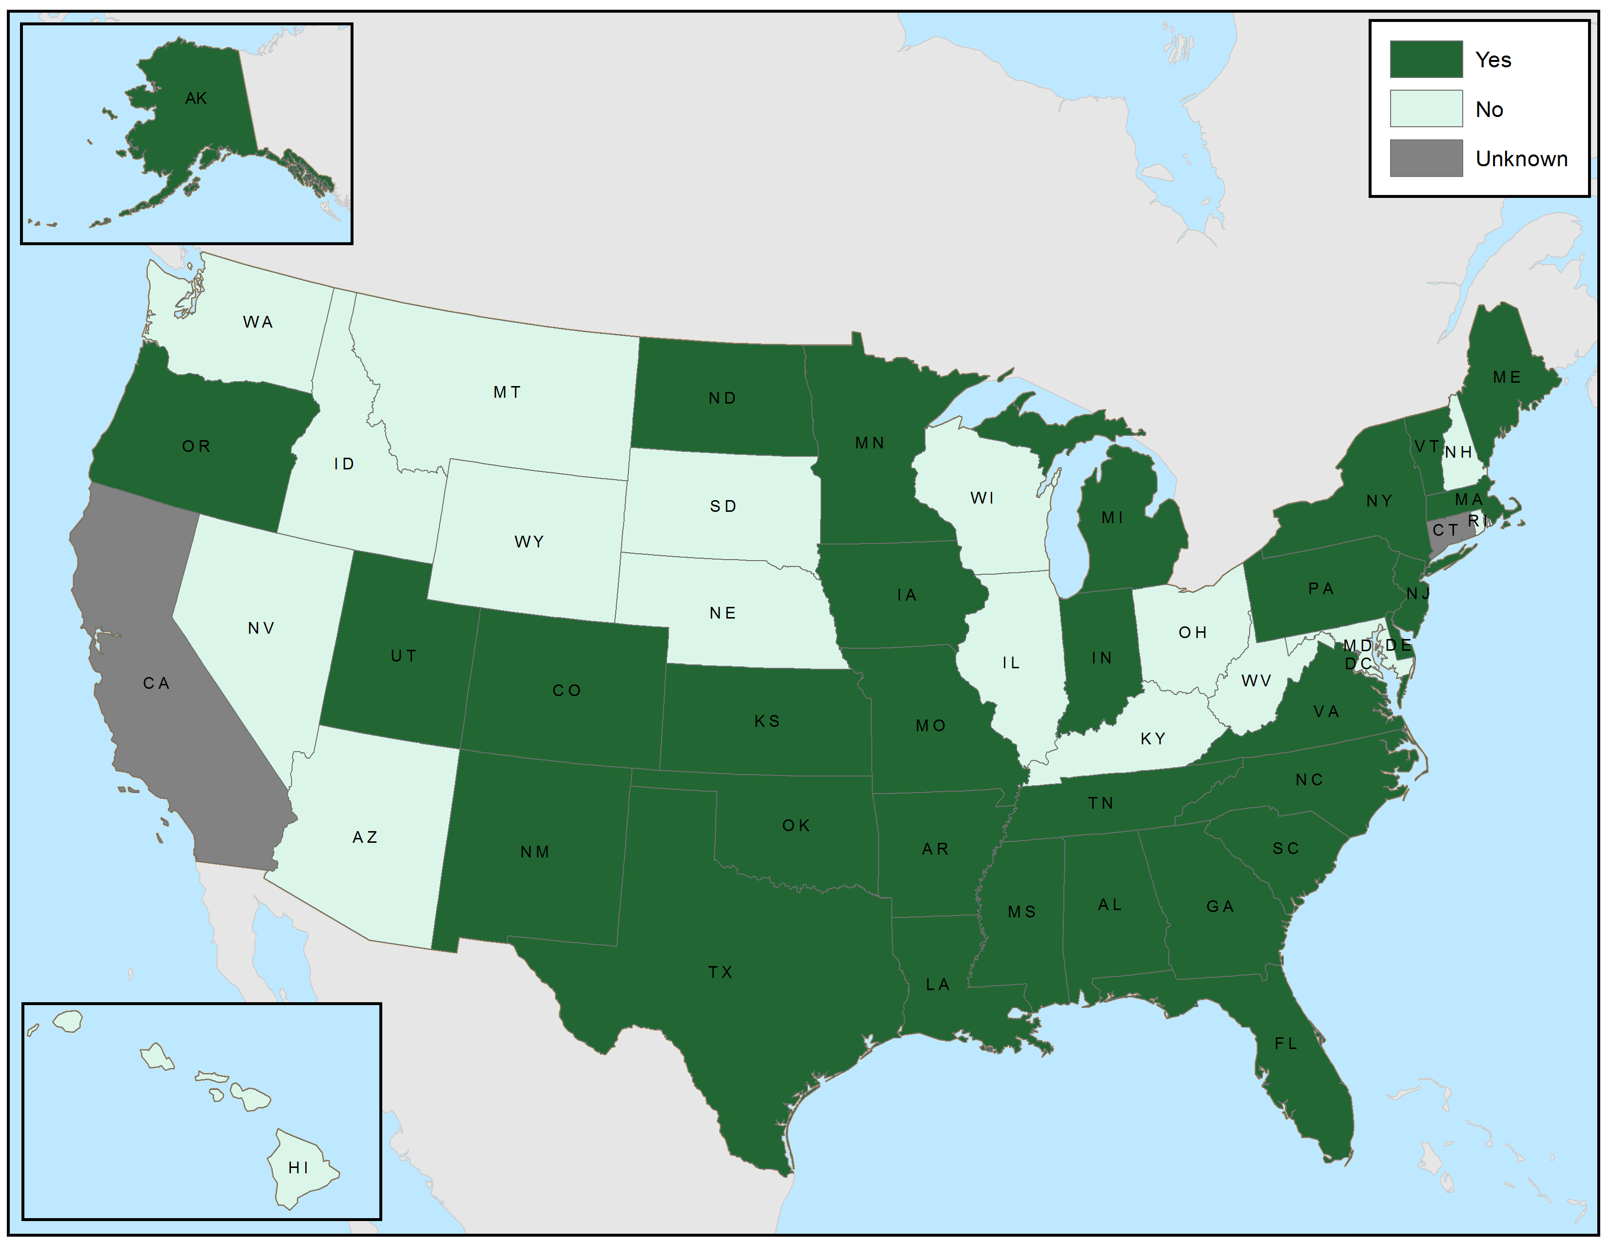
Where are SARTs?
State has SART?
Notes:
Individual states now – when publish summarize at FEMA region level

Slide 13
State Resources by FEMA Region
 | FEMA Region
 | I | II | III | IV | V | VI | VII | VIII | IX | X
Responded to survey, N (%) | 5 (83) | 2 (100) | 5 (100) | 8 (100) | 6 (100) | 5 (100) | 4 (100) | 6 (100) | 3 (75) | 4 (100)
Has SART or similar state organization, % | 60 | 100 | 60 | 88 | 50 | 100 | 75 | 50 | 0 | 50
Has cache of small animal supplies, %** | 80 | 100 | 100 | 75 | 50 | 100 | 75 | 50 | 33 | 75
Has cache of large animal supplies, %** | 40 | 0 | 40 | 63 | 33 | 40 | 75 | 83 | 33 | 75
Plans to allow pets and their owners to shelter together, %** | 75 | 50 | 100 | 63 | 50 | 80 | 100 | 100 | 67 | 50

Slide 14
Local Veterinary Support?
WS CARE; Washington State Department of Agriculture
NYS CARE: NYS Department of Agriculture and Markets
Dr. Minden Buswell, WSDA Dr. Eireanne Collins, NYSDAM

Slide 15
WA: Does your county have a plan for providing vet assistance for animal shelters?
Notes:
30%

Slide 16
WA: How many animals can your vet team treat at an animal shelter?
Notes:
40% can care for up to 100

Slide 17
NY: Does your county have a plan for providing vet assistance for animal shelters?
42.2%
57.8%

Slide 18
NY: How many animals can your veterinary team treat at an animal shelter?
9.0%
72.6%
18.4%

Slide 19
State Veterinary Support?
National Veterinary Medical Response Capabilities Survey

Slide 20
National Veterinary Capabilities Survey
Created by NASAAEP and ASPCA Feb, 2019
Distributed by NASAAEP to all State Representatives on March 1
Follow-up (pestering) by Board of Directors and ASPCA through April.
48 states (96%) completed the survey.

Slide 21
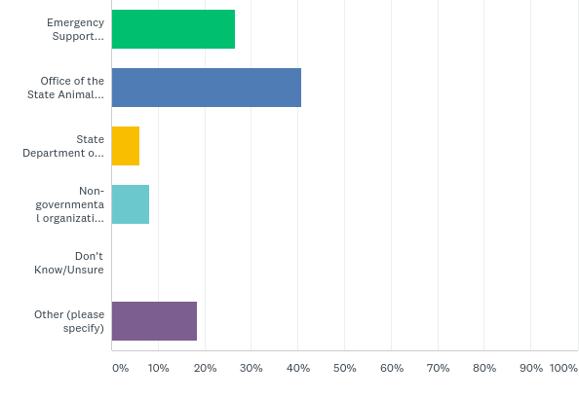
What type of entity serves as the animal emergency resource coordinating body?
Emergency Support Function (ESF)
26.5%
State Animal Health Official
40.8%
State Department of Agriculture
6.1%
NGO
8.2%
Don’t know/ Unsure
Other (please specify)
18.4%

Slide 22
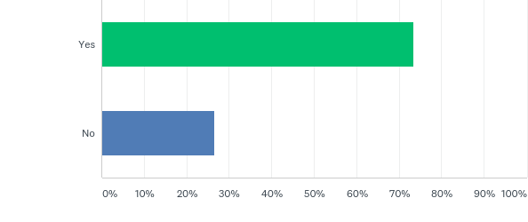
Is there a process to request aid from in-state vets to provide treatment following a disaster?
Yes
73.5%
No
26.5%

Slide 23
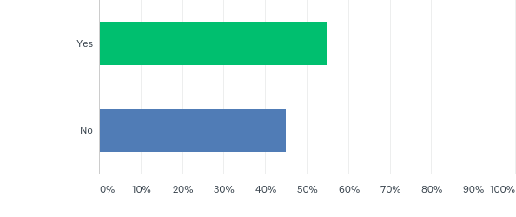
Does your state currently have a vet response/ reserve corps (VRC) or similar group?
55.1%
44.9%

Slide 25
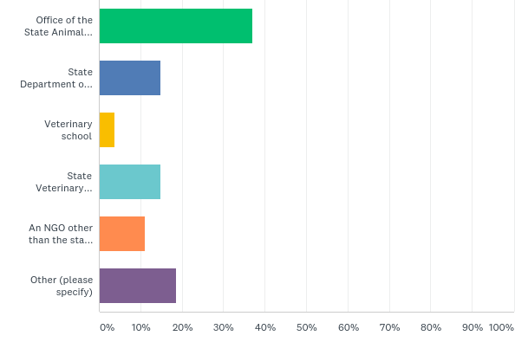
Under what entity does the VRC reside?
State Animal Health Official
37.0%
State Department of Agriculture
14.8%
Veterinary School
3.7%
State Veterinary Medical Association
14.8%
NGO (other than VMA)
11.1%
Other (please specify
18.5%
Answered: 27 Skipped: 23

Slide 26
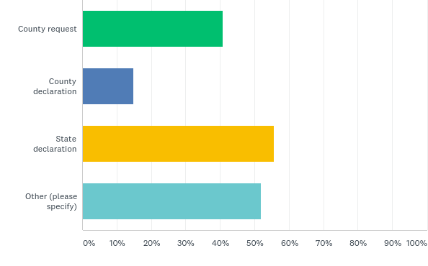
How is the VRC activated? Select all that apply.
County request
40.7%
County declaration
14.8%
State declaration
55.6%
Other (please specify
51.9%
Answered: 27 Skipped: 23

Slide 27
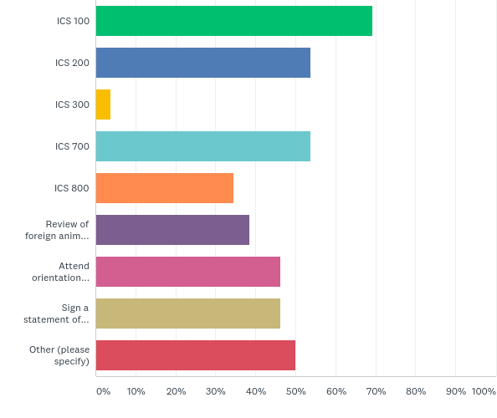
What training is the VRC required to complete prior to deployment? Select all that apply.
ICS 100
69.2%
ICS 200
53.9%
ICS 300
3.9%
IS 700
53.9%
IS 800
34.6%
Review of FADs/Bio-security protocols
38.5%
Attend orientation session
46.2%
Sign a Statement of Liability/Understanding
46.2%
Other (please specify)
50.0%
Answered: 26 Skipped: 24

Slide 28
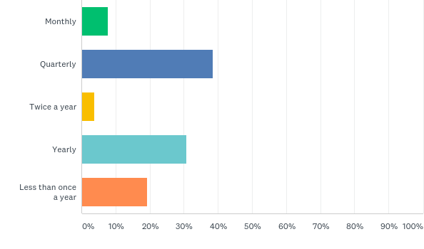
How often do you keep in contact with your VRC (meetings, updates, newsletters, etc)?
Monthly
7.7%
Quarterly
38.5%
Twice a year
3.9%
Yearly
30.8%
Less than once a year
19.2%
Answered: 26 Skipped: 24

Slide 29
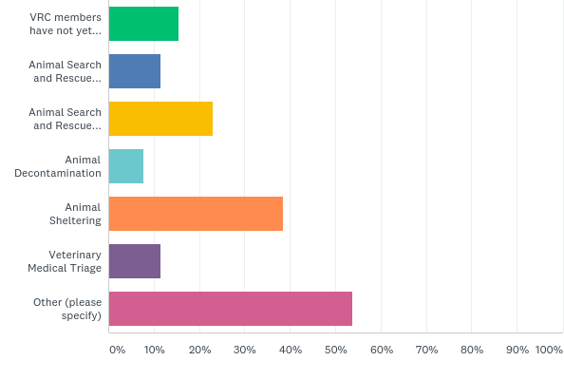
What types of training have VRC members had in last 24 months? Select all that apply.
VRC members have not yet had training
15.4%
Animal Search and Rescue Small Animal
11.5%
Animal Search and Rescue Large Animal
23.1%
Animal Decontamination
7.7%
Animal Sheltering
38.5%
Veterinary Medical Triage
11.5%
Other (please specify)
53.9%
Answered: 26 Skipped: 24

Slide 30
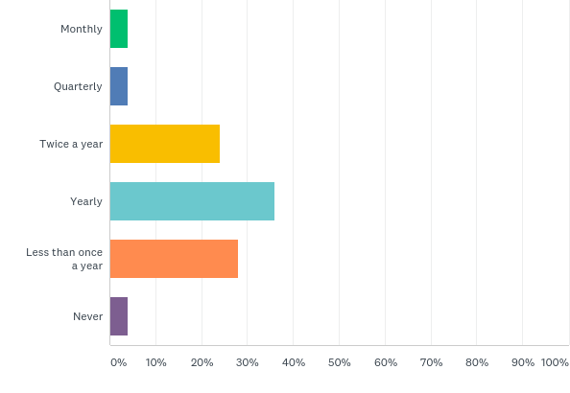
Approximately how often are the VRC training sessions held?
Monthly
4.0%
Quarterly
4.0%
Twice a year
24.0%
Yearly
36.0%
Less than once a year
28.0%
Never
4.0%
Answered: 25 Skipped: 25

Slide 31
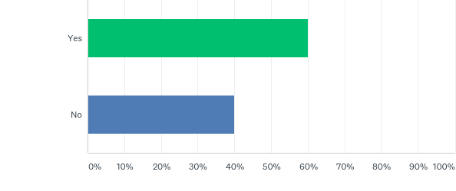
Does the VRC participate in drills and exercises (e.g., TTX, functional, full-scale)?
Yes
60.0%
No
40.0%
Answered: 25 Skipped: 25

Slide 32
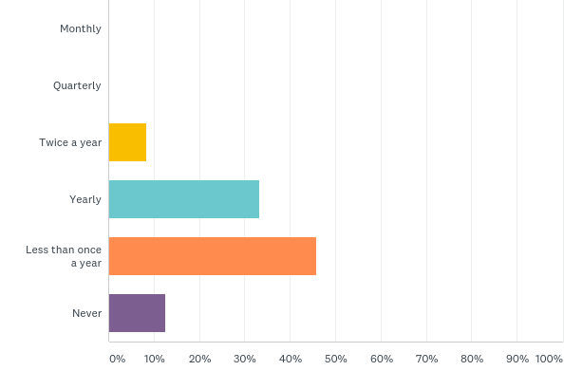
How often are drills and/or exercises performed?
Monthly
Quarterly
Twice a year
8.3%
Yearly
33.3%
Less than 1 a year
45.8%
Never
12.5%
Answered: 24 Skipped: 26

Slide 33
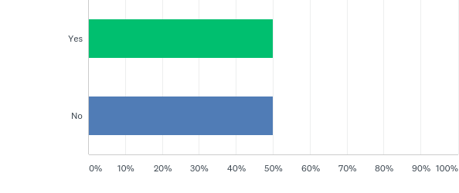
Does your VRC or VMA maintain a cache of supplies or equipment?
Yes
50.0%
No
50.0%
Answered: 26 Skipped: 24

Slide 34
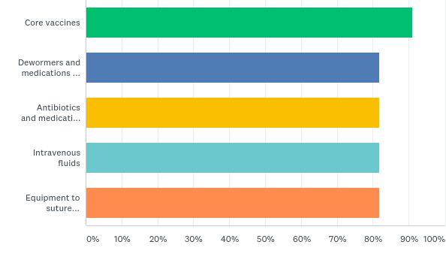
Are assisting vets/VRC able to provide medical supplies to treatment site? Select all that apply.
Core vaccines
90.9%
Dewormers and meds to treat parasites
81.8%
Antibiotics and meds for inflammation/ pain
81.8%
Intravenous fluids
81.8%
Equipment to suture and treat wounds
81.8%
Answered: 11 Skipped: 40

Slide 35
Has your state ever activated the VRC?
Yes
50.0%
No
50.0%
Answered: 26 Skipped: 25

Slide 36
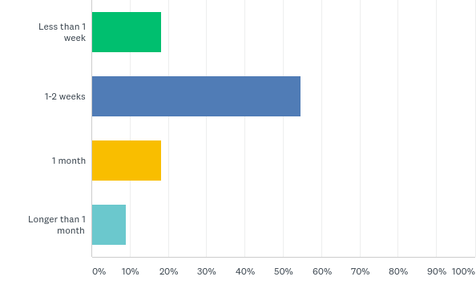
What is the longest period of time the VRC has been deployed?
Less than 1 week
18.2%
1-2 weeks
54.6%
1 month
18.2%
Longer than 1 month
9.1%
Answered: 11 Skipped: 40

Slide 37
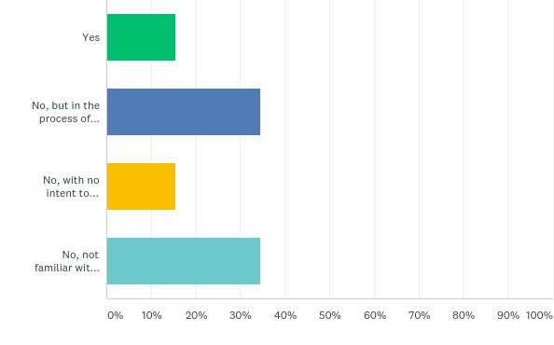
Do you align your VRC job descriptions with the FEMA Animal Resource Typing Guidelines?
Yes
15.4%
No, but in the process of making them align
34.6%
No, with no intent
to change
15.4%
Not familiar with Animal Resource Typing
34.6%
Answered: 26 Skipped: 25

Slide 38
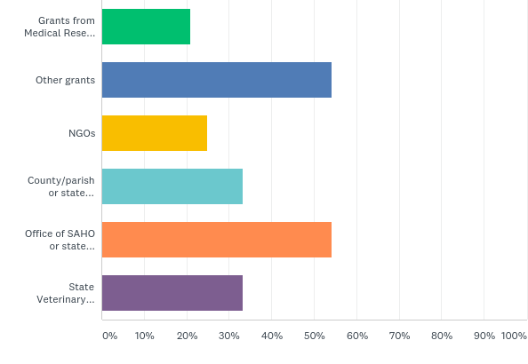
What funding sources have you used for VRC training? Select all that apply.
Grants from Medical Reserve Corps/NACCHO
20.8%
Other grants
54.2%
NGOs
25.0%
County/parish, state emergency management
33.3%
Office of SAHO or State Department of Agriculture
54.2%
State Veterinary Medical Association
33.3%
Answered: 24 Skipped: 27

Slide 39
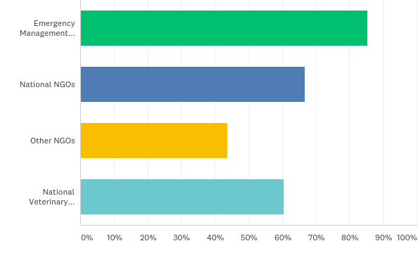
If unable to meet vet needs in state, where would you request resources? Select all that apply.
Emergency Management Assistance Compact (EMAC)
85.4%
National NGOs
66.7%
Other NGOs
43.8%
National Veterinary
Response Team (NVRT)
60.4%
Answered: 48 Skipped: 3

Slide 40
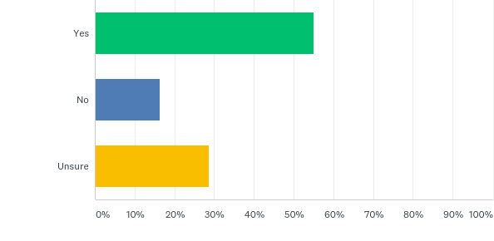
Is a license reciprocity process in place for invited vet personnel licensed in other states?
Yes
55.1%
No
16.3%
Unsure
28.6%
Answered: 49 Skipped: 2

Slide 41
Please select the NASAAEP discussions you would like to see regarding VRCs and emergency animal medical treatment capabilities. Select all that apply.

Slide 42
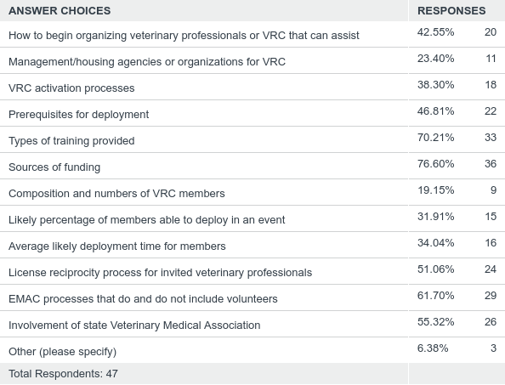

Slide 43
What’s Next?
Share the data at NASAAEP Summit next month
Encourage states to develop and maintain VRCs
Provide information and trainings
Identify potential grant opportunities
Enhancing the number of veterinary teams that are deployable through EMAC
Additional trainings on FEMA Animal Resource Typing and Mission Ready Packages
Maintain a strong federal response team

Slide 44
National Disaster Medical System (NDMS)
Supports state, local, tribal and territorial authorities following disasters and emergencies by supplementing health and medical systems and response capabilities.
ESF-8, Public Health and Medical Services, of the National Response Framework, employs the NDMS to provide patient care, patient movement, and definitive care, as well as veterinary services.
Disaster Medical Assistance Teams
Trauma and Critical Care Teams
Disaster Mortuary Operational Response Team
Victim Information Center Team
National Veterinary Response Team

Slide 45
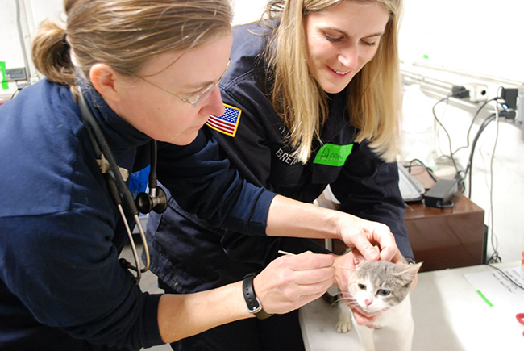
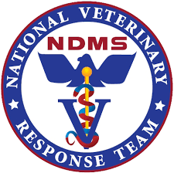
NVRT
The primary Federal resource for the treatment of injured or ill animals affected by disasters.
During a response, NVRT provides assessments, technical assistance, public health and veterinary services; supported by a cache of equipment, supplies and pharmaceuticals.

Slide 46
50 Amazing Sessions
National Vet Capabilities Survey
Impact of Climate Change and Planning for Animals in Disasters
WSCARE and NYSCARE Surveys
Animal Sheltering Types
Creating a CART
DoD Veterinary Capabilities
Crisis Communication

Slide 47
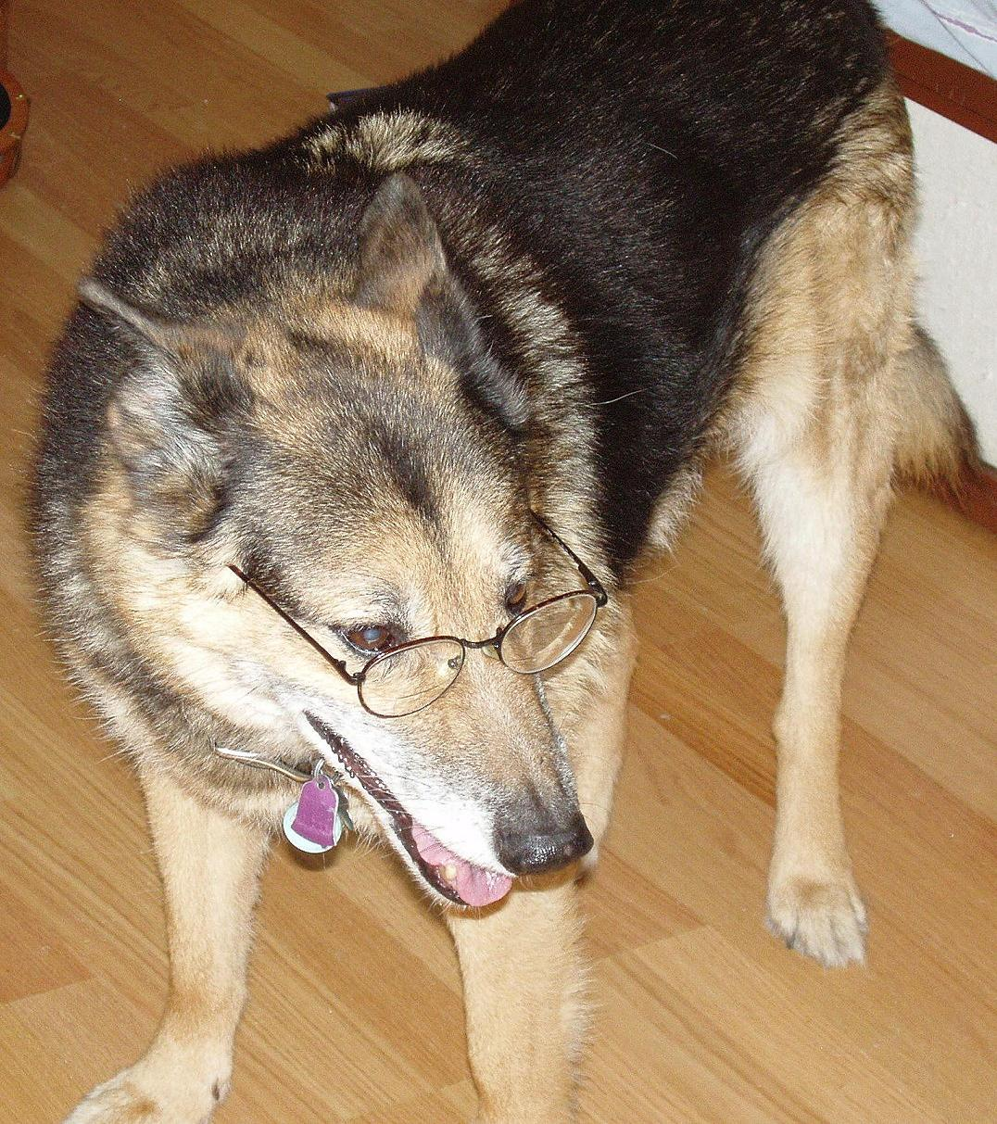
Thank You!!
Dick.green@aspca.org
Andy, 2008
Andi, 2019

