Slide 1
Speaking Dog! Canine Communication Webinar Series #2 of 3
Enjoy the music!
The webinar will begin at its scheduled time.
Join the webinar using built-in computer audio or dial
669-900-6833 or 646-558-8656
Webinar ID: 584-229-034

Slide 2
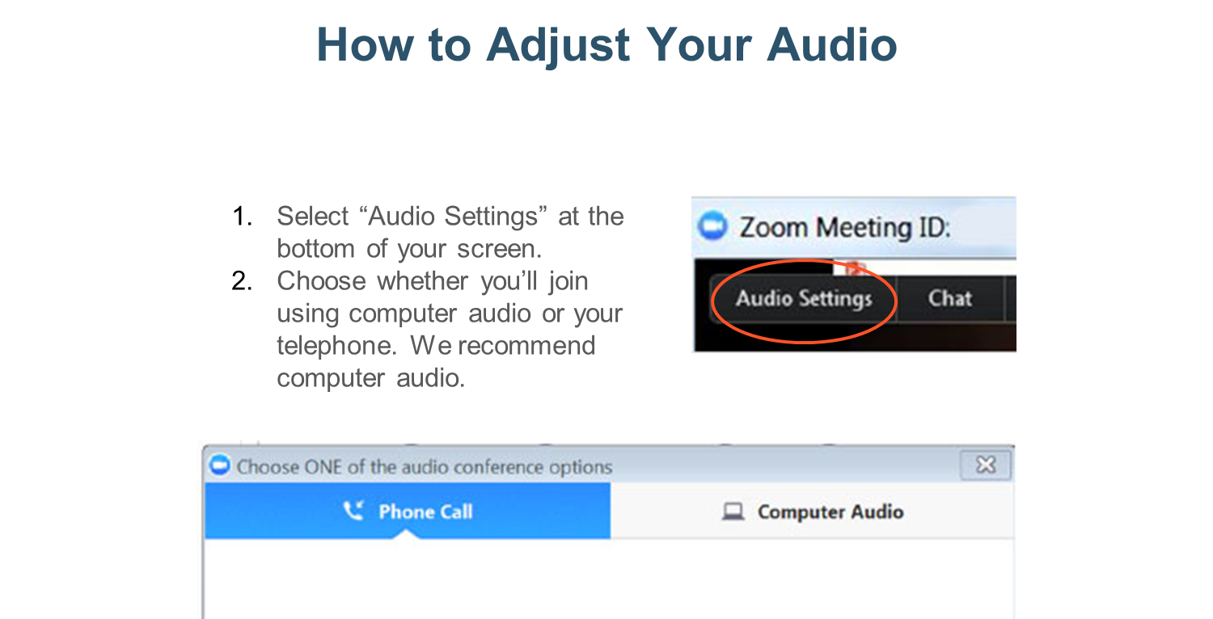

Slide 3
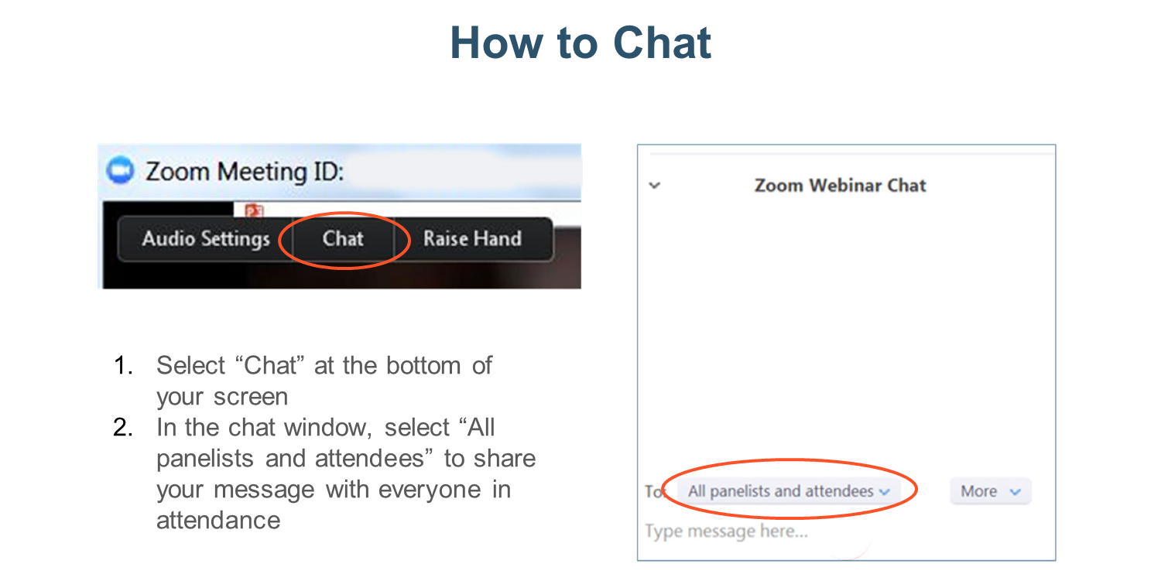

Slide 4
Speaking Dog! Canine Communications Part 2
Dr. Pamela Reid
PhD, CAAB Vice President, ASPCA Behavioral Sciences Team
Notes:
You have to look at the whole dog and the context in order to accurately interpret what’s going on
4

Slide 5
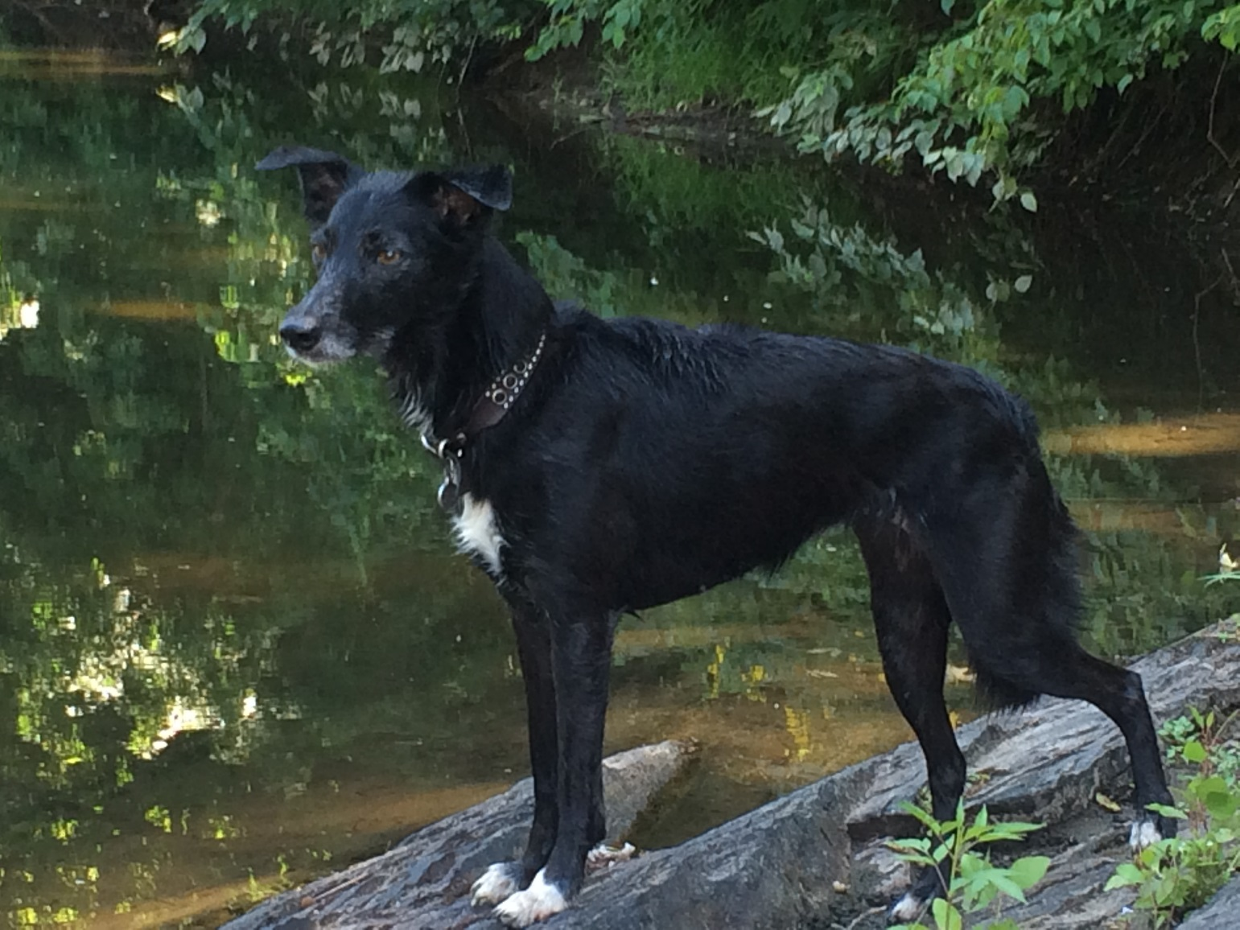
The Whole Dog
Putting the pieces together
Notes:
You have to look at the whole dog and the context in order to accurately interpret what’s going on
5

Slide 6
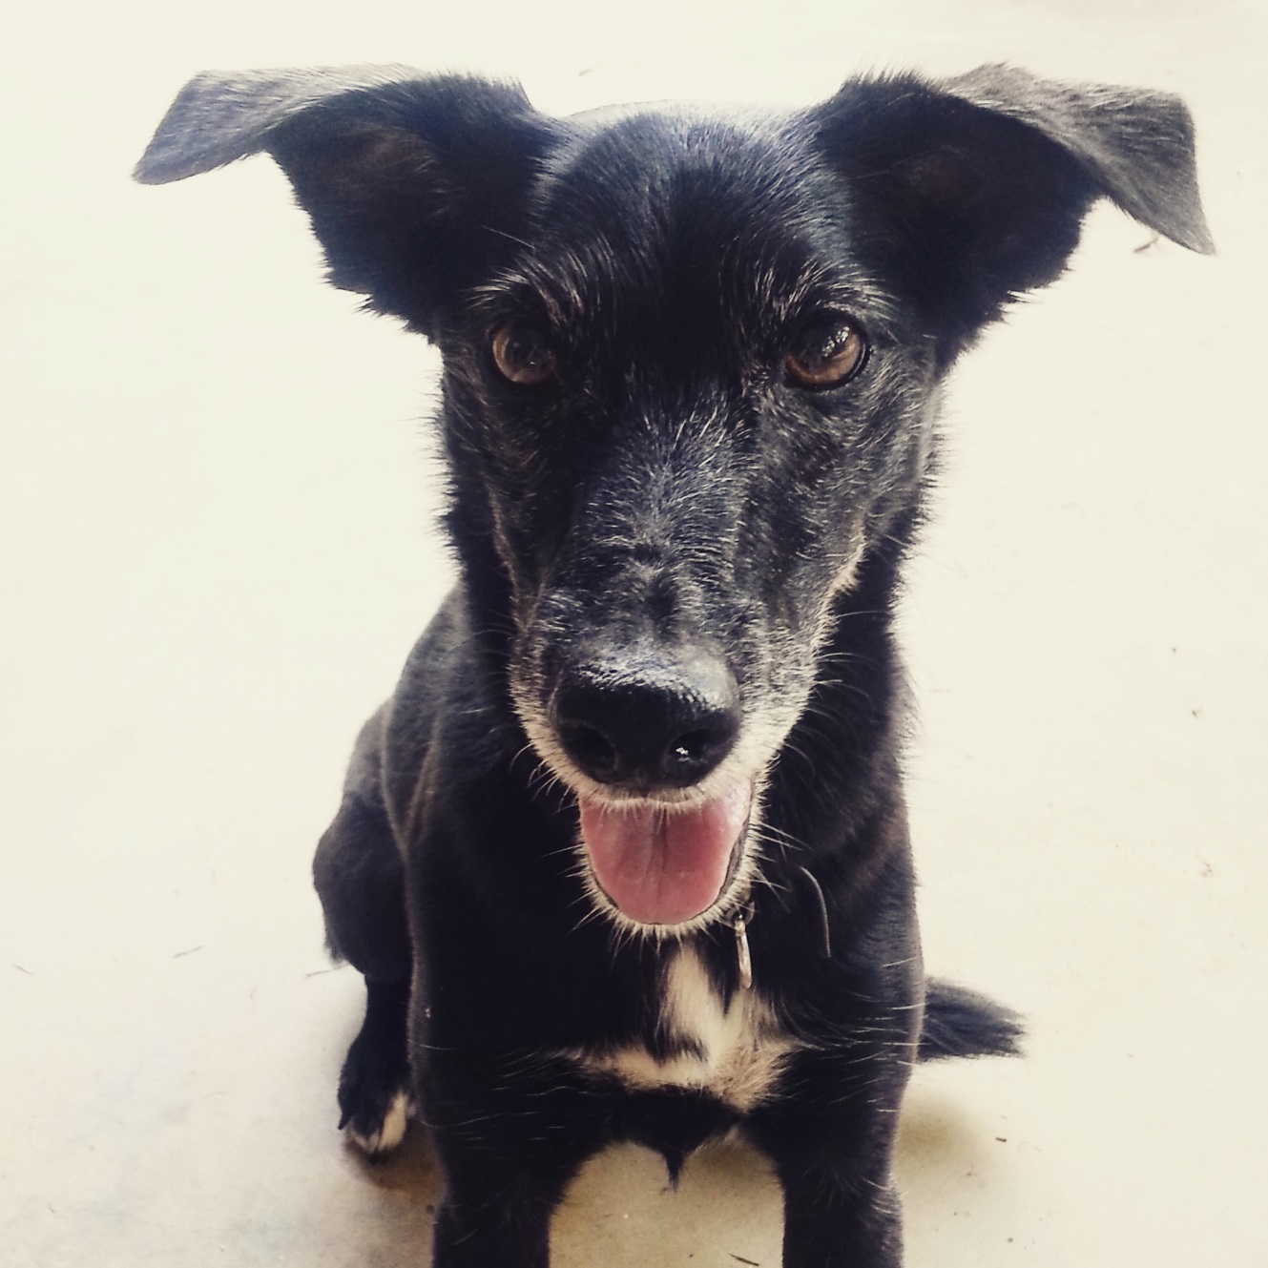
Relaxed, Neutral
Round eyes
Natural ears
Relaxed facial musculature
Open mouth
Notes:
6

Slide 7
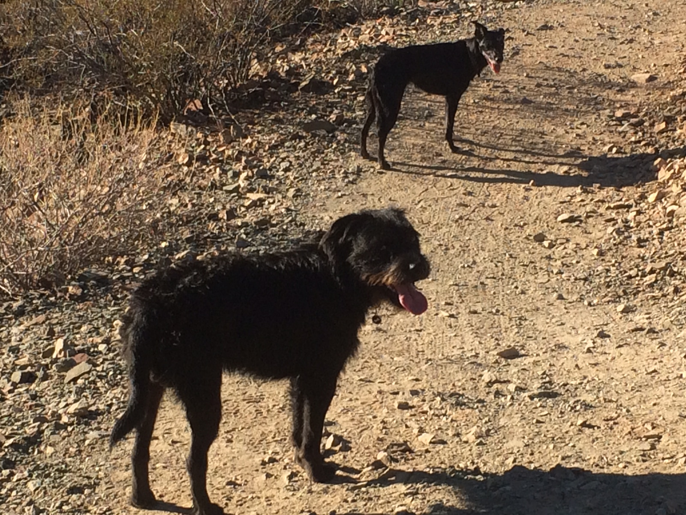
Relaxed, Neutral
Notes:
7
Describe the posture of these dogs

Slide 8
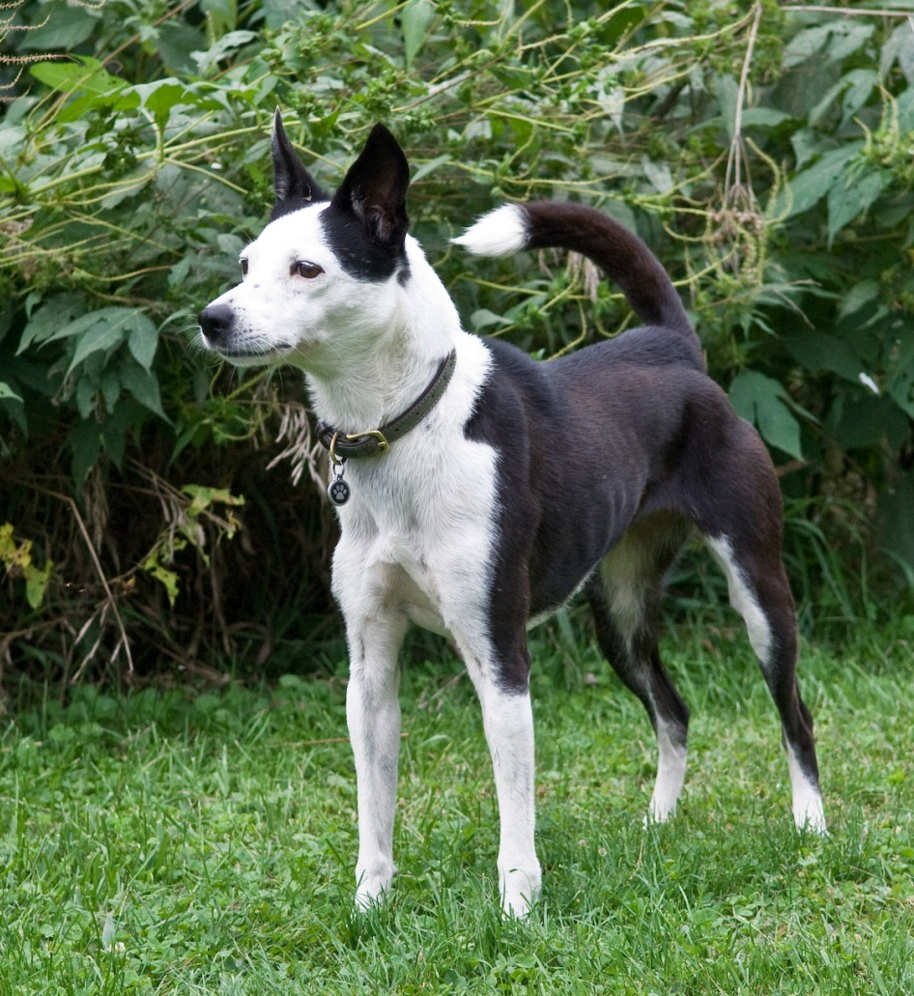
Alert, Aroused
Focused gaze
Erect ears
High stiff tail
Weight shift slightly forward
Closed mouth
Hackles raised
Notes:
8
This dog is aroused - note erect tail and ears, upright stance, piloerection (raised hackles), weight slightly forward
Arousal is a precursor to many behaviors, including aggression
Proceed with caution until you have a better read on the dog

Slide 9
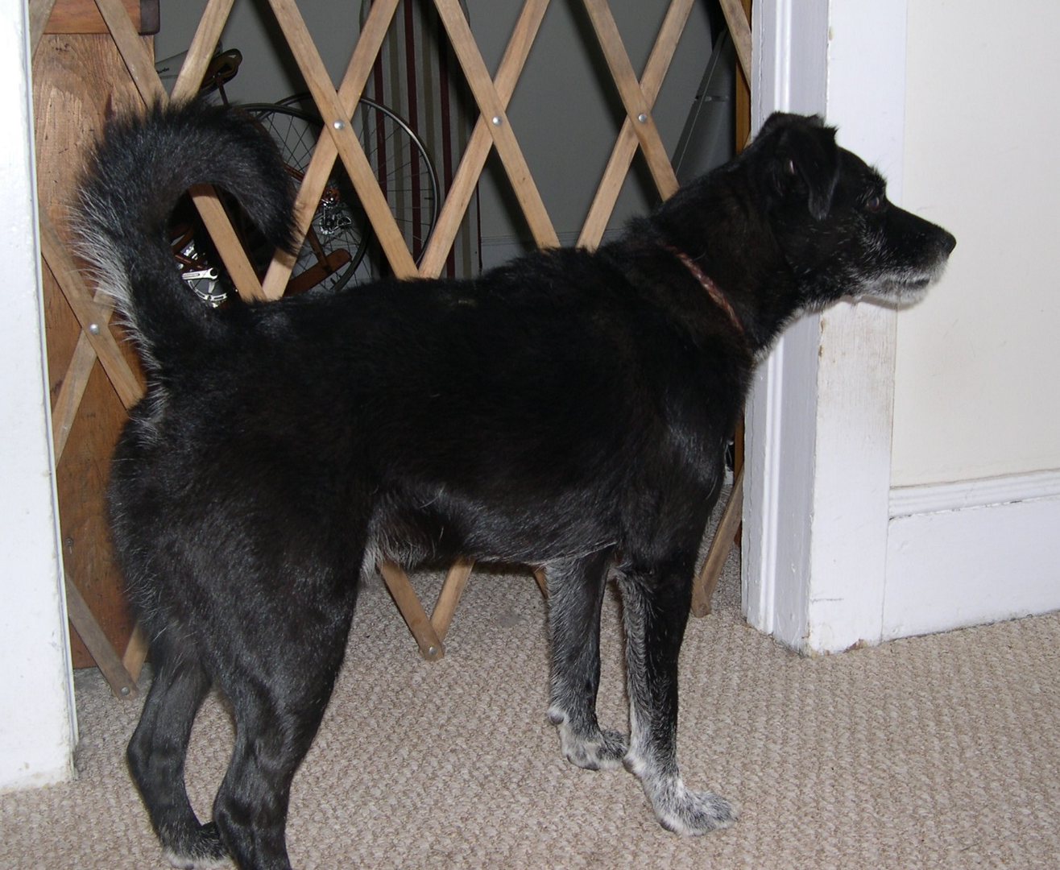
Alert, Aroused
Focused gaze
Erect ears
High stiff tail
Weight balanced
Closed mouth
Dog has scruffy coat so harder to detect piloerection
Notes:
9

Slide 10
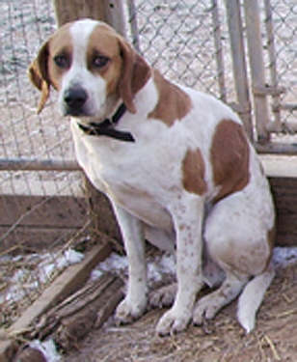
Fearful
Lowered ears
Tucked body
Lowered posture
Notes:
10

Slide 11
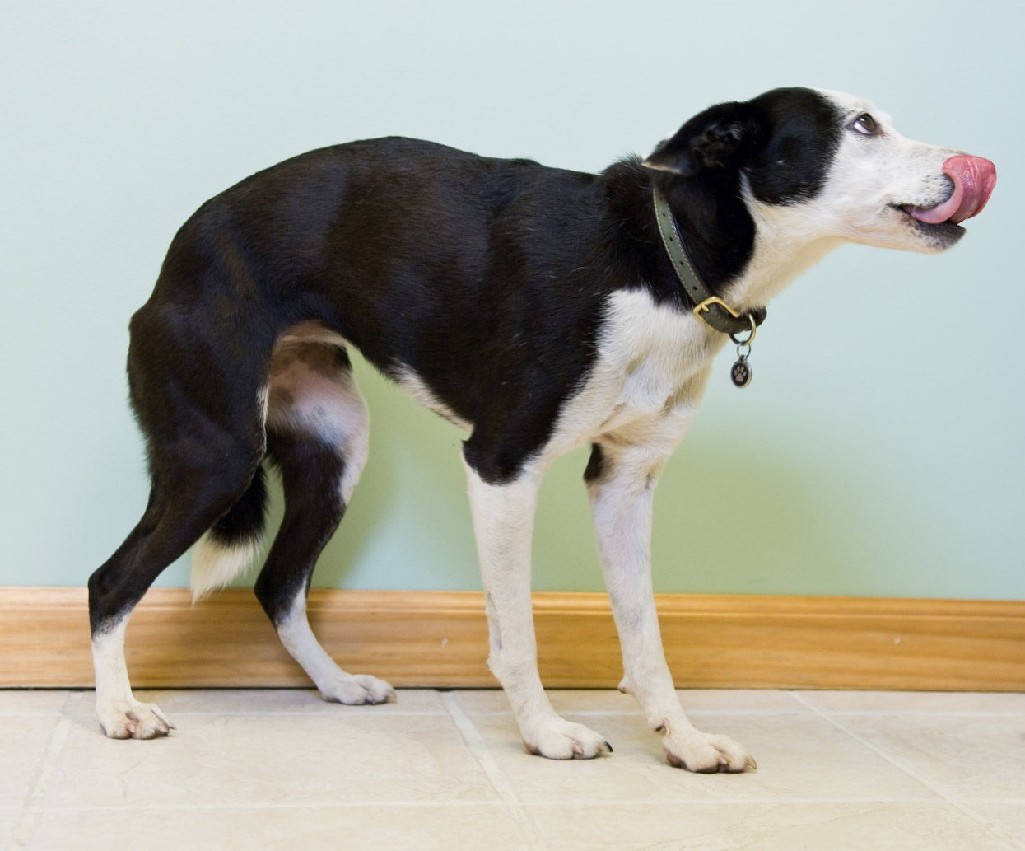
Fearful
Round eye
Flattened ears
Tucked tail
Lowered posture
Lip lick
Notes:
11

Slide 12
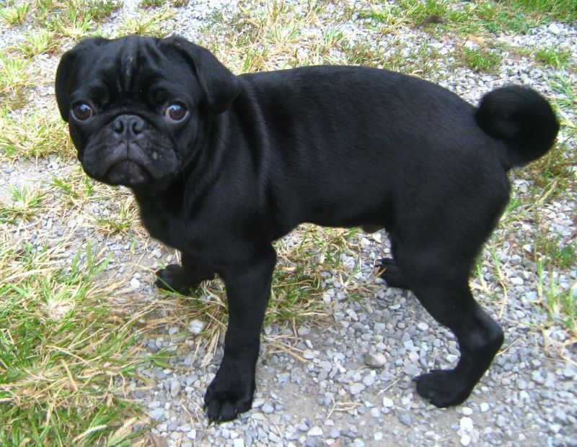
Fearful
Flattened ears
Lowered tail
Lowered posture
Notes:
Even though this dog has drop ears, naturally very wide round eyes and a spitz-type tail, he can still convey a lot of information with his body.
12

Slide 13
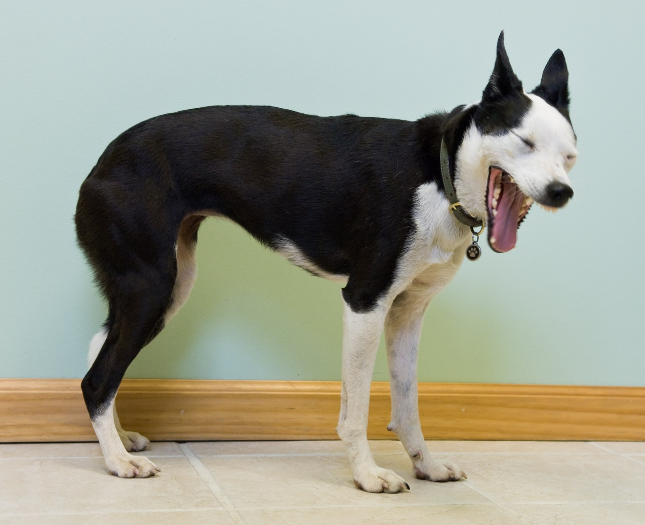
Anxious, Agitated
Stress yawn
This dog is nervous while waiting at the veterinary clinic
Notes:
13

Slide 14
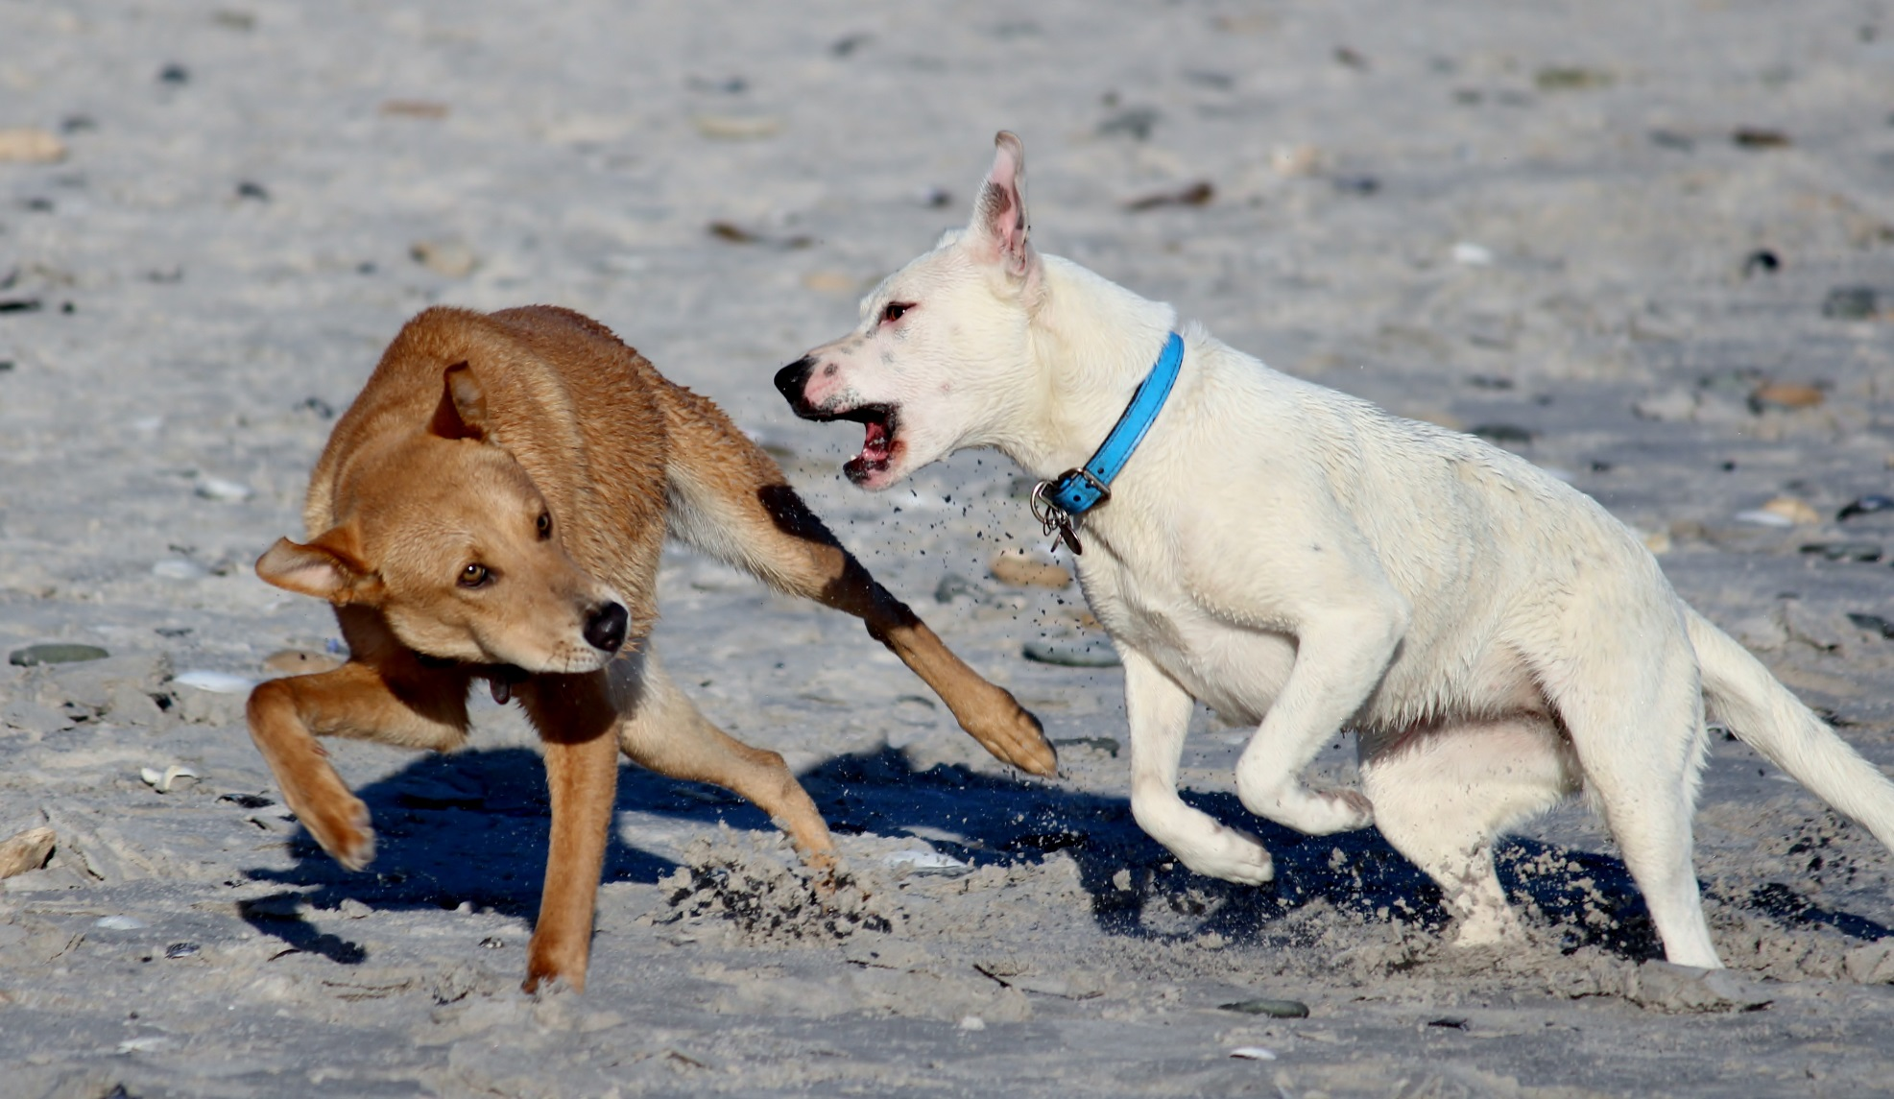
Contrast the language of these two dogs
Notes:
Are they playing? Or in the midst of an altercation? No way you can tell from this photo.

Slide 15
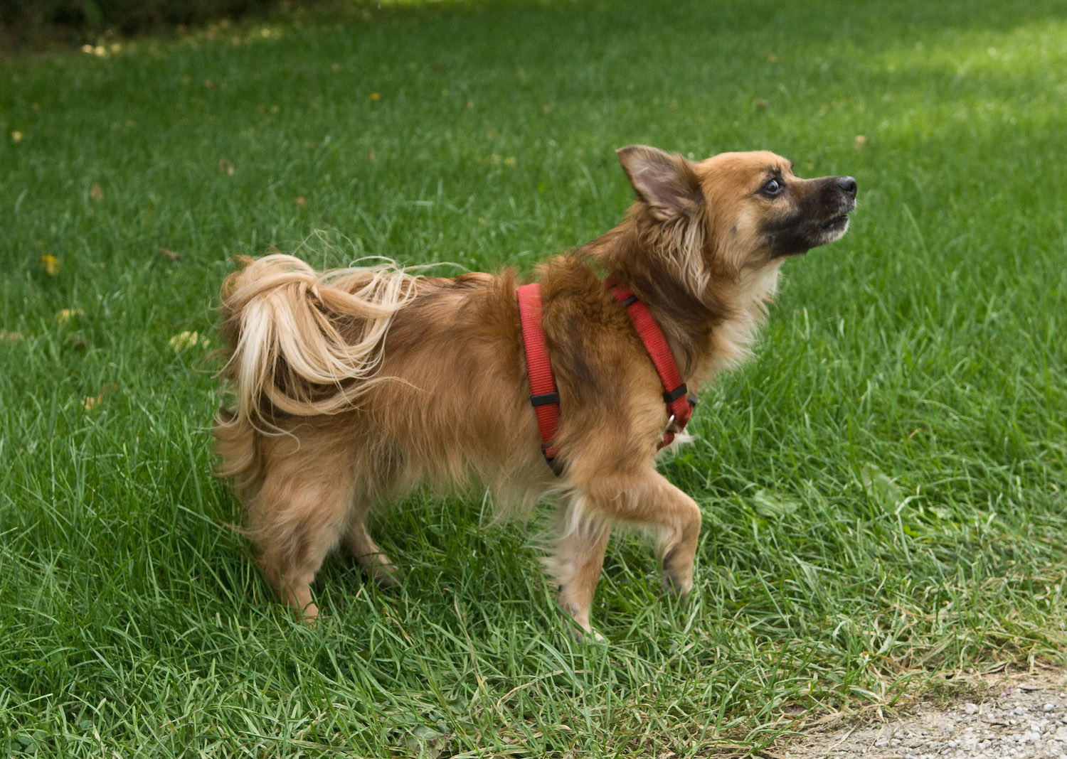
What is this dog communicating?
Notes:
15

Slide 16
Indirect gaze
Ears back
Weight shifted away
Mouth closed, forward commissure
Paw raised
Dog is scared of the photographer
Notes:
This dog is afraid of the person approaching him
He turns his body sideways, his head is turned away, gaze indirect, and his weight is shifted to enable him to flee if he can
However, he is growling to indicate that he will defend himself if he is cornered and can’t escape
16

Slide 17
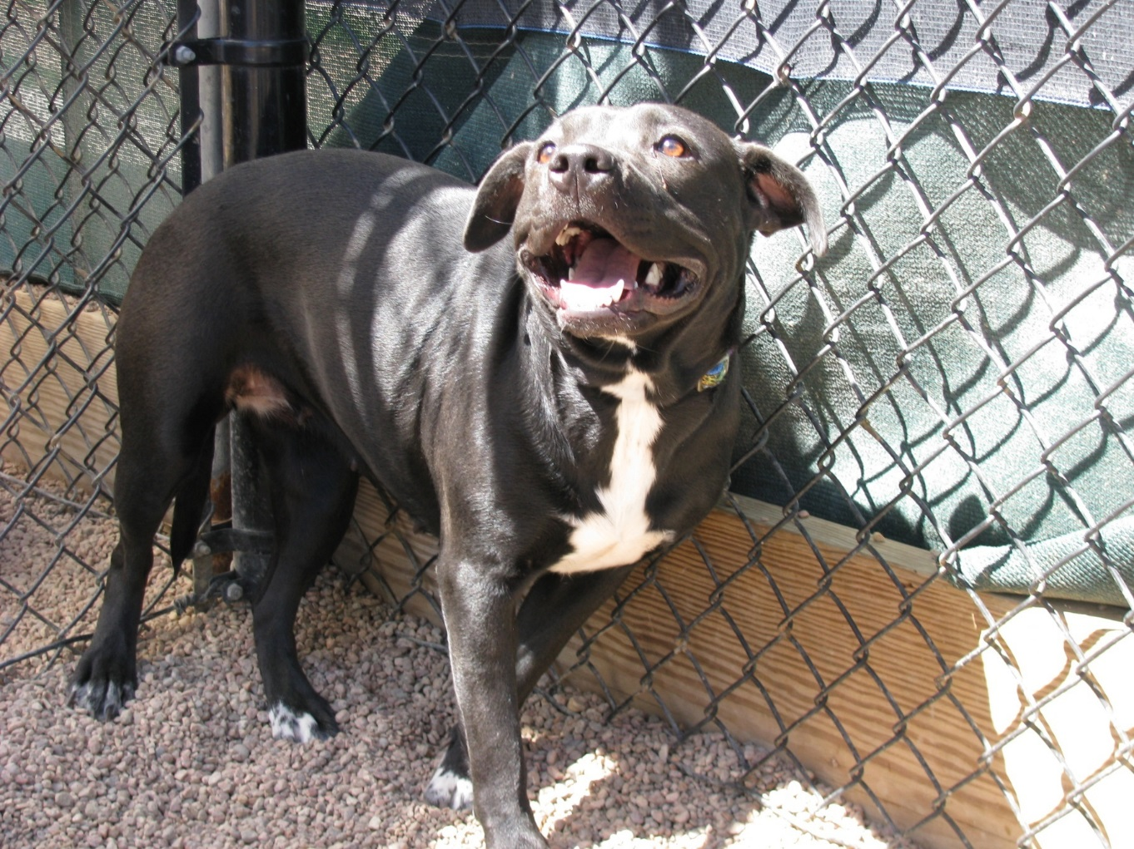
What is this dog communicating?
Notes:
17

Slide 18
What is this dog communicating?
Wide eyes
Ears back
Low tail
Lowered posture
Weight shifted away
Dog is cornered!
Notes:
18

Slide 19
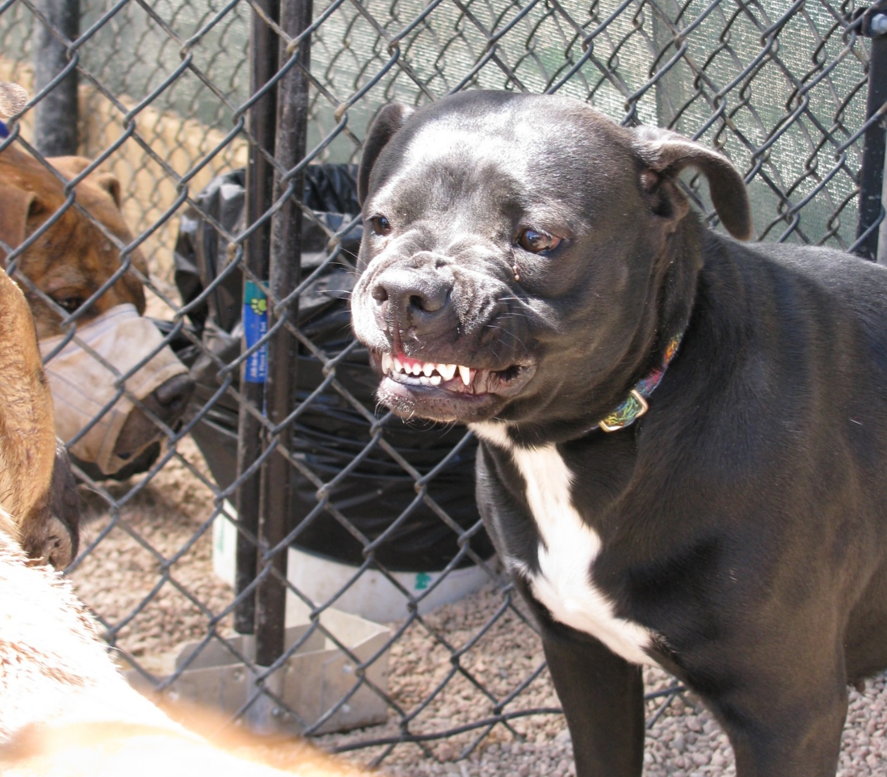
This dog had been warning another dog to keep its distance. The dog moved closer.
Back off!!!
Notes:
19
If lecturing, you could delete the text and ask “what do you think happened?”

Slide 20
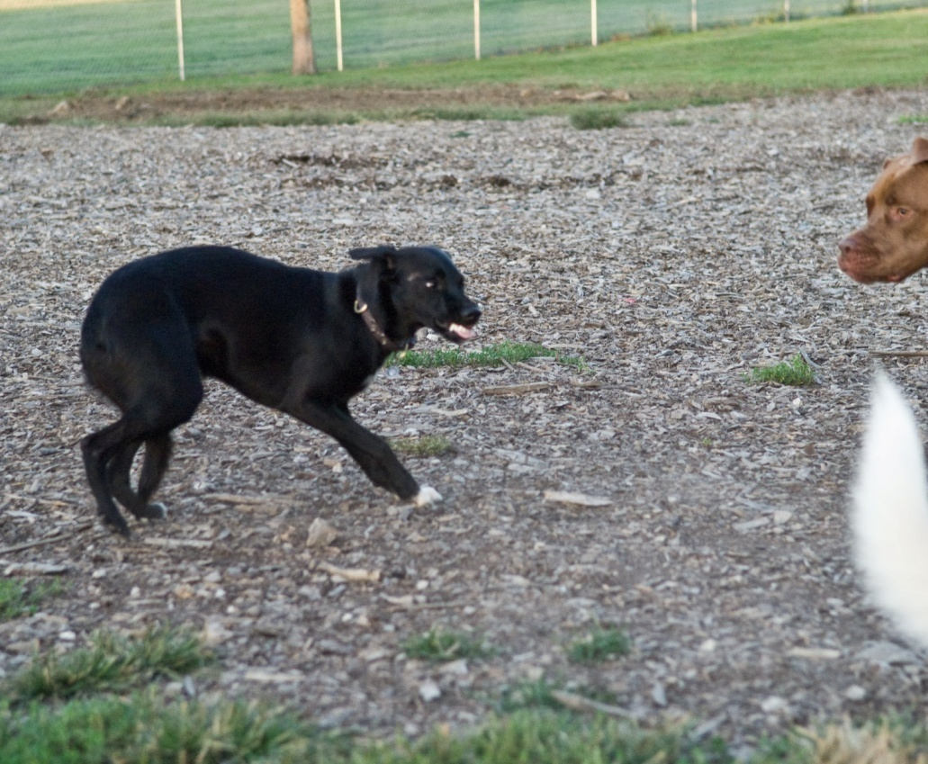
Indirect gaze (“whale eye”)
Flattened ears
Tucked tail
Lowered posture
Weight shifted away
Lips retracted, teeth showing
Back off!!!

Slide 21
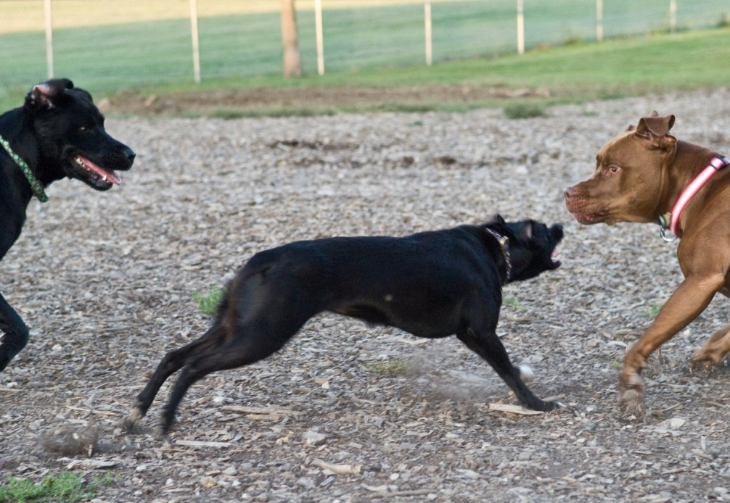
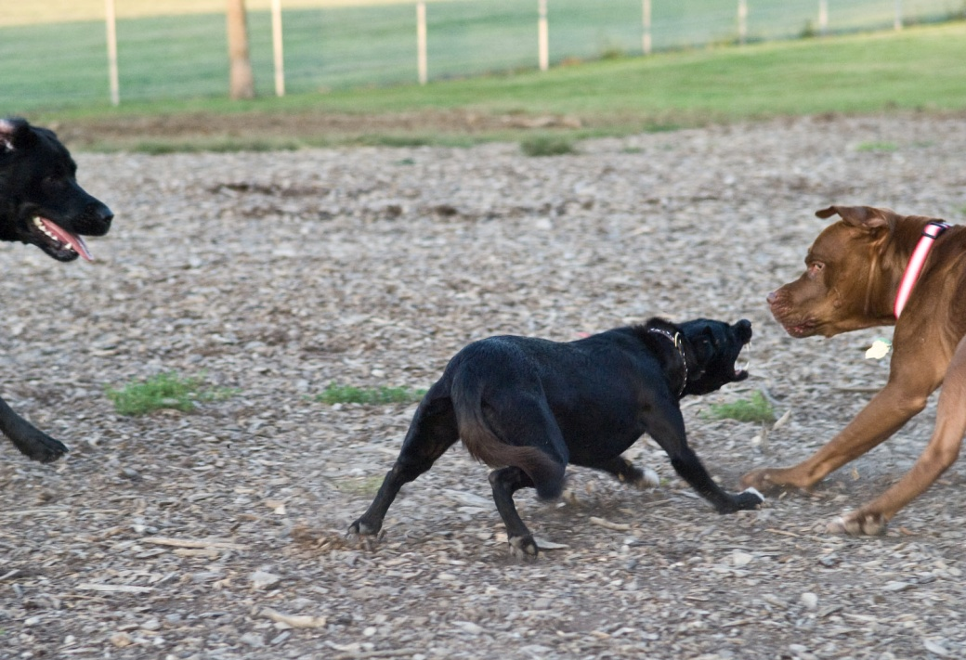
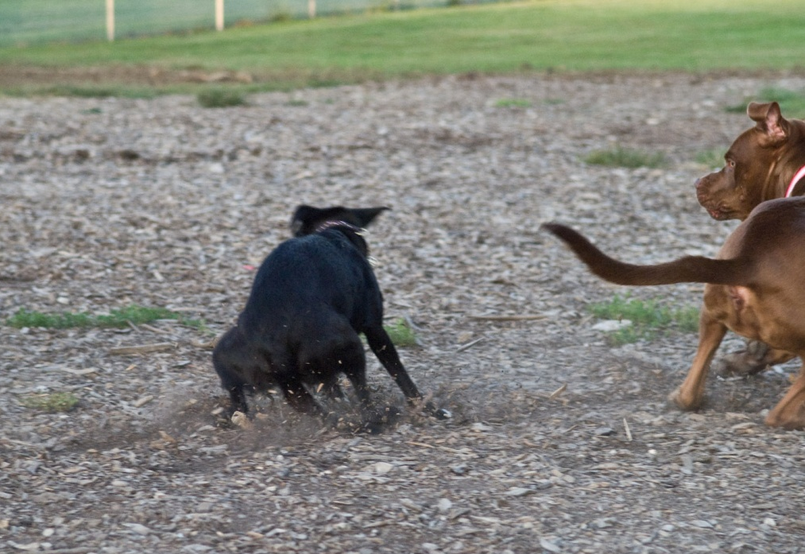
Notes:
21
This sequence illustrates how a fearful dog can end up biting
The dog is afraid of the other dog and has plenty of room to escape but he chooses to threaten the dog first before retreating
This is likely because he doesn’t feel he can escape safely without being pursued and run down
Alternatively, he may be adopting the strategy that the best defense is a good offense: see if he can intimidate the others into leaving him alone

Slide 22
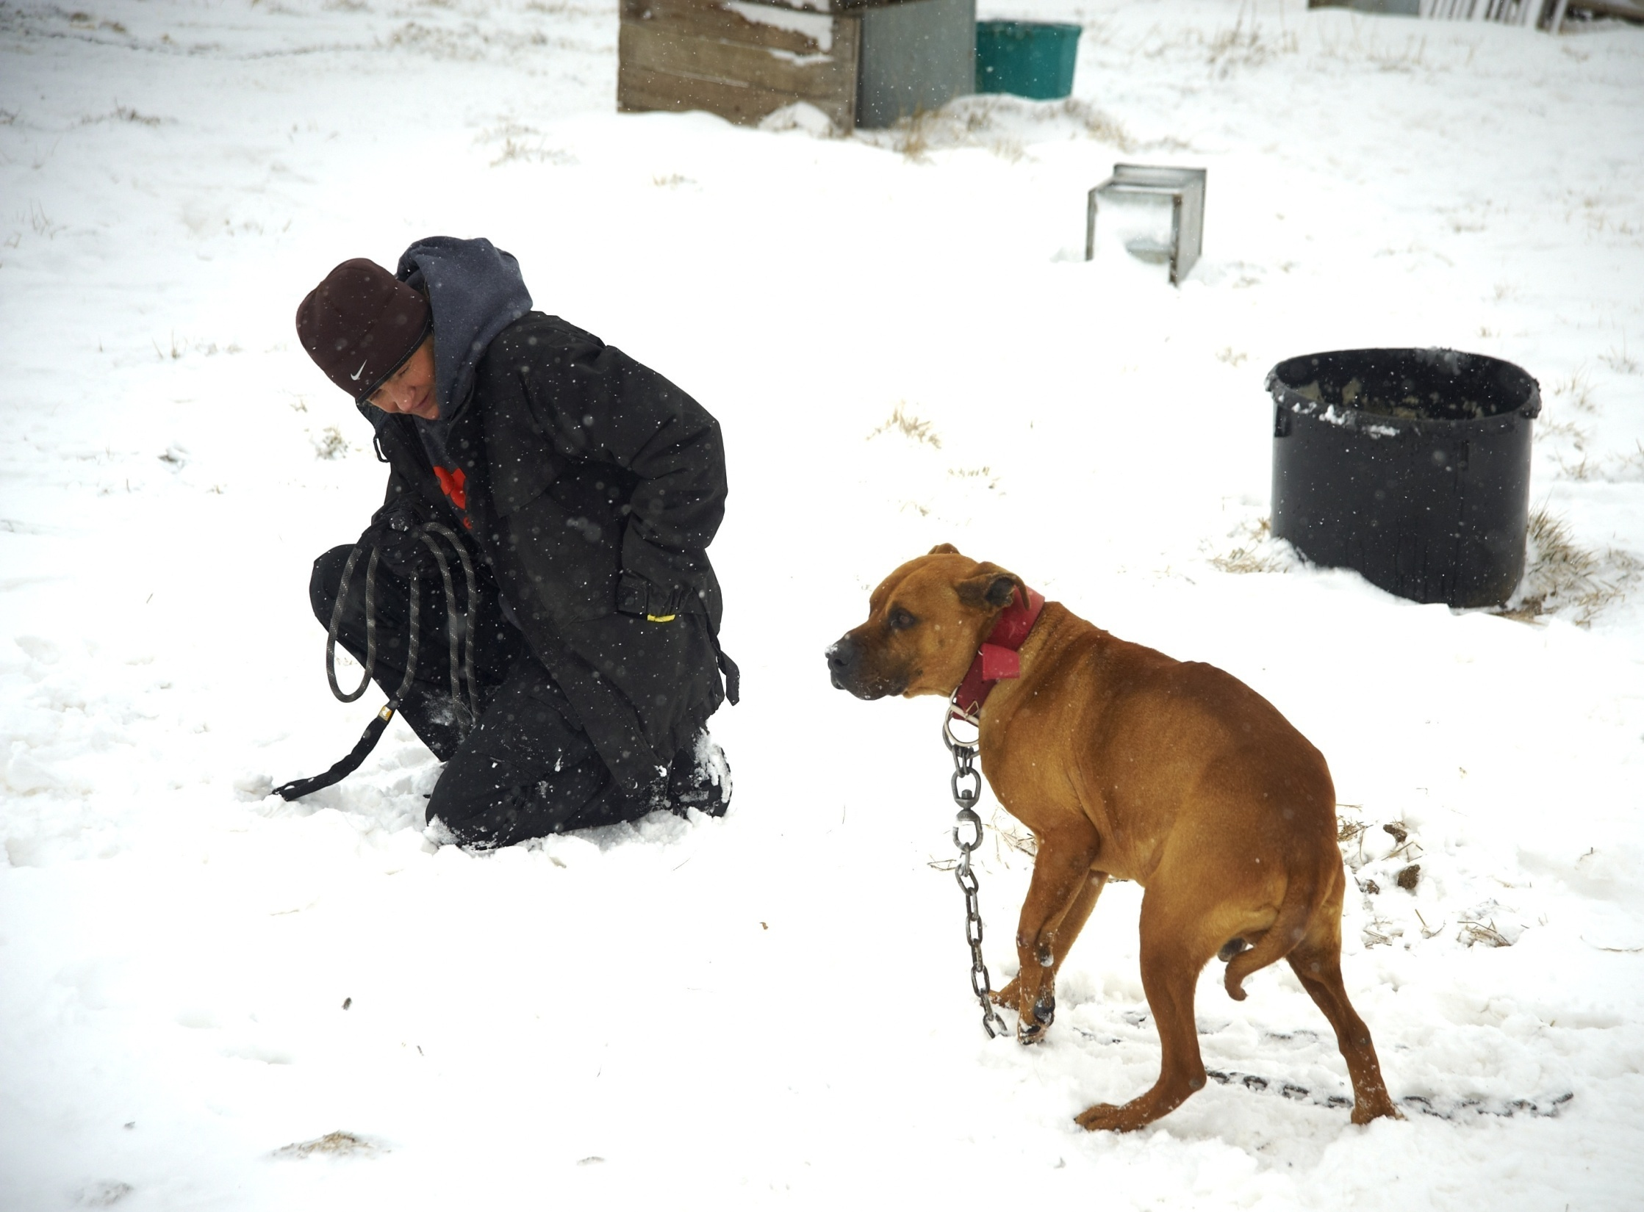
Dogs that are uncomfortable usually respond well when humans mimic dogs’ submissive, non-threatening body language.
Notes:
22
The handler is not looking directly at the dog and is making herself small & non-threatening in an effort to help the dog feel more comfortable. And to avoid escalating a situation.

Slide 23
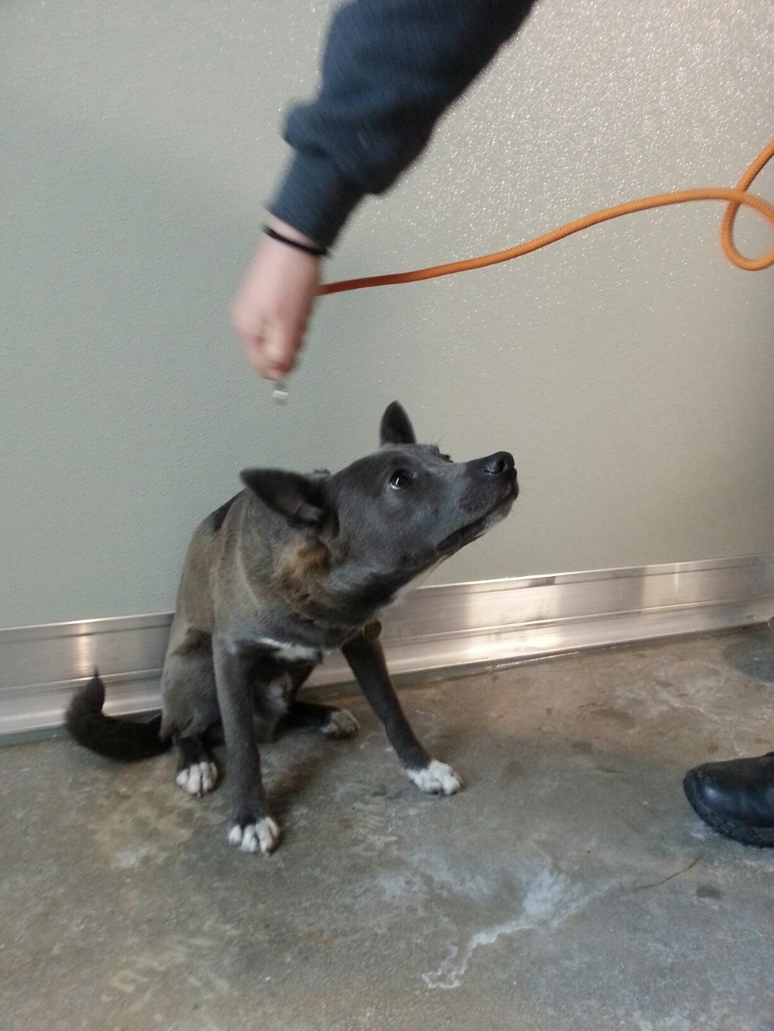
What would you change about this interaction?
Notes:
23
Looming over, reaching over the dog’s head

Slide 24
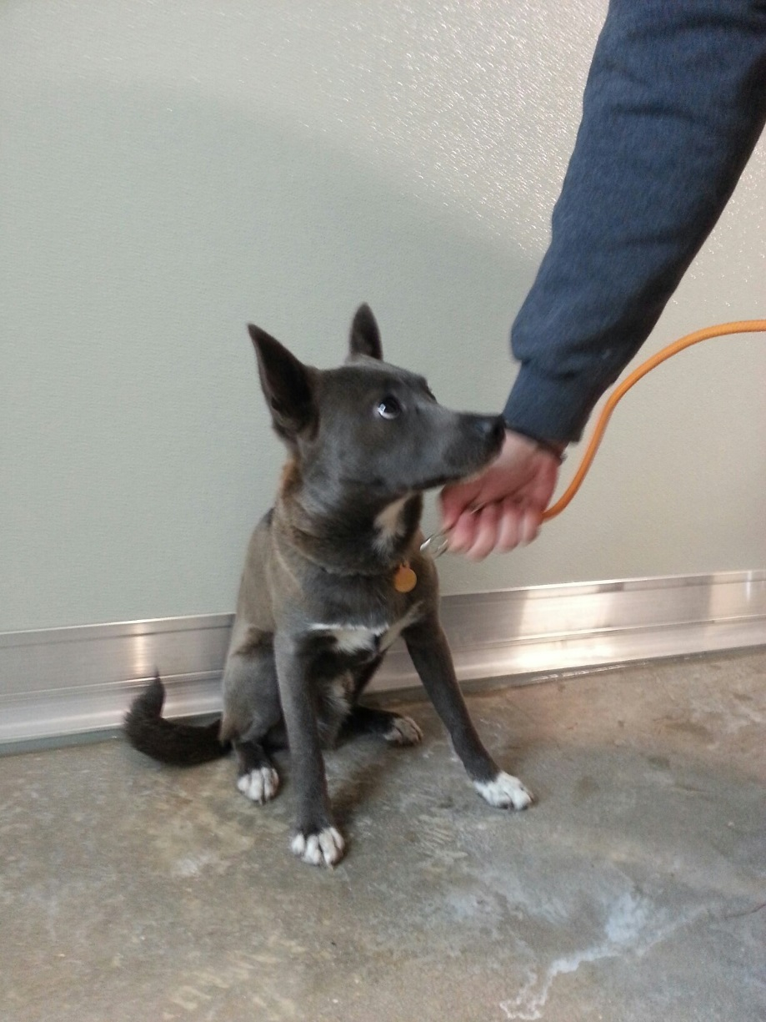
What would you change about this interaction?
Notes:
Better, still standing over but not as threatening.
24

Slide 25
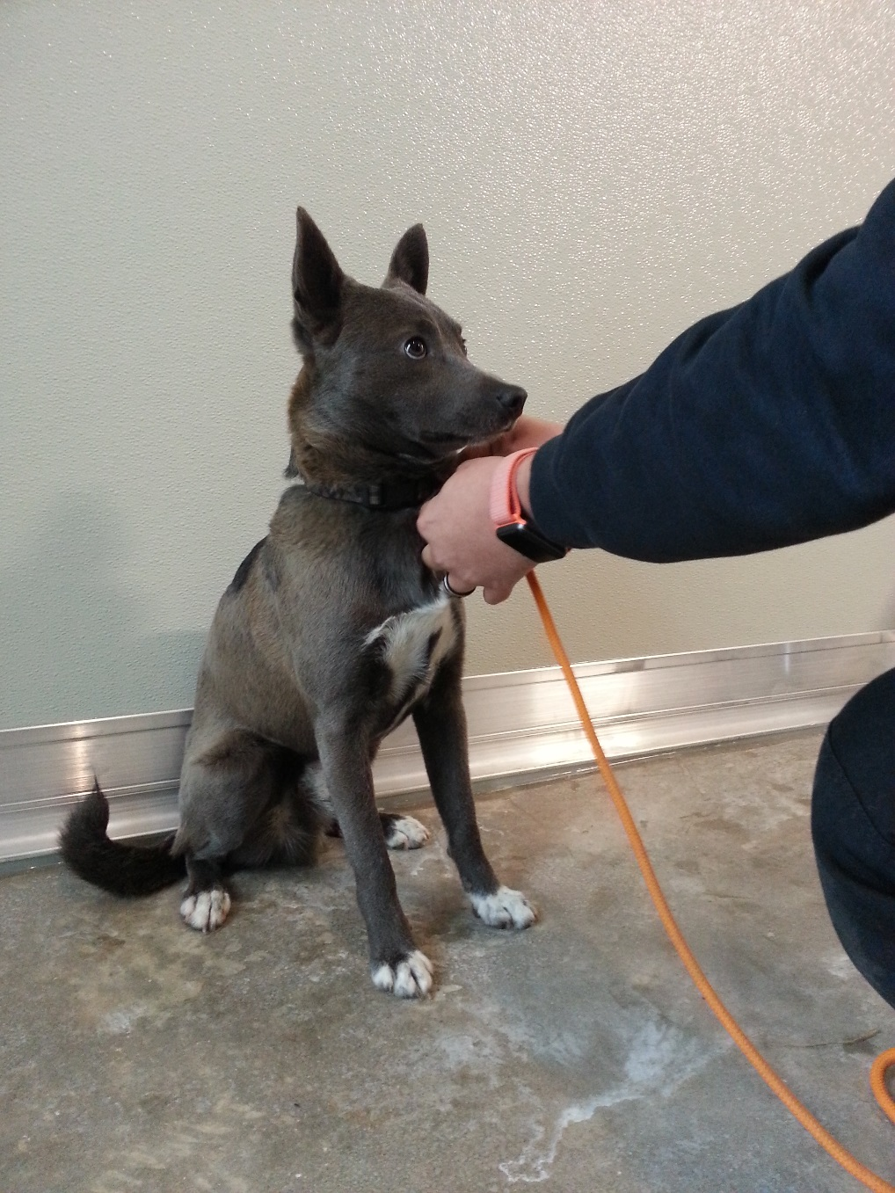
Notes:
Best: kneeling down, reaching toward rather than over. Dog is still afraid but less so.
In presentation, these can be on the same slide so when you click the next picture comes up.

Slide 26
Do not turn your back on a dog that’s feeling uncomfortable.
Notes:
Turning your back on fearful or aggressive dog is a very bad idea – they may have the confidence to approach when your back is turned
Video shows a dog that’s afraid of the child. As long as the child (and parent) are facing the dog, the dog’s tendency is to back away. When the child runs past the dog (fast movement AND not facing the dog), the dog lunges at the child.

Slide 27
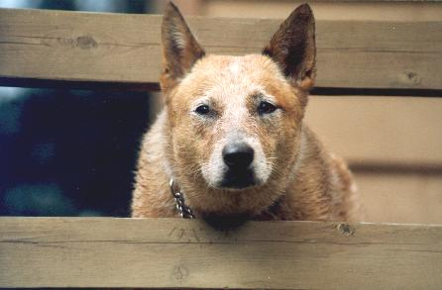
Would you pet this dog?
Notes:
27
Erect forward ears
Closed mouth
Narrowed eyes & intense gaze
Weight forward
Very intent and focused on something. No information on motivational state.
Dog is actually staring at sheep. He might completely ignore you if you were to pet him. Or he might bite you to get you out of the way of his focus of interest.
What should you do instead if you needed to interact with this dog? Speak to him in a friendly voice, see if you can distract him, see if his demeanor changes. If it does not, you might be able to sidle up beside him and put a slip lead over his head, if he’s really focused on something else. Talk to him so he knows you’re there so you don’t startle him. Again beware of redirected aggression.
If he’s staring at you like this and his demeanor doesn’t change when you speak to him, lower your head slightly but keep your eyes on him (but don’t stare directly at him), and slowly back away until you can put something between you and him. Movement should be minimal, calm, and slow so as not to trigger an attack. Move quickly only when you’re confident you can protect yourself (such as if you can slam a gate shut between you).

Slide 28
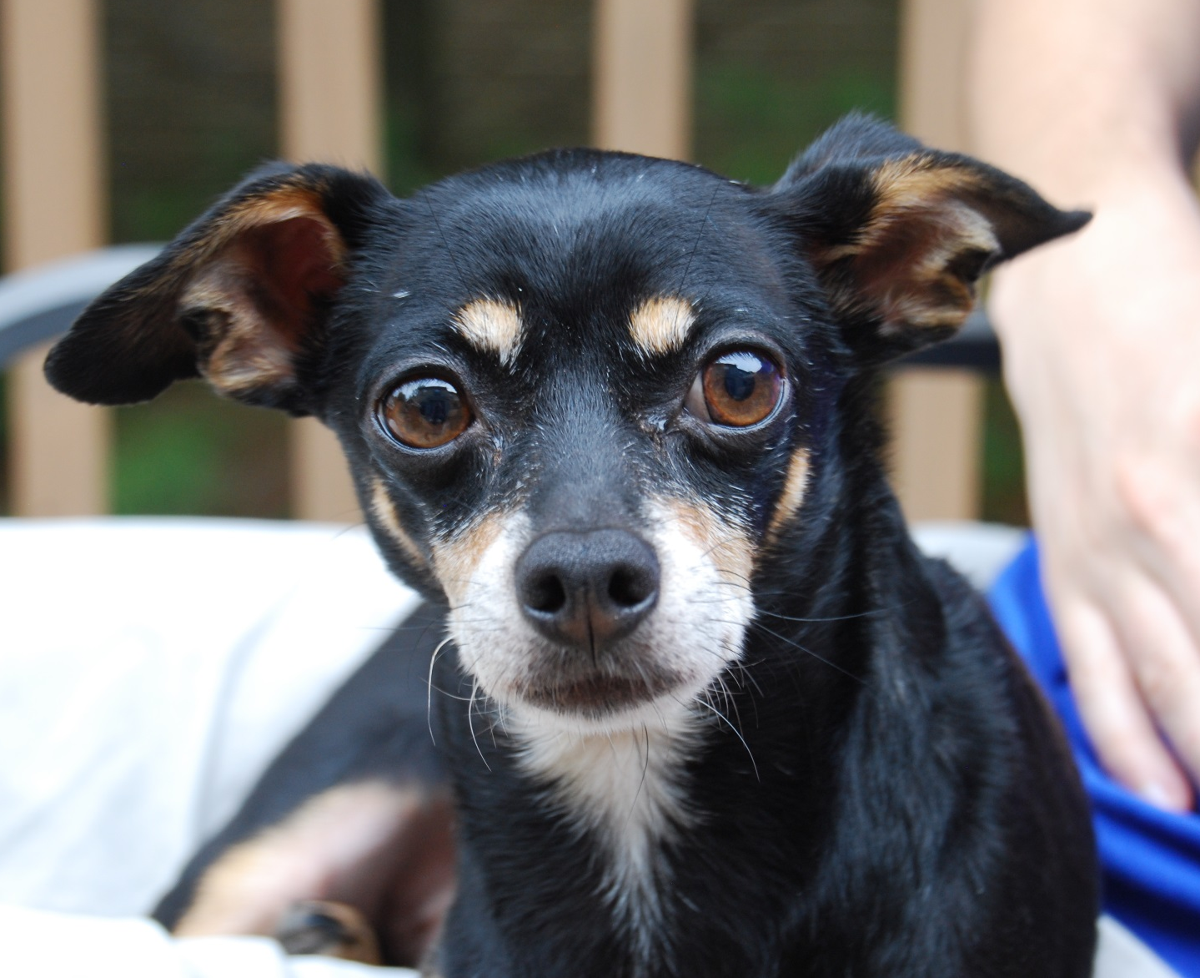
When uncertain about a dog’s motivation, always default to tossing treats
Notes:
Tossing is the relevant thing – UNDERHANDED TOSS (less threatening)!!
That allows the dog to associate you with something pleasant BUT does not force the dog into closer proximity than he’s comfortable with
28

Slide 29
Notes:
Offer treat, hard stare, bite attempt
Demonstration of how quickly a dog’s motivation can change
And why it’s a bad idea to offer treats from your hand

Slide 30
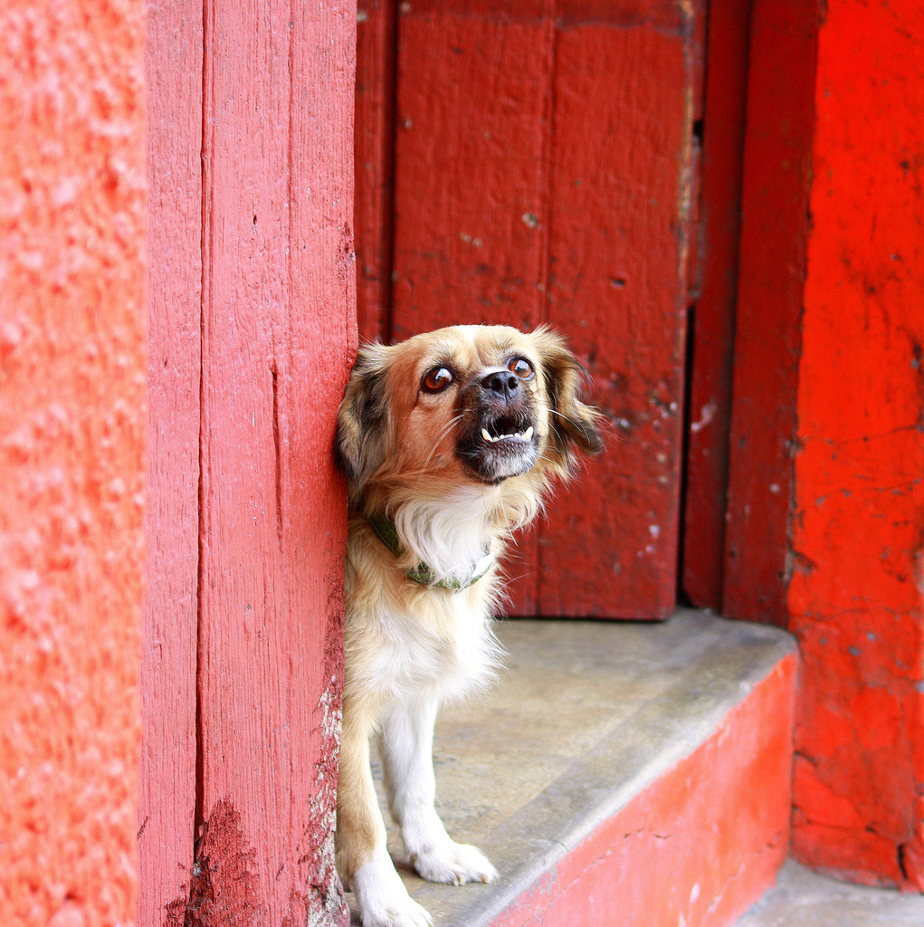
Vocalizations
Attention/Play
Distress/Conflict *
Alarm/Territorial *
Defensive Threat *
Offensive Warning *
Predatory Chase
Notes:
30
The ones with asterisks are the ones that people need to take heed

Slide 31
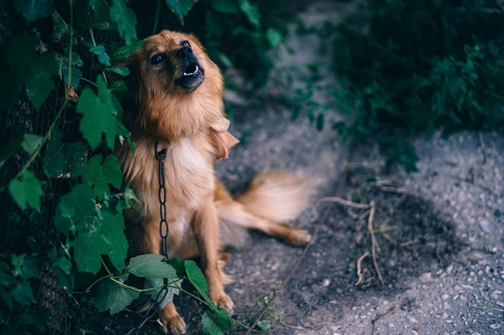
Dr. Sophia Yin analyzed dogs’ barks and determined that specific vocalizations were associated with different contexts.
Notes:
Assume this dog is woofing at you. Would you approach? How would you deal with this dog if you had to take him off his chain?

Slide 32
Growls are a dog’s warning signal. You DO NOT want to punish a dog for growling, lest you inhibit the dog from warning.
PHOTOGRAPH COURTESY OF BETH MARTIN
AUDIO CLIPS PROVIDED BY PATRICIA MCCONNELL
Notes:
These growls were recorded in three different contexts: (1) play, (2) guarding a bone, and (3) in response to the approach of a stranger. Can you tell which is which? Dogs can – they react differently to the different recordings
1 = deep growl – guarding a bone
2 = growl combined with panting – play
3 – more high-pitched growl (more defensiveness) – stranger
Tell the audience the 3 scenarios – play each one and have them call out which they think it is.
32

Slide 33
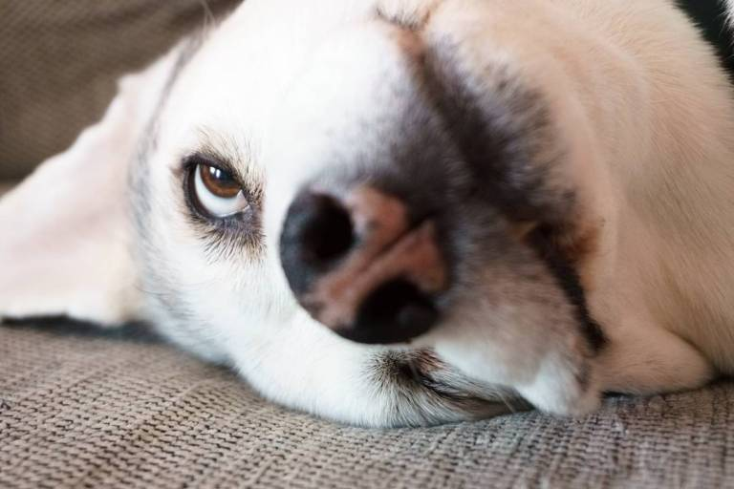
Olfactory Signals
Scent
Pheromones
Notes:
33
Olfactory bulb in dogs is xx times the size of a human’s
NEED DATA – olfactory bulb size, number of receptors and/or measure of sensitivity

Slide 34
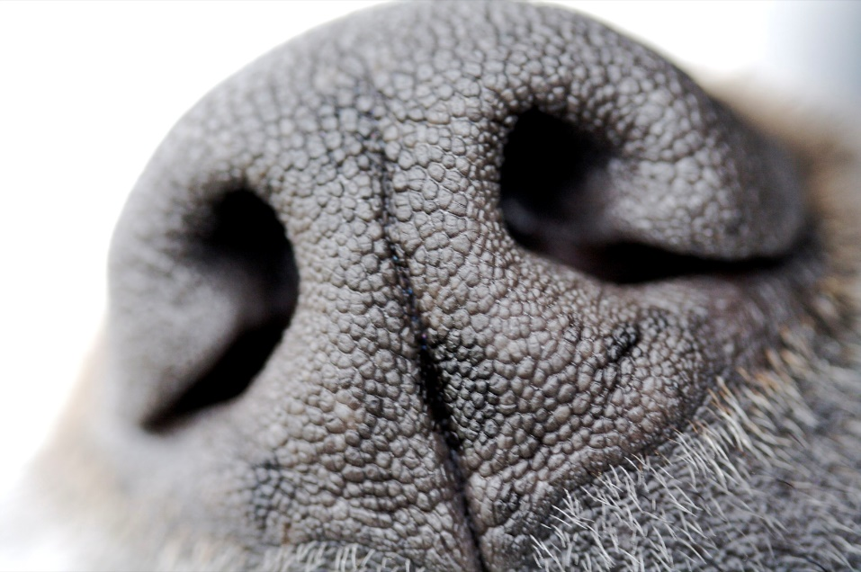
Olfactory Receptor Cells
~5,000,000
~300,000,000
This Photo by Unknown Author is licensed under CC BY-NC-SA
Notes:
34
40x greater in dogs compared to humans
NEED DATA – olfactory bulb size, number of receptors and/or measure of sensitivity

Slide 35
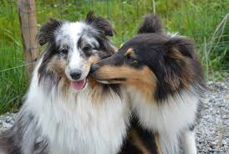
Dogs are believed to possess a vomeronasal organ, located on the upper palate, that specifically detects pheromones. This is why some dogs breathe deeply and even chatter their teeth and drool when they sniff.
Notes:
This is especially the case for male dogs sniffing the urine of females in estrous

Slide 36
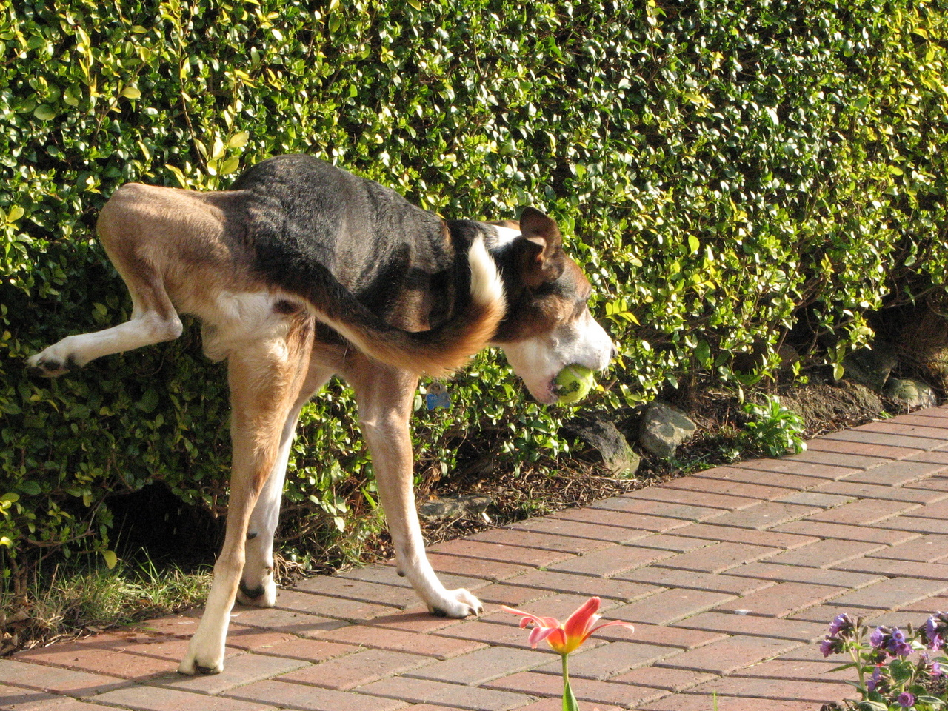
Dogs communicate information about identity, sex and reproductive status through urine marks. Both males and females exhibit raised leg urinations.
Copyright © 2007 P. Reid. All Rights Reserved.
Notes:
Individual body odors emanate from urine, feces and anal gland secretions
Dogs spend more time sniffing the urine of unfamiliar individuals
Males are more likely to scent mark than females
Males overmark other males’ urine more than females’ urine
Both males and females may be more likely to urine mark in novel environments
In domestic dogs, urine marking and overmarking has no clear relationship to dominance status

Slide 37
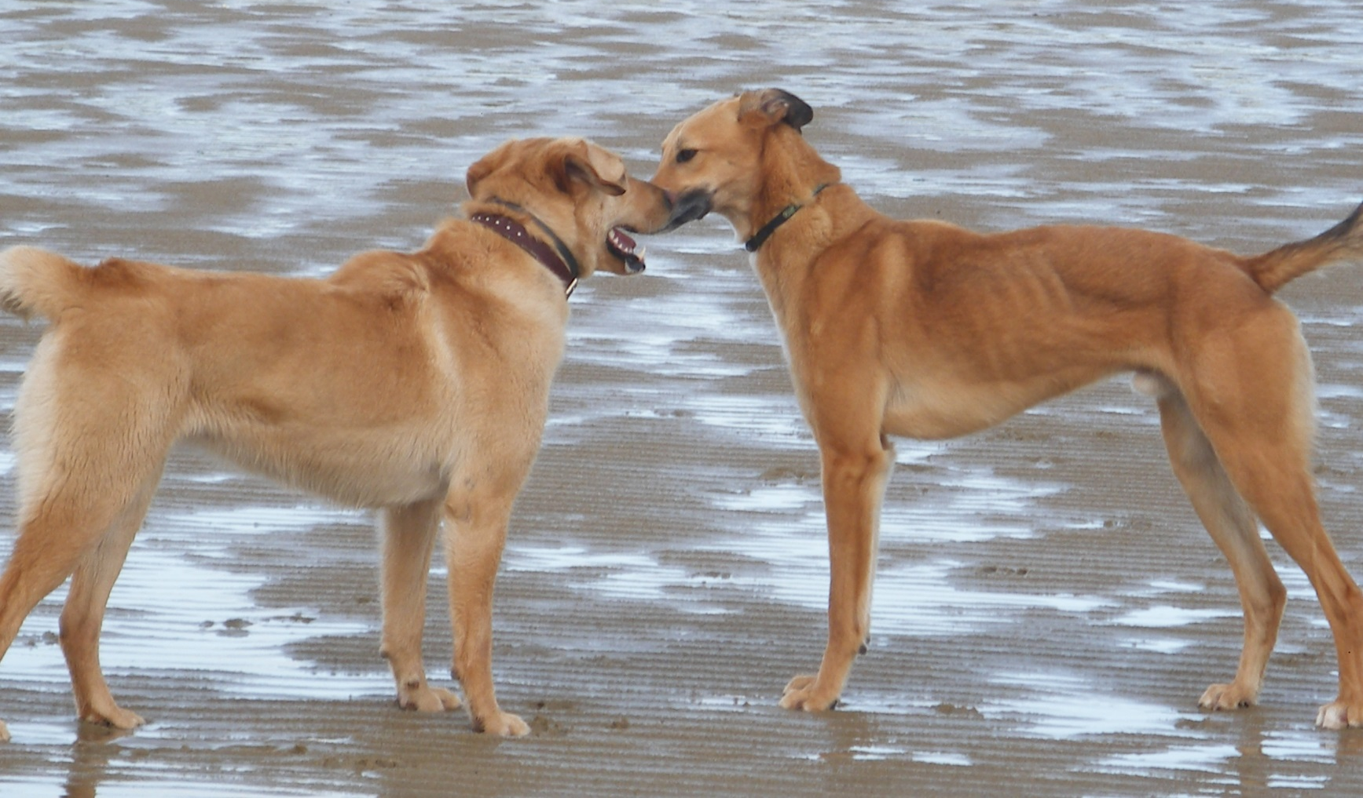
Dog-Dog Greetings
Dogs gather information from sniffing each other’s faces and genitalia.
Copyright © 2007 P. Reid. All Rights Reserved.
Notes:
Most dogs prefer to sniff while trying to avoid being sniffed themselves
Best to allow dogs to greet with minimal interference from you or the leashes. Stay beside or slightly behind the dog, and always opposite to the other dog’s handler (should I include video?)
Maintain a slightly loose leash but hover closely so you can pull the dogs apart quickly if needed. You may have the best view of the other dog so be sure to communicate what you’re seeing to the other dog’s handler (and vice versa).

Slide 38
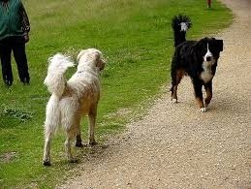
If they aren’t comfortable getting close enough to sniff, they assess each other’s motivations visually.
Notes:
Which dog is behaving deferentially in this photo?

Slide 39
Notes:
Describe this greeting sequence. Take home message: don’t freak out the instant a dog reacts to another dog and label the dog aggressive. Dogs need to be able to communicate and establish a relationship.

Slide 40
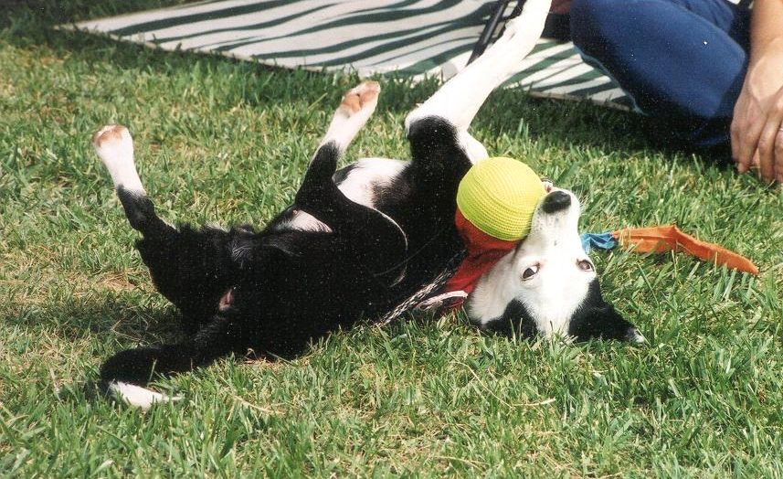
Questions?

