Slide 1
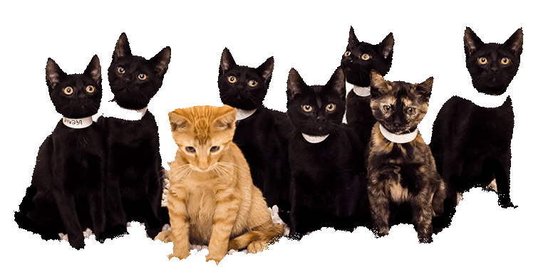
Campaign Kickoff
Enjoy the music! The webinar will begin at its scheduled time.
Join the webinar using built-in computer audio or dial
669-900-6833 or 646-558-8656
Webinar ID: 257-418-493
ASPCApro.org/meowfornow

Slide 2
How to Adjust Your Audio
Select “Audio Settings” at the bottom of your screen.
Choose whether you’ll join using computer audio or your telephone. We recommend computer audio.

Slide 3
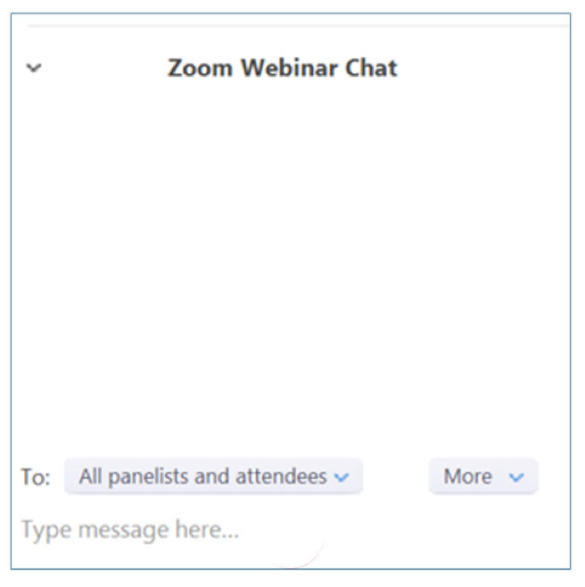
How to Chat
Select “Chat” at the bottom of your screen
In the chat window, select “All panelists and attendees” to share your message with everyone in attendance

Slide 4
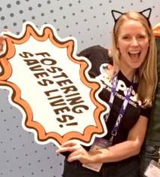
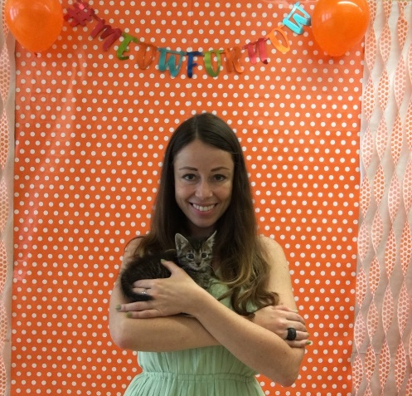
Today’s Presenters
Tina Reddington Director ASPCA Los Angeles Volunteer Program
Olivia Melikhov Director ASPCA Social Media Strategy

Slide 5
What we Learned in L.A.

Slide 6
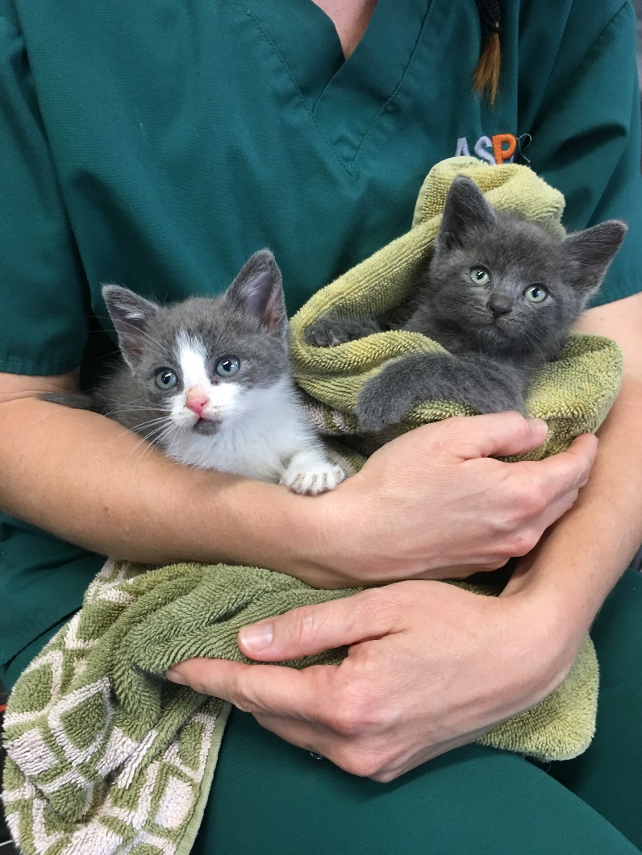
Case Study: ASPCA LA Foster Program
Neonate
Pee Wee
Young
Adult
Under 4 weeks (bottle babies)
4 to 8 weeks (eating on their own)
9 weeks to 5 months
5 months and older

Slide 7
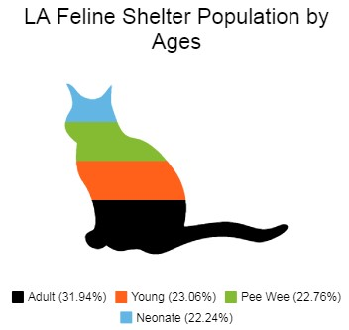
90% of the kittens under 5 months of age come in during “Kitten Season”
Notes:
-Almost 34,000 kittens under the age of 5 months enter LA County and LA City shelters annually. That’s almost 70% of total feline intake.
-Juvies account for 64% of the feline euth

Slide 8
Live Release Rate (LRR) for juvenile cats before Pee Wee Program (2016): 21%
LRR for juveniles after 1st complete year of Pee Wee Program (2018): 50%
Note: “Juvenile cats” includes kittens and neonates, as well as any cats without a date of birth entered.
Notes:
Add some fish to dangle
Strategies for recruiting fosters – online webinars, local facebook group, proactive vs reactive

Slide 9
About the Campaign

Slide 10
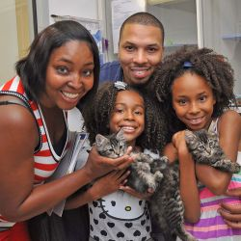
What is the Meow for Now Kitten Foster Campaign?
An effort to help animal welfare organization take their foster programs to the next level and expand their network of foster families to take some of the kitten-season burden off staff’s shoulders.
Notes:
Speak about how we’re doing this for the second year and a row and it’s going to be even bigger and better!

Slide 11
Meow for Now Campaign
1,000’s of Kittens Saved
New & Informed Fosters in Your Community
500+ Agencies
YOU!
The Public

Slide 12
Who Should Join?
Animal Shelters
Rescues
Municipal Agencies
Already have a cat foster program and are looking to grow it or connect more deeply with their community

Slide 13
5 Benefits of Joining:
“Yay! More foster families and less shelter crowding!”
Exclusive trainings and tips on how to elevate your foster program.
The ASPCA’s public-facing Meow For Now campaign will drive foster volunteers directly to you.
Potential for your content to be shared on ASPCA channels and through influencer/celebrity social media posts.
Access to private Facebook Group.
Access to fostering experts to answer your questions and guide you in best practices.

Slide 14
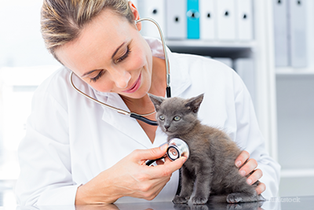
Benefits: Trainings and Tips
Here are some of the types of trainings and resources we’ll provide:
How to increase efficiencies in your foster program in order to save money and save lives.
Innovative ways to secure and sustain a larger network of foster volunteers for your organization.
Shelter medicine protocols to improve the health of your foster population.
Social media tips and tricks to raise awareness about your foster program.
A “Pawckage” that you can provide your foster families with.

Slide 15
Benefits: Gain More Foster Families
The ASPCA will be launching a public-facing kitten foster campaign in May, driving cat lovers to consider fostering.
All campaign registrants will be listed on the national campaign page at ASPCA.org/MeowForNow as part of an interactive map.
Prospective foster parents will be invited to connect with their local participating organization to foster kittens.

Slide 16
Benefits: Content Sharing
Be sure to use the #MeowForNow hashtag in all relevant social media posts during the campaign for a chance to be featured on ASPCA social media channels and on influencer social media channels like @Cats_of_Instagram (10M followers!)
For the second year, we’ll be doing a nationwide livestream in which we’re inviting shelters/rescues around the country to share live content of adorable kittens. Dubbed as “the meow heard ‘round the world,” we’ll be re-sharing compelling live videos on ASPCA channels and partner channels as well.
We’ll provide you with customizable shareables, flyers, and posters that you can customize with your logo and information.
Notes:
nationwide livestream in which we’re inviting shelters around the country to do Facebook Live content of adorable kittens. We’re referring to it as “the meow heard ‘round the world!” The goal is to use social media to raise awareness about our Meow For Now campaign and get people to pledge to foster in their community. We’ll be talking more about the “Kitty Lives” livestream during our upcoming media and social media webinar.

Slide 17
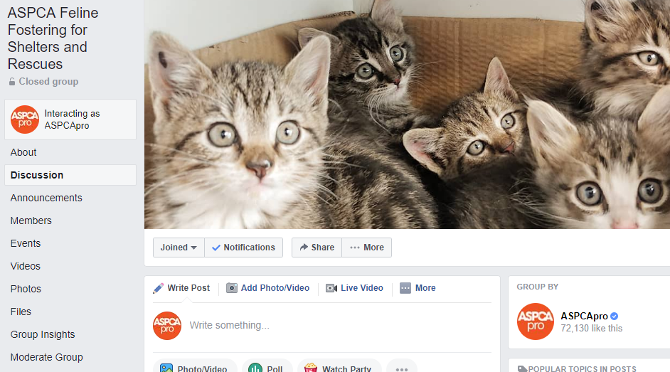
Benefits: Facebook Group
Advice from ASPCA and other experts
Networking opportunities
Tips, tricks, and downloads
Opportunity to share of best practices and ideas with each other
Notes:
Don’t forget medical info they will receive, foster guide, etc

Slide 18
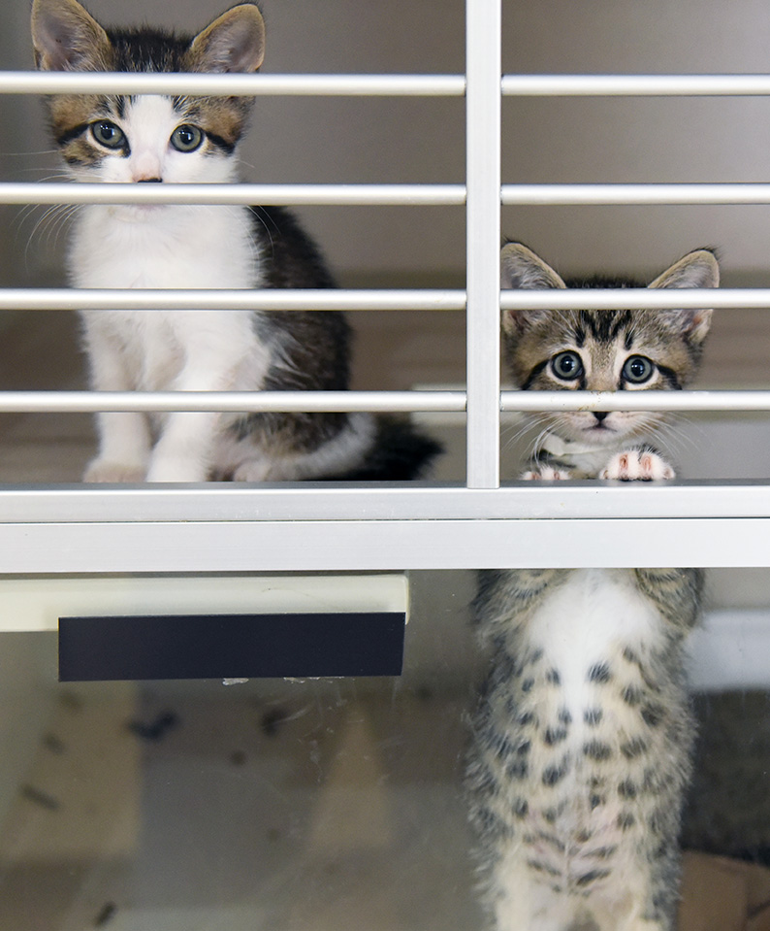
Your Role in this Campaign
Stretch yourselves and your organizations by trying innovative techniques to elevate your foster program!
Join Facebook group
Share your successes with others
Give us feedback in a post-campaign survey
Turn Kitten Mountain into a Molehill!

Slide 19
Campaign Timeline
Feb. 20 Campaign registration opens to organizations
March 12 WEBINAR: How to Leverage Online Orientations Sessions to Get More Fosters in the Door and an On-Deck System to Keep Them Active
March 20 Campaign registration closes
April 24 WEBINAR: Using mega-adoption events to get your foster kittens into loving homes
May 10 Public-facing campaign launch
June 30 Campaign ends

Slide 20
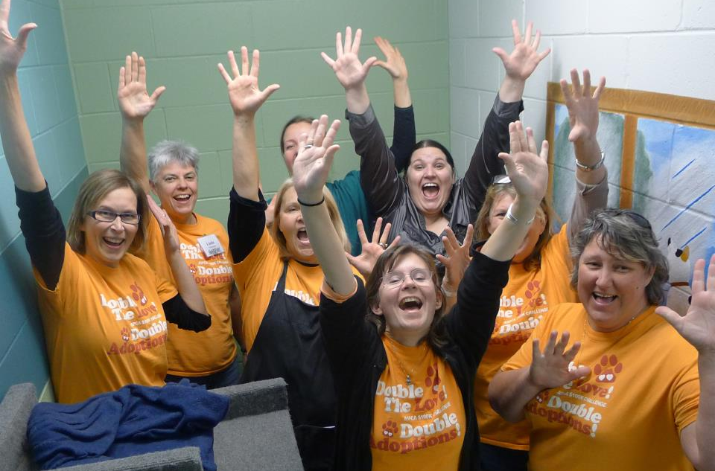
Are you in?
Join: ASPCApro.org/meowfornow

Slide 21
Questions?
Join: ASPCApro.org/meowfornow
Reach us: ASPCApro@aspca.org

