Slide 1

Notes:
Purpose:

Slide 2
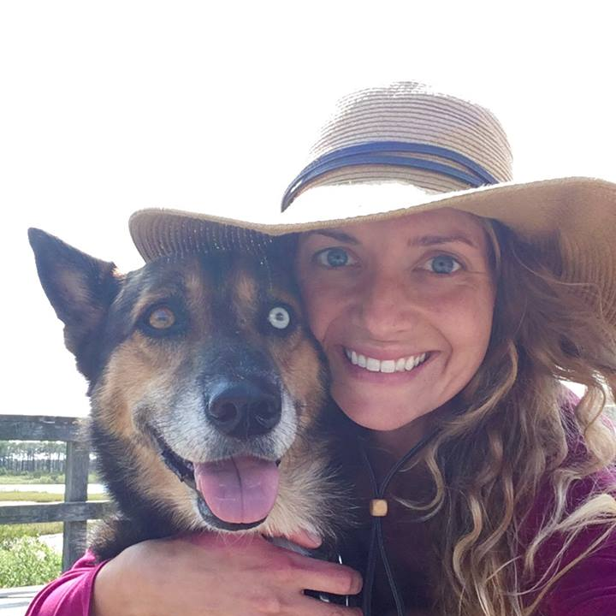
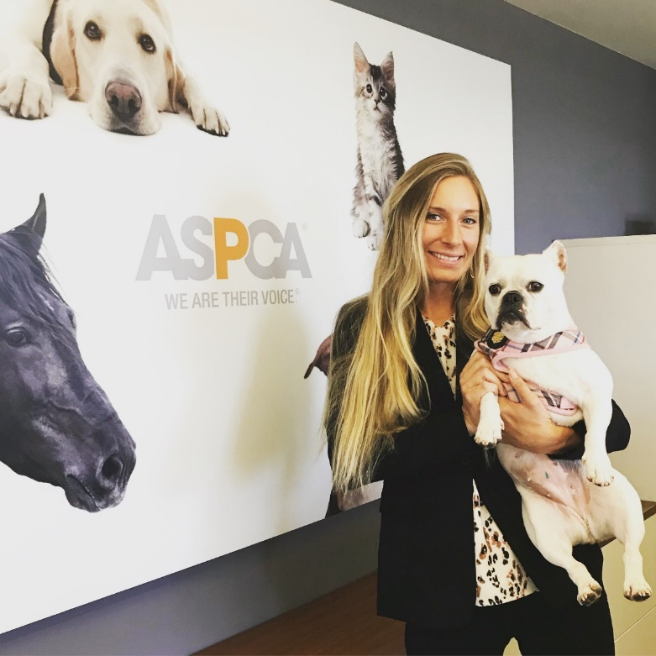
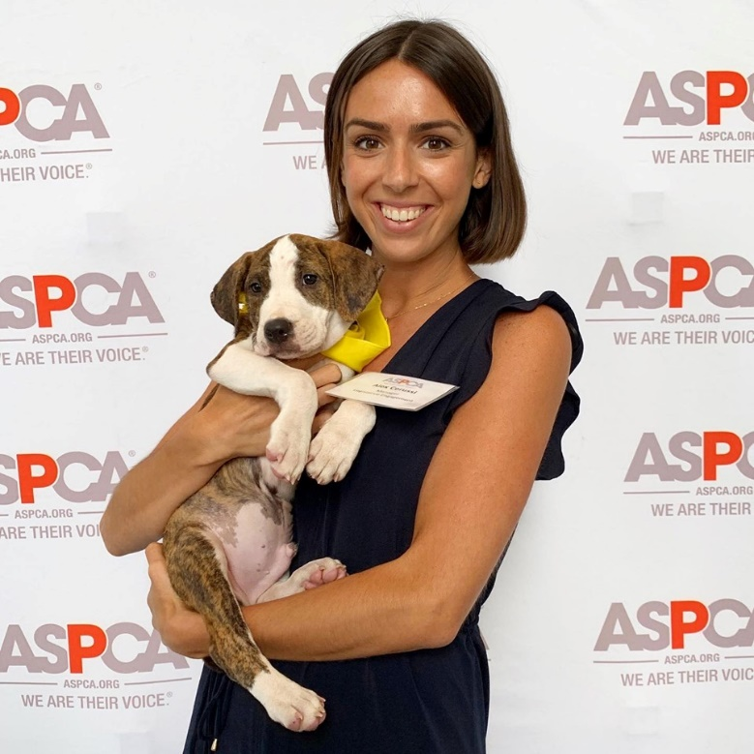
ASPCA Legislative Engagement Team
Kathryn Kopanke, Outreach Manager
Audrey Tamez, Director of Legislative Engagement
Alex Cerussi, Outreach Manager
Notes:
Add Alex

Slide 3
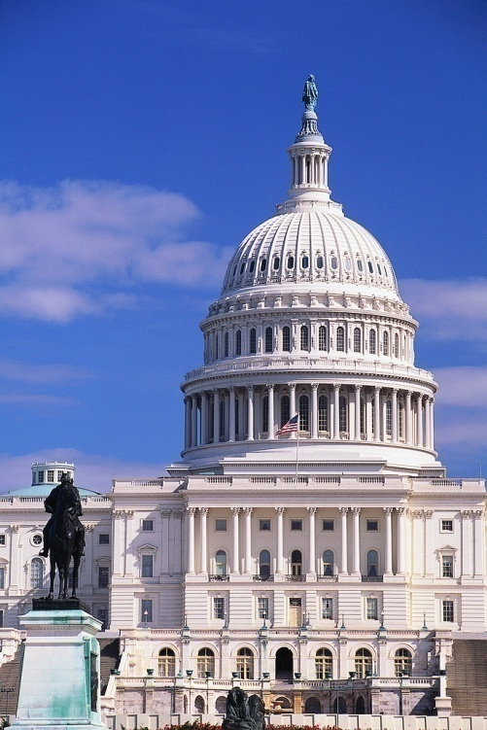
What is Congress?
U.S. House of Representatives: 435 legislators (1 per 750,000 constituents); elected to 2 year terms
U.S. Senate: 100 members (2 per state); elected to 6 year terms
Notes:
You all have one federal representative and two federal senators

Slide 4
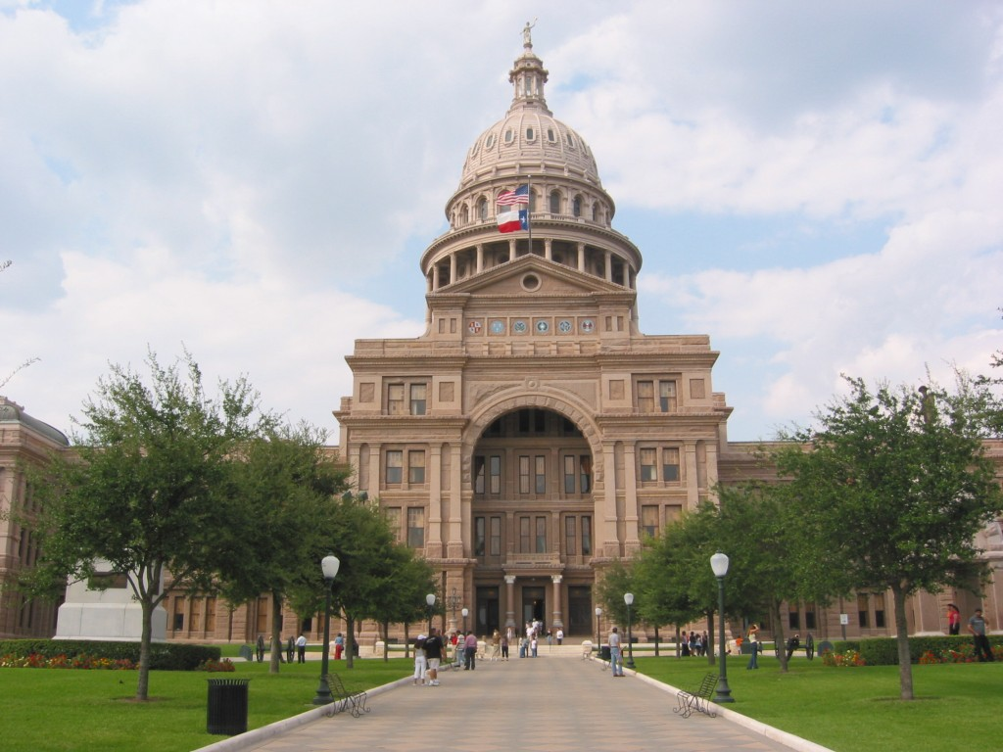
State Legislatures
Vary in make-up
Typically, 1 state representative and 1 state senator
Session timing varies, typically first half of each year

Slide 5
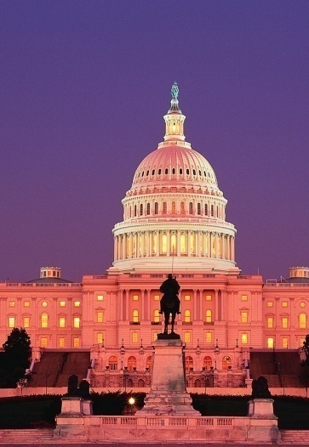
The Life Cycle of Legislation
Session vs. Congress
How bills are affected
Where are we now?

Slide 6


How a Bill Becomes a Law
Returned to original house
Bill is introduced
Committee
Hearings
Floor Action
1
2
3
6
If passed
If passed with amendments
If concurs
HOUSE
Committee
Hearings
Floor Action
Goes to President
4
5
7
SENATE
If signed
Becomes law
8

Slide 7
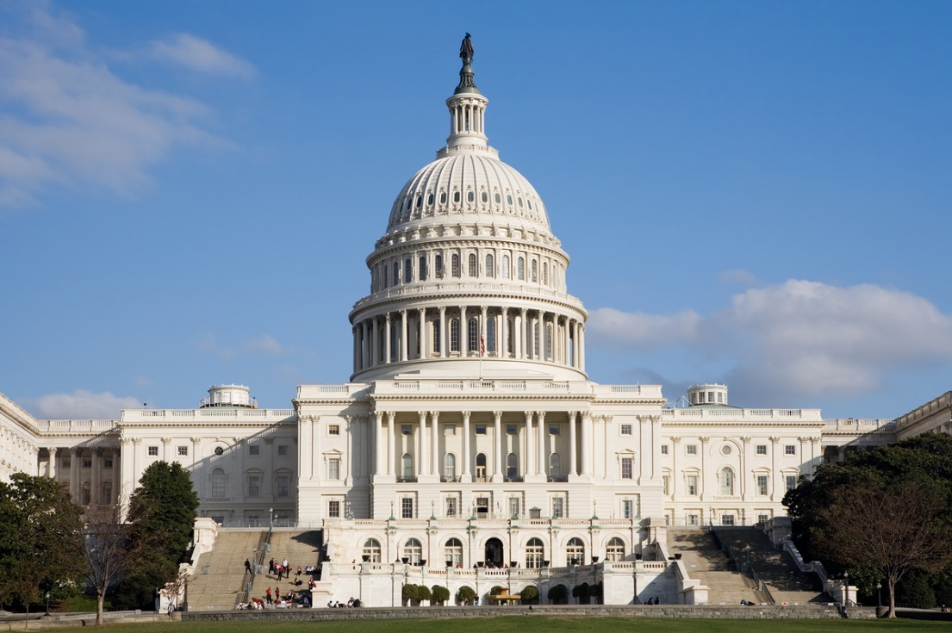
ASPCA Government Relations Department
The Government Relations department is committed to introducing and guiding legislative initiatives supporting animal welfare.
Provides political expertise at state and federal levels, lobbying, legislative drafting, and training and guidance to legislators, nonprofits, and the public on animal welfare topics.
Monitors legislation and acts through lobbying, bill drafting, as well as crafting letters of opinion, testimony, action alerts and media interviews to shape animal protection legislation.
Notes:
Mention how we’re divided into state and federal teams and LE supports those two teams

Slide 8
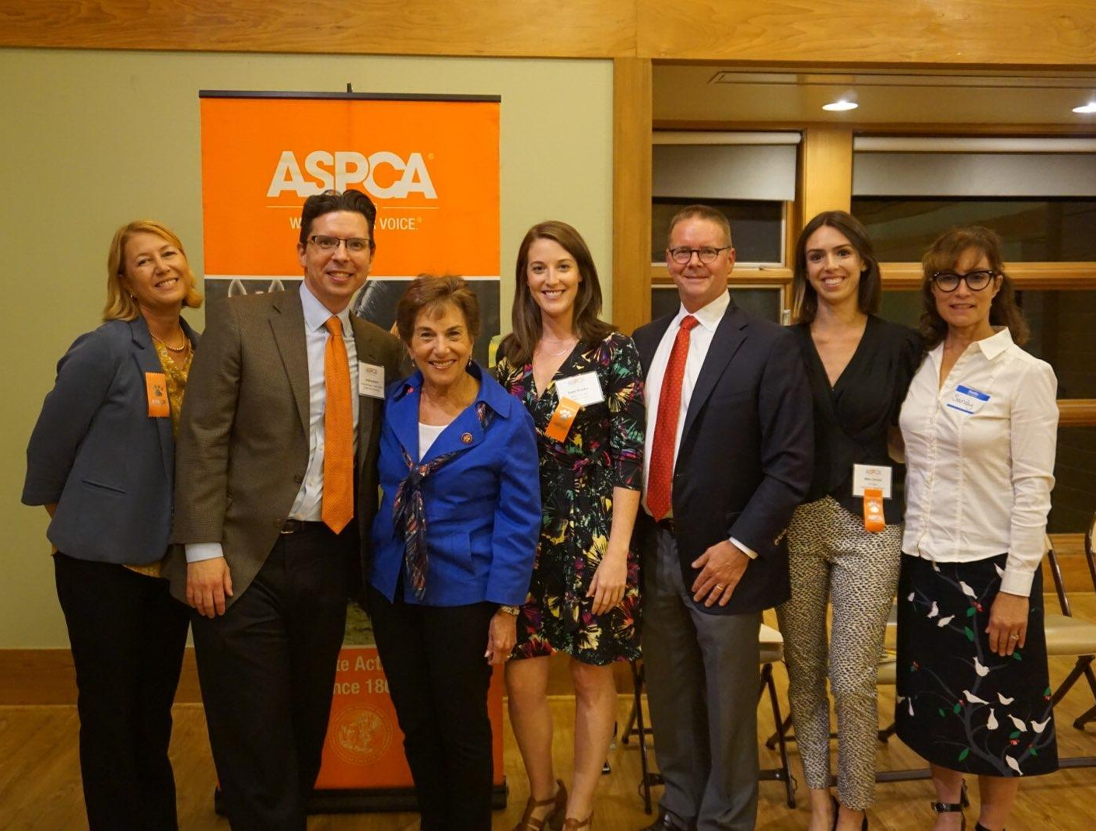
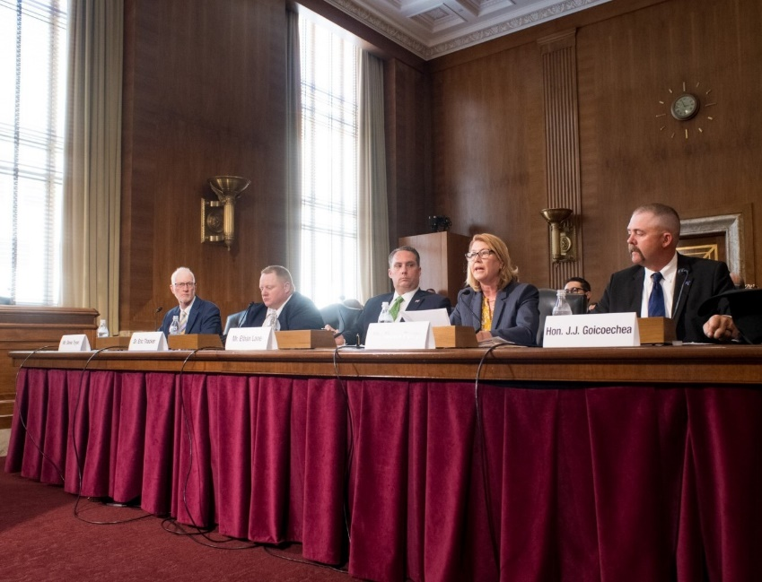
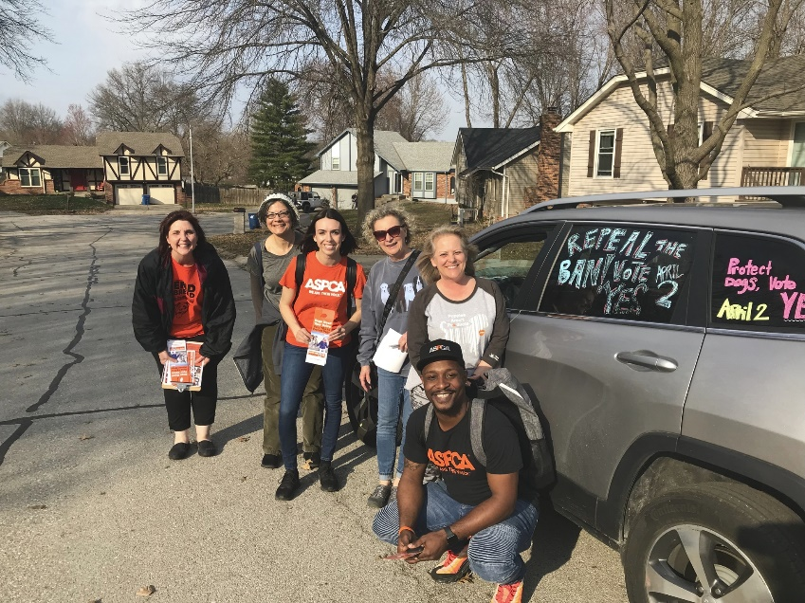
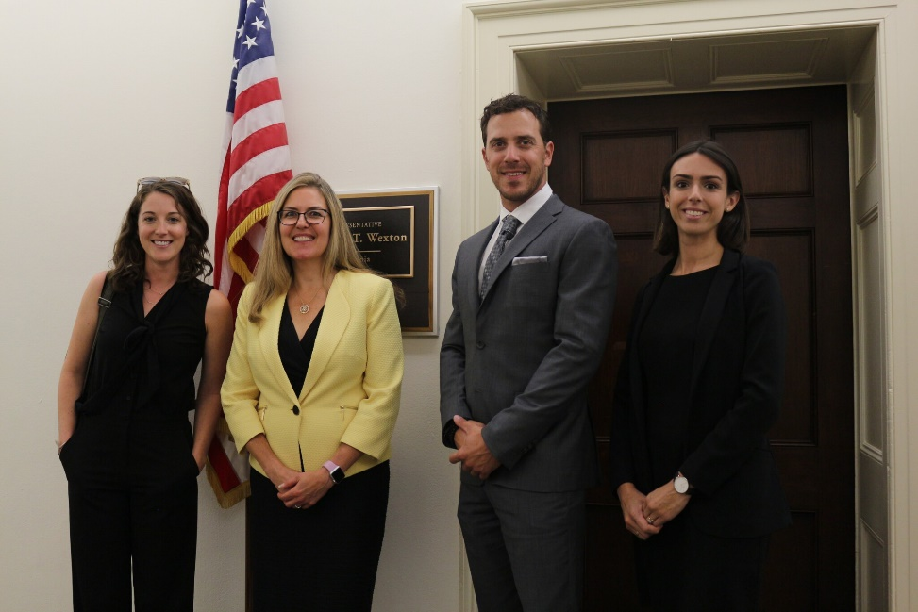
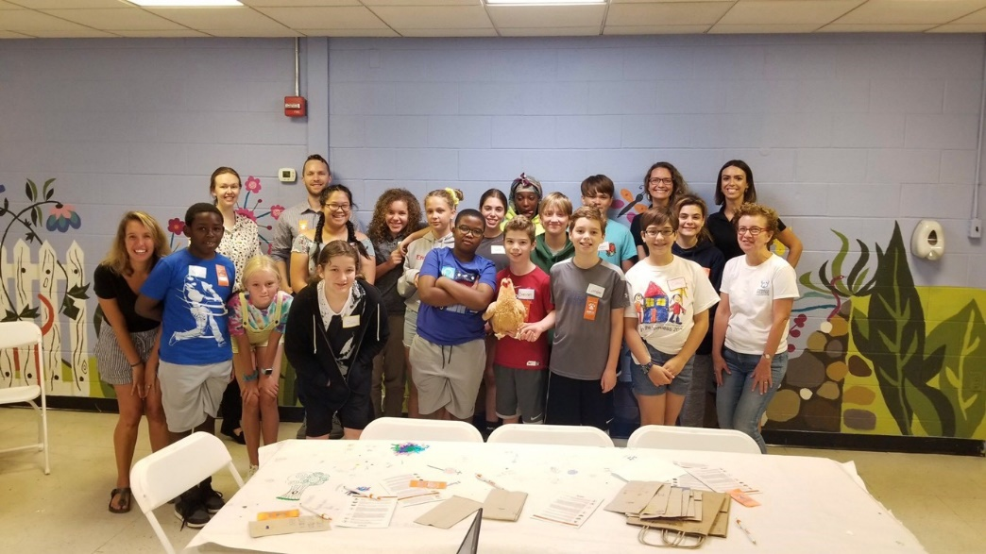
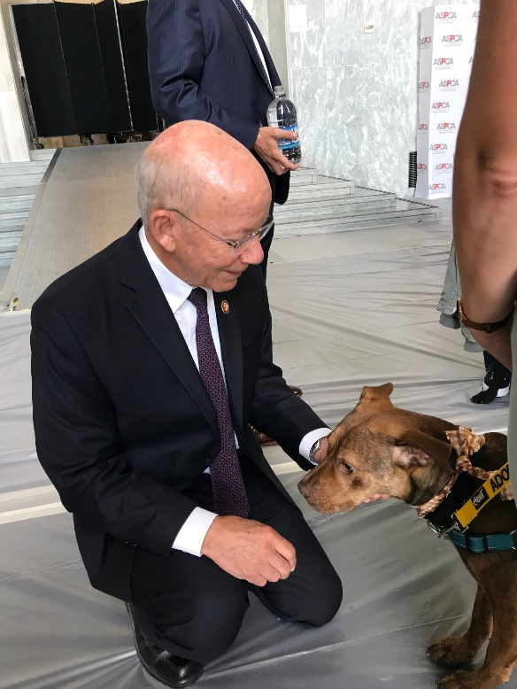
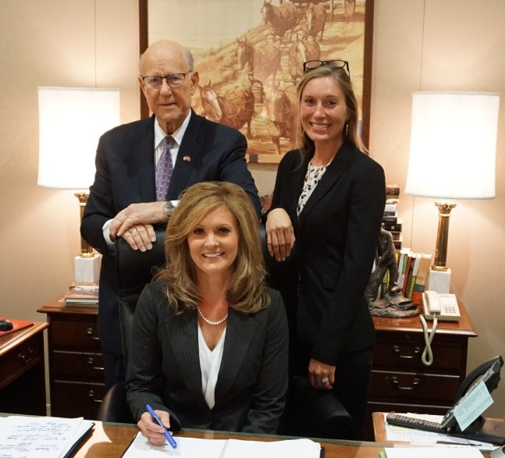
Notes:
What is Government Relations . . . in photo form

Slide 9
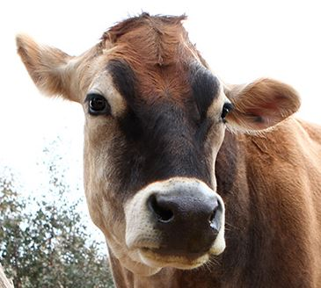
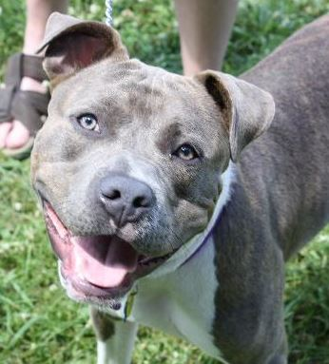
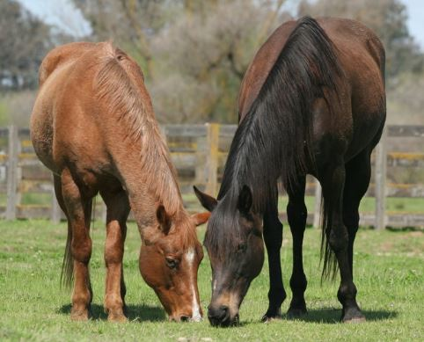
Federal Legislation
Our Federal Affairs team lobbies Congress to advance federal animal protection laws and policies. This work covers a wide variety of issues including protecting farm animals, strengthening animal fighting laws, protecting animal victims of domestic violence, and ending horse slaughter.
Notes:
Purpose:

Slide 10
Two primary types of legislation
Authorizing
Appropriations

Slide 11
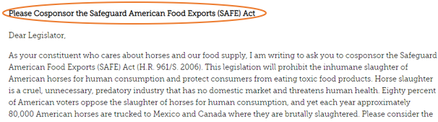
What Are Cosponsors?
Building cosponsors signals bill support and applies pressure to ranking members
Over 218 cosponsors means support of a majority of the House and builds momentum towards committee consideration or a floor vote
Cosponsorship is a meaningful tool to move legislation
Notes:
Be sure to explain what “ranking members” are

Slide 12
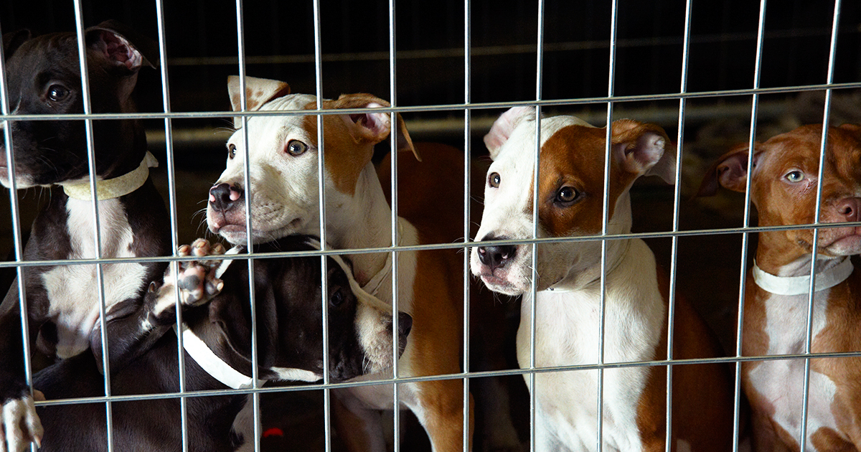
HEART Act
S. 513/H.R. 1228
Ensures owners of animals seized in federal animal fighting cases are held financially responsible for the animals' care and expedites the disposition process for seized animals by:
Reducing time period to notify parties interested in rehabilitation and rehoming from 60 days to 30.
Allowing courts to take animal welfare into account when considering further delays.
Notes:
Cosponsor # + update bill #s / Live evidence – animals diminish quickly in shelter spaces no matter how amazing the shelter staff are. Dogs can sometimes wait for over a year throughout the court process before they’re able to be re-homed.

Slide 13
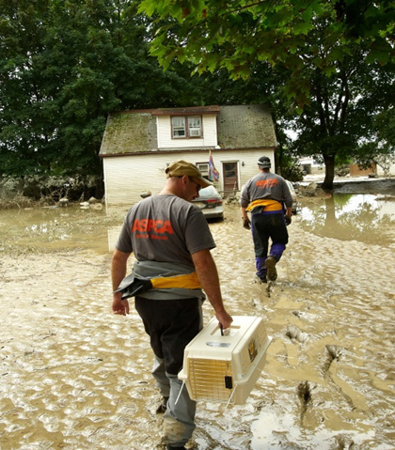
PREPARED Act
(H.R. 1042)
Protects animals during emergency or disaster situations by:
Requiring facilities regulated by the Animal Welfare Act (AWA) to create, implement, and file contingency plans for potential emergencies with the U.S. Department of Agriculture (USDA).

Slide 14
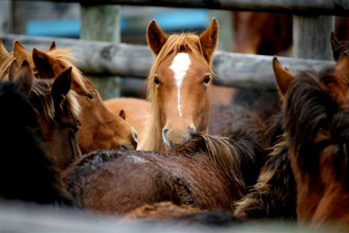
SAFE Act
(H.R. 961 / S. 2006)
Protects horses from slaughter and consumers from exposure to toxic horsemeat by:
Prohibiting slaughter of horses in U.S. and their export for that purpose.
Notes:
Carolyn

Slide 15
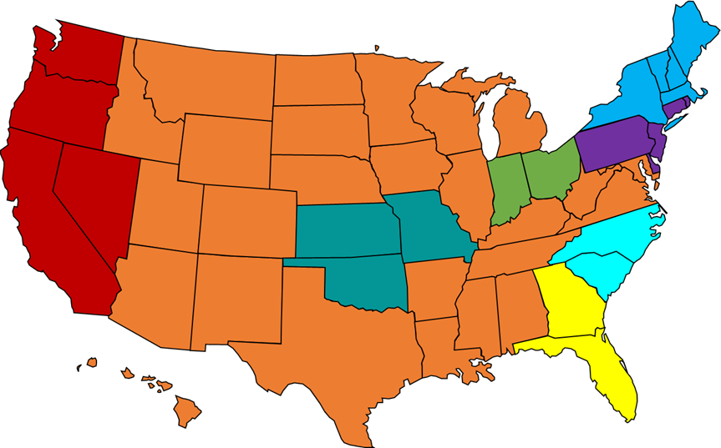
State Legislation
The ASPCA’s State Affairs team lobbies for animal protection legislation at the state and local (city/county) level in strategically planned regions across the country.
The wide variety of issues includes:
  Efforts to remove barriers to keeping pets and people together
  Promote humane treatment of farm animals
  End puppy mills
  Help law enforcement more effectively fight cruelty
Notes:
List verbally where we have state directors

Slide 16
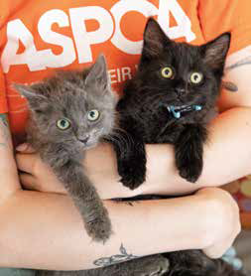
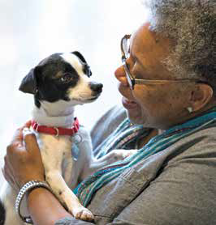
Pet Friendly Housing
  NV – HOA BSL Prohibition and prohibition on no pet policies as well as requiring state financed housing to be pet friendly (passed 2019)
  CA – State financed housing to be pet friendly
  City of LA and County of LA – both implementing ordinances to require locally financed housing be pet friendly

Slide 17
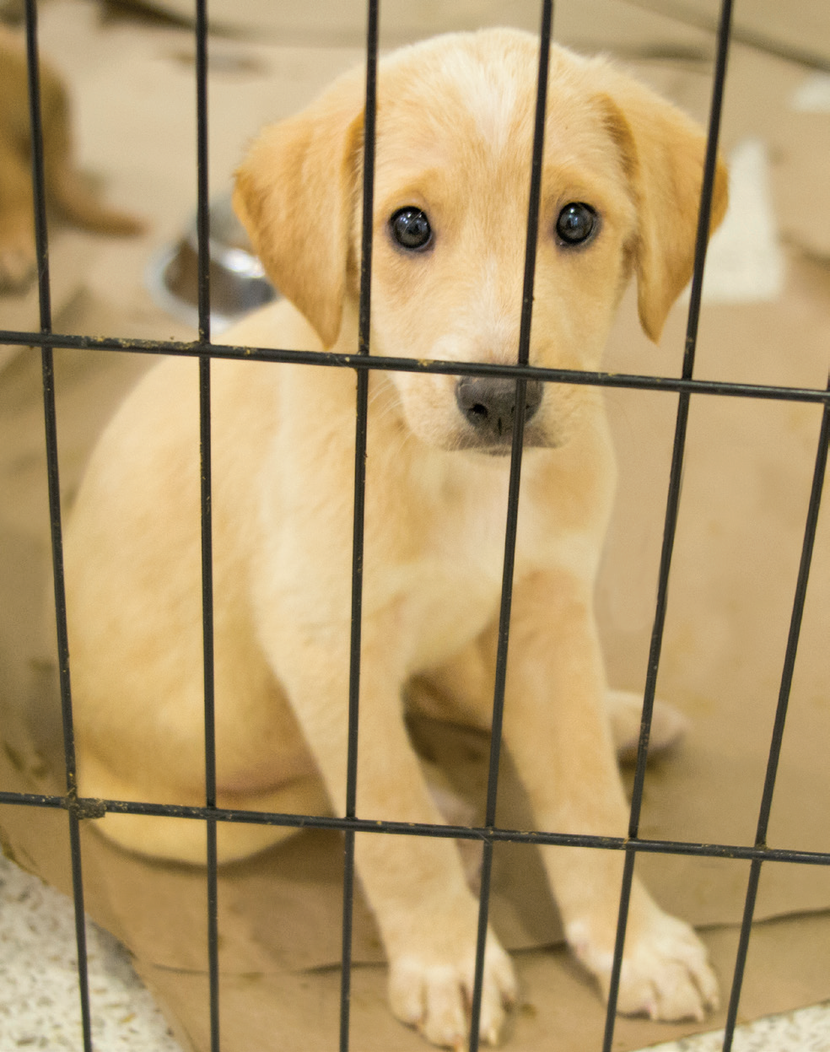
Puppy Mills
NY – Pet Store Reform Act; prohibit the retail sale of pets in pet stores
FL, GA – Defeat attempts to preempt the ability of localities to regulate the sale of pets in pet stores
Prohibit the practice of pet leasing – Bans successfully passed in NV, CA, NY, CT, IN, NJ, WA

Slide 18
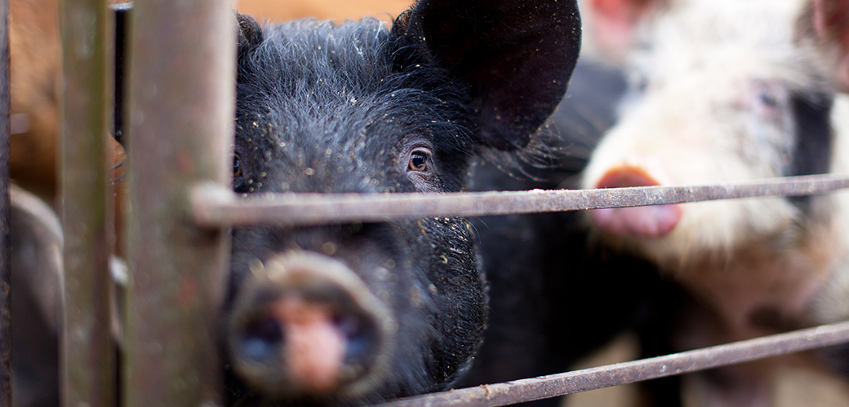
Farm Animal Welfare
  Humane Certification – provide incentives for farms to become humane certified and implement practices that allow farm animals to live better lives (VT, CA)
  Ag-gag – defend against attempts to silence whistleblowers investigating day-to-day activities of industrial farms
  Right to Farm – defend against attempts to limit the ability of local govs to regulate conditions on farms and limit the ability to seek damages from an agricultural operation

Slide 19
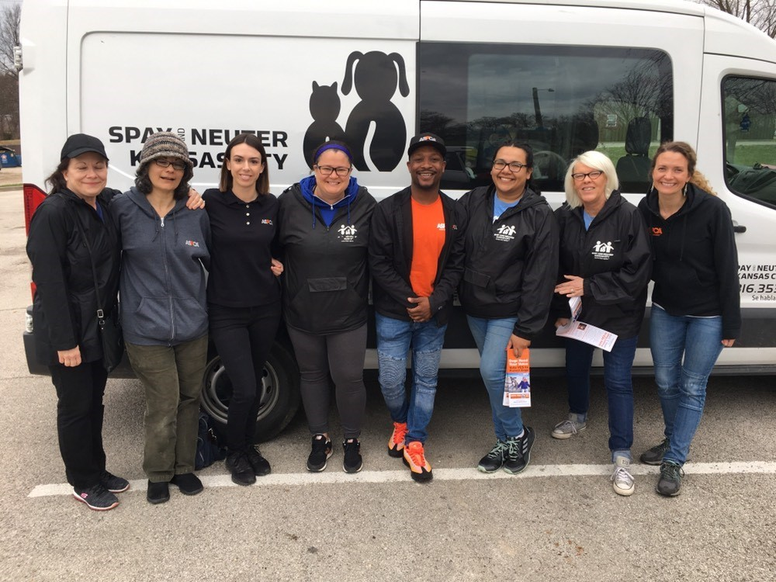
Local Effort Highlights
Breed Specific Legislation (BSL)
ASPCA mission: Keep Pets and People Together
Springfield, MO Pit Bull Ban Repeal
Liberty, MO Pit Bull Ban Repeal
Parma, OH Attempted Pit Bull Ban Repeal
Notes:
Highlight our partnership with local rescues/shelters/animal advocacy groups to get the word out and repeal the ban!

Slide 20
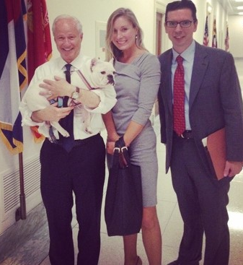
Why Do We Lobby for Animals?
Without laws, animals have no formal protection.
Animals cannot advocate for themselves.
You can be VERY influential!

Slide 21
Who Can Lobby?
The ‘Cans’ and ‘Cannots’
Can a non-profit and its members advocate for animal welfare legislation to a legislator's office? Yes!
Can a non-profit invite elected officials out for a visit at their facility? Yes!
* Remember, you're all voters and it's your duty to build this relationship!

Slide 22
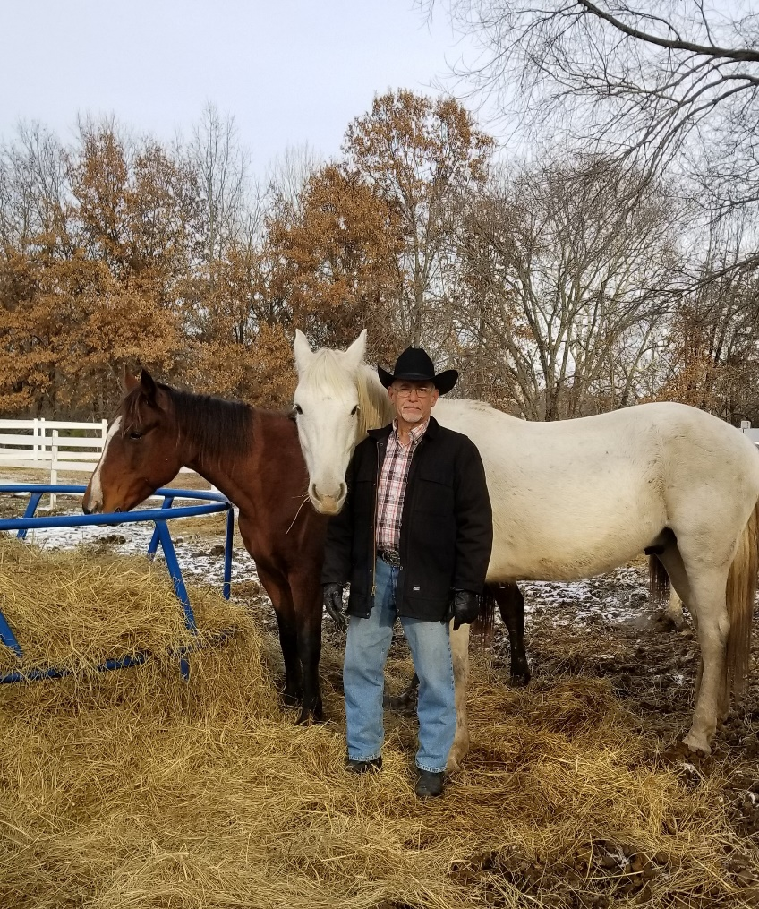
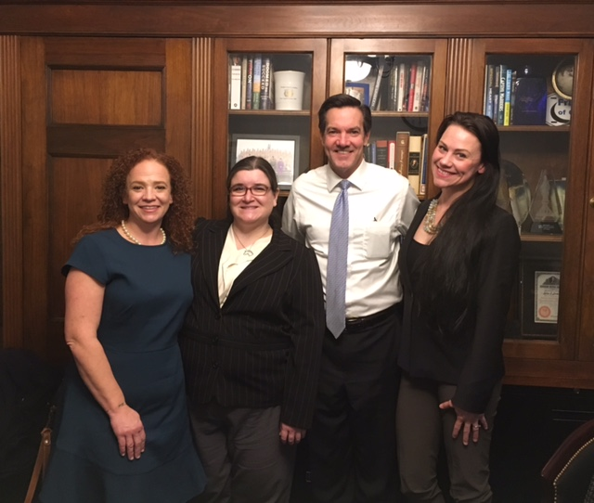
Why Should YOU Lobby?
Leaders of Heart of Phoenix Equine Rescue, WV, visited with then-Representative Evan Jenkins, in D.C. and came back before a crucial vote to show their dedication to ending horse slaughter
Bob White of Owl Hollow Farm, MO, hosted his legislator out for a farm tour and discussed the importance of passing the SAFE Act and the HEART Act

Slide 23

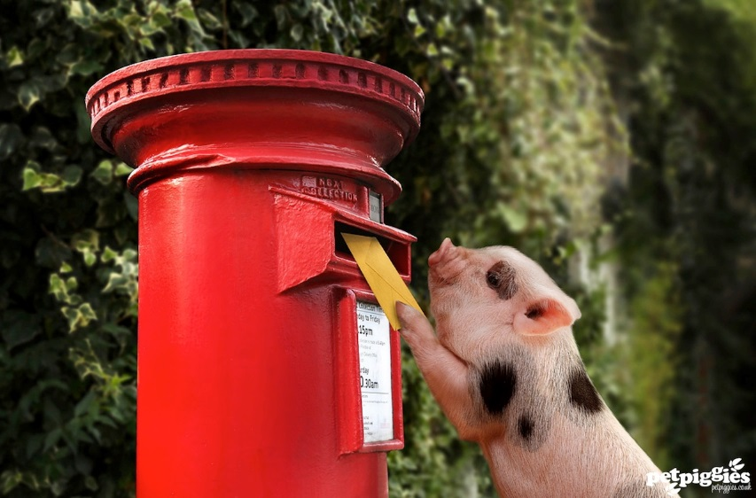
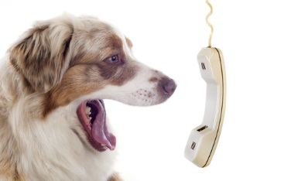
Effective Means of Advocacy
  In-district Meetings
  Invite Your Legislator Out to Your Facility
  Social Media
  Letter Writing
  Letters to the Editor
  Phone Calls
  Encourage Your Volunteers to Get Involved!

Slide 24
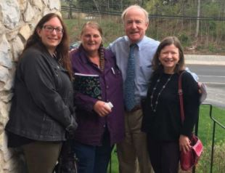
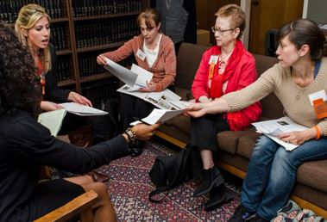
ASPCA District Captain Program
Communicate animal protection issues to legislators
Organize events
Recruit volunteers
Drive social media campaigns
Be an ASPCA voice in your district
Notes:
Purpose:

Slide 25
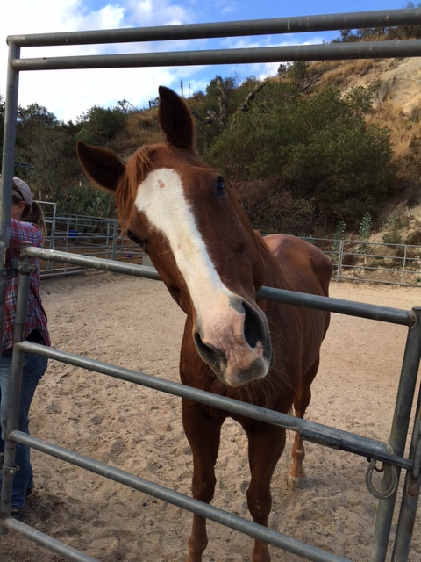
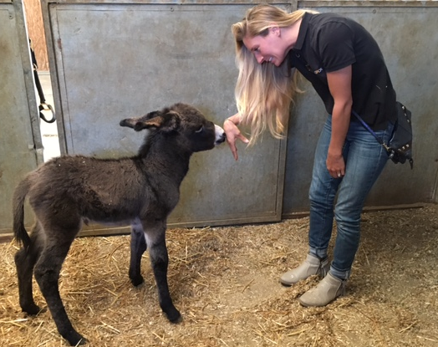
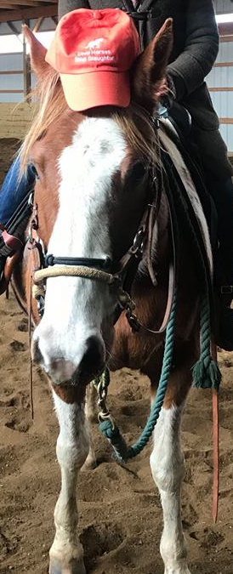
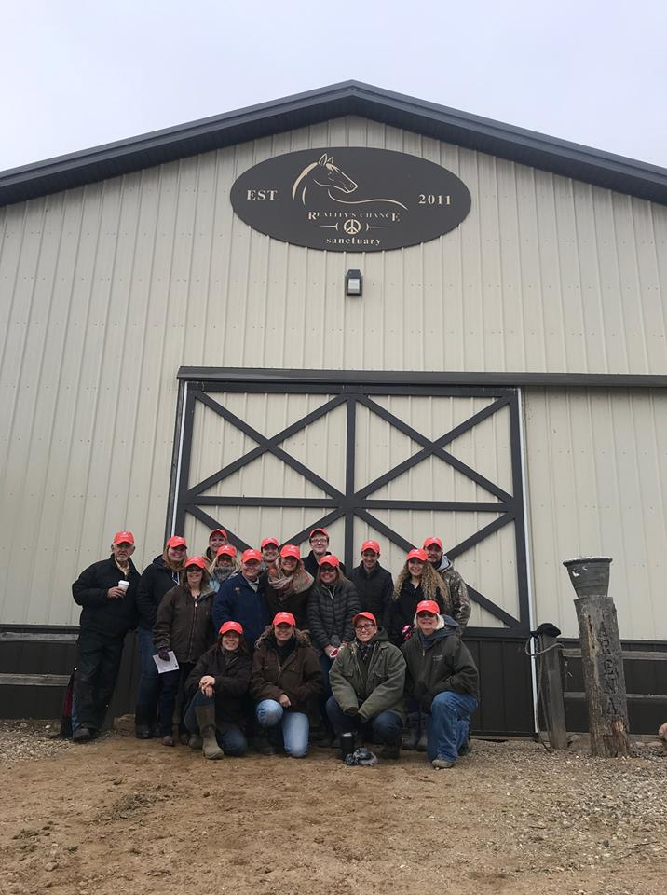
Horse Action Team
The Horse Action Team (HAT) is made up of almost 3,000 volunteer equine welfare animal advocates from across the country.
The main goal of the HAT is to put an end the horse slaughter for human consumption in America and the shipment of U.S. horses abroad for that purpose
Sign up here today!

Slide 26
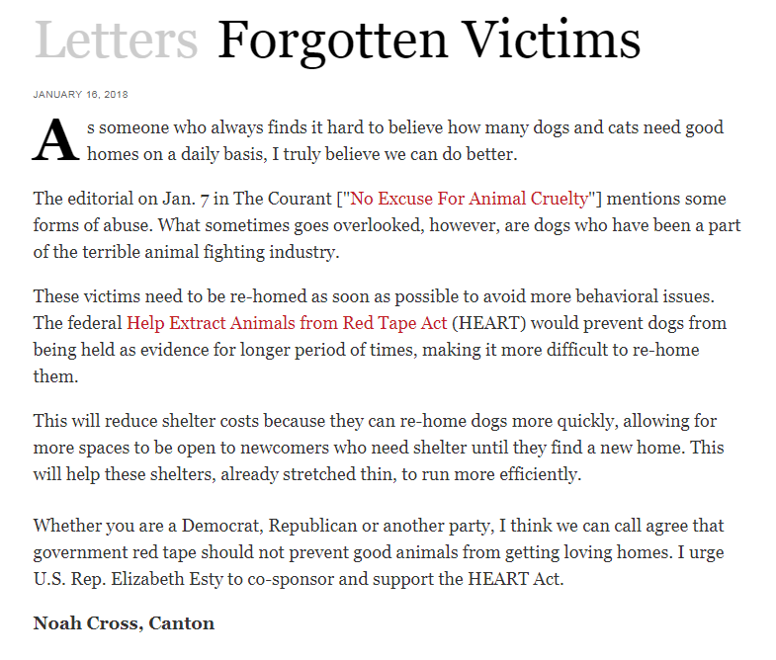
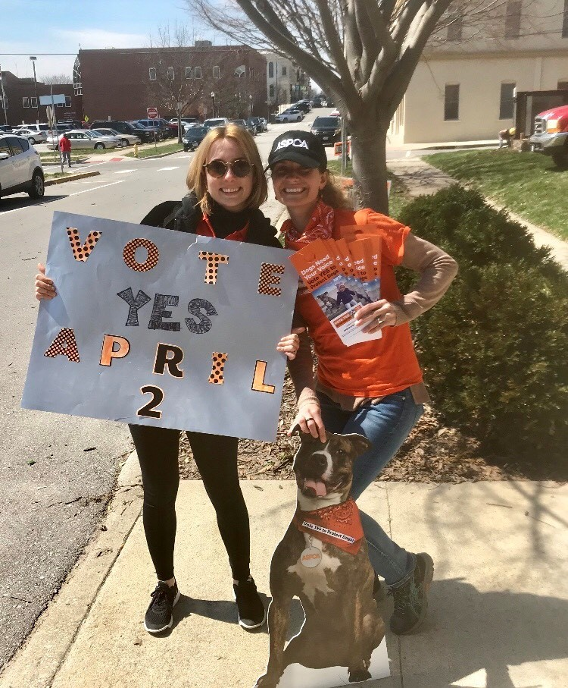
Regional Advocacy Field Team Volunteer Program
RAFT is national volunteer program for volunteers who will work hand-in-hand with the District Captain in their area to actively engage on ASPCA priority legislation.
RAFT Activities
  organizing and participating in phone banking projects
  Drafting letters for Letters to the Editor (LTE) banks
  Attending and helping organize advocacy events and in-district lobby meetings
  Driving social media advocacy campaigns
  Supporting ballot measure work
  Sending personal letters to their legislators

Slide 27

What Can You Expect Next?
YOU HAVE TO SIGN-UP TO RECIEVE EMAILS FROM US!
Email grassroots@aspca.org so that we have permission to follow-up with you!
Copy of PowerPoint to share with your network
District/State-Specific Advocacy Asks & Information on Your Legislators
Our Assistance With Your Advocacy Needs
Notes:
Follow up, materials provided, ppt, district office information

Slide 28
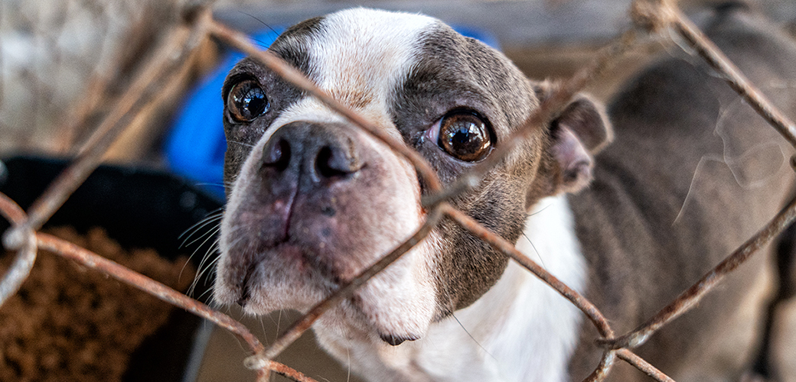
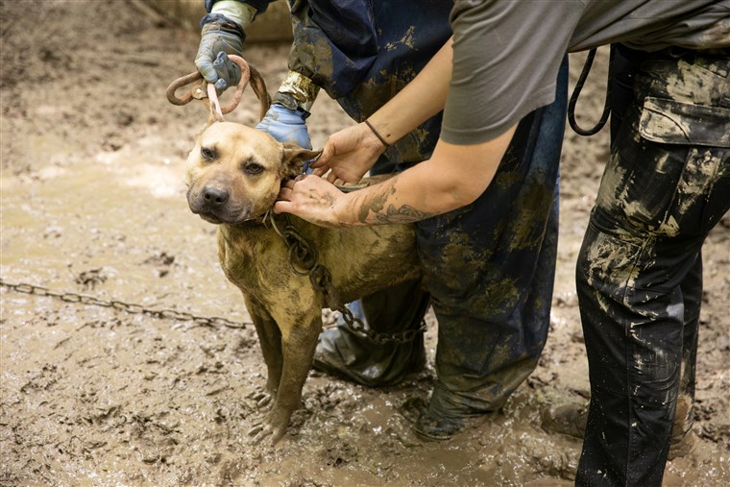
Having Issues in Your Community?
Email us at grassroots@aspca.org and we'll connect you with the right folks at the A!

Slide 29
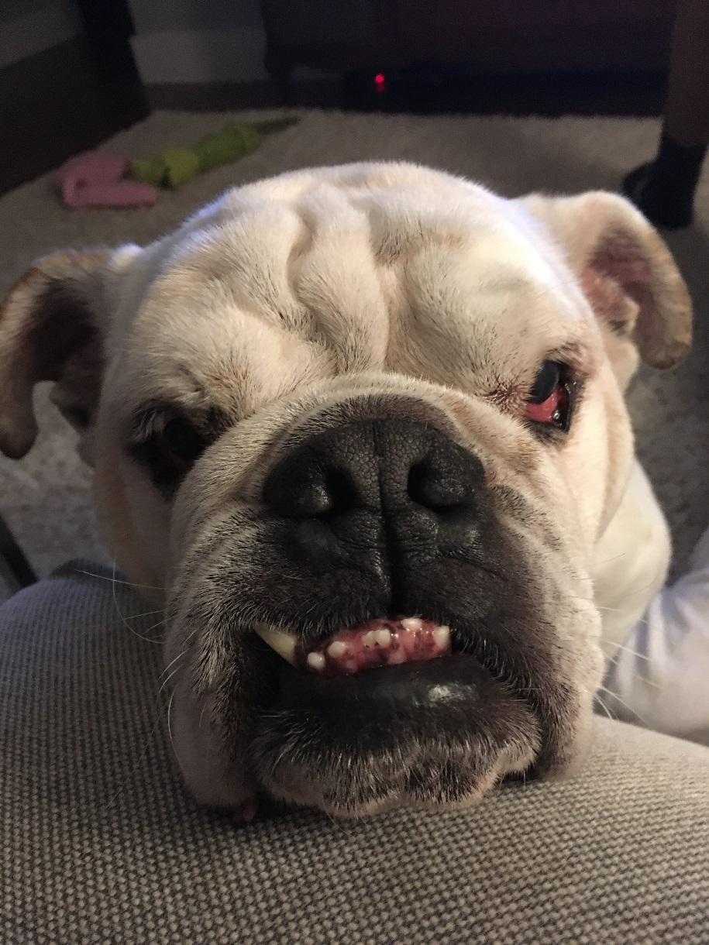
Questions?

Slide 30
Legislative Engagement Contact
Audrey Tamez: Audrey.tamez@aspca.org - 202-302-1217
Kathryn Kopanke: Kathryn.Kopanke@aspca.org – 202-480-440
Alex Cerussi: Alex.Cerussi@aspca.org – 202-573-3441

