Slide 1

Help A Horse Home Challenge
Enjoy the music!
The webinar will begin at its scheduled time.
Join the webinar using built-in computer audio or dial
669-900-6833 or
646-558-8656
Webinar ID: 500-389-590

Slide 2


How to Adjust Your Audio
Select “Audio Settings” at the bottom of your screen.
Choose whether you’ll join using computer audio or your telephone. We recommend computer audio.

Slide 3


How to Chat
Select “Chat” at the bottom of
your screen
In the chat window, select “All panelists and attendees” to share your message with everyone in attendance

Slide 4

Notes:
Welcome and Intro from Susan F.

Slide 5
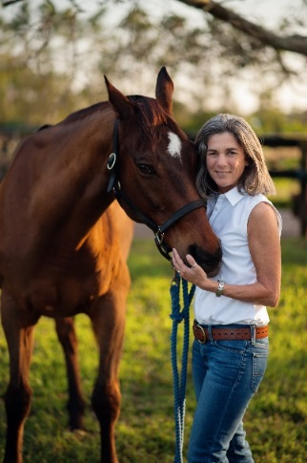
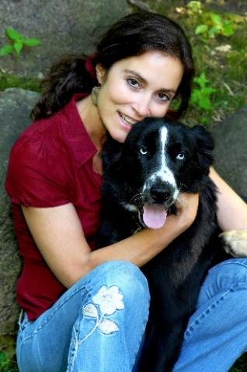

Your Presenters
& Panelists
Matt Stern
Senior Director, Operations
Policy, Response & Engagement
Emily Weiss
Vice President
Equine Welfare
Sandy De Lisle
Senior Manager Content Development
HelpaHorseHome@aspca.org

Slide 6
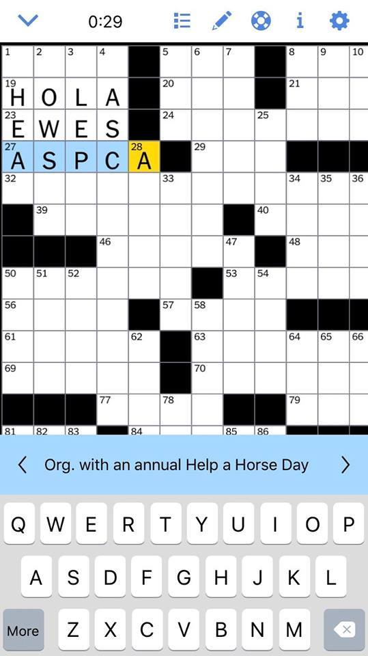
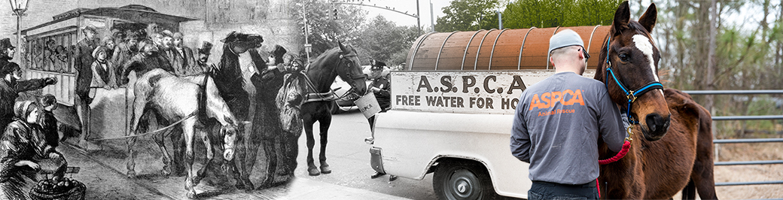
History of Help a Horse Day
Notes:
SANDY
As many of you know, ASPCA’s Help a Horse Day is celebrated every year on April 26 – a date chosen for its significance to the ASPCA’s long history of horse protection. April 26th in the year1866, was when the ASPCA founder Henry Bergh stopped a cart driver from beating his horse, which led to the first successful arrest for mistreating horses. Fast forward to last month when we at the ASPCA were thrilled to learn that Help a Horse Day hit the big time when it was featured in the Sunday New York Times crossword puzzle, highlighting just how mainstream, equine welfare has become!
In this, our sixth year of the contest, we have tweaked the name to Help a Horse Home: The ASPCA Equine Adoption Challenge. Our new name keeps the spirit of the old contest while acknowledging our new and exciting direction to find more homes for horses.
I’m going to pass it over now to Dr. Emily Weiss, our Vice President of Equine Welfare, to explain a little bit more about that shift in our focus.

Slide 7
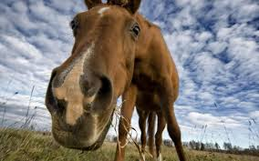
Equine Adopter Research

Slide 8
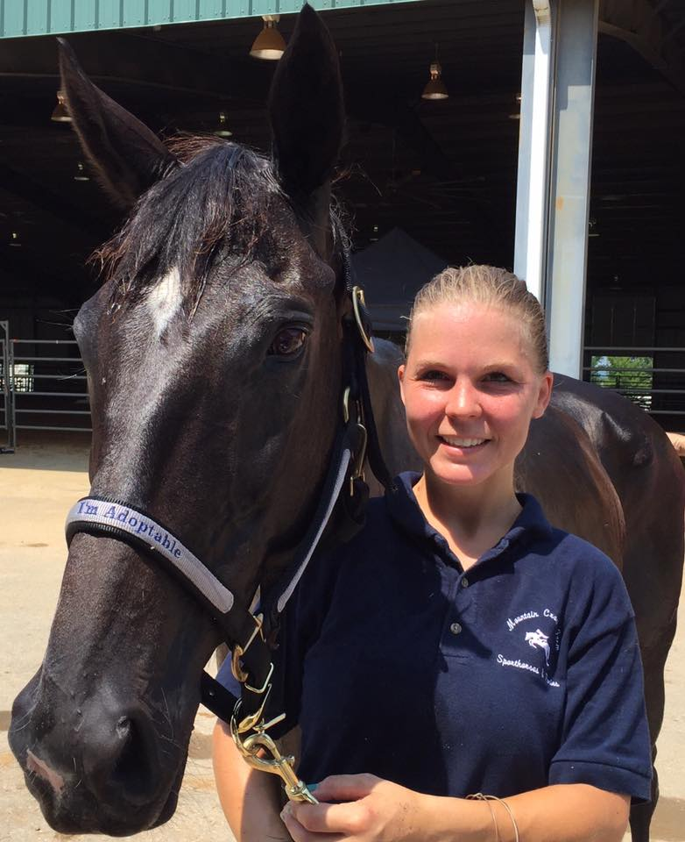
2.3 million people (1.2 million households) have space, resources and a strong interest in adopting
Notes:
We estimate 2.3 million people (or 1.2 million households) have the space, resources and a strong interest in adopting

Slide 9
2018
Focus on Finding Good Homes
In 2018, we shifted the contest and boy did you knock it out of the park!
OVER 1000 horses adopted!
OVER 2.2 Million dollars raised for your rescues!
Notes:
NOTE: Can someone make good visuals of the data?

Slide 10
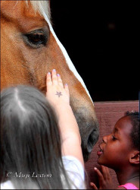
We Learned There are Homes for Horses In Transition and Horses Who Need Rescuers…

Slide 11
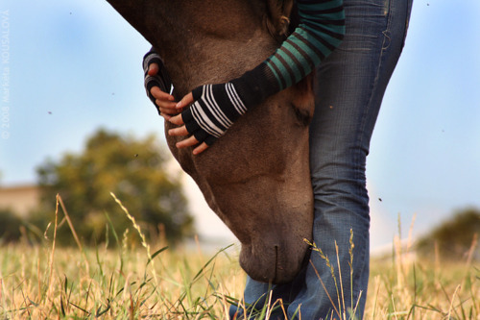
Who are the horses in shelters and rescues?
Lost
in
Transition
Notes:
They are the very same horses that are in our homes… that are competing…. That are companions…that are therapy horses… they simply got lost in transition…. Let’s not stigmatize them –

Slide 12
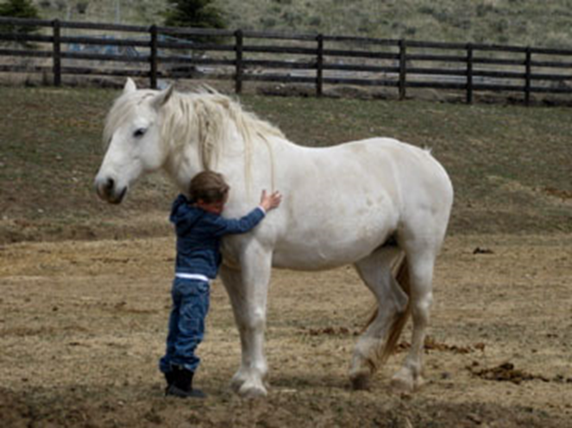
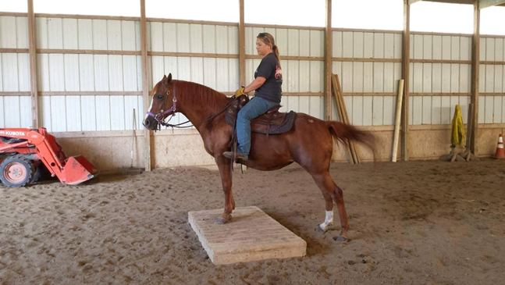
Changing the Perspective of Horses in Need of Homes
We think big – we want to change the perspective of horses in need of homes. And bigger than that – we want to engage horse enthusiasts to change the landscape for at risk horses… We can’t do that without changing business …
Notes:
Elevating the status of horses in need of homes gives us the ability to grow empathy and change perspectives
A contract that does not provide transfer of ownership = this horse is different…

Slide 13
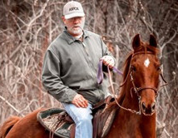
Keeping Them Safe
What we have learned from you…
Assess
Train
Make good matches…
Microchip
Follow up
Open door policy for horses to come back easily and without judgement

Slide 14
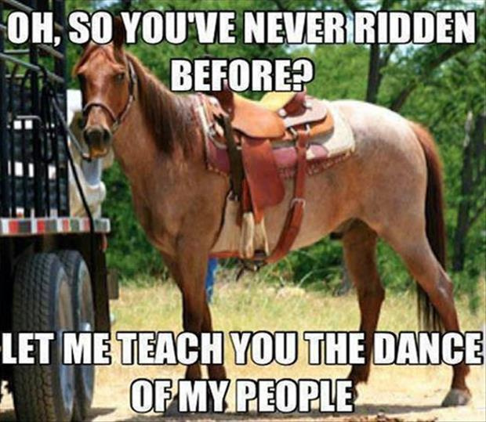
What This Contest Is Not…

Slide 15
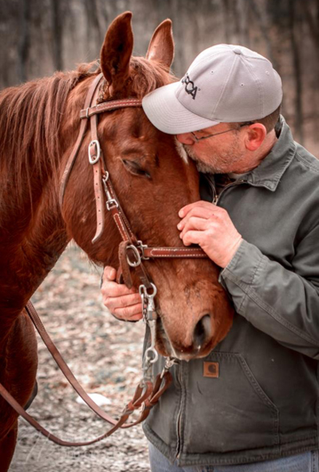
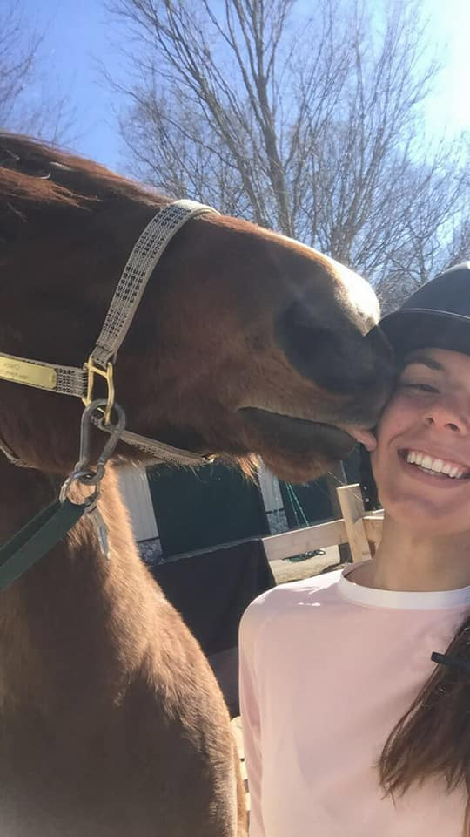
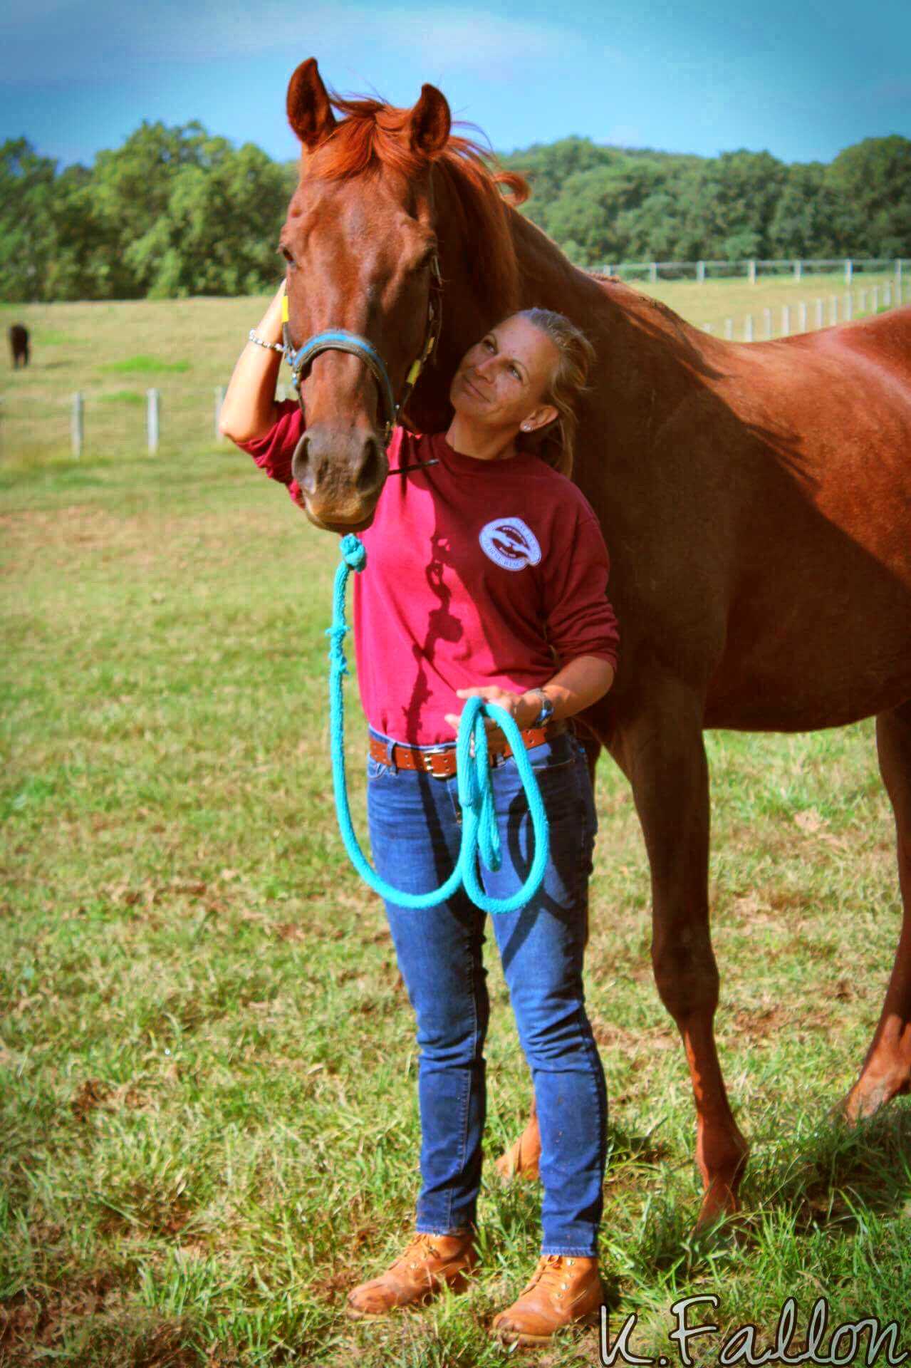
It’s about finding those good homes!

Slide 16
Notes:
Our new name keeps the spirit of the old contest and aims it very squarely at the goal of getting horses home…

Slide 17
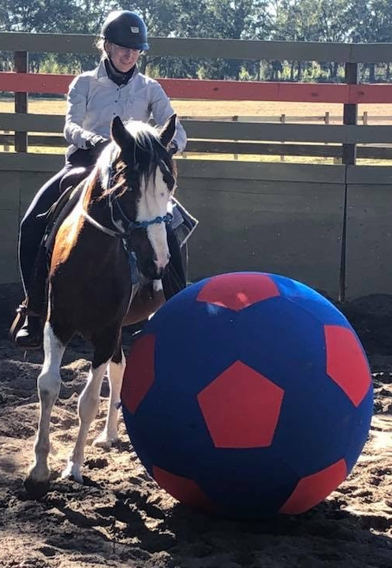
What’s New/Different This Year?
Winners determined based on increases in adoption
Social media prizes
More money in prizes
4 divisions instead of 3
Collaboration through transfer will be encouraged
More support and resources
Notes:
Sandy will be sharing what those exclusive resources are a bit later

Slide 18


$150,000 in prizes!
The new Challenge grand prize of $35,000
Eight division prizes totaling $100,000
Three new social media prizes totaling $15,000
Notes:
So this year we are giving away $150,000 in prizes, up by more than one-third from last year.
We’ve established a new grand prize of $35,000.
The four divisions will each have two prizes, for total of 8, and these will add up to $100k.
And there will be three new social media prizes totaling $15k

Slide 19
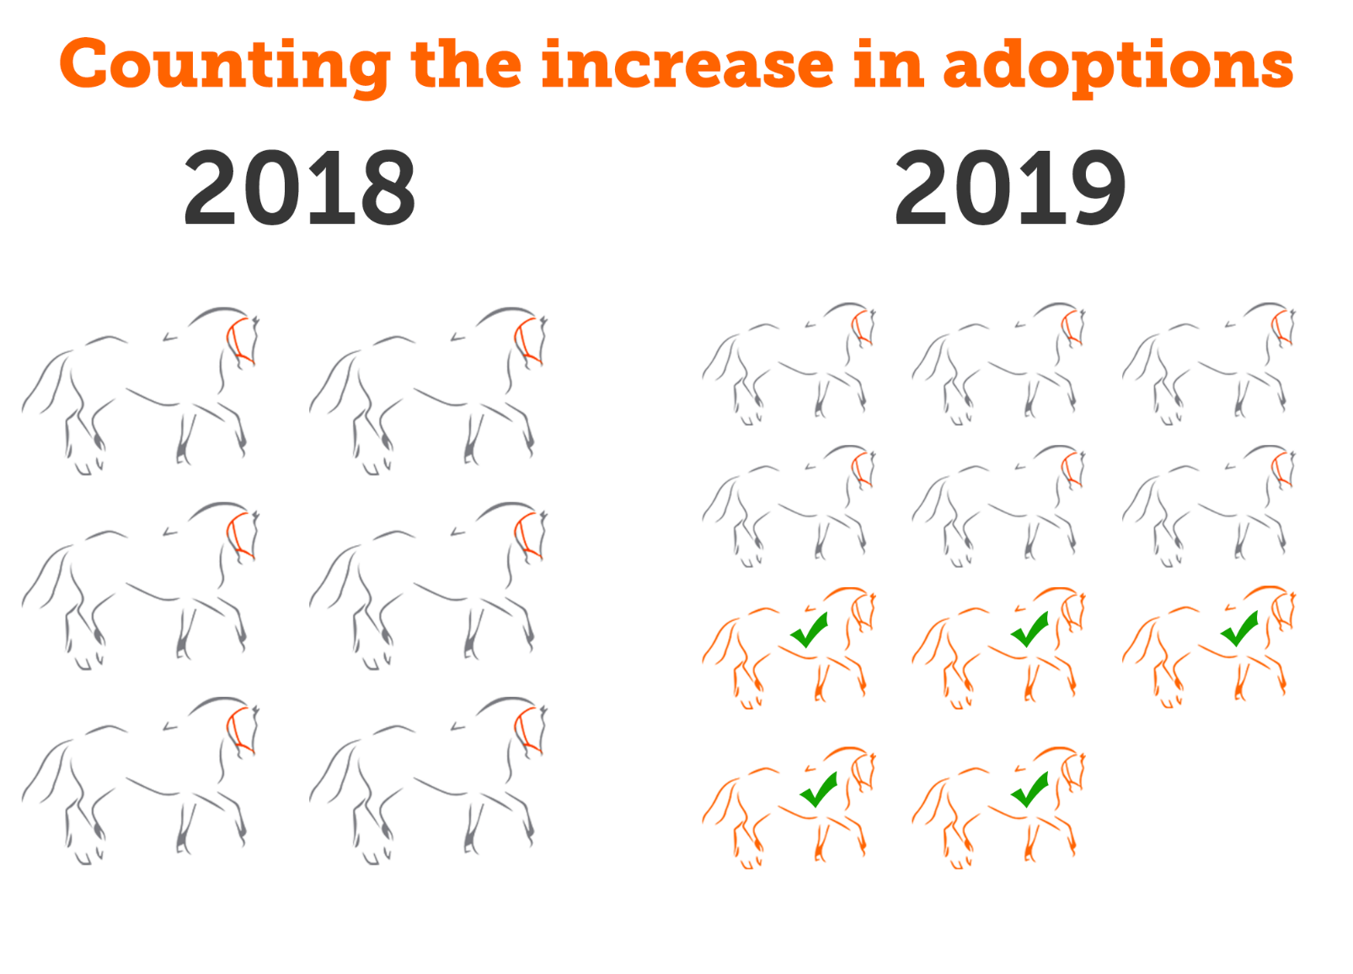
Notes:
So to elaborate on what Dr. Weiss said, the division prizes and grand prizes will be won by the groups with the largest increase in the number of horses adopted during the contest period from last year to this year. The graphic on this slide represents a group that adopted out 6 horses during the 2018 contest that goes on to adopt out 11 horses this year. So the key number we will be looking at for this group and comparing it to other groups to determine if it wins a prize is 5. If 5 happened to be the largest increase in their division, this group would win the first prize for that division.
And just so there’s no concern about the 2018 number – you did not need to participate in last year’s contest to be considered for a prize. You will be asked when you register to provide the # of adoptions your group did during the contest period in 2018.

Slide 20
Announcing the New Grand Prize!
This year we’re introducing a contest-wide grand prize of $35k
The group with the largest increase in equine adoptions will win the Equine Adoption Challenge Grand Prize
This group can be in any division!
$35,000
Notes:
So let’s talk about the grand prize. This year we wanted to have a winner for the entire contest, not just the division winners. This $35,000 prize will go to the group with the largest increase in equine adoptions out of all the groups in the contest. And because we’re counting the increase in the number of adoptions, and not the total number, any group can have a shot at this prize, no matter which division they’re in.
Once the grand prize winner is selected, they will no longer be eligible to win a division prize, opening up the field to the groups having the next largest increases in the number of adoptions.

Slide 21

Division Prizes
$100k in prize money will be split among the
top two winners in each division.
All challenge participants will be placed in one of four divisions based on the number of adoptions they completed last year in the period from April 26 – June 30: very large, large, medium, small.
These divisions will be determined after registration closes
 | Division 1 | Division 2 | Division 3 | Division 4
1st Prize | $25,000 | $20,000 | $15,000 | $7,500
2nd Prize | $15,000 | $10,000 | $5,000 | $2,500
Notes:
So in addition to the $35k for the grand prize, we have $100k in prize money to be spread out among the top two winners in each of our divisions. As you heard earlier, there will be four divisions this year instead of three, and your group will be assigned to a division based on the number of adoptions you did last year during the contest period relative to the other groups in the challenge. We hope this will level the playing field a bit more for groups of different sizes. We will let you know by April 19 what division you’re in.

Slide 22
So…how do you win?
The division winners are determined by how many more equines your organization adopts out this year during the contest period compared to last year.
As an example, if these are the top 3 contestants in division 3:
 | 2018 Adoptions 4/26 – 6/30 | 2019 Adoptions 4/26 – 6/30 | Increase year over year
Yellow Equine Rescue | 29 | 36 | 7
Green Equine Rescue | 26 | 35 | 9
Blue Equine Rescue | 22 | 34 | 12
Notes:
As an example, if these are the top 3 contestants in division 3, you can see that the Yellow Equine Rescue adopted out the most horses last year and again this year and blue did the least. But take a look at the last column. The Blue Rescue actually has the largest increase in adoptions year over year, at 12, which is what determines the winner. Next slide.

Slide 23
So…how do you win?
 | Division 3 | 2018 Adoptions 4/26 – 6/30 | 2019 Adoptions 4/26 – 6/30 | Increase
 | Yellow Equine Rescue | 29 | 36
2nd Place | Green Equine Rescue | 26 | 35
1st Place | Blue Equine Rescue | 22 | 34
7
9
12
Notes:
So you can see in this example it’s the blue rescue that wins the 1st place prize, and green the 2nd, even though yellow still did the most adoptions.
We did this for two big reasons. We know that even with four divisions there may still be participants grouped in with others that from their perspective have been doing a lot more or a lot less adoptions than their group. We thought that counting the number of additional horses adopted out would help the smaller groups feel they still had a chance because it’s not about the overall number. But even more importantly, we thought this way of counting puts our focus where we want it, on the increase. Because at the end of the day, this is all about getting more horses home!

Slide 24




The Hoofy Awards!
This year we are offering three prizes of $5,000 each for the best use of social media
Hoofy prizes can go to any group including the division and grand prize winners.
Attend our best practices webinar on April 10, 2019 to learn more about how to create a top-notch social media campaign!
Notes:
And we’re not done yet. This year we’ve reserved $15k in prize money for our new Hoofy Awards!
The ASPCA will award those participants who best leverage the power of social media to raise awareness about their organization and to increase equine adoptions. Hoofy prizes can go to any group including the division and grand prize winners.
More information about the Hoofy Awards can be found in the Rules, and we will be holding a webinar on best practices on April 10 that will showcase the things we’re looking for in a winner.

Slide 25
Transferring Equines to Rehoming Partners
We believe that transferring equines to other partners can be an effective strategy for increasing adoption
As an incentive to send horses to partners that might be better placed to find a particular horse a home, we will give challenge credit to both the sending and receiving partners.
The sending partner will get credit for ½ an adoption at the time of the transfer.
The sending partner will get credit for an additional ½ an adoption if the receiving partner adopts out the horse during the contest period.
The receiving partner will get credit for a full adoption if the horse is adopted during the challenge period and they are a challenge participant.
Notes:
We believe that transferring equines to other partners can be an effective strategy for increasing the number of adoptions. If your group is good at placing quarter horses, for example, but you’ve got a couple of thoroughbreds that have literally been going nowhere for months if not years, it might make sense for you to transfer those thoroughbreds to a group that excels at placing those horses.
As an incentive to send horses to an equine re-homing partner that might be better placed to find that particular animal a home, we will give credit to both the sending and receiving partners in these transfers.
Of course, we only want you to be transferring horses to responsible organizations that have the capacity to adopt these horses out.
You can find information on all of this in our rules, which are linked to on our HaHH website.

Slide 26
The Fine Print
Your organization must be in good standing with the secretary of state of the state where you’re incorporated
You must be registered to solicit funds in your home state
A majority of your board must be independent
Compensated board members may not serve as board chair or treasurer
The land where your organization is located must either be owned by the organization or a valid lease must be in place
Notes:
So no contest would be complete without fine print and there are a few things we want to highlight for you.
In the course of running this contest over the last couple of years, we’ve discovered that many great groups hadn’t put their legal house in order.
Some of the lapses left groups out of compliance with state laws and potentially subject to legal action, things like the basic requirement of being in good standing with the secretary of state of your state, or being registered to solicit funds in your home state if that is required by your state.
These issues not only concern us but virtually all the animal welfare funders out there
So we want the challenge this year to be an opportunity for your groups to tidy things up, not only making you eligible to win our challenge prizes, but to make you more appealing to other funders and stakeholders and more effective in executing a long-range vision and achieving your goals.
These requirements are listed in our rules and I want to stress that you have until grant applications are due on July 9 to make whatever changes you need to in order meet these requirements.
We are available to you to answer your questions and provide basic guidance during our scheduled office hours which you’ll hear more about in a moment or via email anytime.
It’s our hope that you will see this as an excellent opportunity to grow with our support and encouragement, and be better positioned to help more horses, which is what I know all of us want to do.

Slide 27
Help a Horse Home
Challenge Timeline
Date | Milestone
January 23 | 2019 Challenge announcement
January 23 – April 4 | Registration Period
April 4, 5 pm ET | Registration Ends
January 23 – April 26 | Plan, create, learn
April 26 (Help A Horse Day) | Challenge launch
April 26 – June 30 Challenge Period | Promote adoption and adopt out more equines than last year!
June 3 | Grant portal opens for HaHH apps
June 30 | Challenge ends
July 9, 5 pm ET | Grant apps with challenge reporting due
Late August | Winners announced
Notes:
So just to review the key dates for this year’s challenge.
Registration opens right after today’s webinar ends and ends on April 4.
And from now until April 26 you can be planning, creating, learning from each other and our webinars and even test-driving the ways you’re going to rev up your adoption engines to find more homes for horse.
This year April 26 falls on a Friday. Although holding an event is NOT a requirement for the challenge, we think that first weekend, from April 26 – 28, would be an exciting and effective time to hold an adoption event that kicks off your challenge participation.

Slide 28
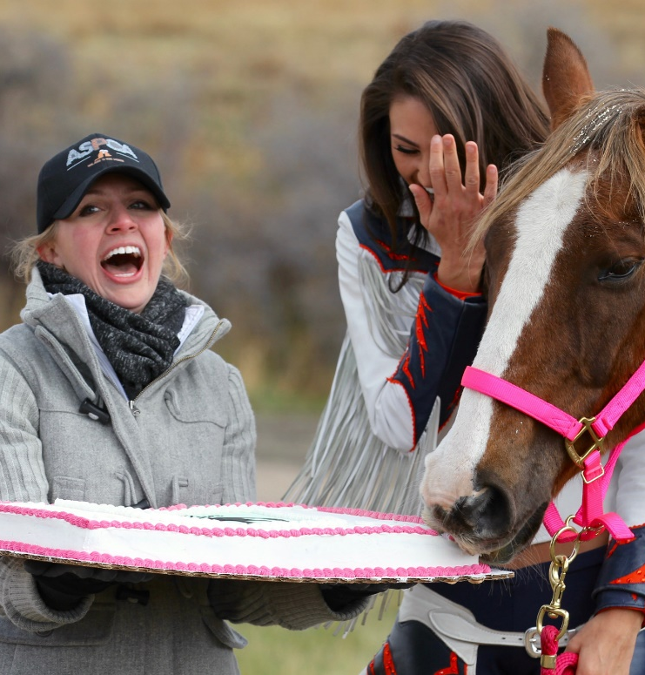
Benefits of Joining
1. The chance to win some of $150,000 in prizes, including a grand prize of $35,000
2. Freebies
Microchips and registrations
Help a Horse Home 24" x 16”
promotional chalkboard
Notes:
We’ve identified four ASPCA-sponsored benefits that all participants will be eligible for:
Matt already told us all about the exciting financial opportunities the contest offers, so I won’t say any more about that, but we also have some great freebies that everyone will get!
Everyone who registers will receive some very helpful freebies
The American Horse Council is working with us, to provide every participating prganization with mid-contest survey.

Slide 29

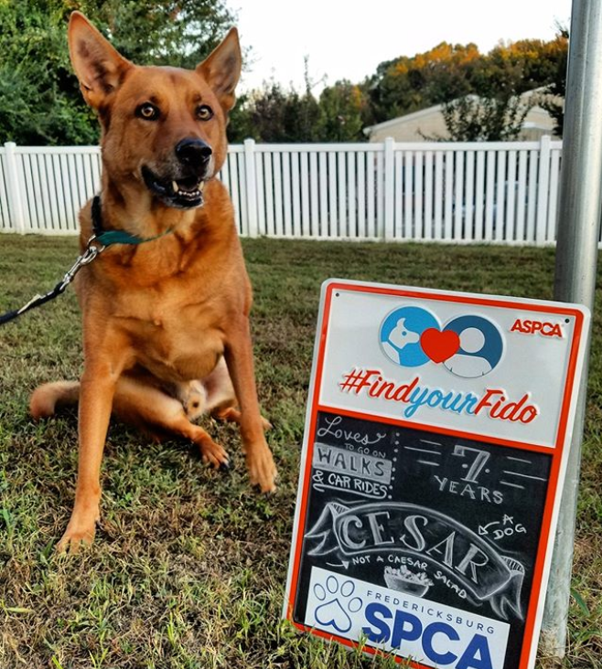
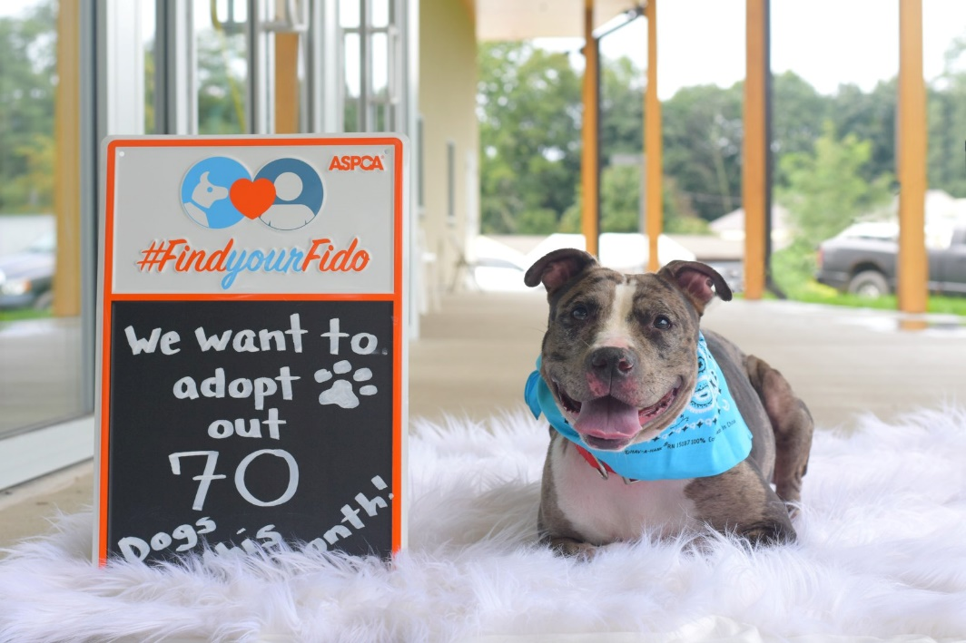
Contest Swag
Notes:
We used similar chalkboards in our recent Find Your Fido campaign and saw incredible engagement when shelters and rescues used the chalkboards on their socials. Find an artistic staff person on volunteer to write informational or fun text on the chalkboards and post on all your channels. We saw groups using the chalkboards for a variety of purposes, including to promote adoptable animals, declare a goal or capture adoptions—you can get as clever as you would like! And you even left space on the chalkboard for you can even customize the chalkboards with your logo and name

Slide 30
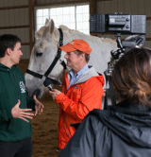
Benefits of Joining
3. National exposure on ASPCA channels, including an online map where the public can find equine adoption centers by state
Press release
Facebook page with 1.8M followers
Instagram with 344K followers
Twitter with 481K followers
We’ll also share some of your adoption stories-online submission form
Notes:
Exposure to the ASPCA’s national audience will be a big perk for joining. We will be creating a public-facing webpage where your organization will be listed and people will be able to search for adoptable horses in their area. We’ll be promoting this page with press releases and on all social channels, where we have lots of eyes on our posts, including on Facebook where we have 1.8 million followers

Slide 31
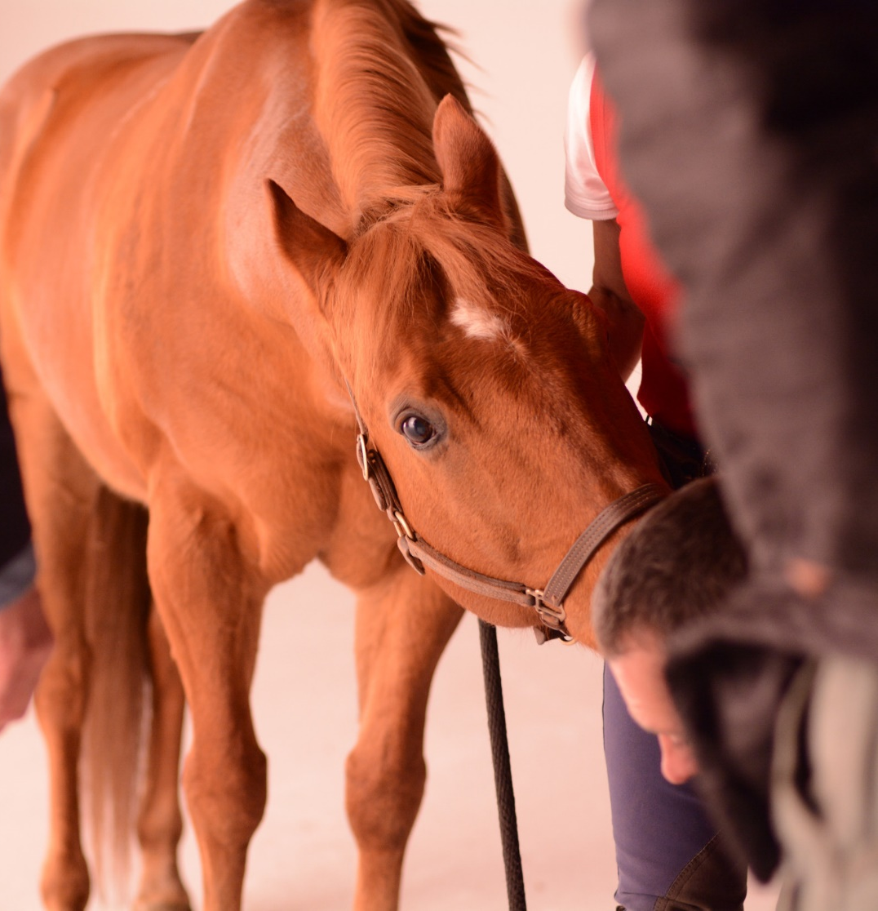
Benefits of Joining
4. Expert advice
Webinars (some exclusive)
Weekly newsletters
Private Facebook group
Media toolkit with helpful guides and customizable templates
Notes:
Another reason you’ll want to join is that We will be providing lots of support to help you find more homes for horses, which I’ll talk about more in depth shortly.
5.

Slide 32
Other Benefits of Joining
Creating Community
“The ASPCA Help a Horse contest really introduced me to the world of horse rescue outside my barn…An incredible network of humans helping horses. Hearing their missions gave me a sense of the horse rescue community, and a fuller heart….Thank You for an opportunity to connect with so many dedicated, passionate people.”
This Old Horse Volunteer
Notes:
In addition to the official benefits of joining the contest, there are numerous “soft” benefits that I’d like to highlight here with quotes from 2018 contestants. Please keep in mind that only two of these 6 groups were awarded Help a Horse grant money, but they all thought participating in the contest was beneficial. If you join you’ll also be creating community.
Check out this quote from a volunteer at This Old Horse who was thrilled with the community HaH created.

Slide 33
Other Benefits of Joining
Driving Innovation
“We thank the ASPCA not only for the award, but for the opportunity to push ourselves toward goals for the horses.”
—Hidden Pond Farm
“This year we started not only a foster program, but a foster to adopt program that also could be tied in with our first-time horse owner classes. People new to horses can take the class and then "test drive" adoption by fostering a horse.”
—Pony Tales Refuge and Rehab
Notes:
Joining HaHH will also help you to drive innovation, you'll be inspired to think outside the box like these past contestants who tried out new tactics and programs as a result of participating in the contest.

Slide 34
Other Benefits of Joining
Promoting New Skills
“We advanced our use of social media by incorporating the talents of (volunteers)and recorded the number of "hits" we received, vis-a-vis our campaign offerings. On their advice we learned to "share" posts and events. In other words, we came out of the dark ages.”
Georgia Equine Rescue League
Notes:
As I mentioned previously, we’ve got loads of resources and trainings coming your way to help you innovate and gain new skills to adopt out more horses. From evaluating, training and matchmaking for your horses to social media tips and tricks we want to help equip you with the tools you need—all you need to do is register for the challenge and we will email you information on how to download or register for these resources. And be sure to join the private Facebook group, too, because we always post reminders in the group about upcoming offerings.

Slide 35
Other Benefits of Joining
Playing to People’s Competitive Nature
“The adopters liked knowing they were helping our organization to possibly win a prize and also adopt a rescued horse.”
Animal Rescue League of Iowa
Notes:
Animal Rescue League of Iowa’s notes in this quote that There’s something to be said about the benefits of the buzz around a friendly competition. People want to get behind their home team And simply saying you are competing in a national challenge to win prize money is often a big enough hook to get your local media involved and your community clambering to support you.

Slide 36
Other Benefits of Joining
Readying You for Other Grants
“All the materials I gathered to write my Help a Horse grant remain gathered and more easily usable for the next grant attempt. I will not have to reinvent the wheel’ each time, now.”
Warriors of the Rainbow Horse Sanctuary
Notes:
Preparing for the Help a Horse Home Challenge will help you get your legal and financial house in order, making it easier to apply for other grant opportunities and possibly boost your rating by organizations that rate charities.

Slide 37
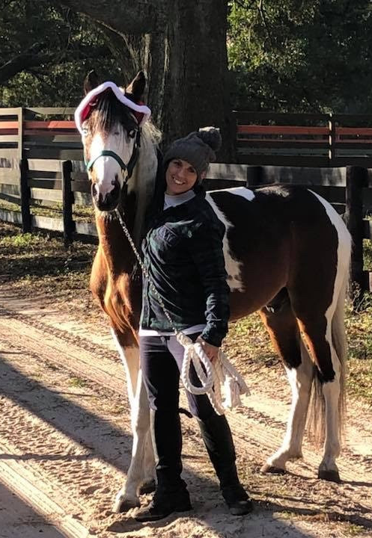
How We’ll Support You
Facebook Group
Office Hours-
Feb 1 at 3 EST
3. Weekly newsletters
Notes:
We want you to join us and benefit from all those perks—and to help you have the most successful campaign possible, we will be supporting you every step of the way by providing information and the opportunity for you to ask questions and get feedback. .
First, we have a very active private Facebook group for contestants and their supporters where we will share contest information and answer your questions. Also, there’s a lot of community building going on on the group and since we are encouraging groups to consider trying transferring horses between agencies, the group could be a great place to find transfer partners.
Second. We’ll provide online office hours—the first of which is next Friday, February 1. After you register for the challenge, we’ll email you a link to join us in a Zoom meeting where we will have ASPCA staff available to answer your questions about the competition. We’ll have two more office hours throughout the contest period, and you’ll be notified of those via email if you register for the challenge.
Third, we’ll send weekly updates with important challenge information to keep you in the know. The newsletters will begin the second week in April after registration closes.

Slide 38

How We’ll Support You
4.Webinars
Feb. 6- How to Home Special Needs & Unrideable Horses
Feb. 13-How to Home Horses in Transition
April 10- Get More Horses Adopted with Social Media (plus media toolkit)
Notes:
We’ve got three excellent webinars on the calendar to support haHH this year, including registration for the first two webinars is open now. The social media webinar will be an exclusive benefit to those who join the contest, so you ‘ll get information about how to sign up for that one after you register for the challenge. And in conjunction with that webinar, we will be providing a helpful media toolkit with templates and guides to help you engage traditional and social media.
You will also have access to a variety of helpful resources that we will be posting on ASPCApro throughout the contest period, including downloads, videos and other content to help you drive adoptions.

Slide 39
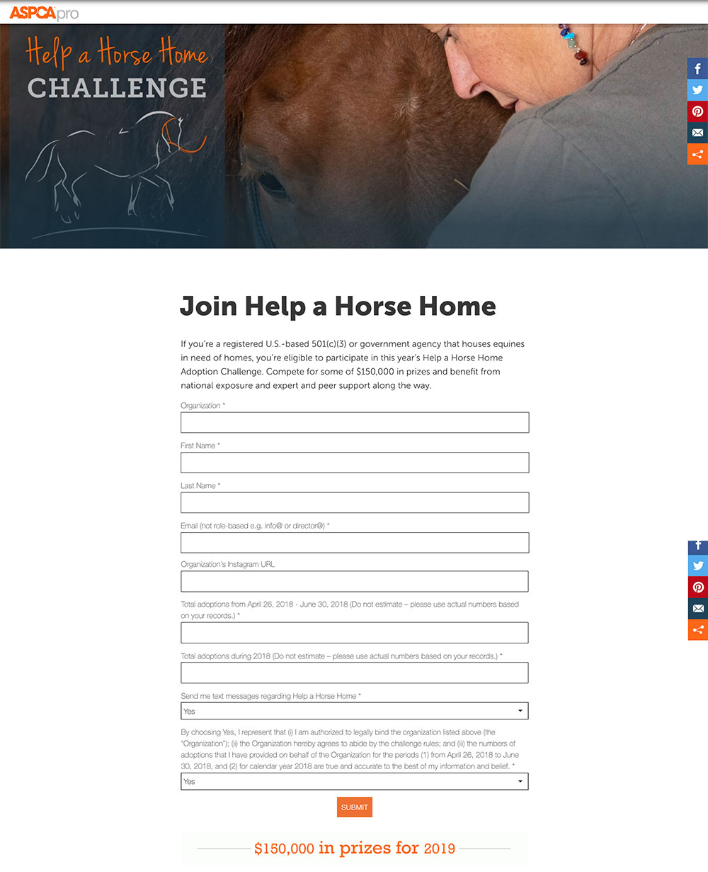
How We’ll Support You
5. ASPCApro

Slide 40
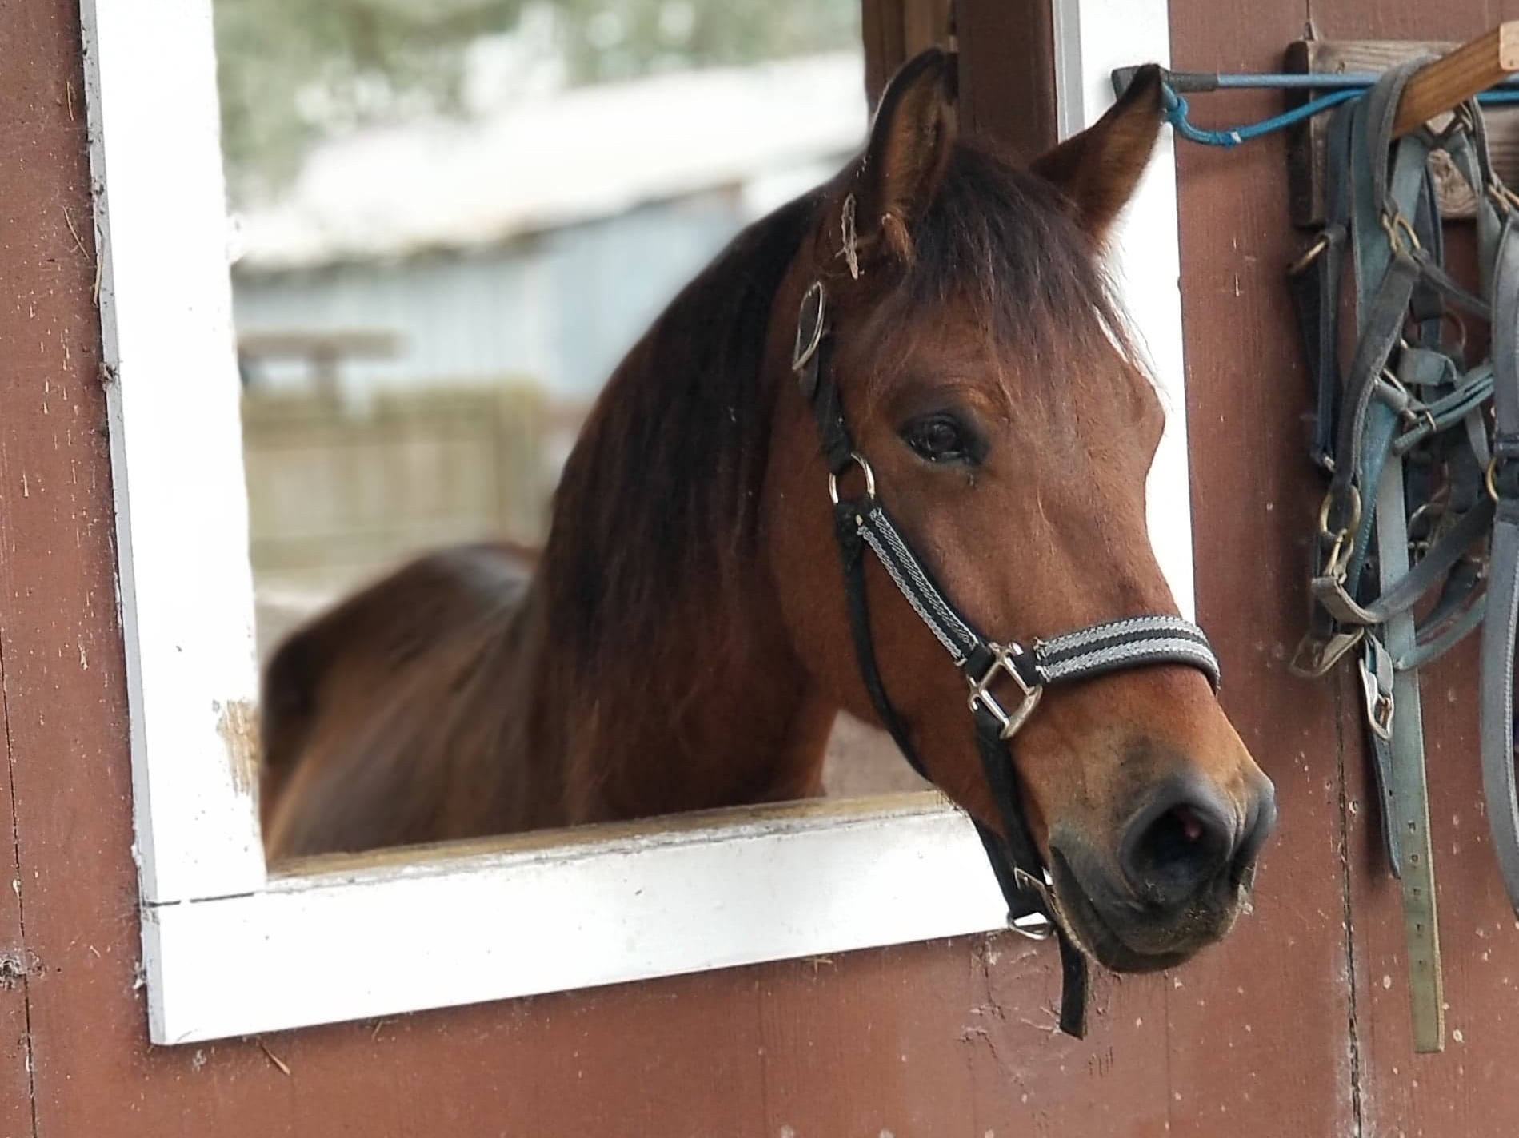
How We’ll Support You
6. Email us at HelpAHorseHome@aspca.org
Notes:
Finally, you can email us anytime at X and we will get back to you promptly.

Slide 41
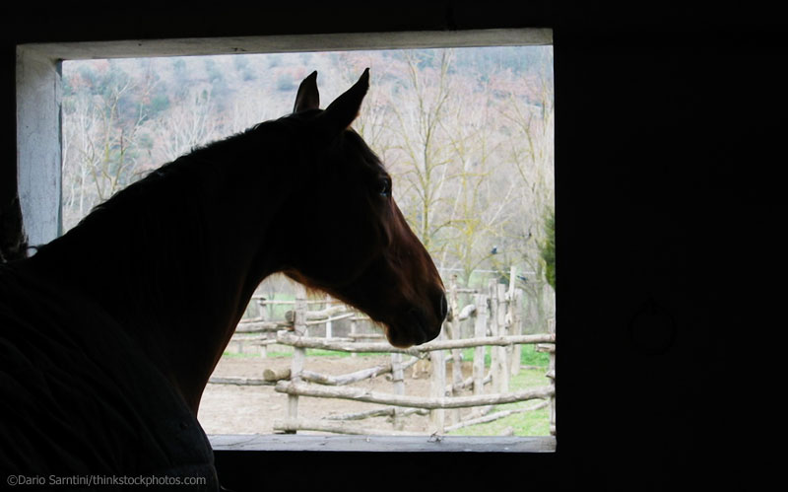

Register for Help a Horse a Home
ASPCApro.org/hahh
Notes:
As you can see there are many benefits for joining and we’re here to help—so Even if you are unsure if you want to apply for a grant at the end of the Challenge, there are so many other benefits to joining that we hope you won’t hesitate to sign up and help more horses home!

Slide 42
Questions?
Register here: ASPCApro.org/hahh
Notes:
At this point, we’d like to take your questions.

