Slide 1

How to Home Horses in Transition
Enjoy the music!
The webinar will begin at its scheduled time.
Join the webinar using built-in computer audio or dial
669-900-6833 or
646-558-8656
Webinar ID: 166-537-968
ASPCApro.org/hahh

Slide 2

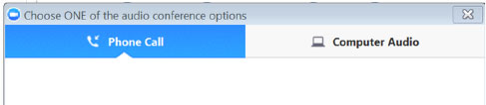
How to Adjust Your Audio
Select “Audio Settings” at the bottom of your screen.
Choose whether you’ll join using computer audio or your telephone. We recommend computer audio.

Slide 3
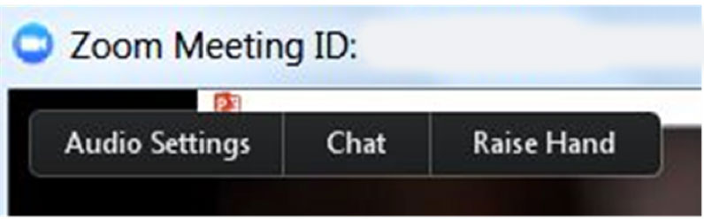
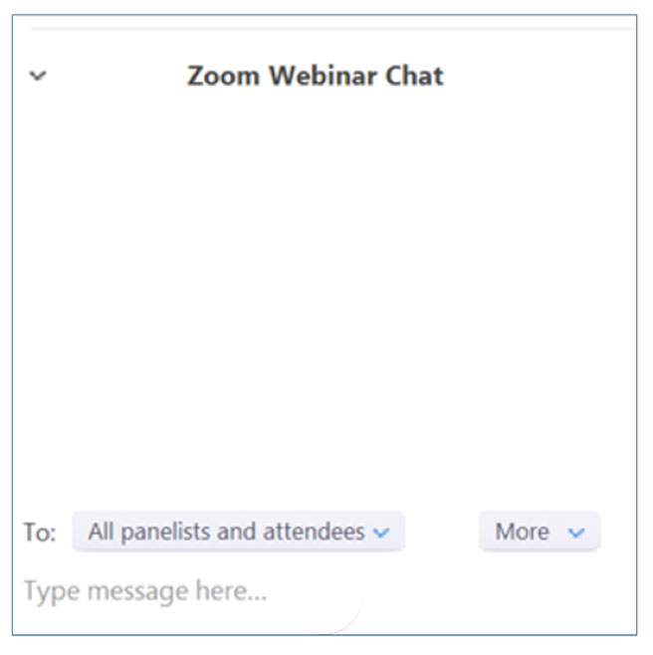
How to Chat
Select “Chat” at the bottom of
your screen
In the chat window, select “All panelists and attendees” to share your message with everyone in attendance

Slide 4
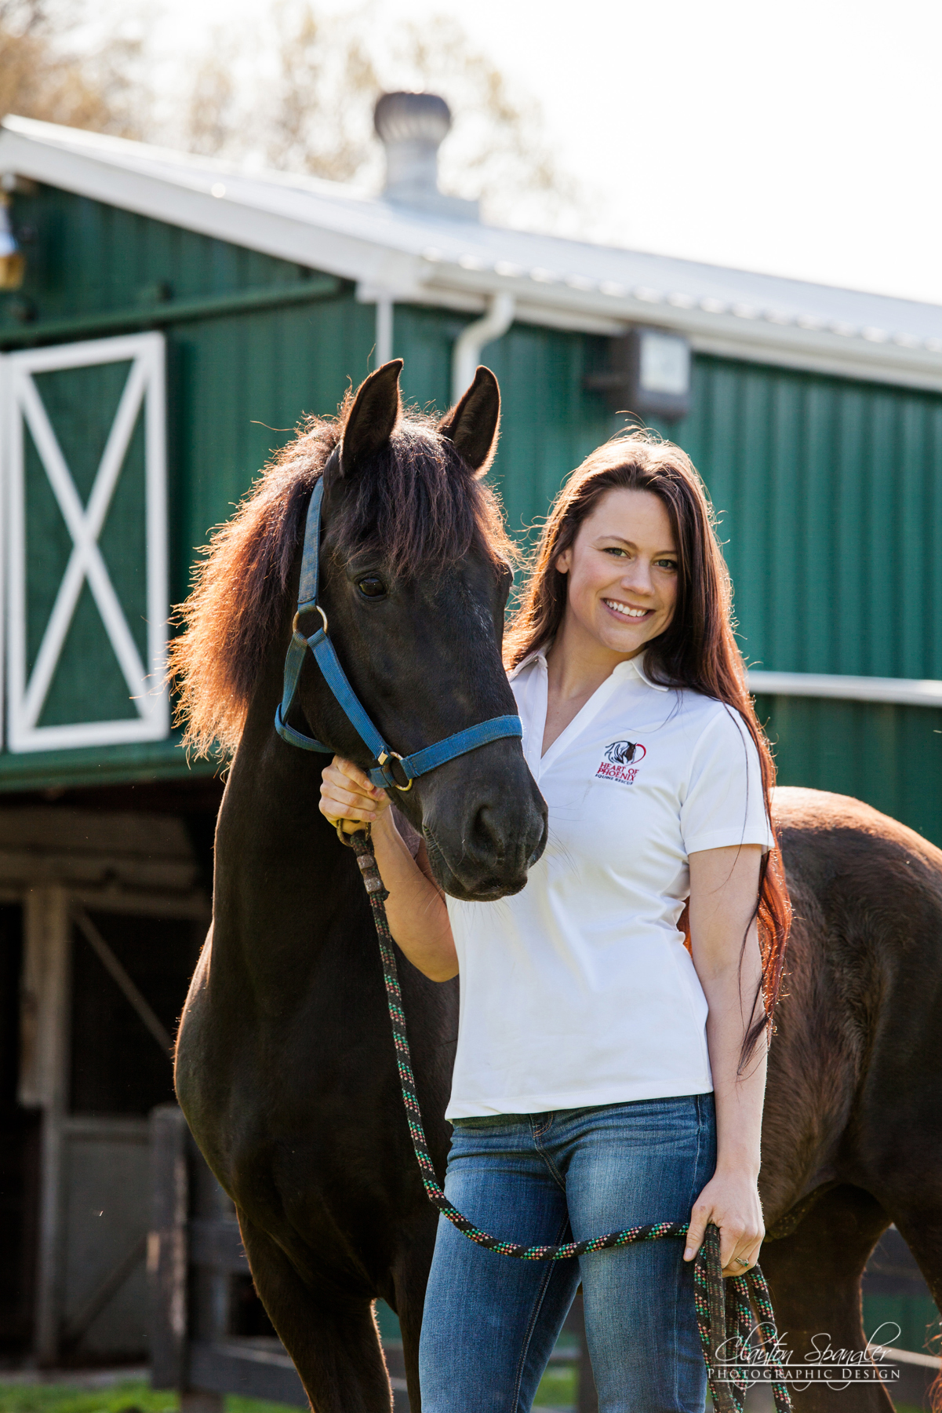
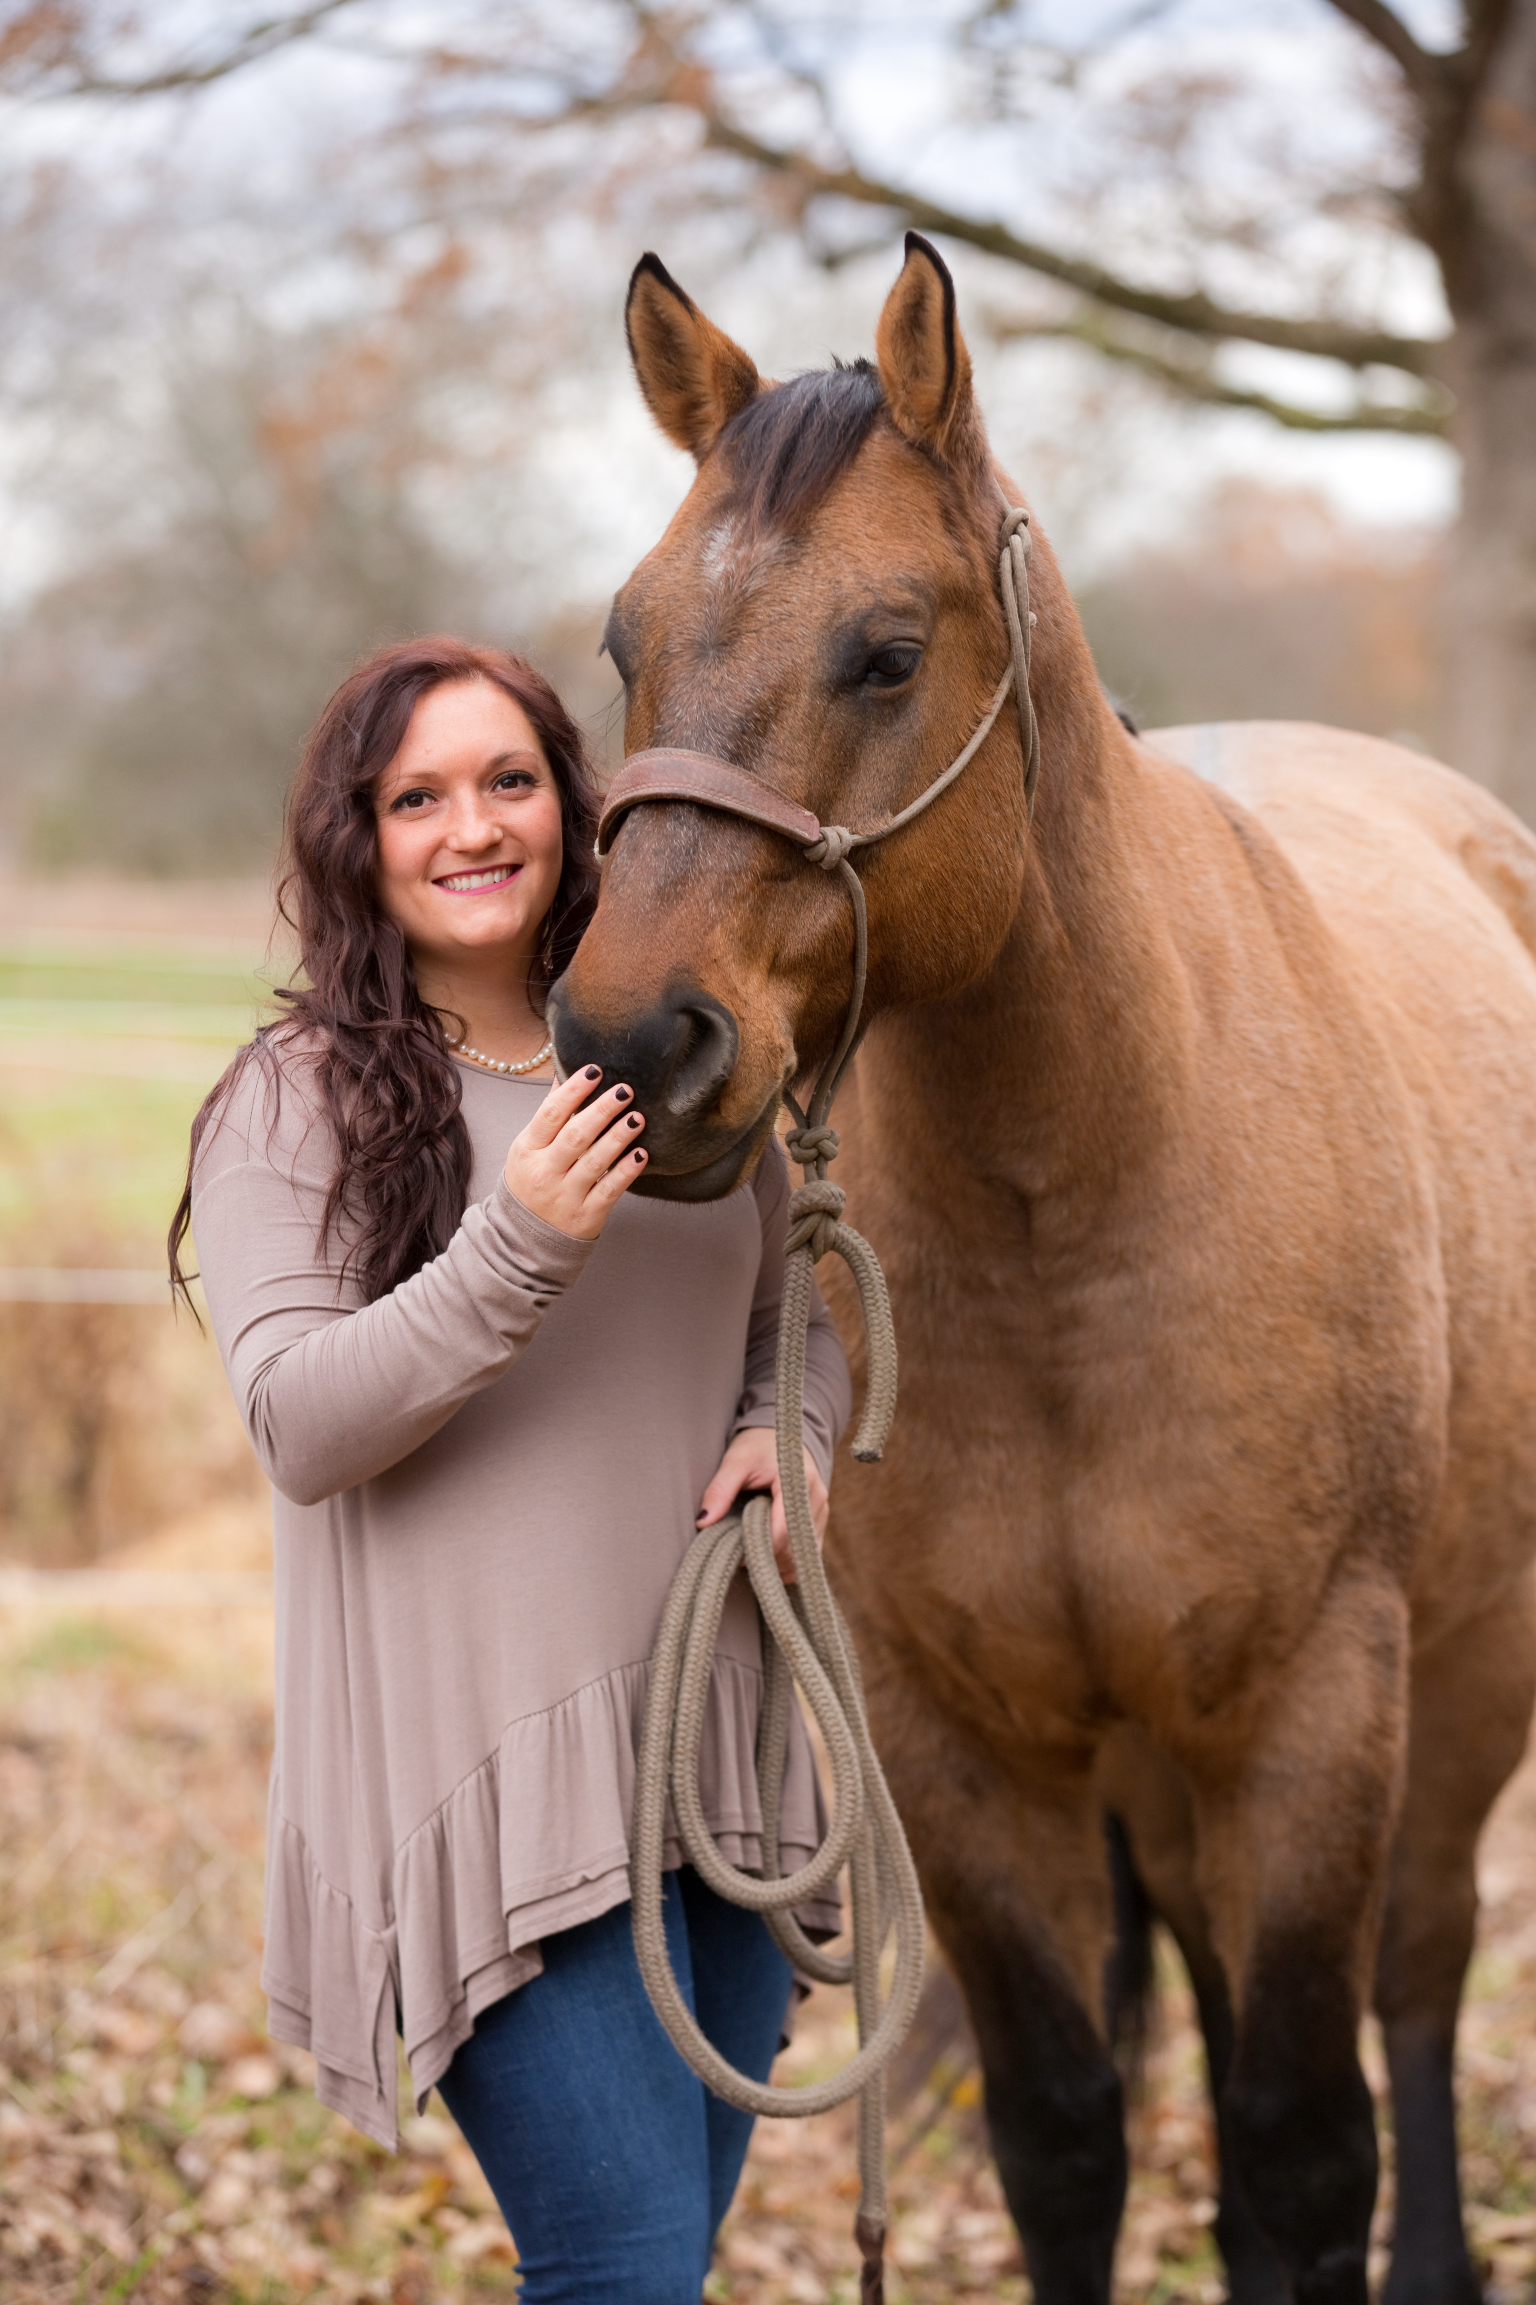
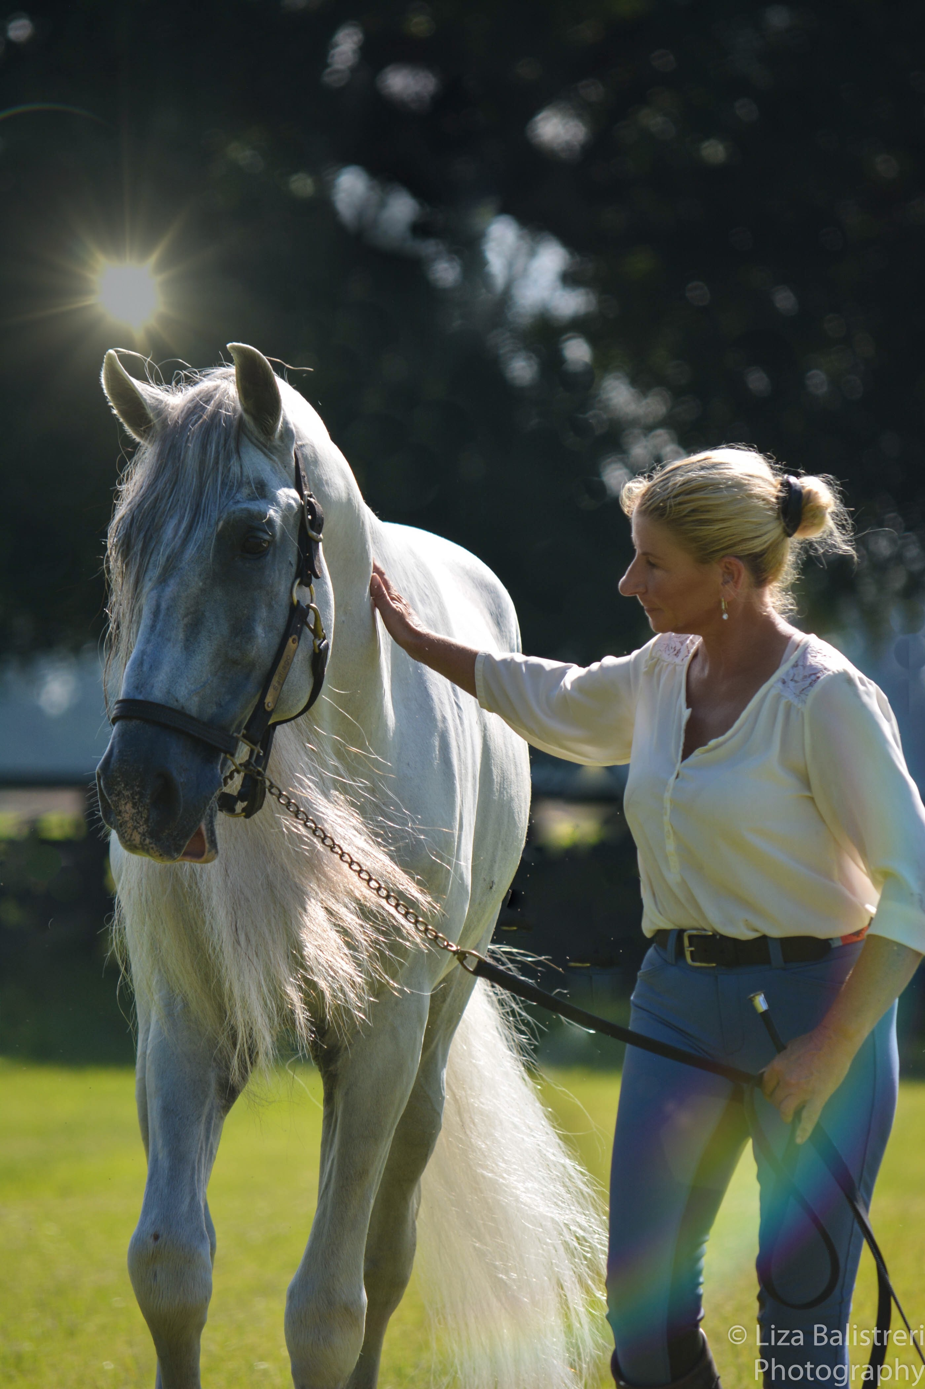
How to Home Horses in Transition
Tinia Creamer
Founder and President,
Heart of Phoenix Equine Rescue
Shea Hutsenpiller
Rescue Director, Hickory Hill Farm
Yvonne Barteau
Founder,
Horses without Humans

Slide 5
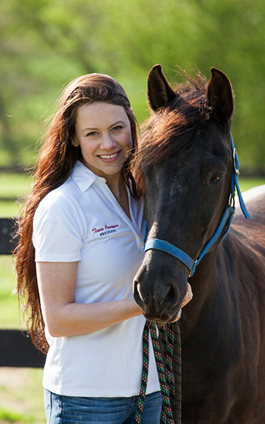

Creative Strategies for Increasing
Adoption
Tinia Creamer
Heart of Phoenix Equine Rescue

Slide 6
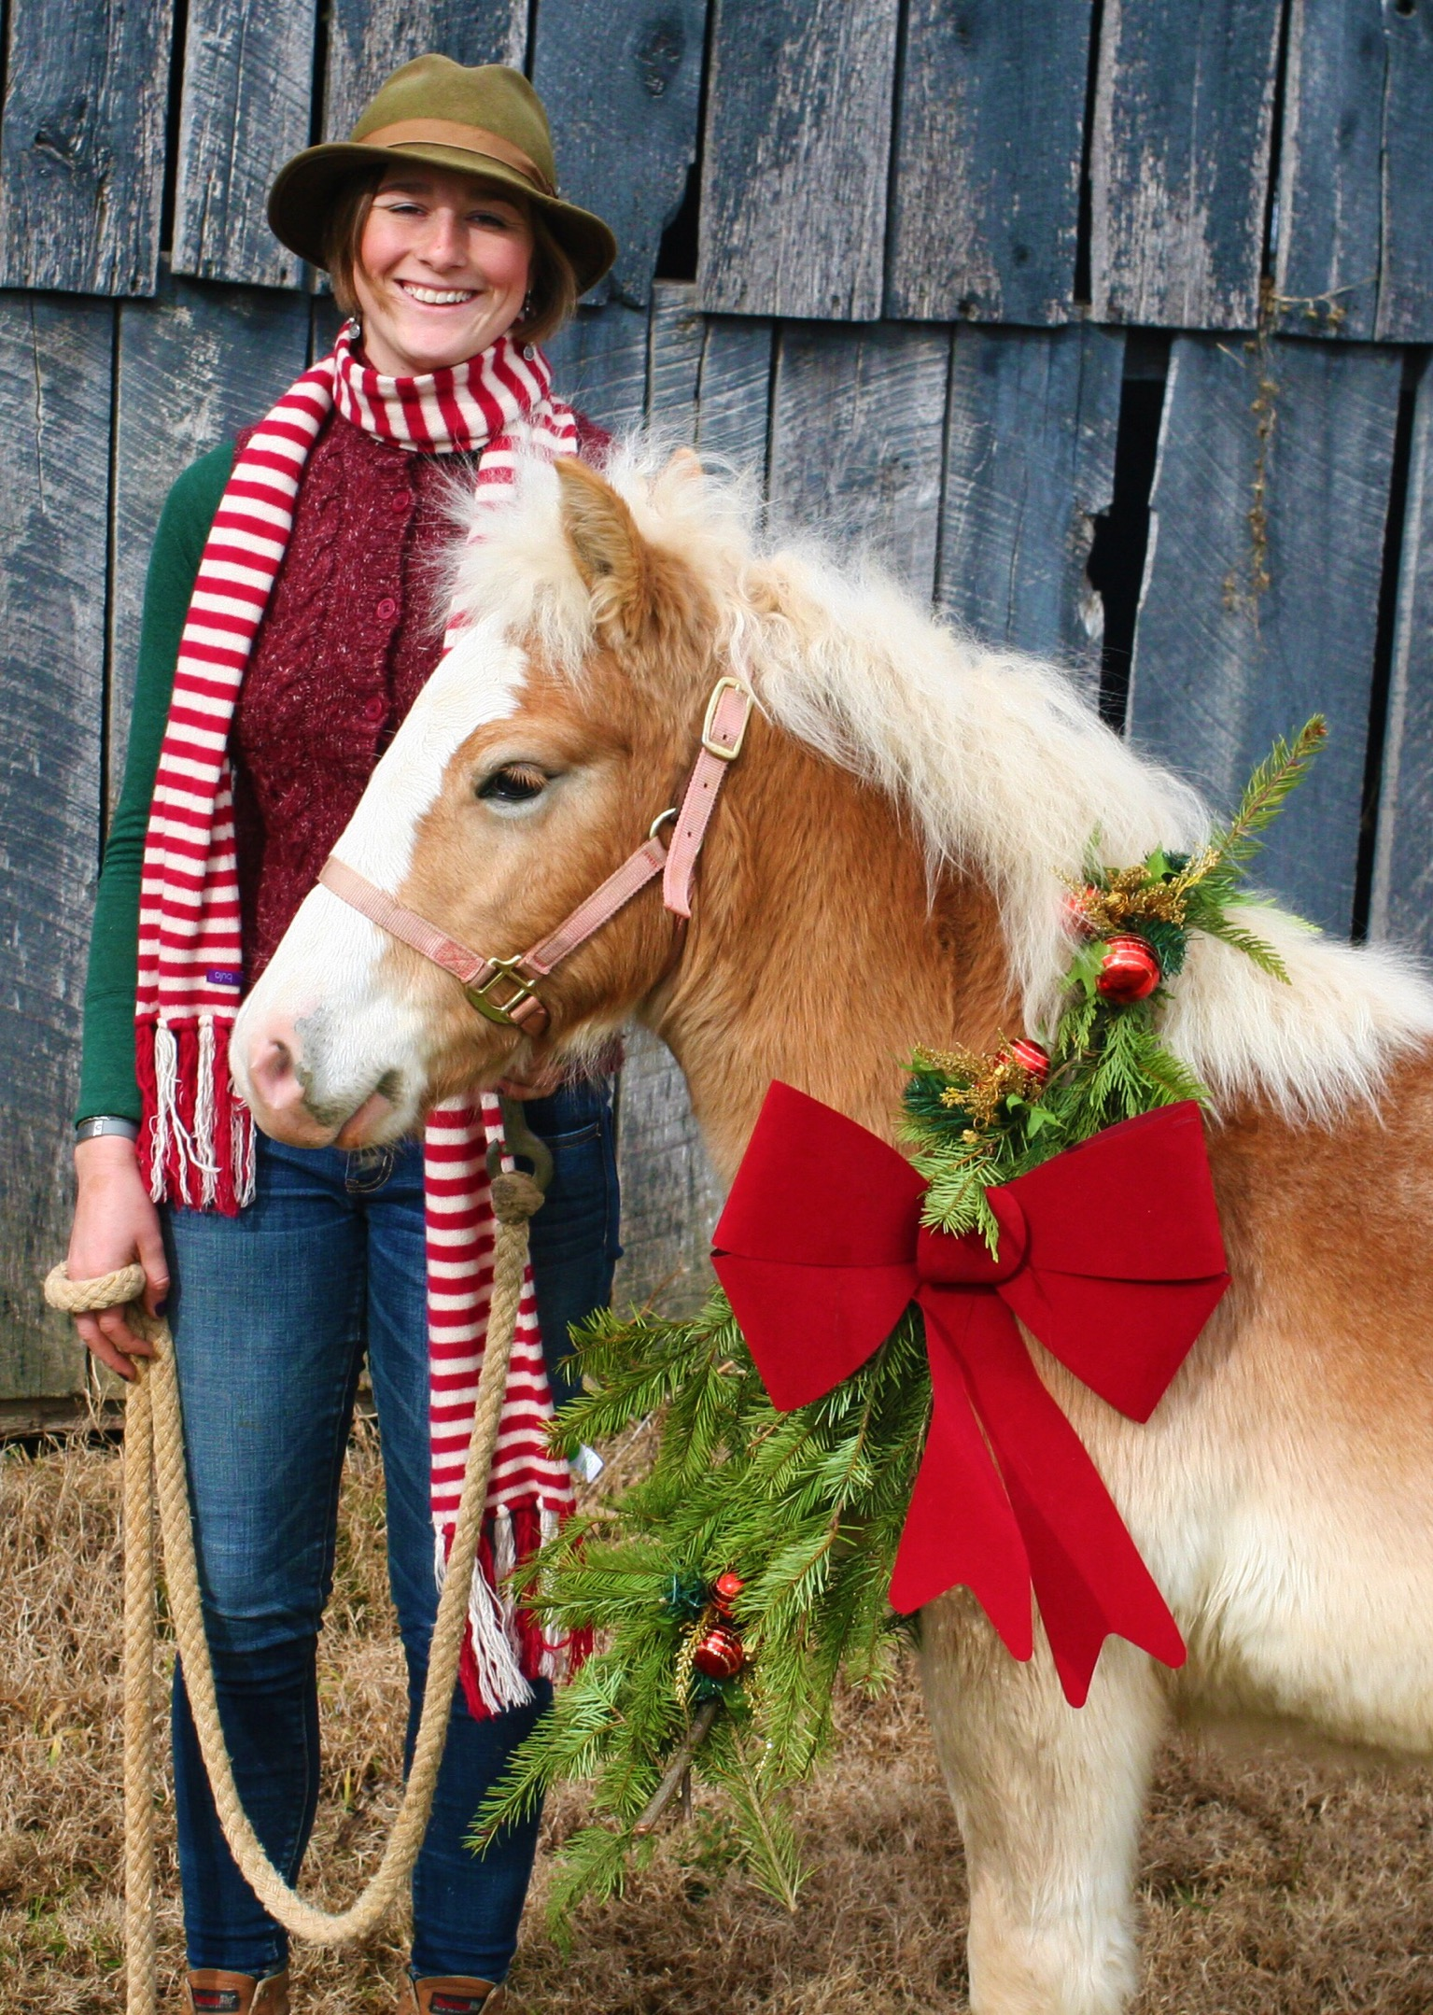
Our Challenges
Operating as an all volunteer organization
Based in the nation’s poorest region
Most horses come in without training and with low BCS
Most adoptions take place far outside of our local area

Slide 7
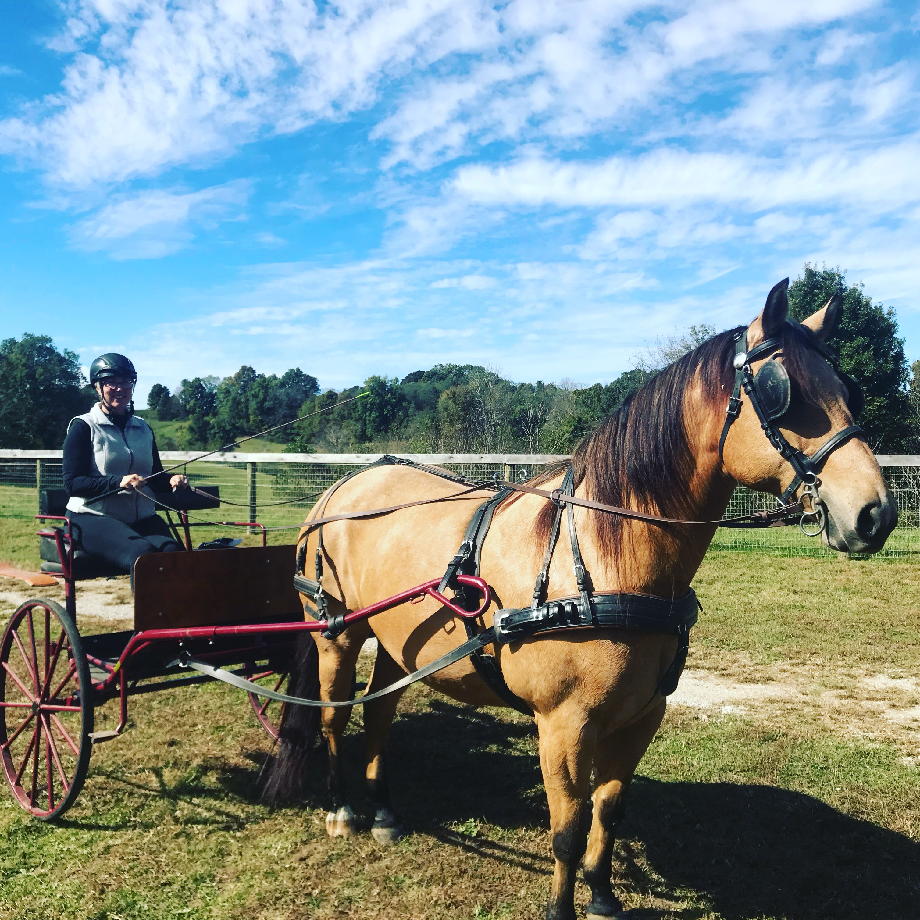
How Heart of Phoenix Facilitates
Adoptions despite Challenges:

Slide 8
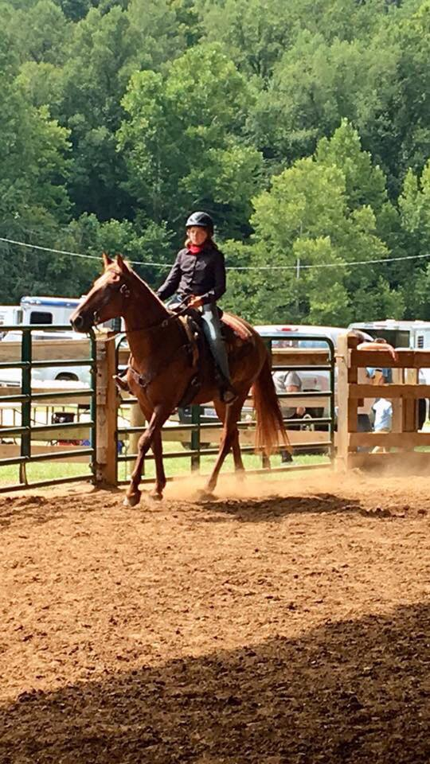
Foster Homes Increase Adoption
Vastly increase exposure of adoptable horses
Increase knowledge about individual horses
Create more faith in the equine communities around your organization in the quality of the horses for adoption

Slide 9
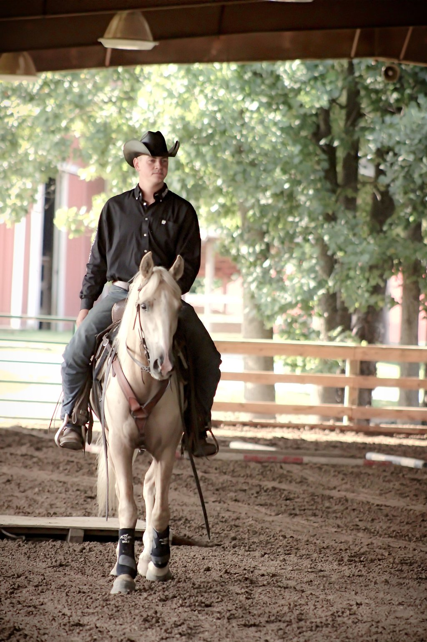
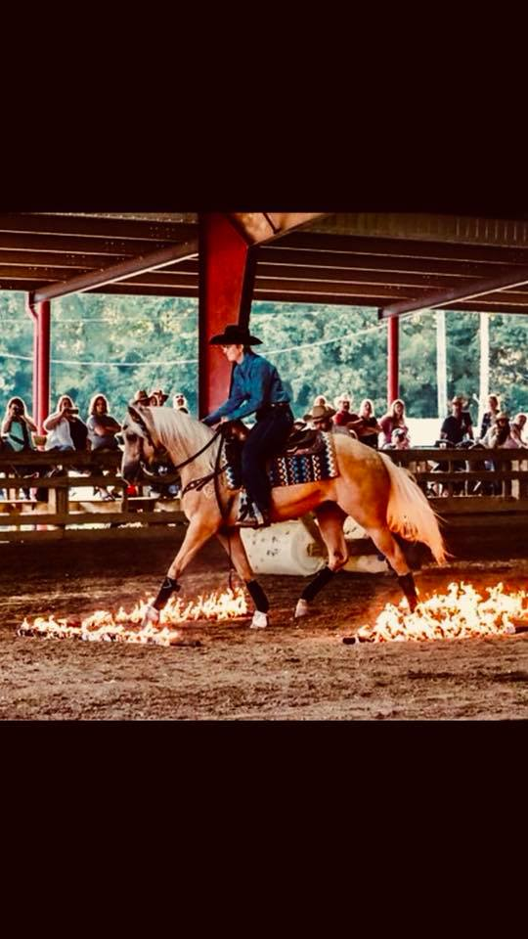
Training Partnerships
Create value in many ways to the adoptable horses
Expand the adoption pool tremendously
Close the divide that can exist within the industry and rescue groups
Create a re-homing base beyond adoption
Consider a trainer challenge

Slide 10
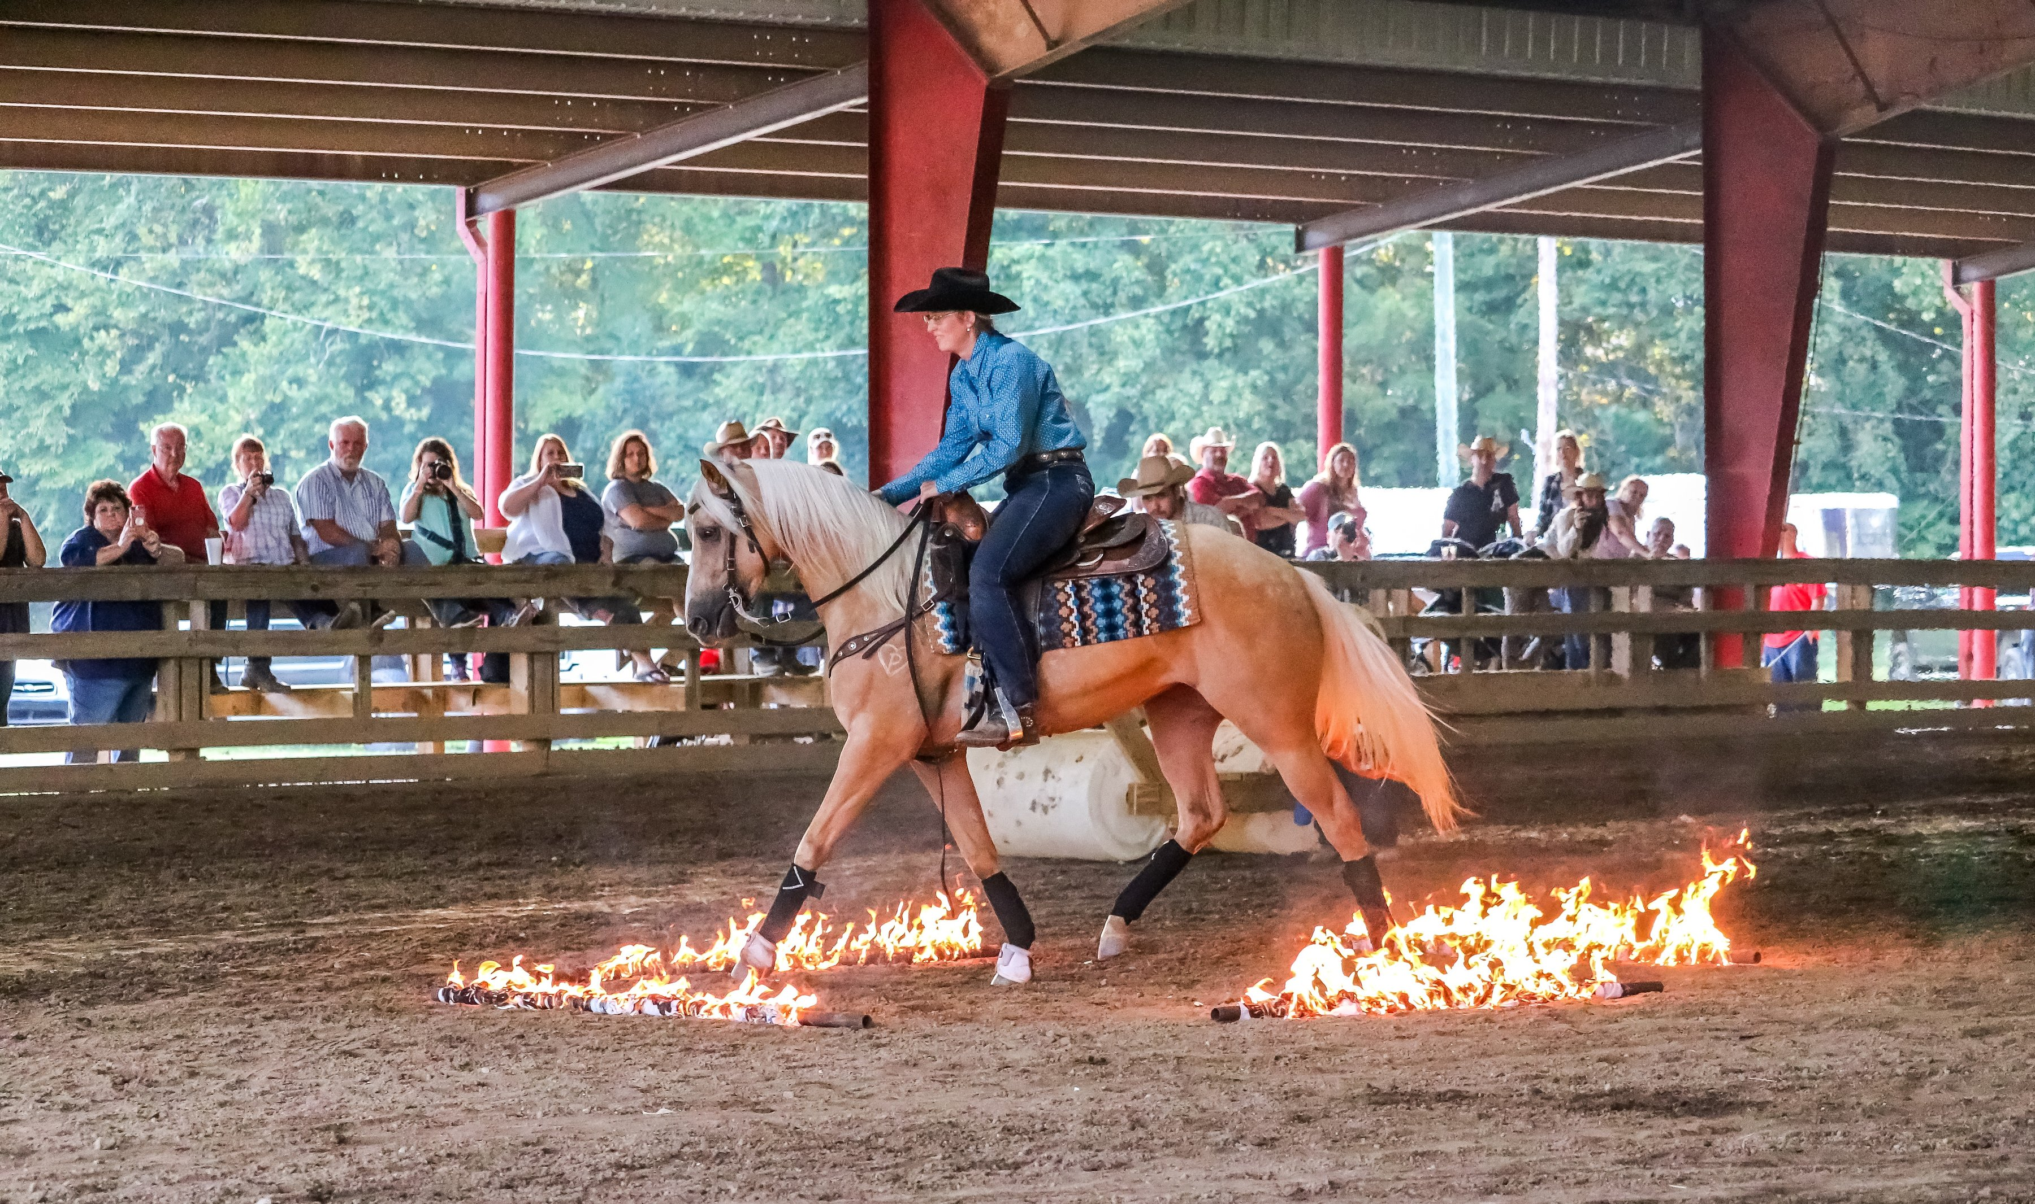
Speak often about the Benefits of Adoption
Lower Fees compared to traditional purchase
Open door, no questions ask return policy (we refund the fee).
The most honest representation
Thorough vet, farrier and dental care
Creates a chain of positive action that aids horses in need

Slide 11
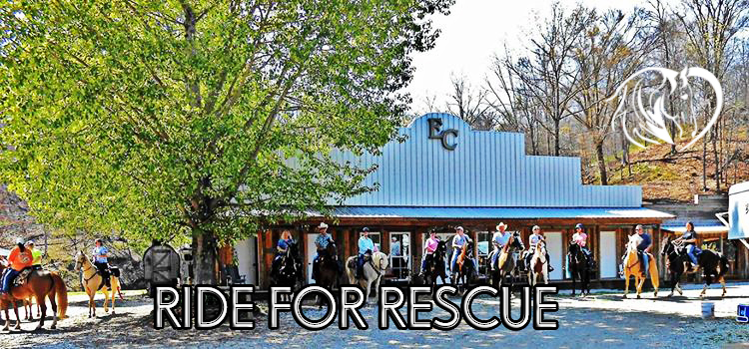
We are Relevant to Everyone
We do not only matter when there is a crisis or when we need donations
We host events that appeal to all horse people
We always think about our integrity
We work with as many equine professionals as possible
We are helpful to horse folks without being judgemental

Slide 12
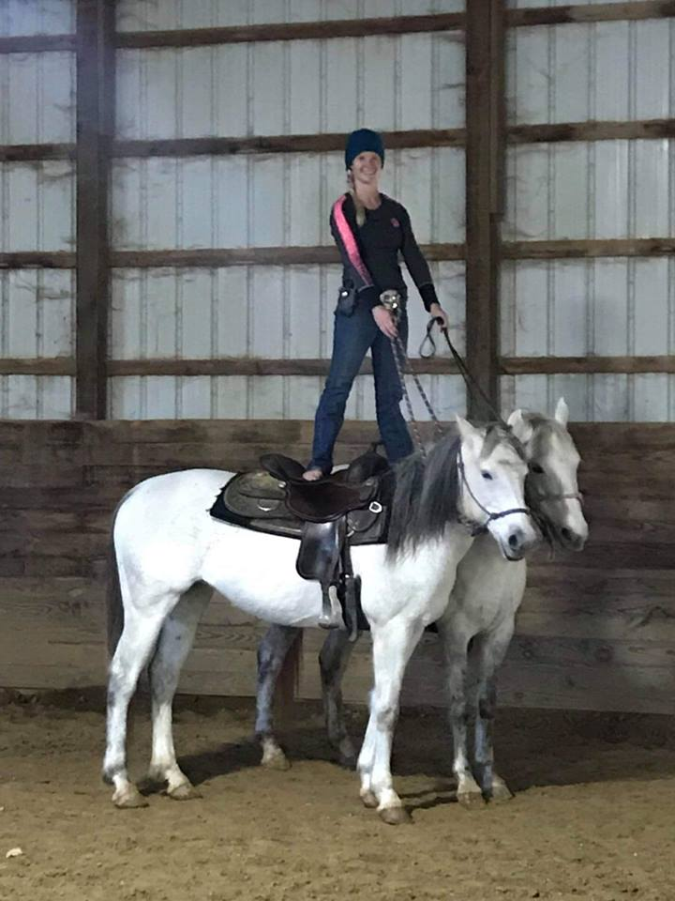
Home Horses without Rescue
Heart of Phoenix facilitates many placements of horses yearly without bringing the horses into rescue.
We built a network of solid horse people that may assist in re-homing horses.
If the horse simply needs re-homed, we see whether networking into a safe situation outside of rescue is possible.
We save our space for horses that have no good options outside of rescue

Slide 13
Celebrating Adoption
We do our best to continue to celebrate adopters and their horses long after adoption.
Frequently share photos and stories from your adopters and horses.
Make “Adoption” trendy. It SHOULD be.
Put your adoptable horses into situations where they can excel and stand out: parades, local shows, trail ride events, and make sure to share when adopters have their horses out and about.

Slide 14
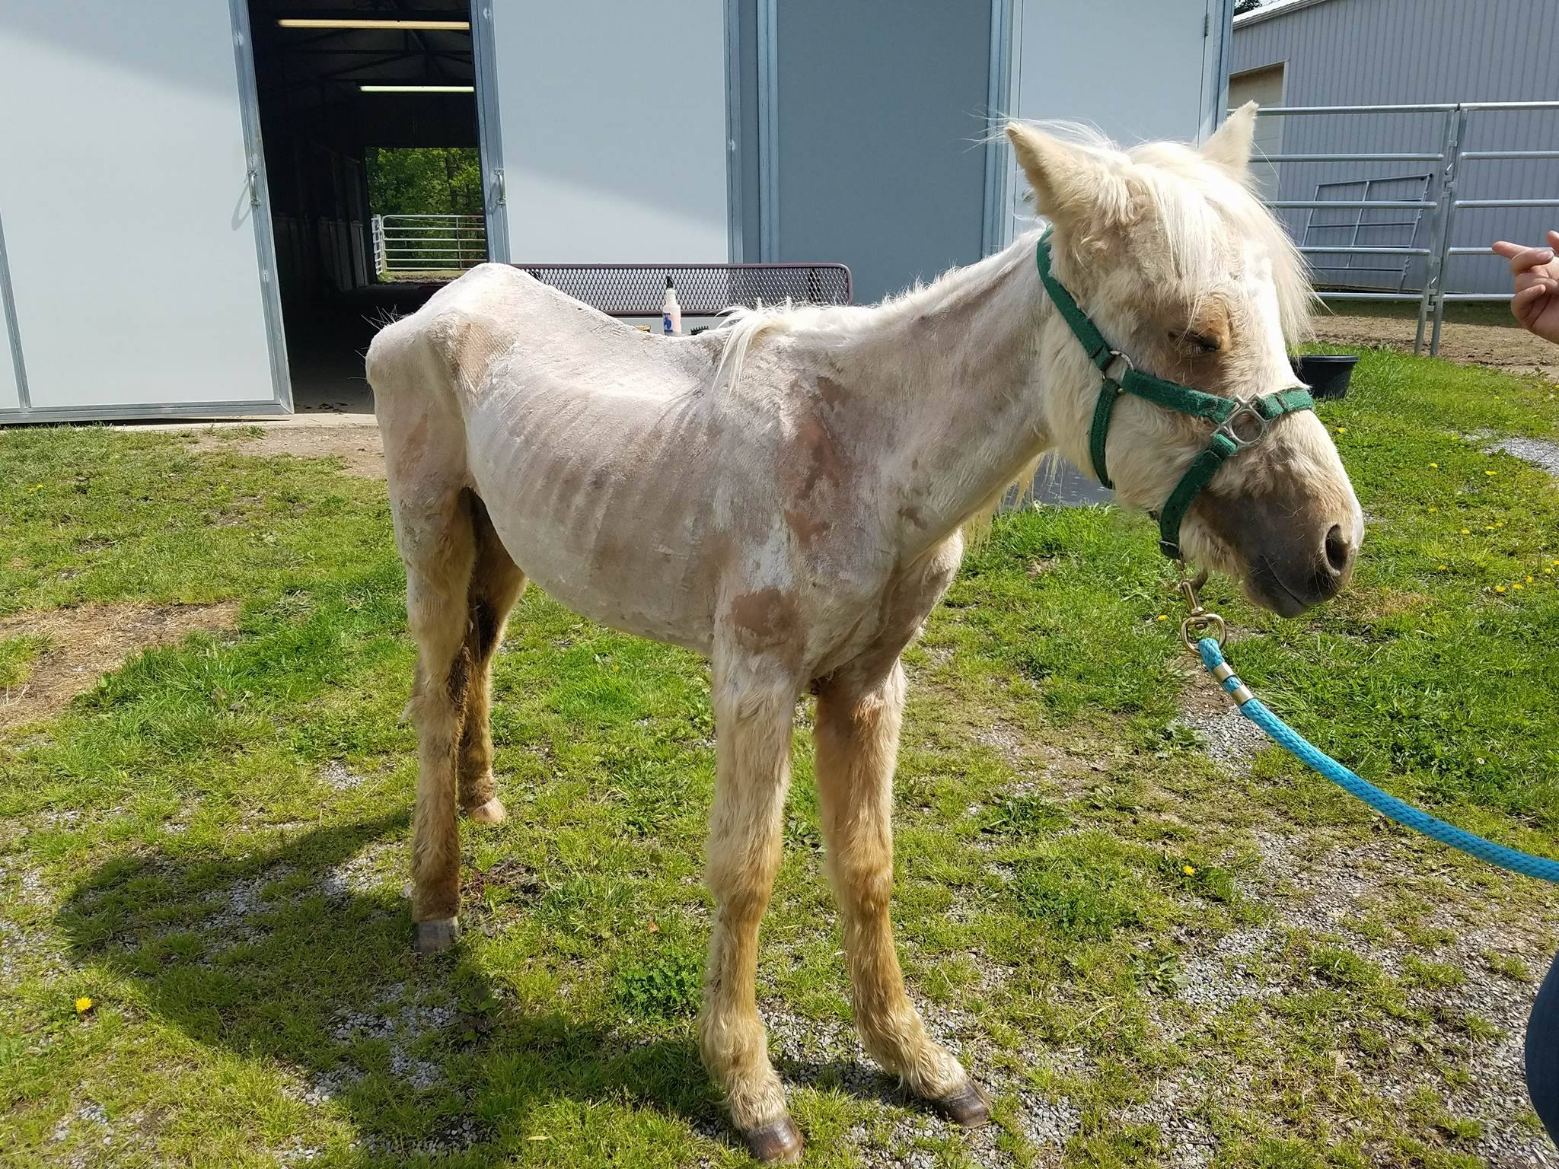
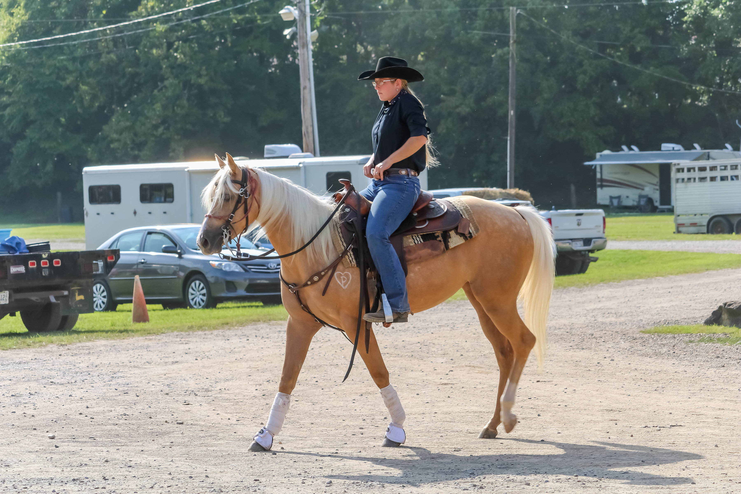
We steer away from. . .
Using language or photos from a horse’s rescue care to market the horse for adoption (i.e. Before and After photos) on website or in ads.
Withholding negative from adopters once speaking in person (we share everything relevant, positive or negative about the horse).
Creating difficult barriers that deter good adopters (expectations of a perfect, instead of a good home)
Partnering horses with adopters that are not suited due to skill level

Slide 15

Hickory Hill Farm
Wilson County, TN
Received 501c3 status in 2016
Approximate Capacity 22-30 equines
28 horses adopted last year
Typical horse: 12 year old, non-gaited, paint, mare

Slide 16
Intake Process
Priority: Law Enforcement & Animal Control
Intakes of <5 - Rescue Director, >5 - intake committee
Basic Intake Process:
  Quarantine period
  Intake vetting & feed plan
  Training evaluation (foster change if necessary or professional assistance hired)
  Adoptable when all vetting & farrier work is UTD, healthy weight, & evaluation complete

Slide 17
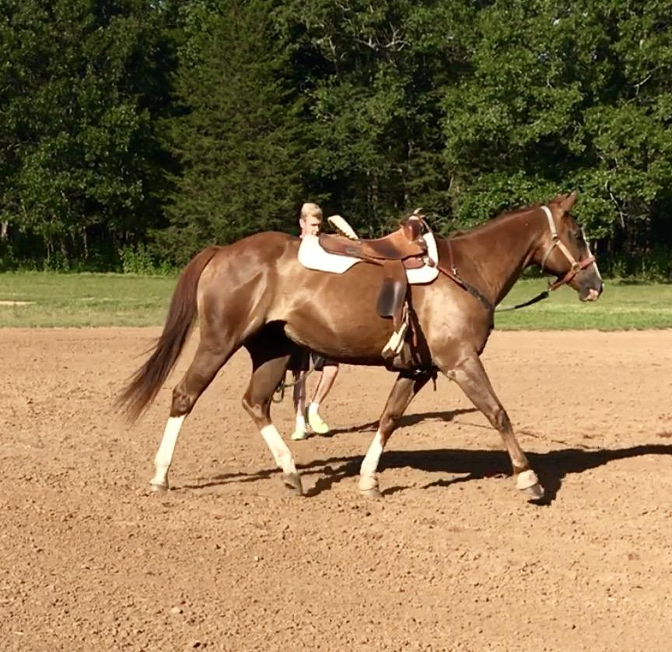
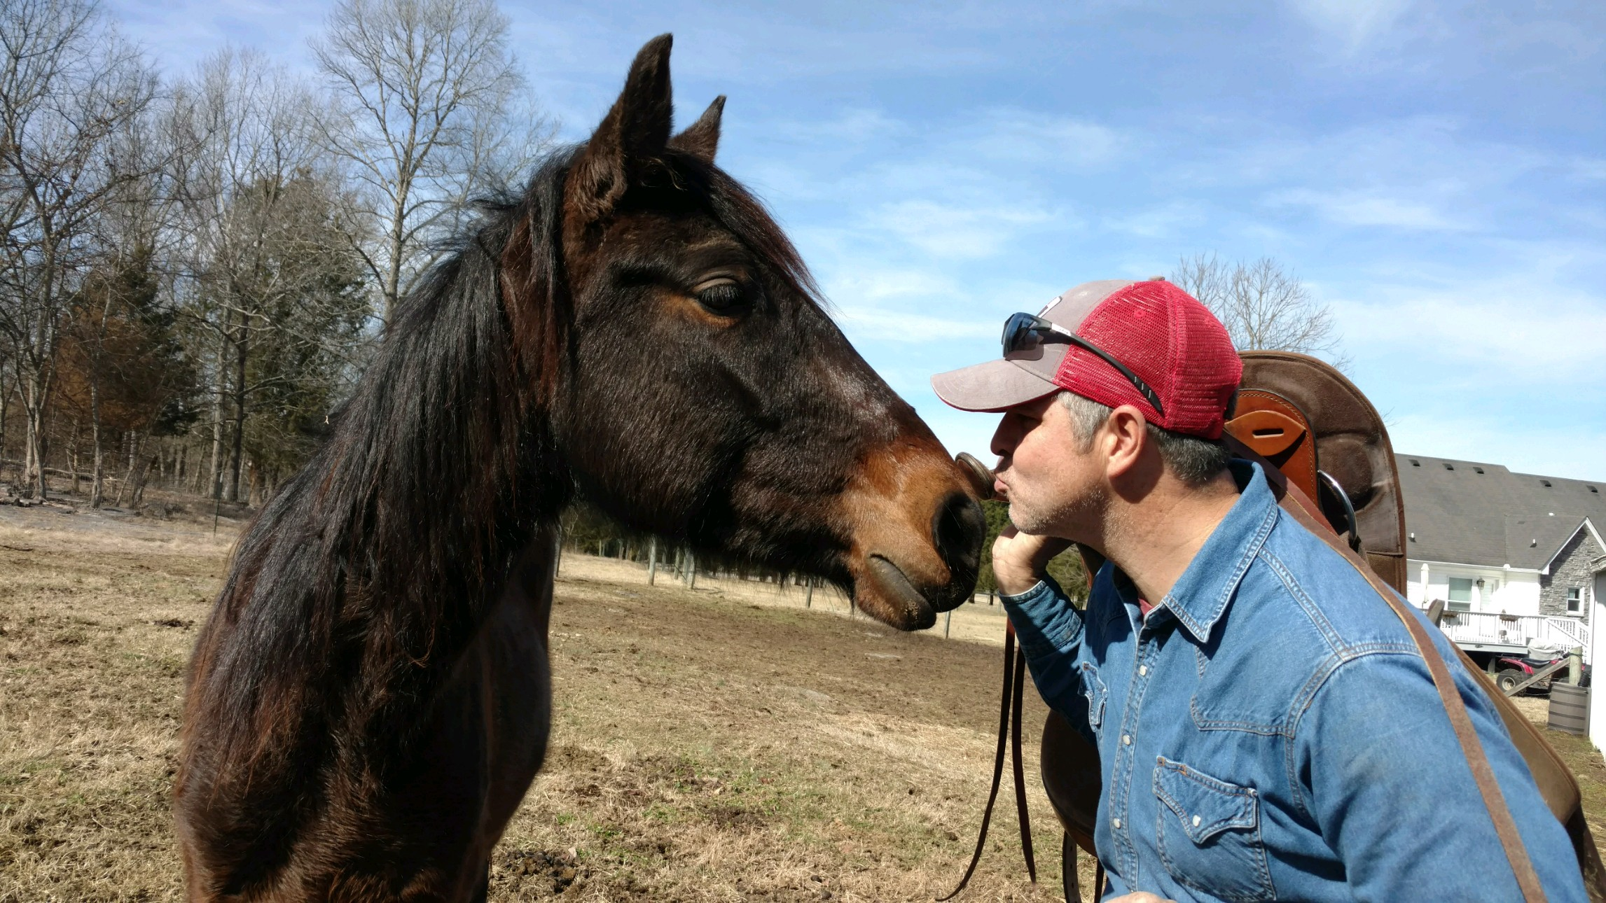
Training Process
Initial evaluation then….
Appropriate foster homes
Advanced fosters
  Utilize Forever Foundation training videos
Trainer partners/fosters
Paid professional trainers

Slide 18
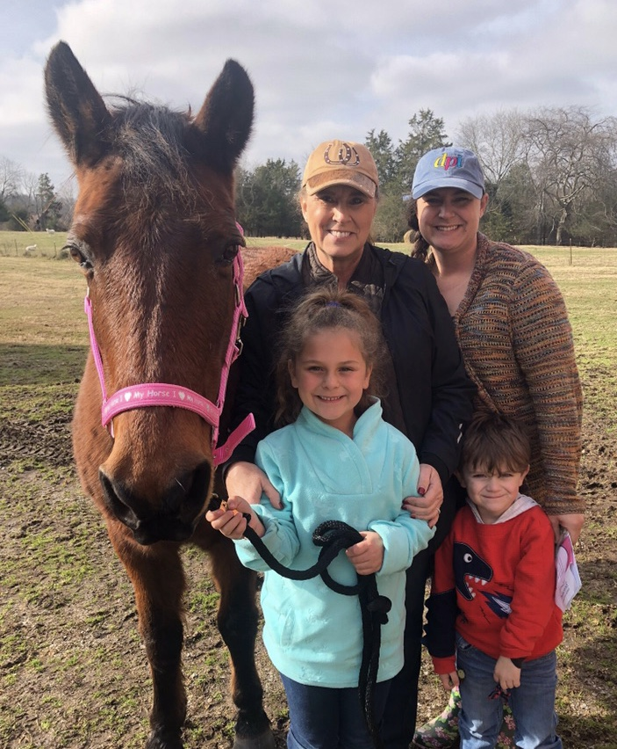
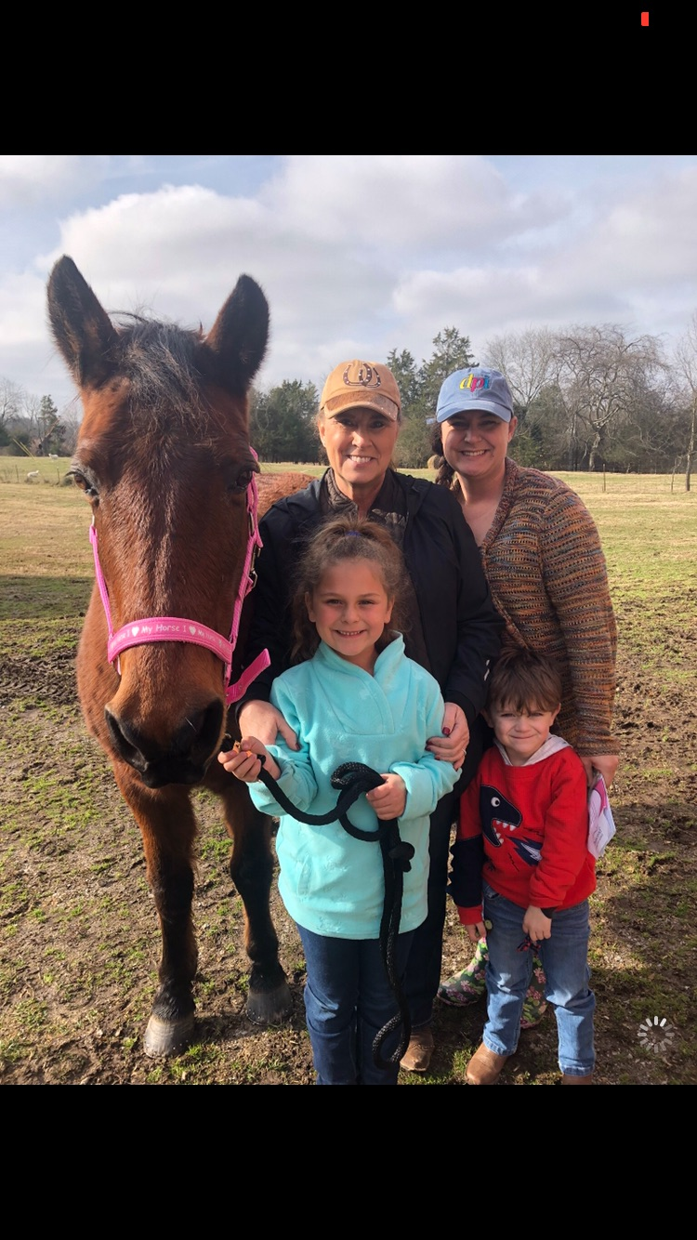
Matchmaking & Adoption
Quality pictures & VIDEOS to showcase horse
First step: Application online
  Adoption Coordinator Role
  Equine Specialist Role
Strive to match the adopters ability/knowledge to an appropriate horse

Slide 19
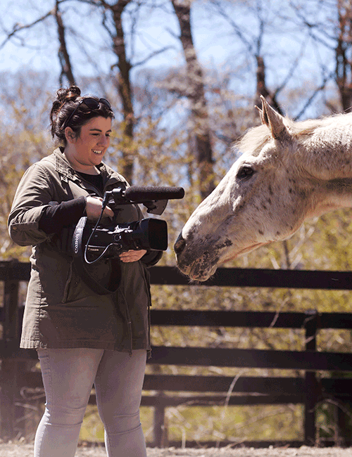
Marketing Tips
Truthful, information filled profiles
  VIDEOS & Pictures
Hit the high notes- including major vices
Field trips! Trail rides, shows, etc.
Utilize social media & sites like Canva
If you’re foster based-
  Encourage fosters to share
  Fosters know the horse best!

Slide 20
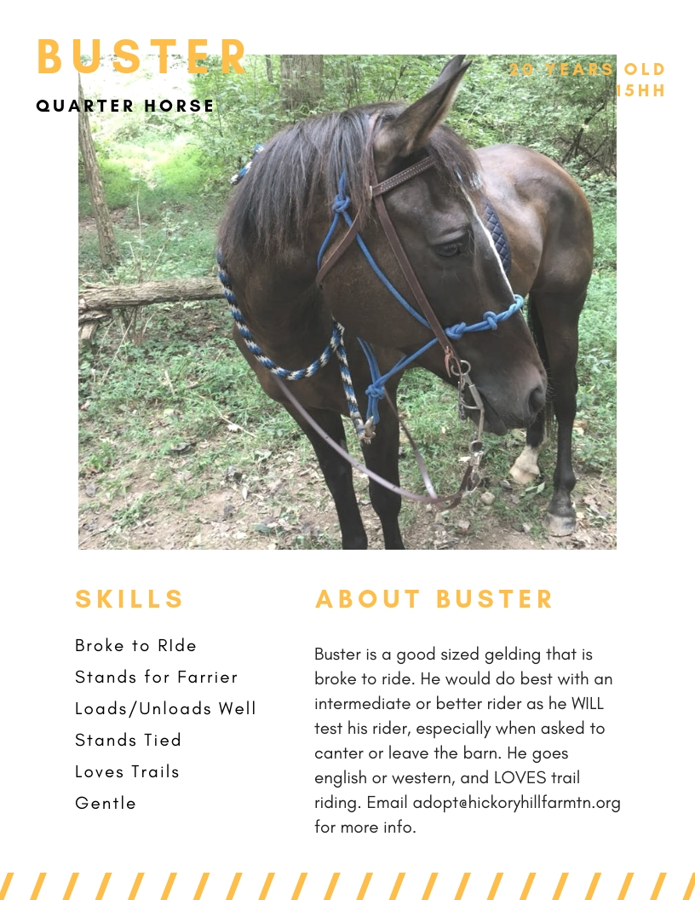
Canva Example

Slide 21
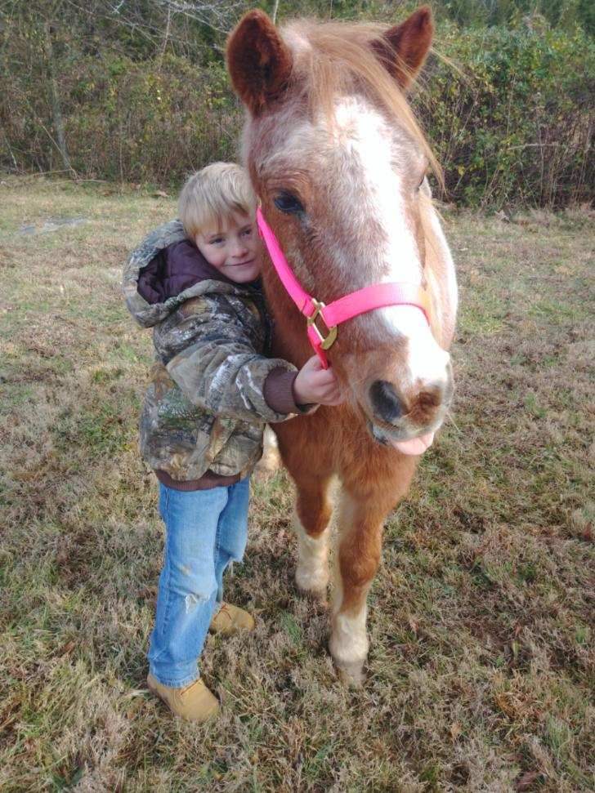
Post Adoption Process
Post Adoption Coordinator Role
Adoption Contract Requirements
Open Door Policy for Returns
Post Adoption Transfers

Slide 22

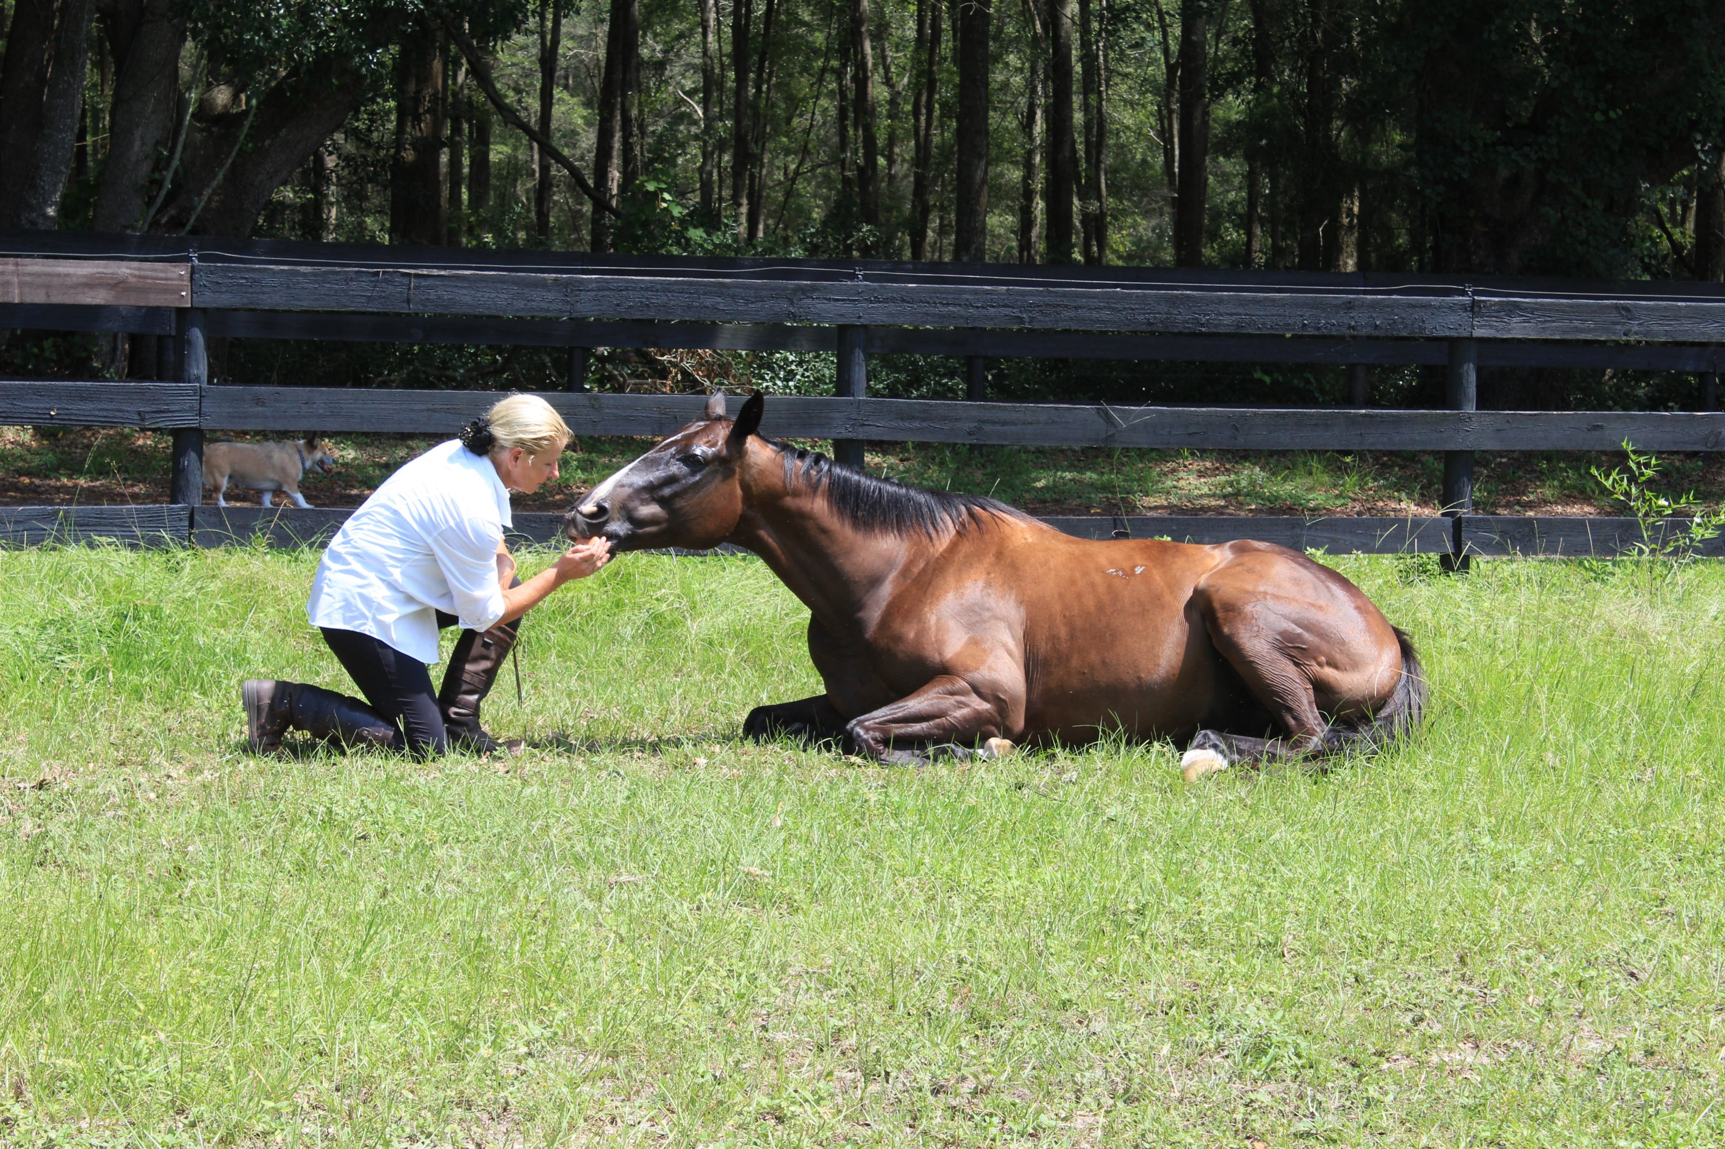
Implementing the changes we wish to see in the equine welfare industry.

Slide 23
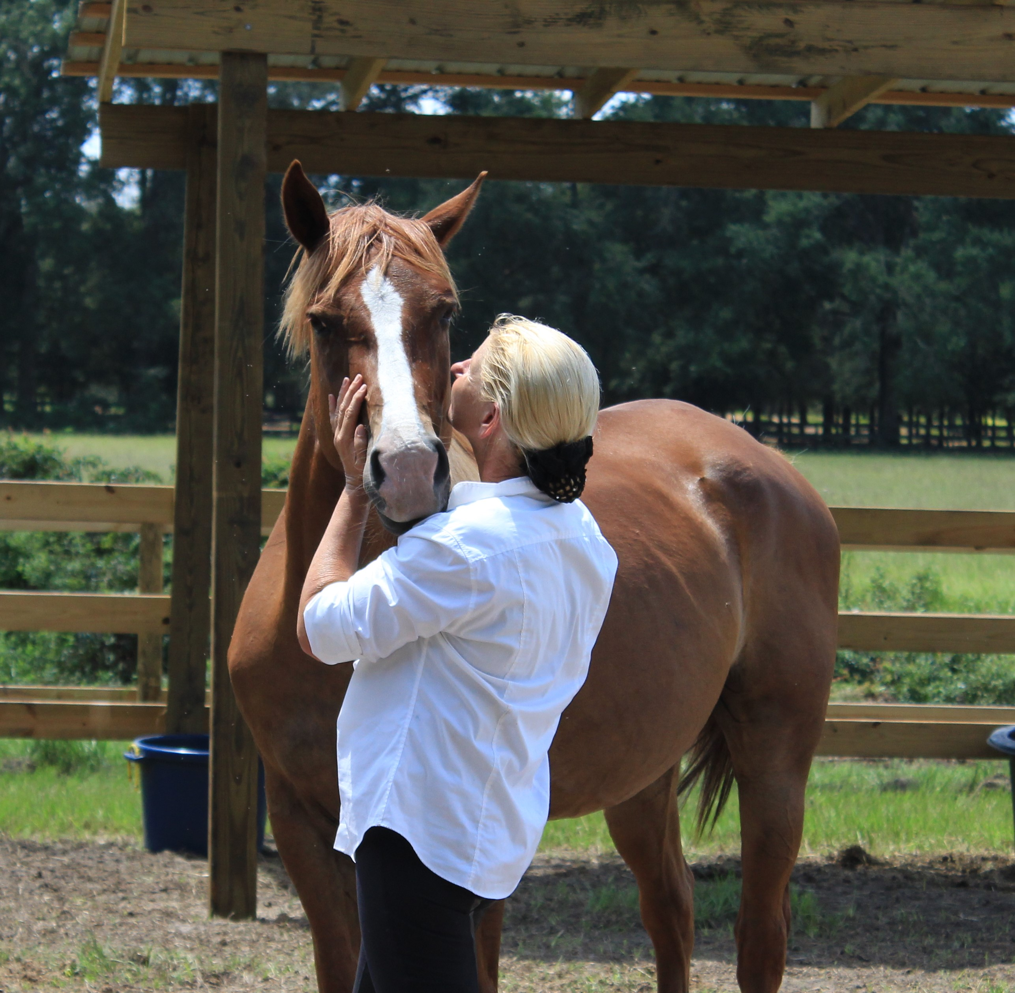
Founder: Yvonne Barteau
Rock Bluff Ranch in Bell, FL
June 17, 2017 -became a 501c3 rescue organization
^{Beautiful} ^{120 acre ranch}
^{Equine hot walker}
Covered outdoor arena with FEI footing
^{Outdoor grass riding field}
^{Two round pens}
^{Trails}
Natural Horsemanship Course -2019!

Slide 24


Slide 25
Our intake process:
The Department of Agriculture
Surrenders
Repurposing Racehorses
Networking with other equine welfare groups
Outbid kill buyers at local auctions
Background Assessment- Quarantine vs. No Quarantine
Overall physical condition assessment
Training and temperament evaluation

Slide 26
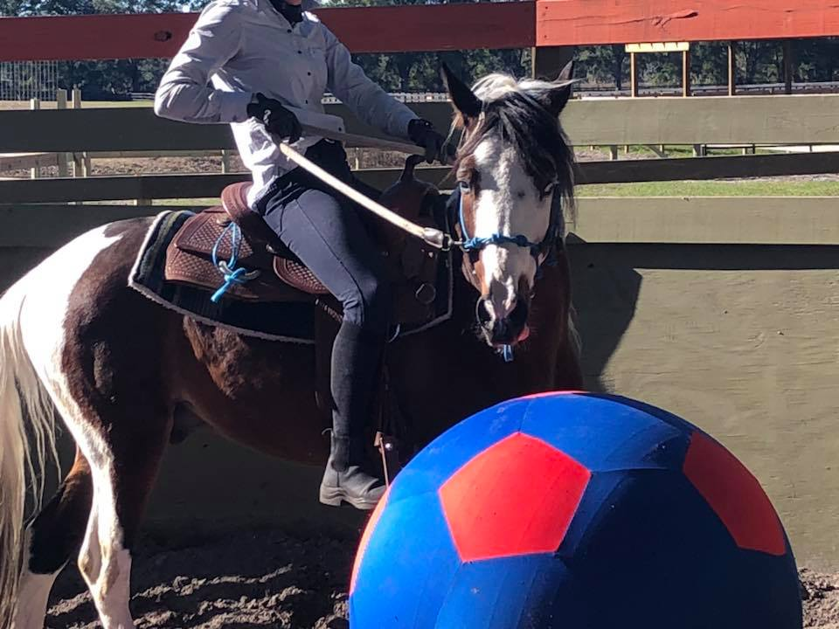
Training
Join up
Ground Control
Desensitization
Line Driving
Basic Dressage- arena work
Obstacle Training
Trail Riding
Specialized -Over Fences, Liberty, Theater, Cross Country

Slide 27
The Right Match
Proper assessment and evaluation of the horse
Honest and full disclosure of where the horse is in training- problem areas, strong points
Proper screening of potential adopter, their goals
Thorough introduction between horse and rider in the round pen, stall, wash rack, paddock ect.
Continued training offered at our facility for both horse and rider
Constantly updating all ads, and marketing so that information on each horse and where they are in training is current.

Slide 28
The Market
Major go-to websites for horse shoppers- EquineNow, HorseClicks, DreamHorse, NewHorse, PetFinder
Facebook Groups –location, discipline
Local Groups-pony club, University of Florida Equestrian Team, extreme trailriders
Small Events- hunter paces, non-rated shows
Open House Events
Reach Out- middle and high school programs
Other ways to handle adoption fees- working off fees saves employment costs

Slide 29
The Follow Up
Every horse coming in to Horses Without Humans has found a home for life
Returned or Exchanged
30 day check
Staff available to travel locally to do lessons and help with any issues that may arise
KYB Connected- free 1 year membership of online classes and videos for all adopters to learn from at their own pace
1 year check
We do allow adopters to sell the horse for profits

Slide 30
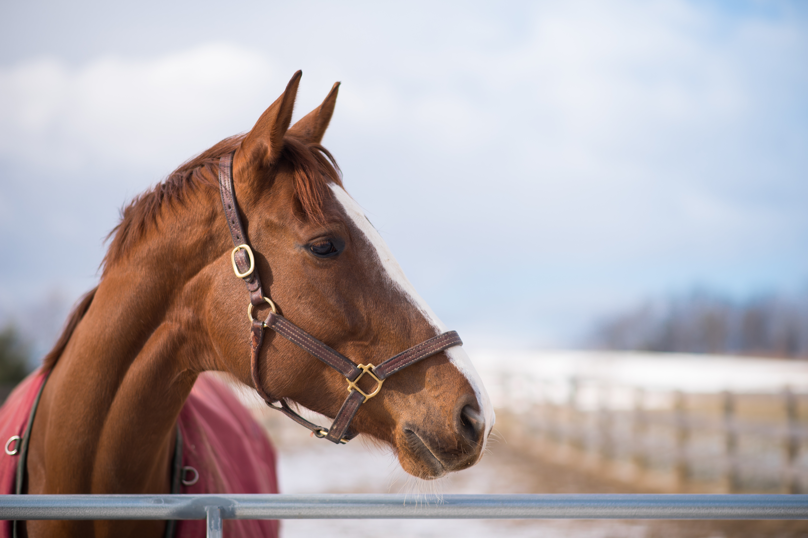
Register now!
ASPCApro.org/hahh
$150k in prizes
Inclusion on MyRightHorse.com
Free microchips
Free vaccines

Slide 31
Questions?
Join! ASPCApro.org/HaHH

