Slide 1
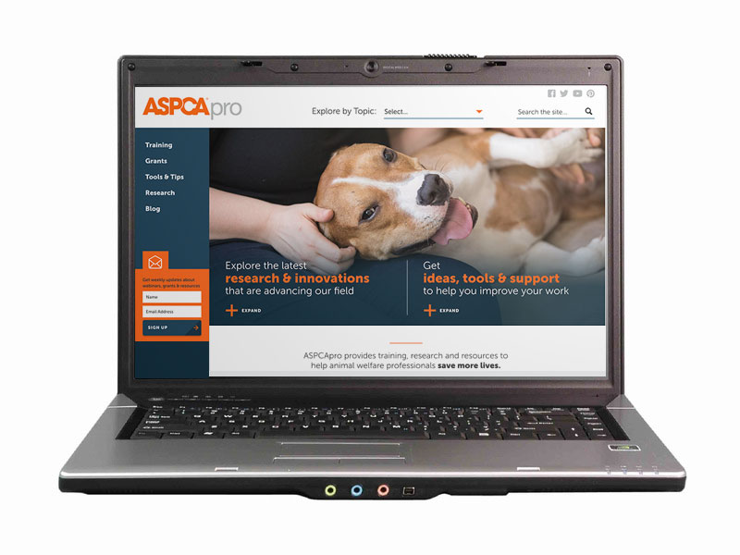
How to Home Special Needs
and Unrideable Horses
Enjoy the music!
The webinar will begin at its scheduled time.
Join the webinar using built-in computer audio or dial
669-900-6833 or
646-558-8656
Webinar ID: 586-324-720

Slide 2

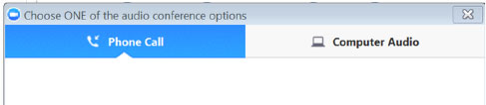
How to Adjust Your Audio
Select “Audio Settings” at the bottom of your screen.
Choose whether you’ll join using computer audio or your telephone. We recommend computer audio.

Slide 3
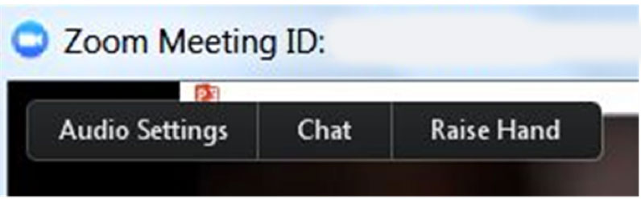
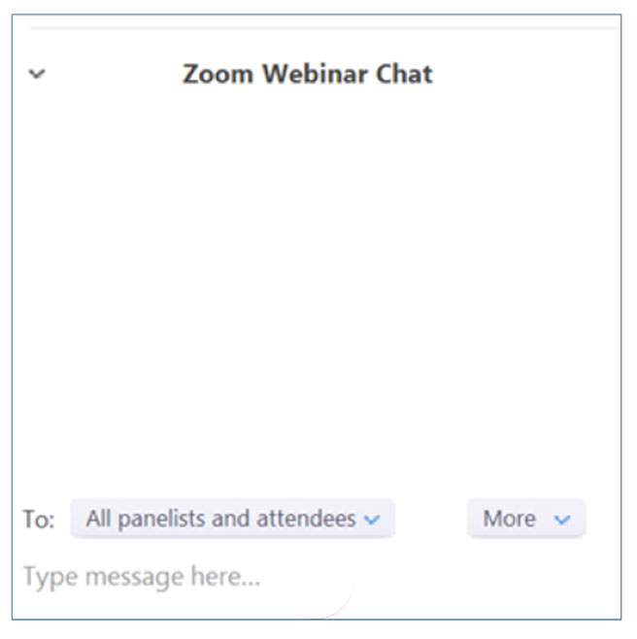
How to Chat
Select “Chat” at the bottom of
your screen
In the chat window, select “All panelists and attendees” to share your message with everyone in attendance

Slide 4
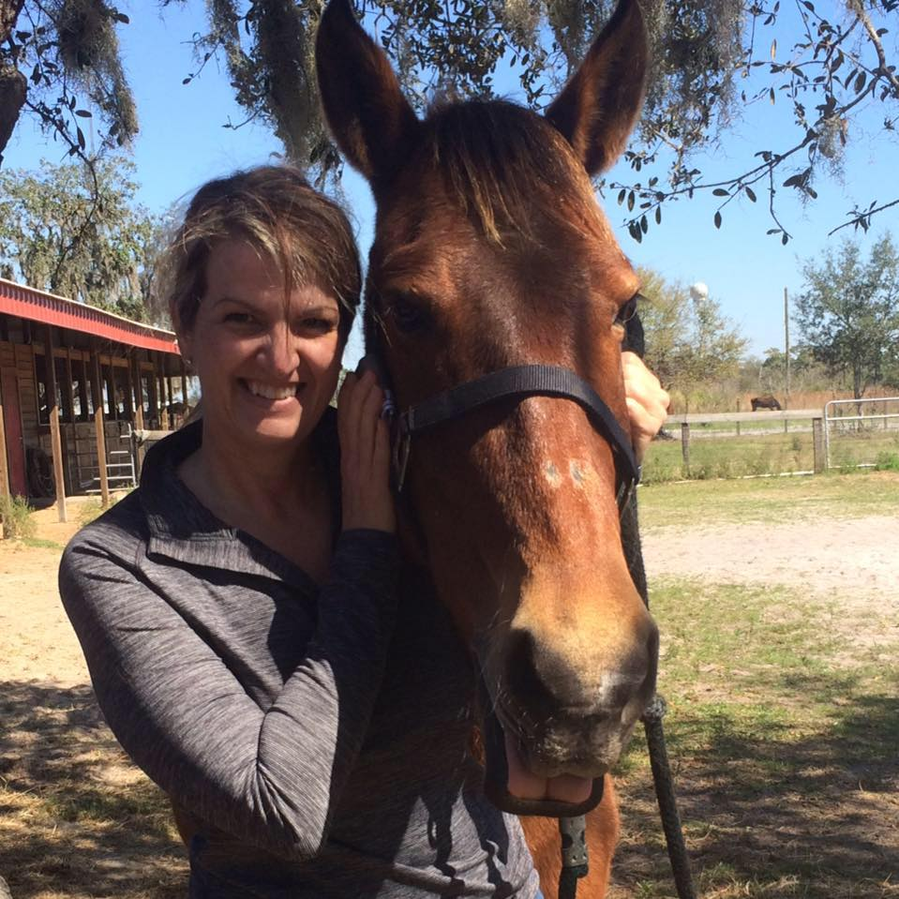
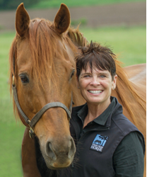
How to Home Special Needs
and Unrideable Horses
Kelly Ford
Executive Board Secretary and Spokesperson
RVR Horse Rescue
Nancy Turner
President and Founder
This Old Horse, Inc.

Slide 5

RVR Horse Rescue Special Needs Adoption
Riverview, FL
501c3 in 2011
All-volunteer
Specialize in extreme cases of neglect, abuse and injury
Average intake 38 equines per year
Average 25 adoptions per year

Slide 6
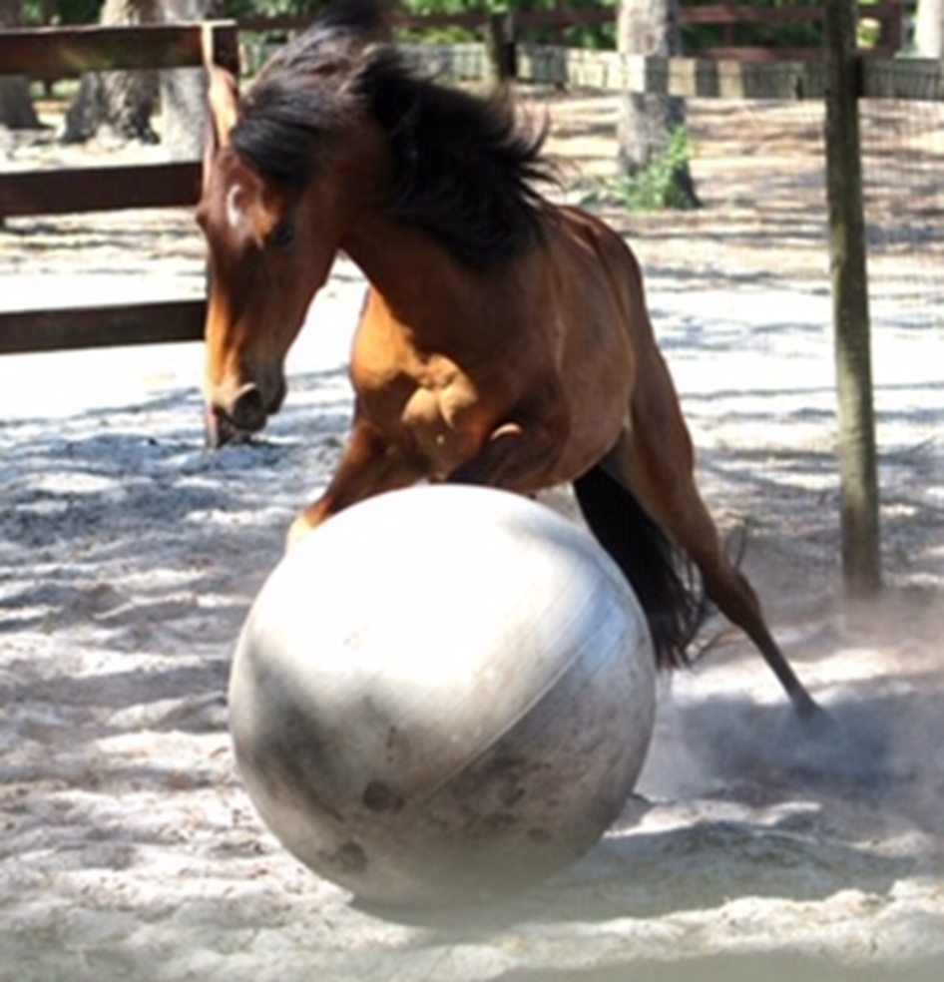
Promotion, promotion, promotion!
Special needs equines featured as often as regular adoptables
Web articles, blog posts, Facebook posts

Slide 7
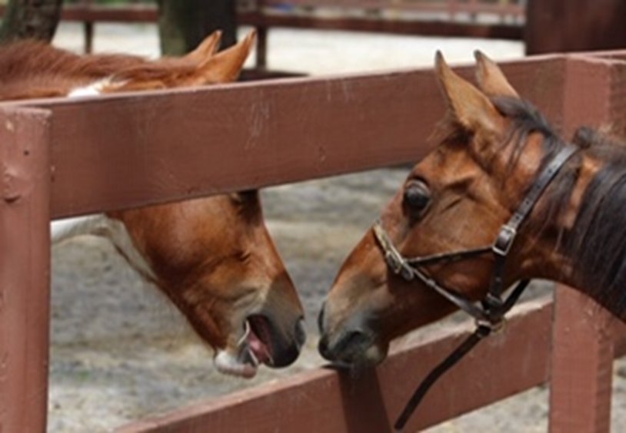
Sharing with the Public
Don’t hide special needs, but showcase abilities, personalities
Share reasons staff/volunteers love them!
Photos of them interacting with volunteers, guests

Slide 8
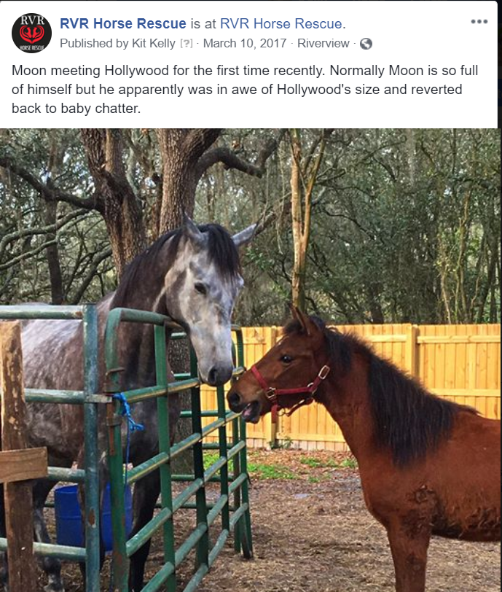
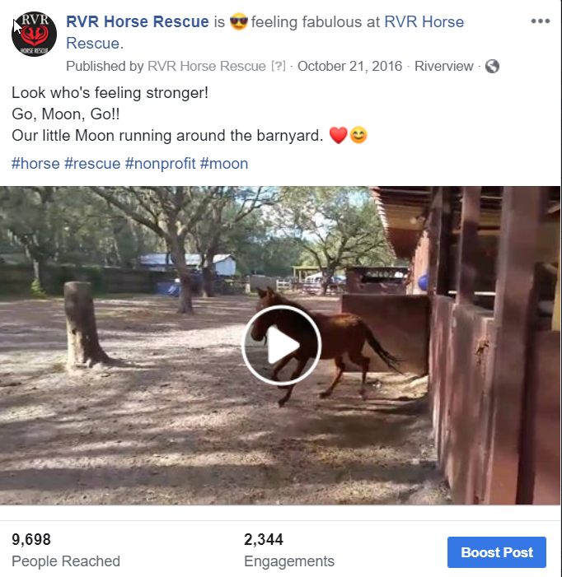
Showcase personality and ability, not just special need.

Slide 9
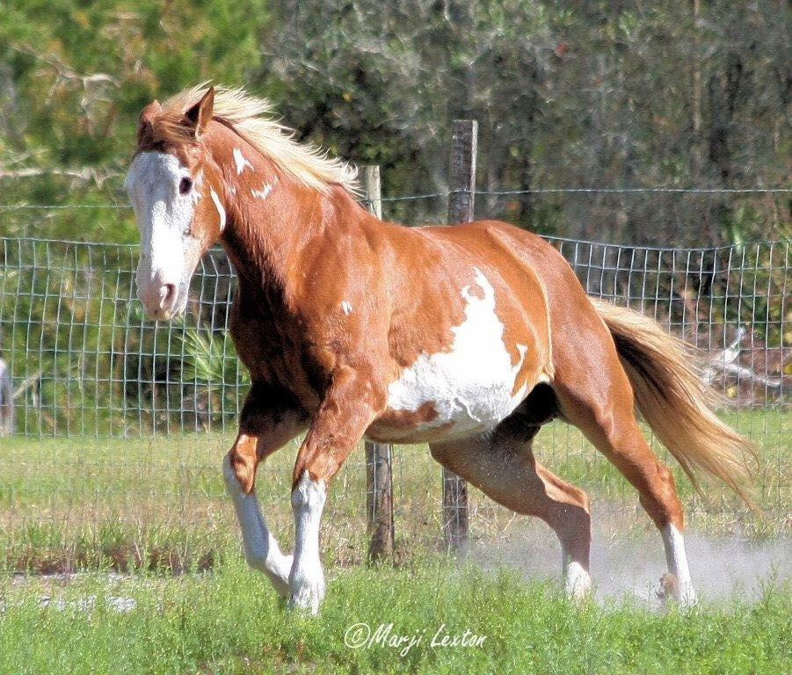
Photography is important
Find a photographer who will donate time to take pictures.
Does not have to be a professional – hobbyist shutterbugs take great pics, too
Cell phones can take great pictures. Learn how to edit.

Slide 10
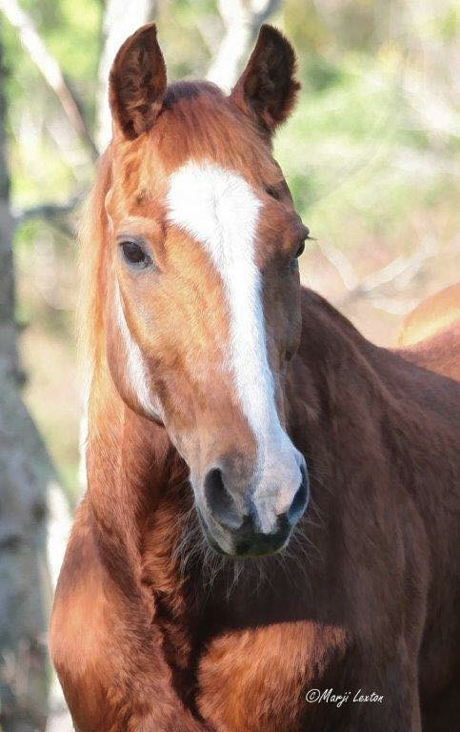
Keep Introductions Open
Pre-screen to find out preferences.
Personality is important.
Someone not looking for something very specific may connect with a “special”.

Slide 11
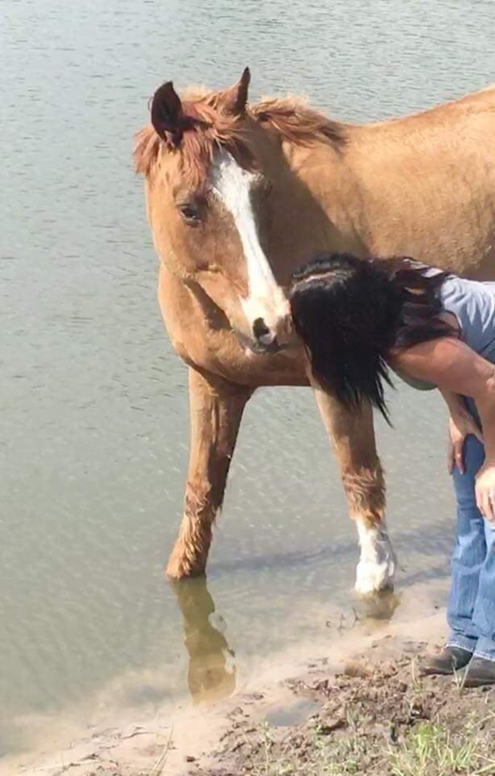
Pre-Adoption Preparation
Extra support may be needed for a prospective adopter of a special needs horse.
Instruction in special need care.
Vet to vet consultation.

Slide 12
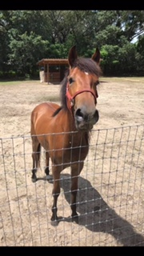
Post-adoption Support
Be open to continued support.
Flexibility is key.
Amendments or addendum to contract

Slide 13
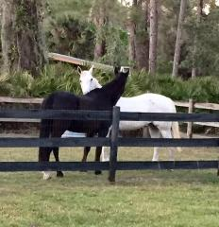
Out of the Box Thinking
Consider your special needs population.
Identify avenues of support
Engage the community around you.

Slide 14
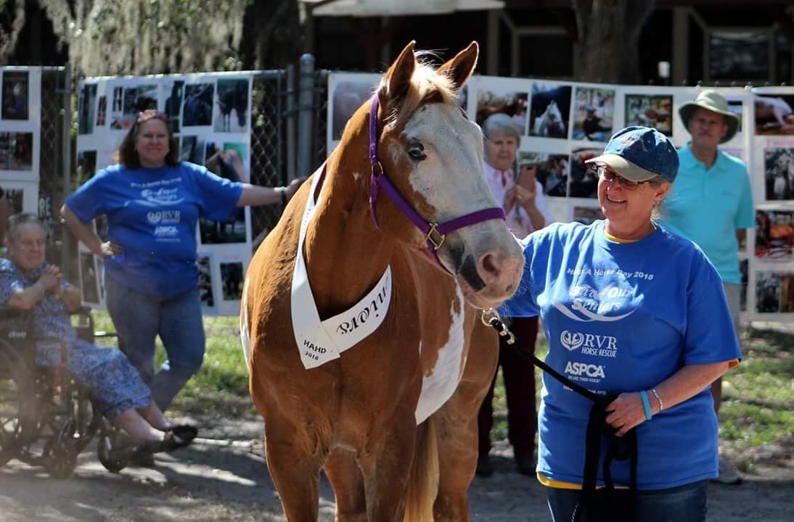
SOS- Save Our Seniors
RVR wanted to increase adoptions of senior horses.
We looked at options in terms of equine and human community
Developed SOS

Slide 15
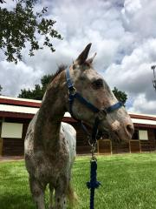
SOS – Partner with Lesson/Show Barns
Senior horses are great for teaching basic horse care!
Grooming, hoof care, tacking up
Children learn, and the seniors enjoy attention and great care.

Slide 16
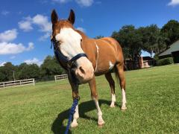
SOS – Special Rates at Boarding Facilities
Reduced boarding rates for SOS horses.
Special care arrangements for SOS owners.

Slide 17
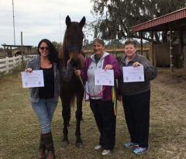
SOS- Group Adoptions
First-timers new to horse ownership.
People who are able to adopt if costs are shared.

Slide 18
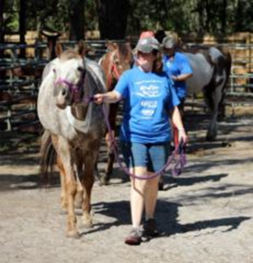
SOS- Partnering with Senior Citizens
Senior horses are great for older horse owners.
Partner facilities take care of the hard work of horse ownership. Senior adopters take care of the TLC.

Slide 19
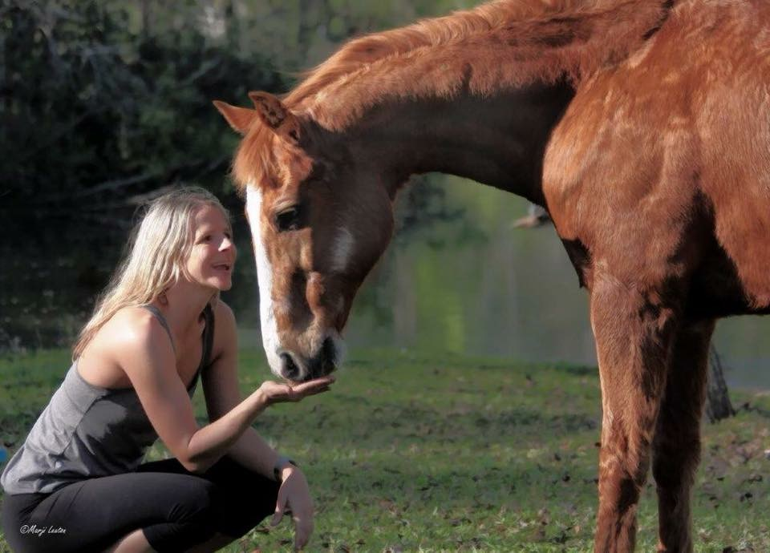
SOS – Making a Difference
Begun in 2017
14 Senior horses placed in 2 years

Slide 21


Slide 28
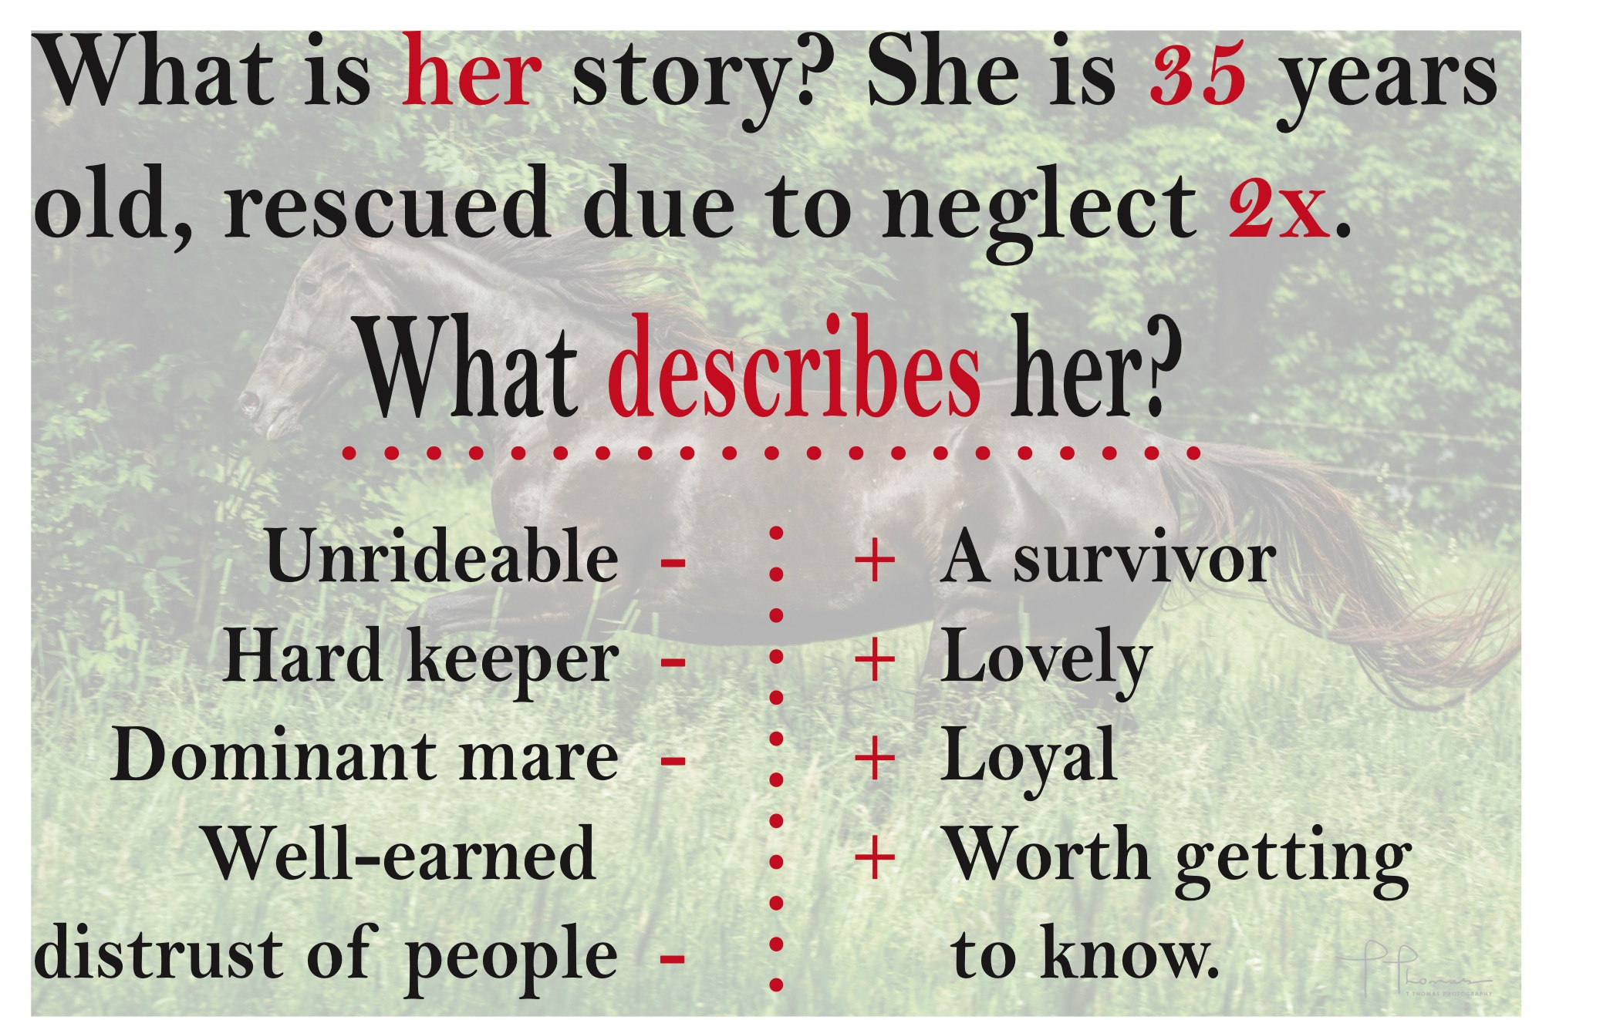

Slide 29
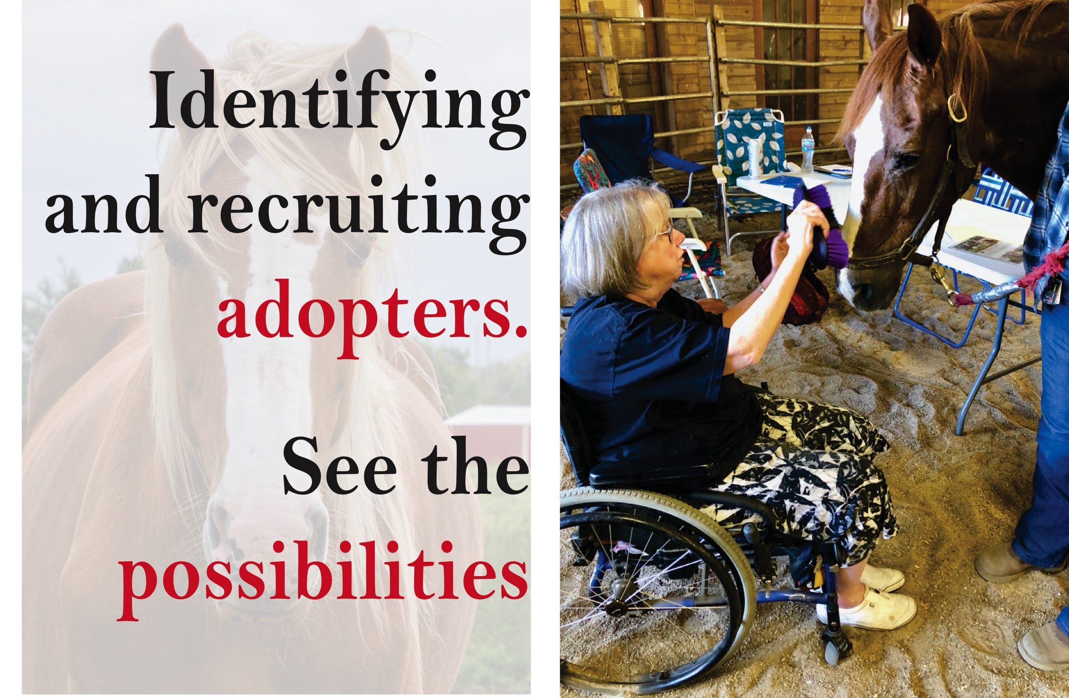

Slide 32
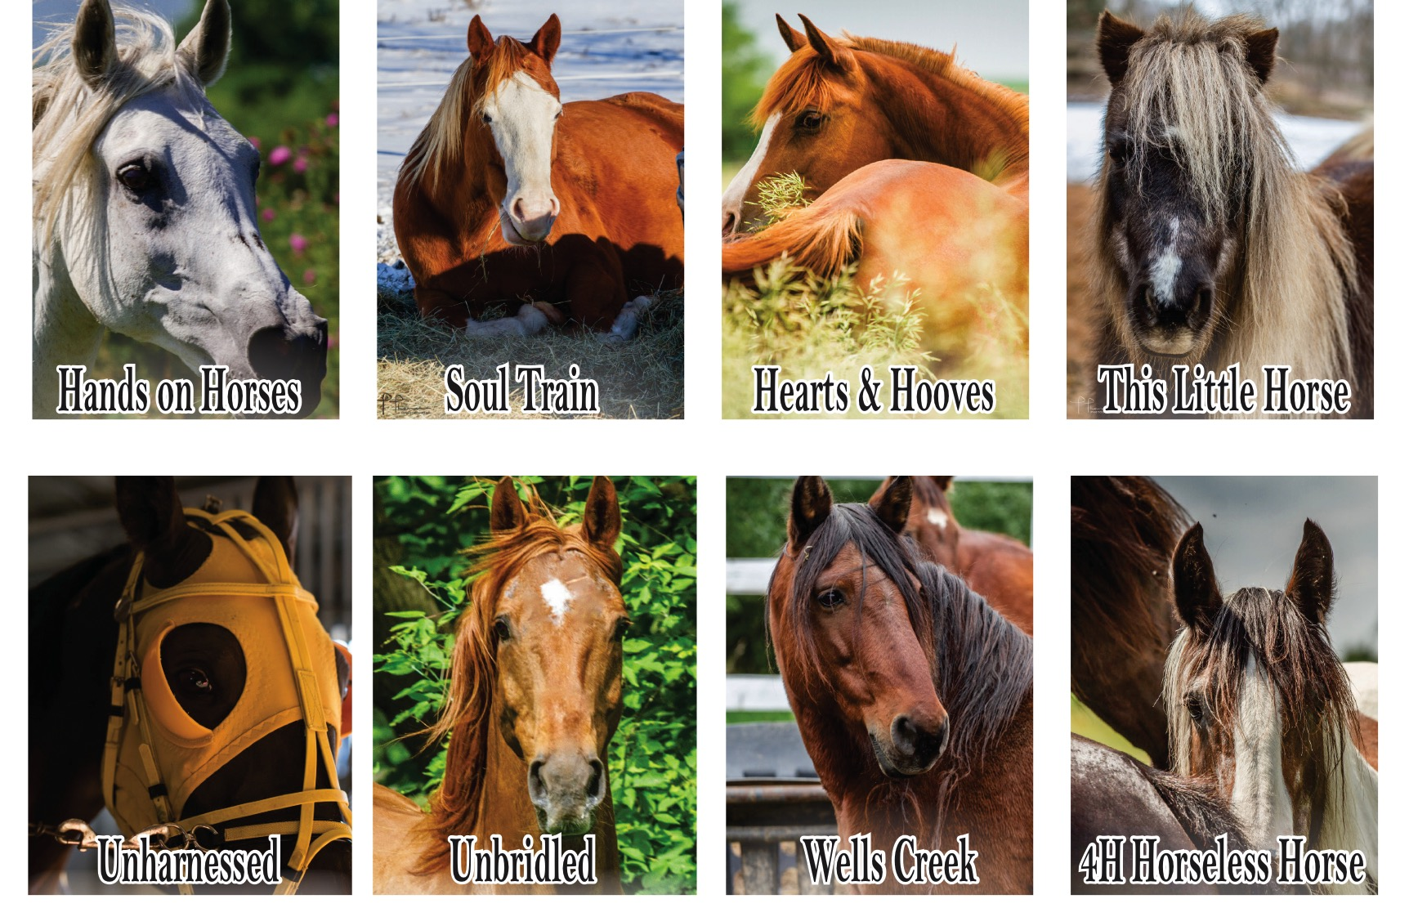

Slide 35


Slide 36
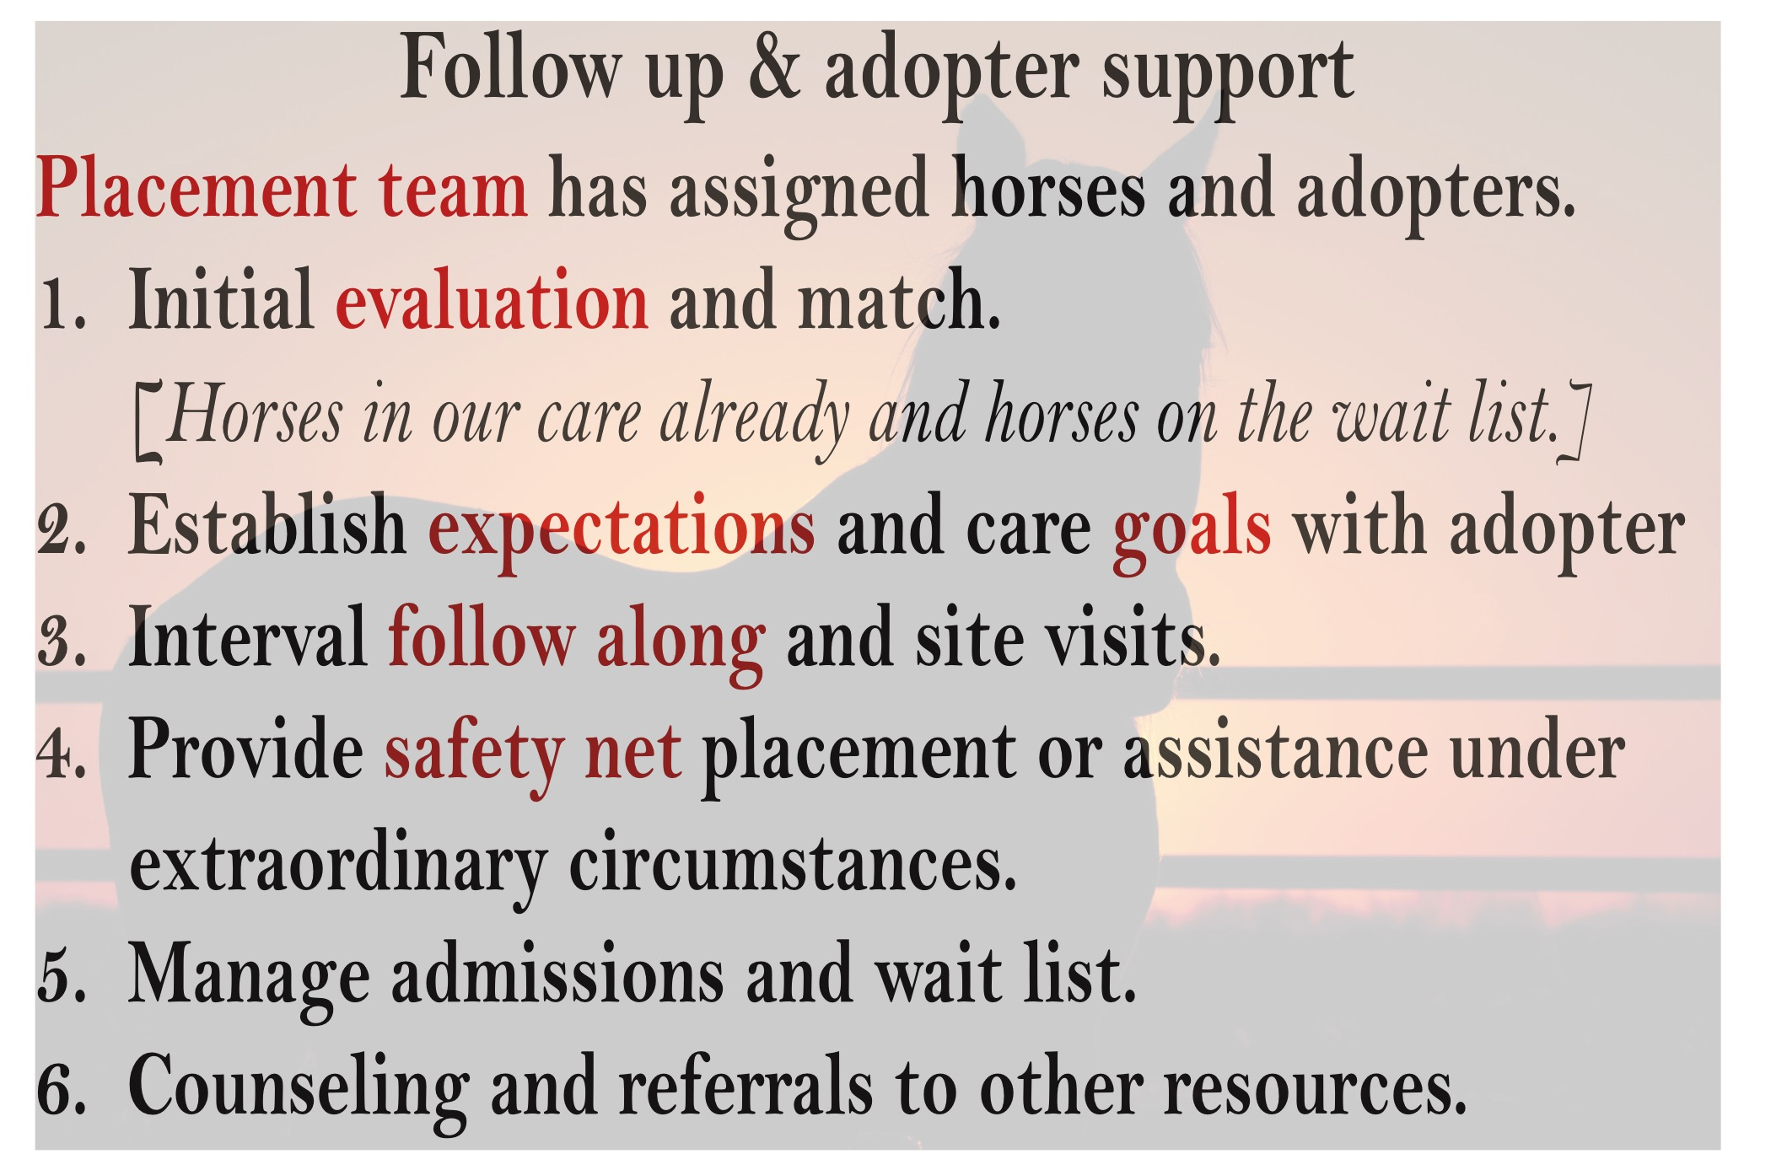

Slide 38
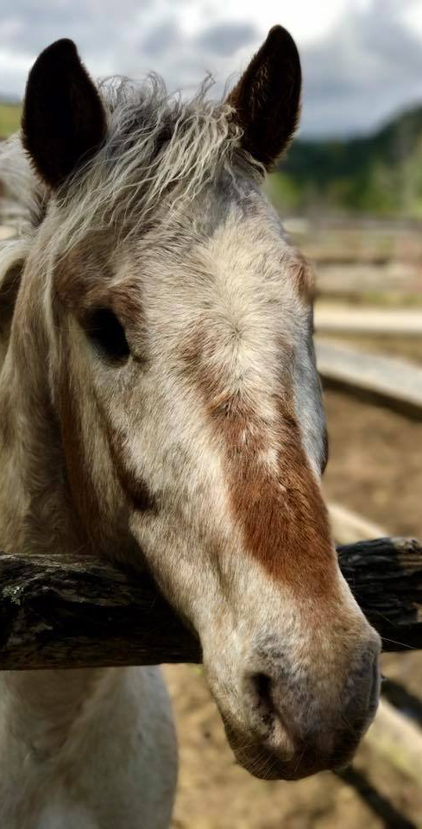
Questions?
Type them into chat.
Please make sure to select “All Panelists and Attendees”

Slide 39

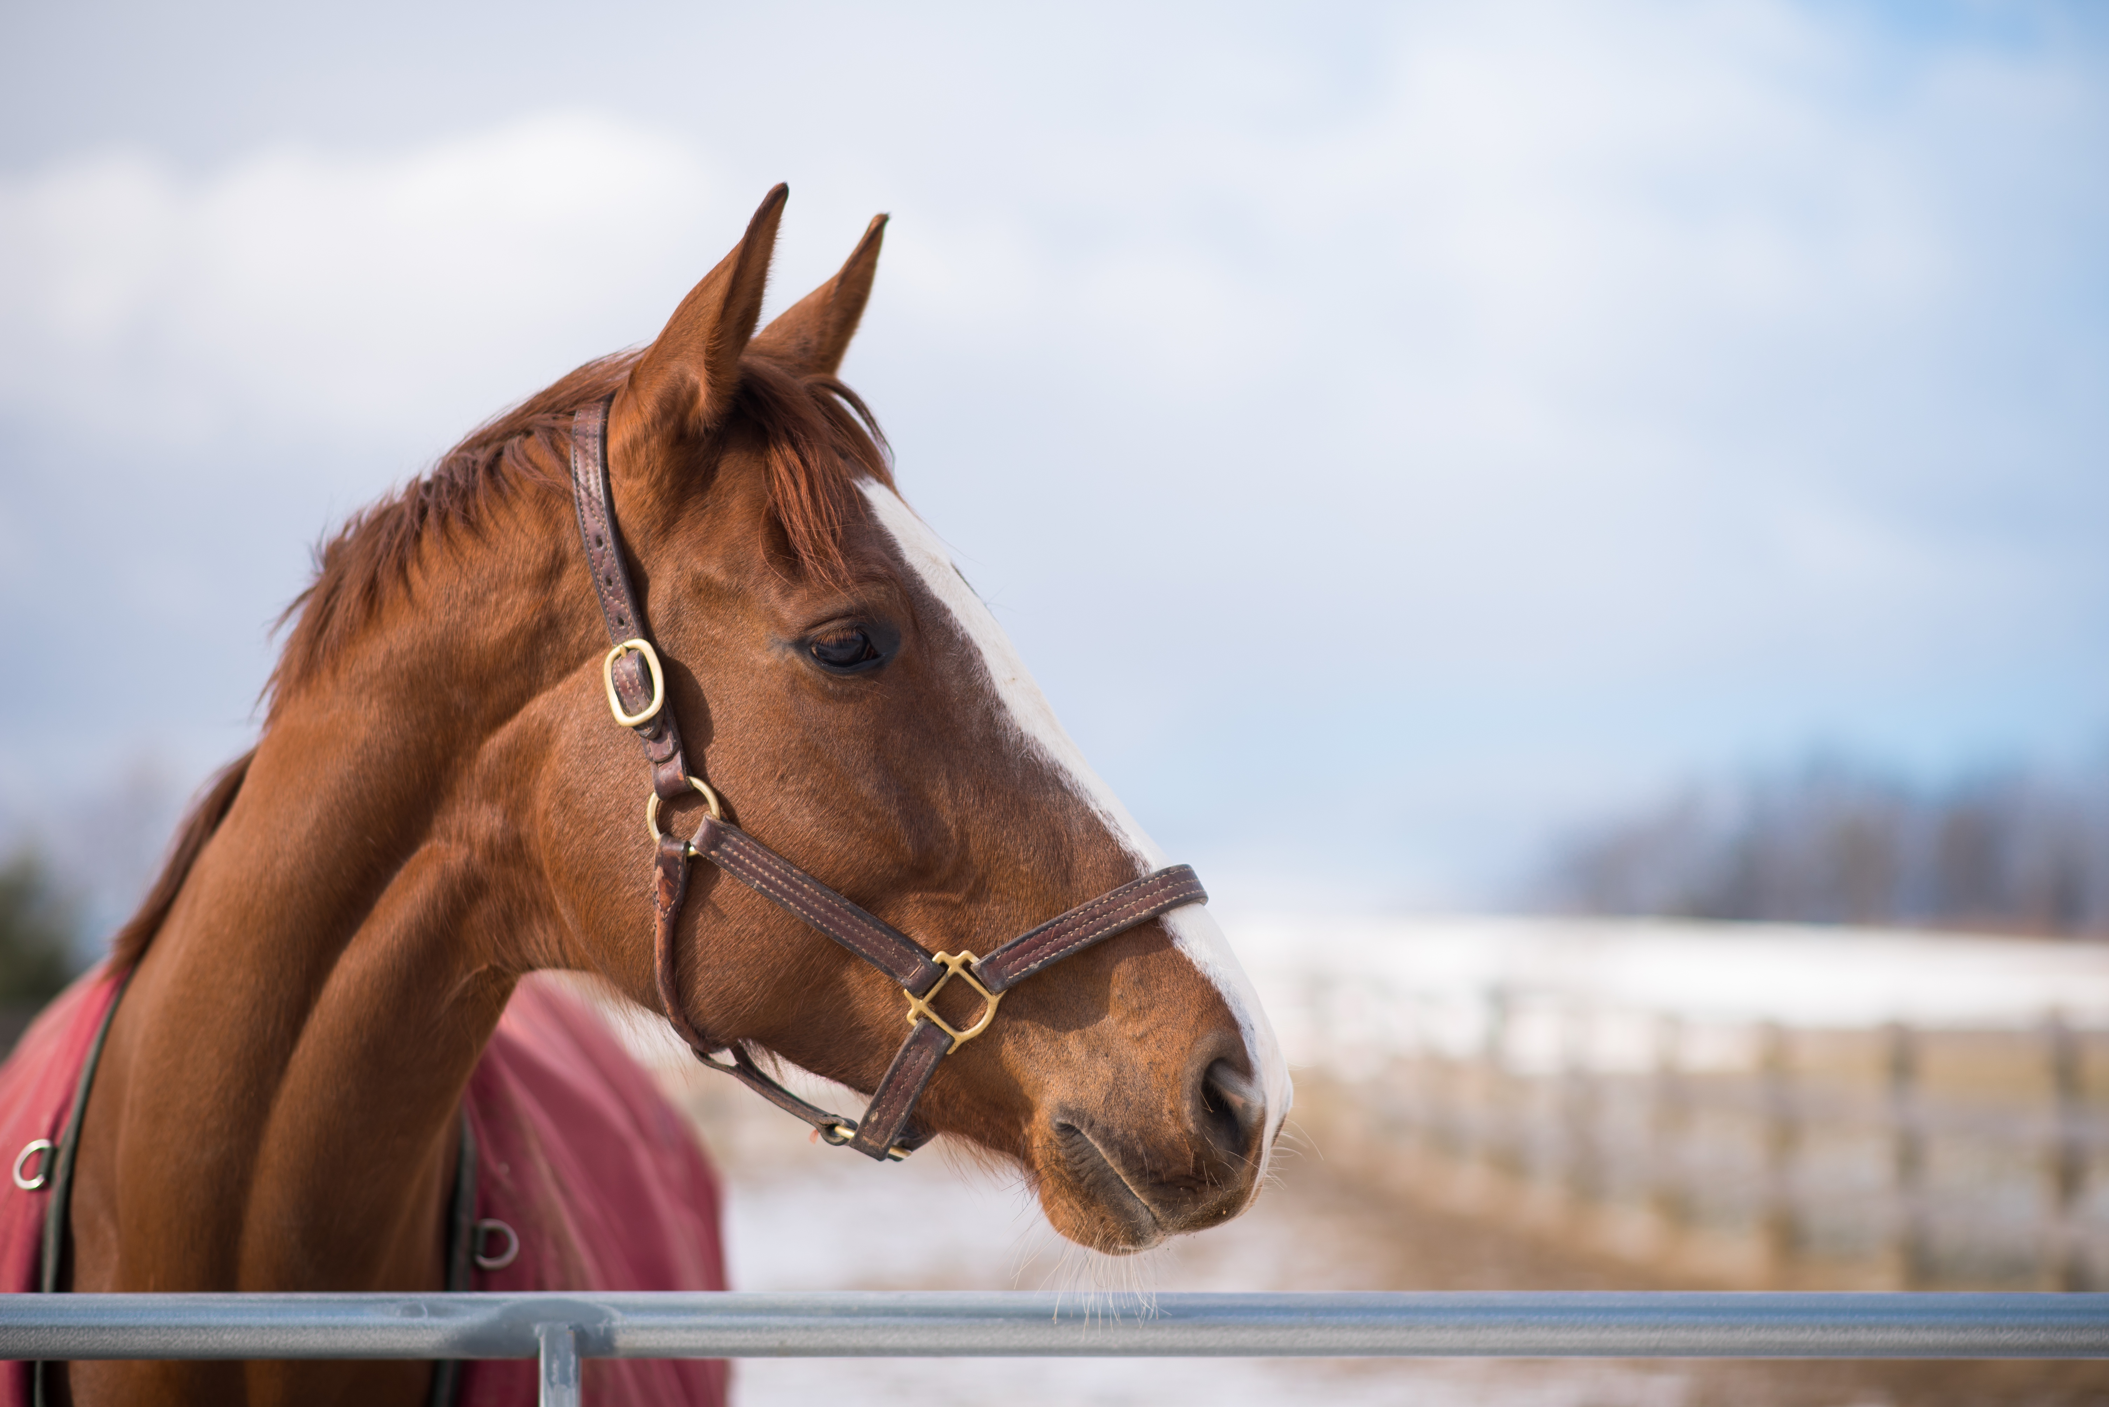
New Perk for Joining Help a Horse Home
Adoption Challenge!
Access to MyRightHorse.com
Over 40,000 users
268,000 page views
Register: aspca.org/hahh

Slide 40
Questions?
Type them into chat.
Please make sure to select “All Panelists and Attendees”

