Slide 1

Welcome to the Get ‘Em Out! Webinar
Webinar ID: 126-228-229

Slide 2
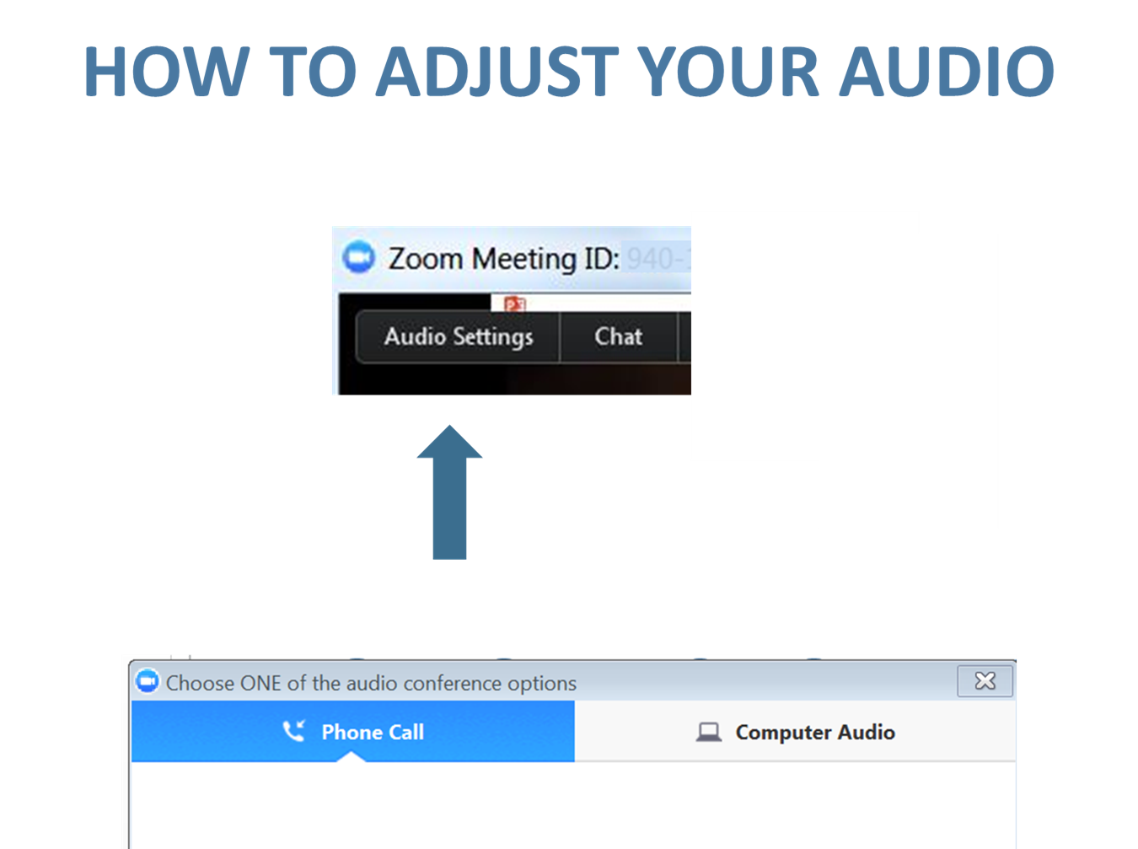

Slide 3
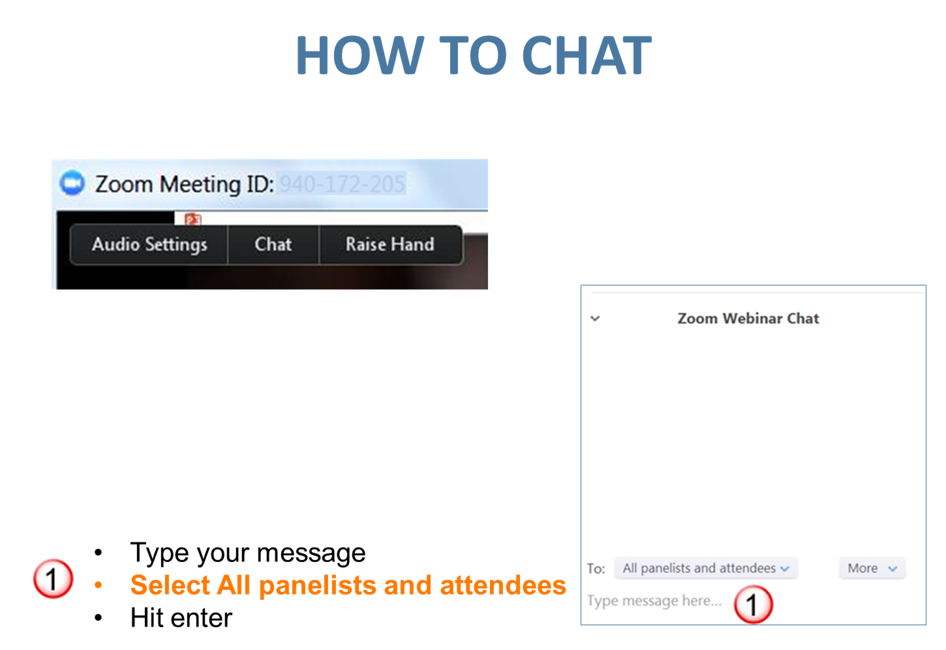

Slide 4
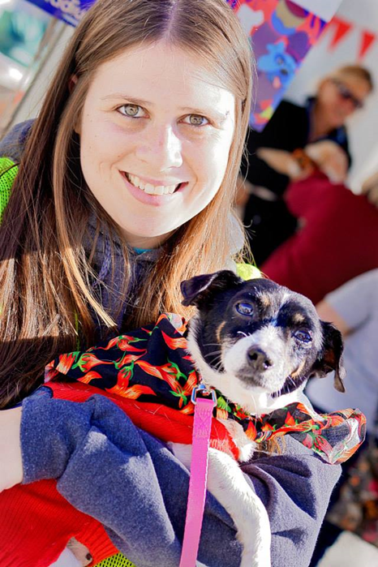

Today’s Presenters
Michelle Harvanek
City of Cleveland Animal Care & Control
Shelter Operations Manager
mharvanek@city.Cleveland.oh.us
Notes:
Susan:

Slide 5
Get Them Out! How to Increase Dog Adoptions with Offsite Opportunities
Michelle Harvanek, Shelter Operations Manager
Cleveland Animal Care & Control

Slide 6
Agenda
Why?
General Tips
Offsite events / public appearances
Enrichment-based offsite opportunities
Training and engaging volunteers

Slide 7
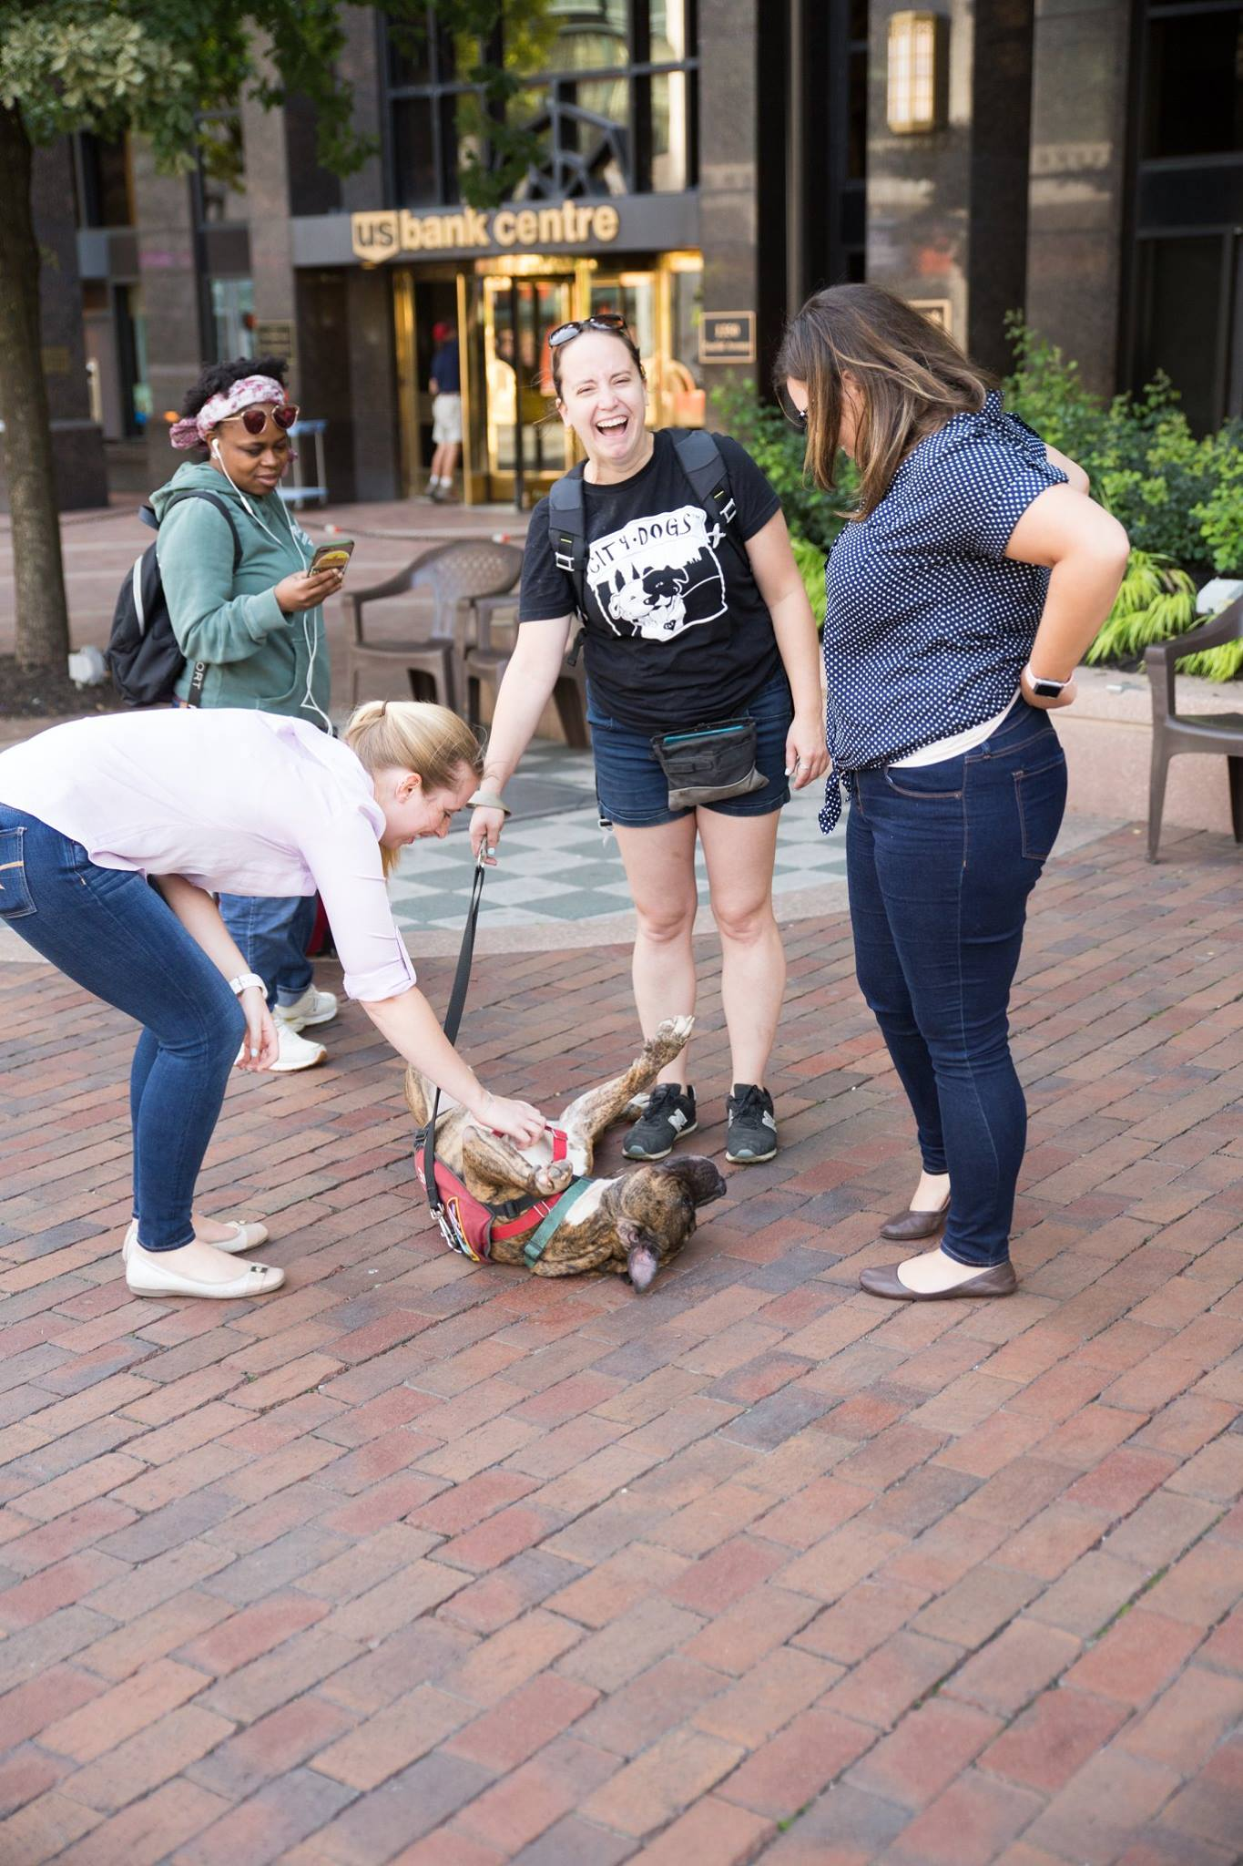
Why go offsite?

Slide 8
General Tips
Start small
Choose the right dogs – but at the same time, don’t place unnecessary restrictions
Train your volunteers
Brand your materials
Be prepared

Slide 9
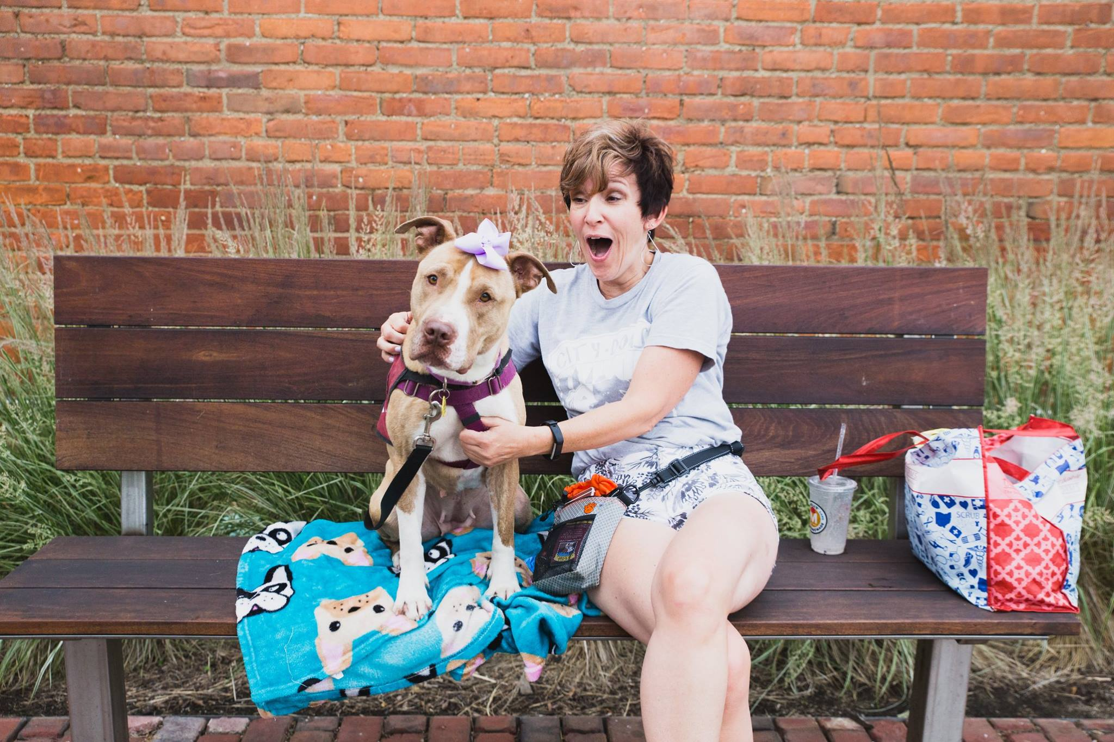
Offsite Events / Public Appearances

Slide 10
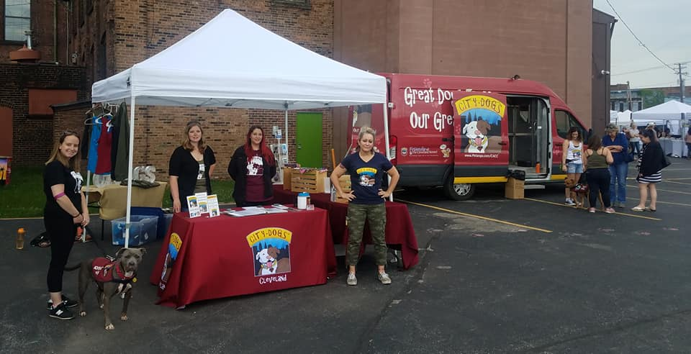
Offsite Events / Public Appearances

Slide 11
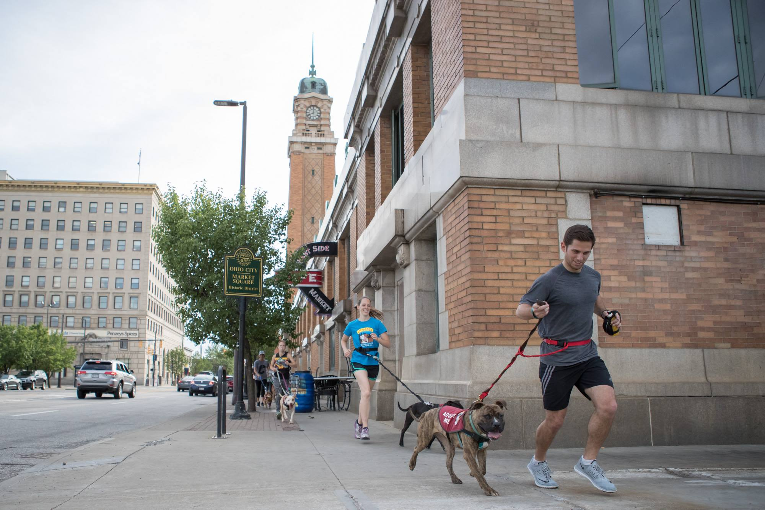
Enrichment-based offsite opportunities

Slide 12
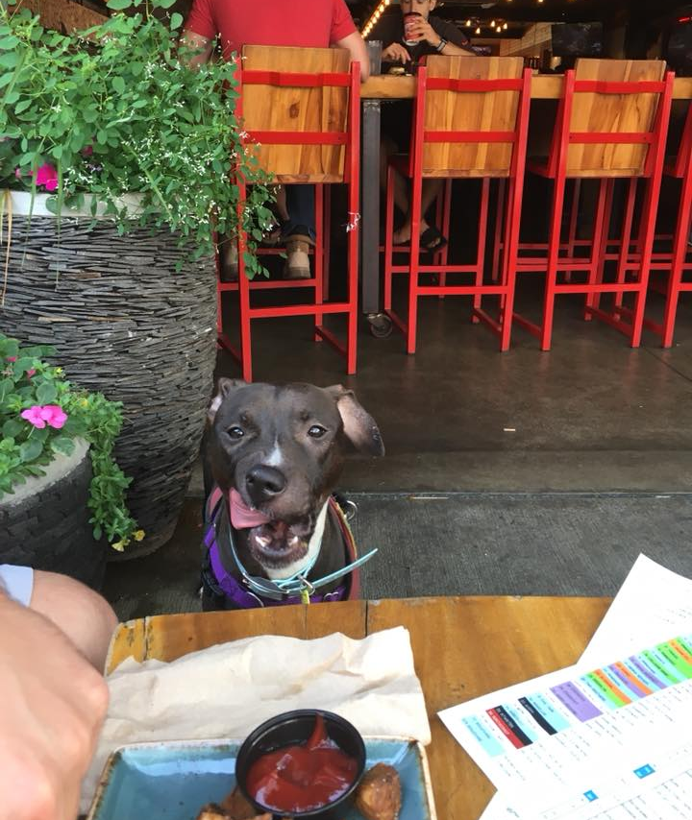
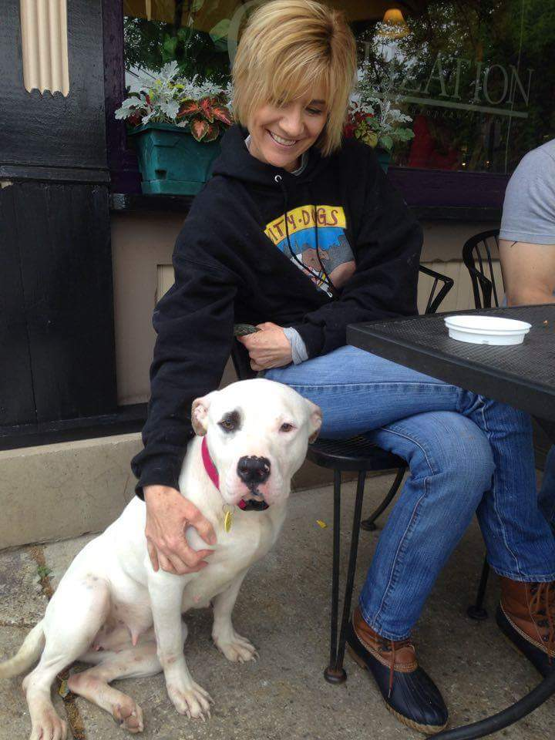
Enrichment-based offsite opportunities

Slide 13
Training and engaging volunteers
Liaisons
  Minimum of two training sessions with a Senior Liaison
Handlers
  Must be trained to walk dogs at the kennel
  Must have trained as a liaison
  Minimum two trainings with a Senior Handler

Slide 14
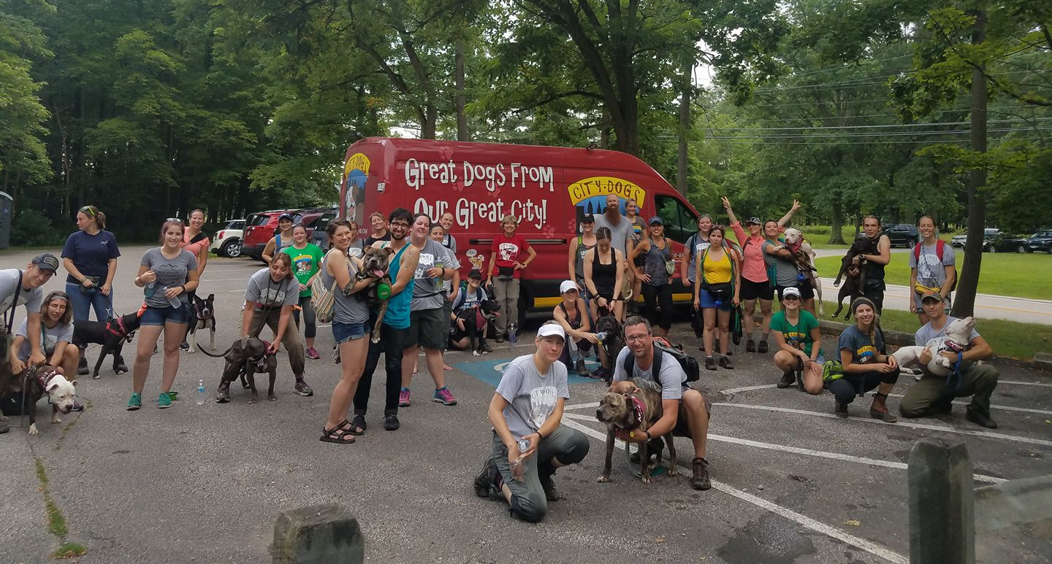

Slide 15
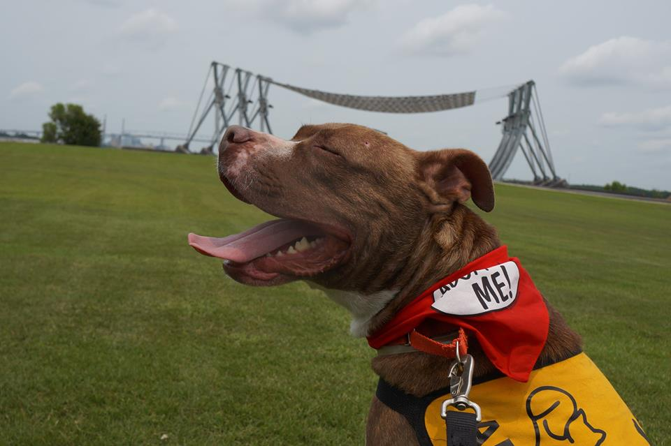
Using an Ambassador Program to Save Lives
Courtney Gumienny, Director of Adoptions

Slide 17
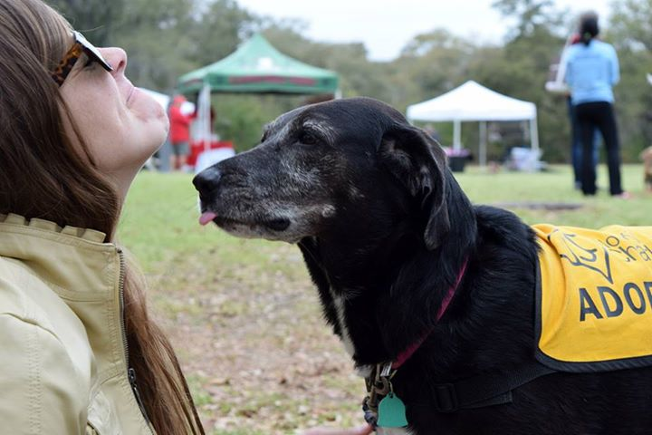
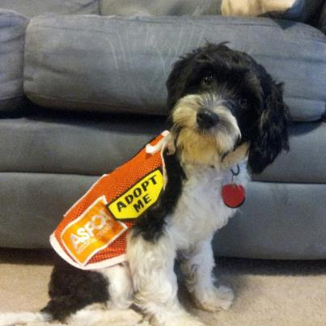
Fewer Returns
17% Shelter
7% AA
Tell me More
3% Shelter Staff
24% AA Familes

Slide 18
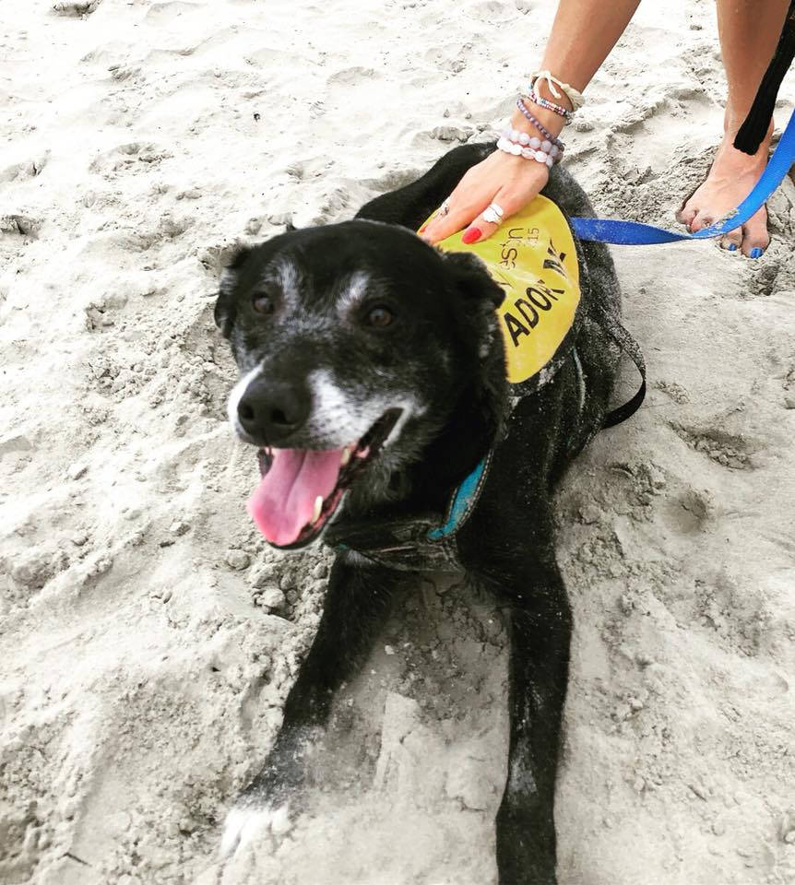
What Dogs are Eligible?
*Senior Dogs
*Big Dogs
*Little Dogs
*Timid dogs
*Barrier reactive dogs
*Loud dogs
*Active dogs
The list goes on…..
Fun Fact: Behavior cases are the only dogs not permitted in the program.
FALSE!

Slide 19
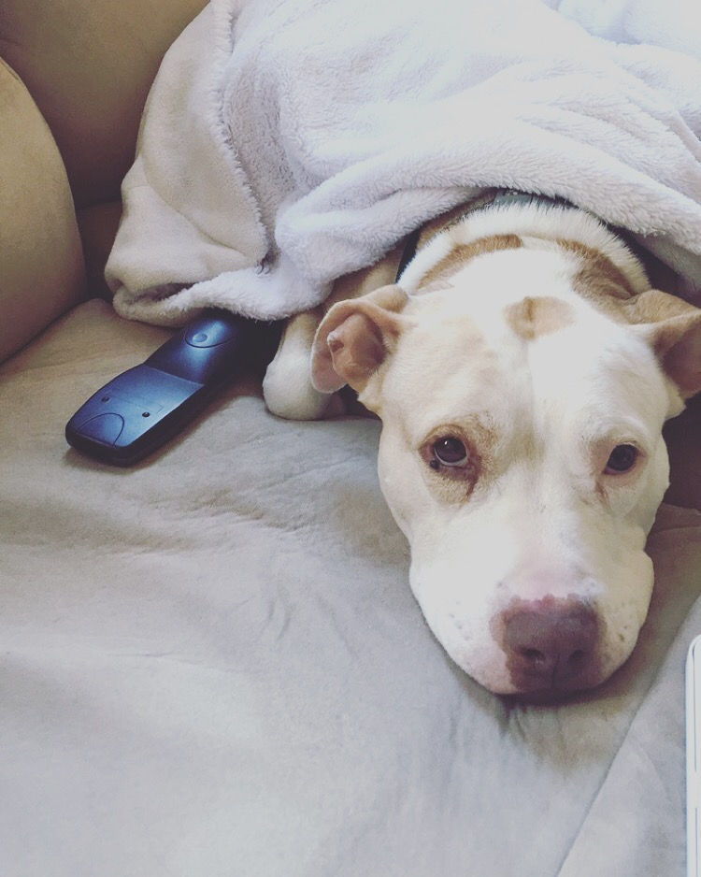
Recruit
Engage existing foster families
Facebook
College Students or Sororities
Military families
AA dogs are walking advertisements
At capacity Plea
Postcard Drop
Ask the finder
Business Ambassadors
Volunteer Orientations
Word of mouth
Campaign

Slide 20
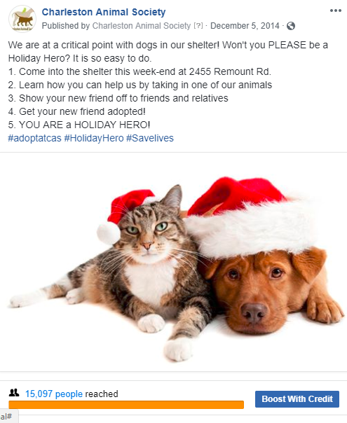

Market
Your
Program

Slide 21
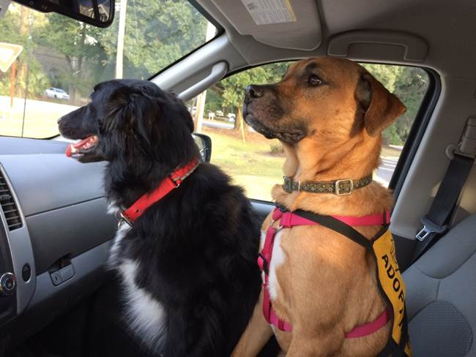
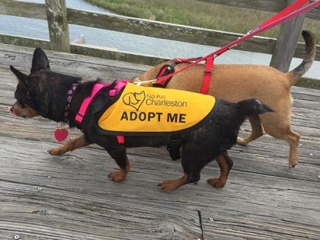
Support
Your
Fosters
*1 on 1 training
*24 hour hotline
*Follow ups &
Encouragement
*Participation in promotions
*Start off “easy”
*Provide Supplies
*Medical care
*Advertise
*Let them get Creative
*Recognition
*Dedicated staff member

Slide 22

Additional tips
*Invite them to events in the community
*Invite them to the shelter to showcase their dog
*Provide them with a booklet with dog friendly establishments in your community
*Advertise dog on your website with a picture, bio, and video
*Change up pictures periodically
*Boost dog on Facebook

Slide 23
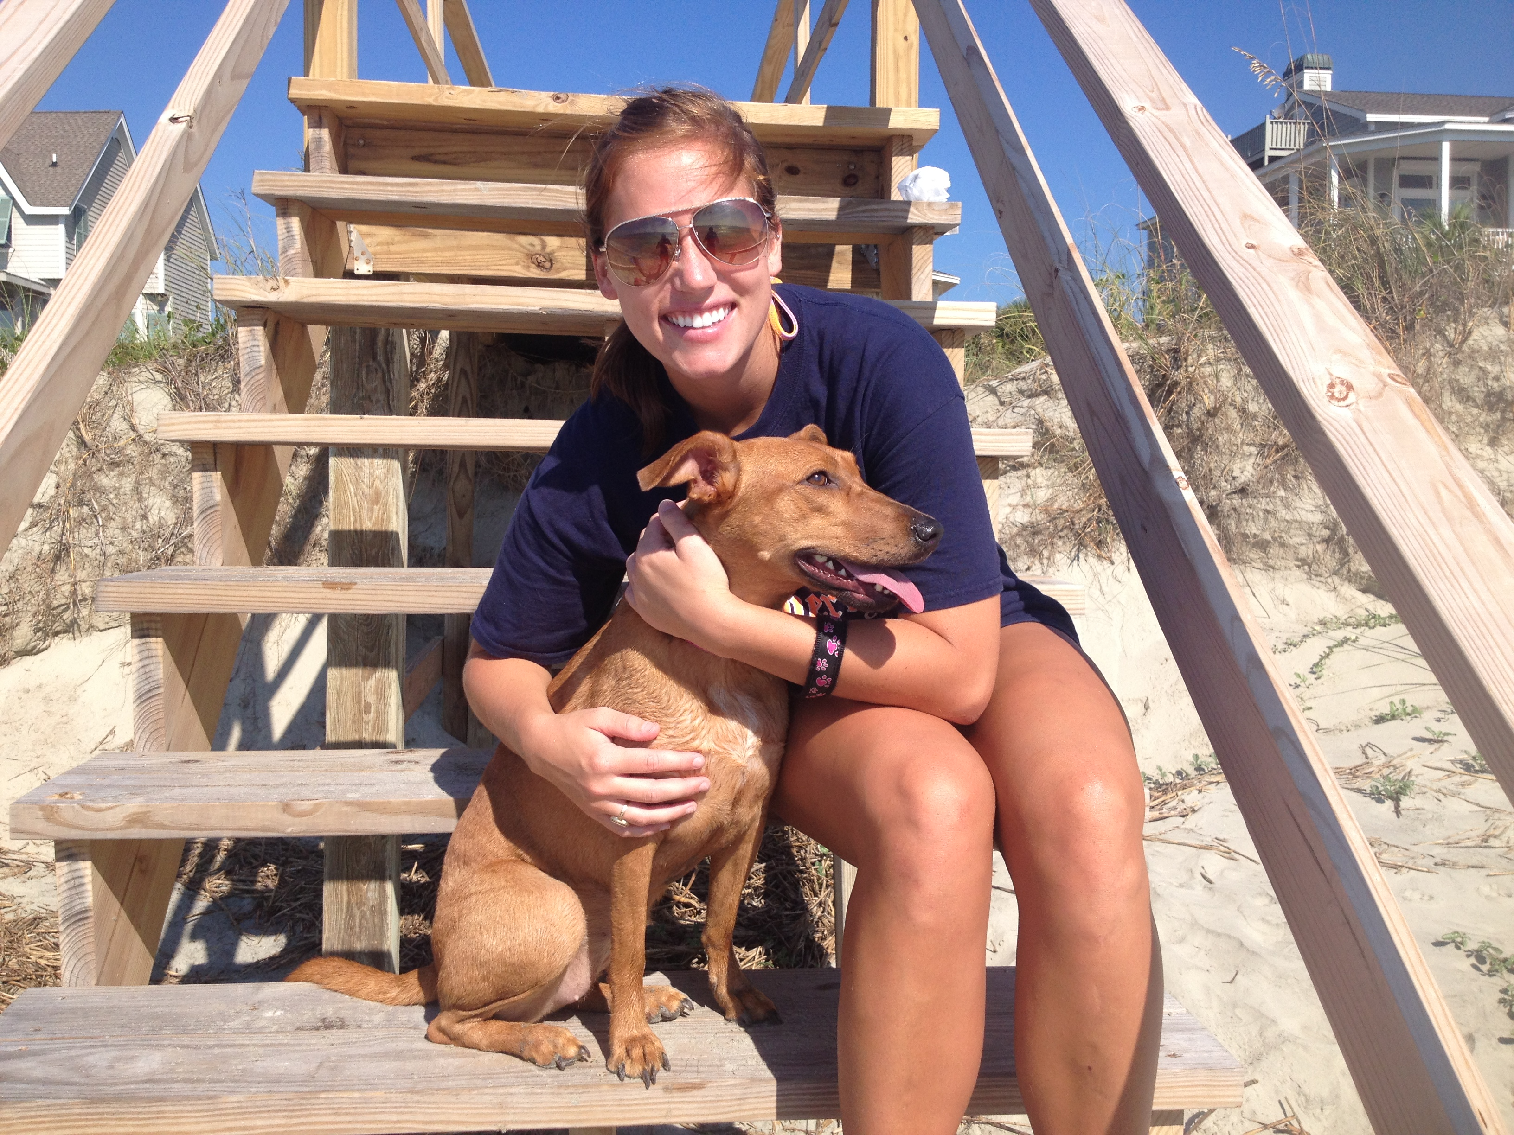
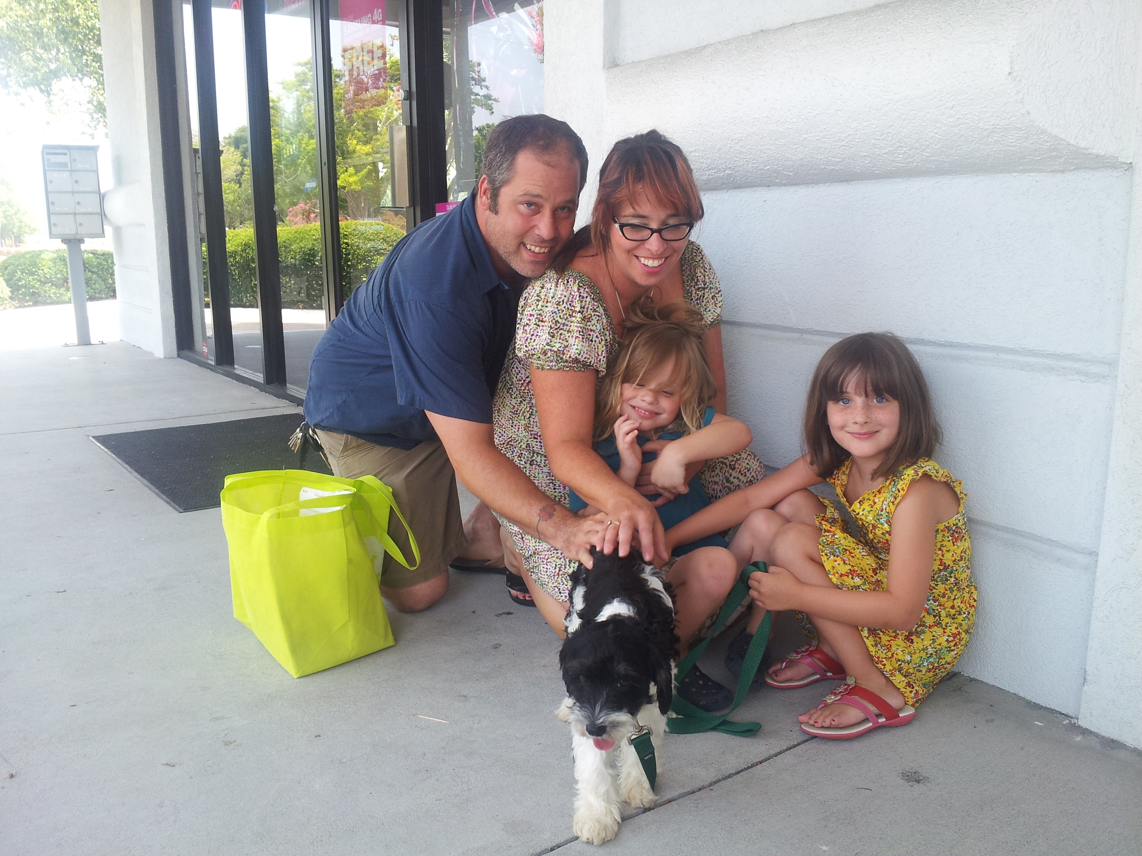
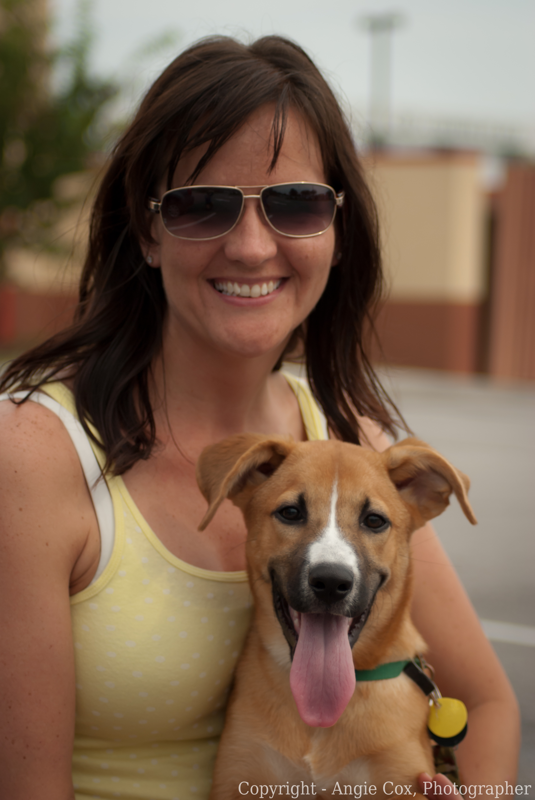
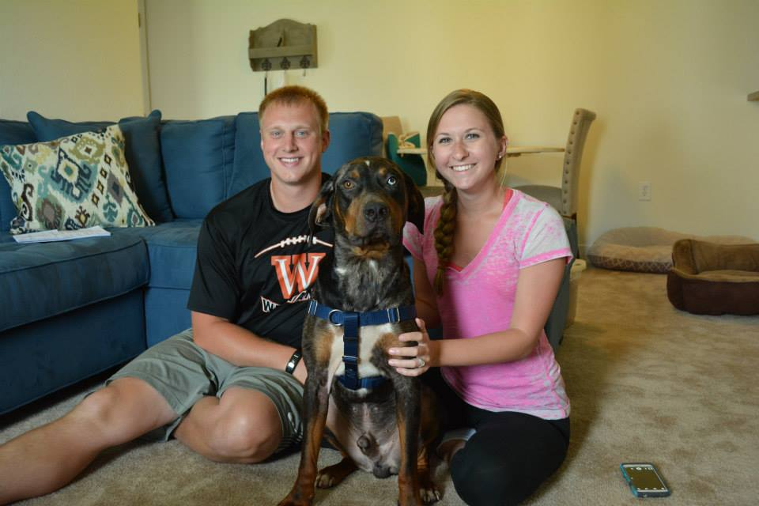

Slide 24
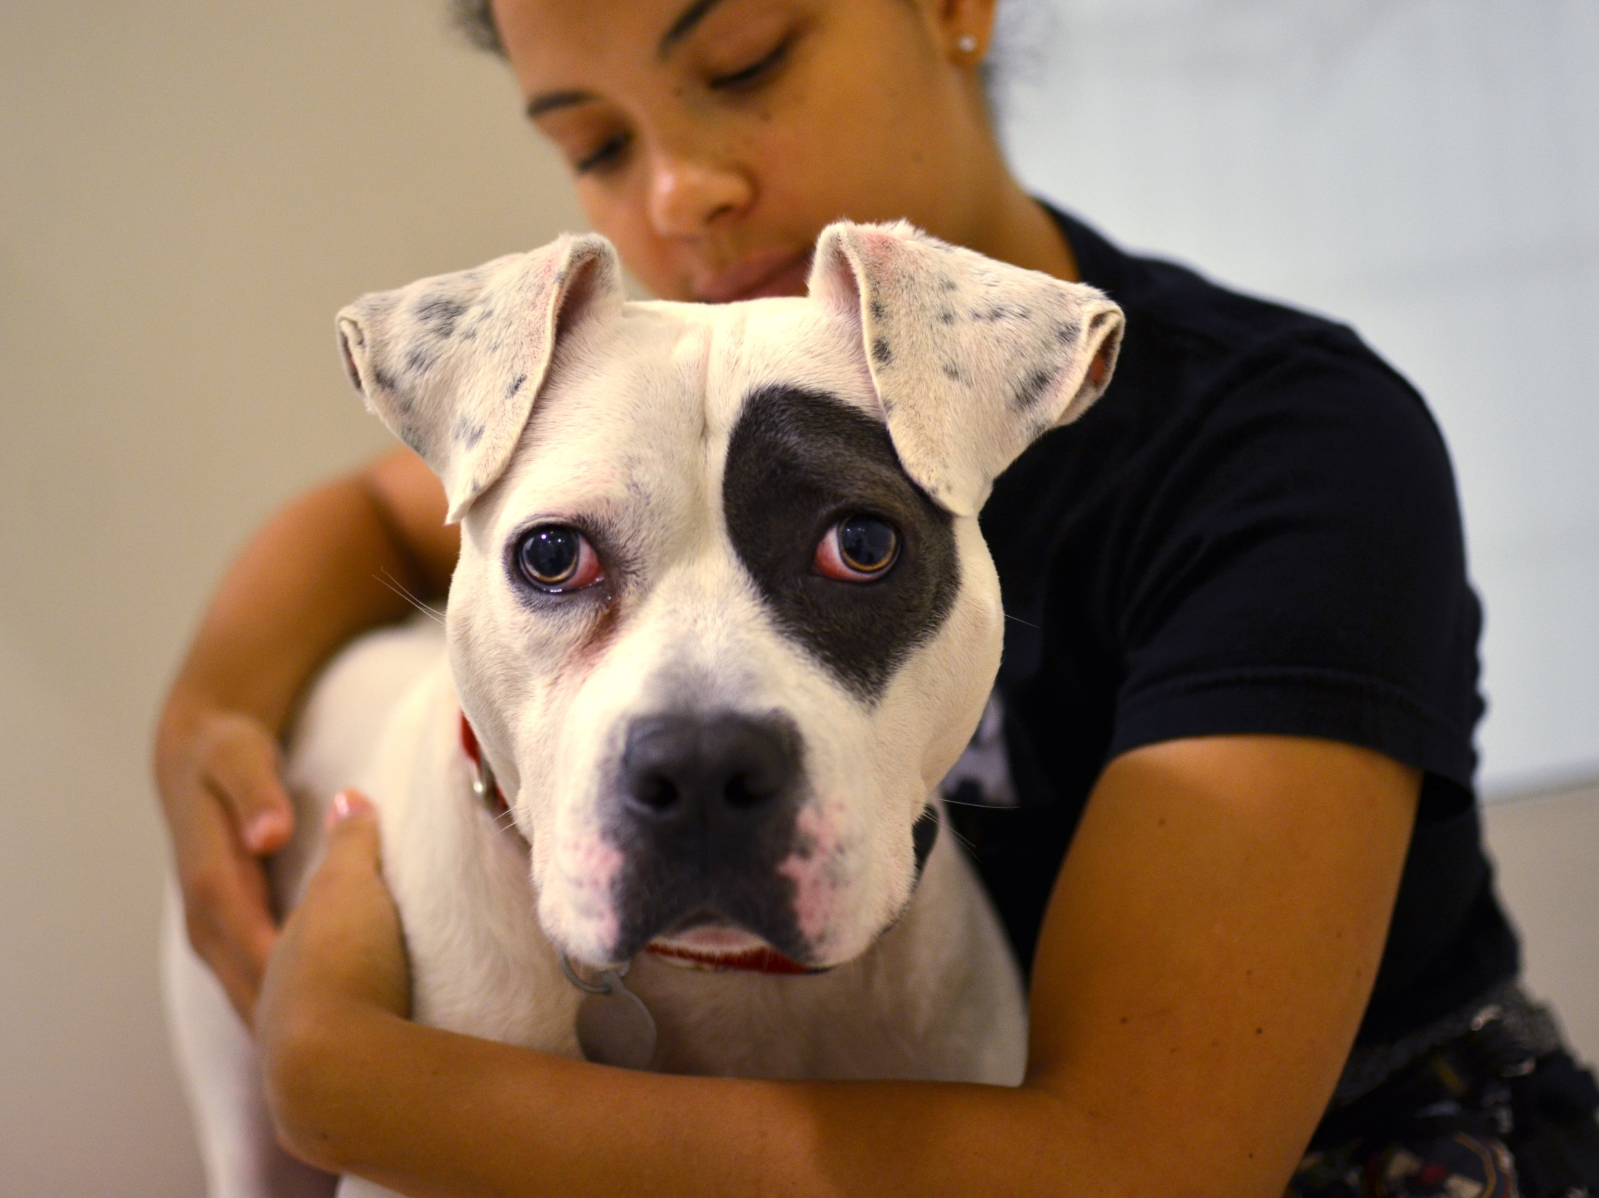
Q&A
Notes:
And now we’d like to take your questions…

Slide 25




Become a Publicity Hound with the ASPCA’s
October 2018
Notes:
Before you go, we want to take a moment to make sure you don’t miss out on the ASPCA’s Find Your Fido, which is a social media campaign to help shelters and rescues just like yours get more dogs adopted during next month’s Adopt a Shelter Dog Month.
What do you get if you sign up? You’ll get free EXCLUSIVE webinars from social media powerhouses like Facebook and The Dodo. They’ll teach you how to make the most of both your regular organic posts and your paid ads. If you want to know how to use the FB algorithm to your organization's advantage, you won’t want to miss these webinars available only to those who register for the FYF campaign. The first one is on Thursday, September 27.
Additionally, we’ll provide you with video tutorials to help you master social media and will cover topics like how to do Instagram Stories and livestream and more.
Every shelter or rescue that signs up will be featured on the ASPCA FYF webpage—this will be great exposure for your organization because during the entire month of October we’ll be encouraging our animal-loving followers across the country to visit this page where they’ll be able to learn more about your organization.

Slide 26

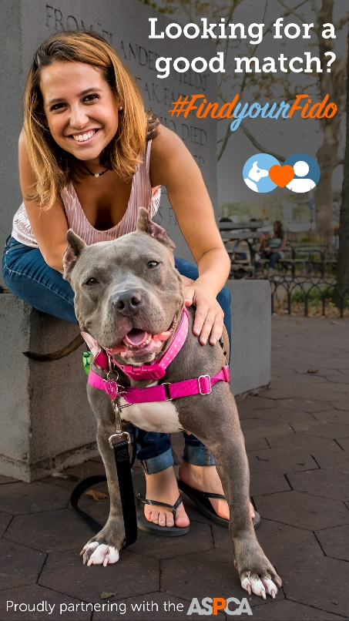

Register by September 21 www.ASPCApro.org/fyf
  Free Resources
Notes:
You’ll receive ready-made FYF-branded shareable graphics, like what you see here, that you can customize for your social media. And we’ll even give you with a social media guide complete with sample posts. And we have a few branded chalkboards left that you can use in your social media posts, but hurry it’s first come, first served. You can register for the campaign by visiting this URL

