Slide 1
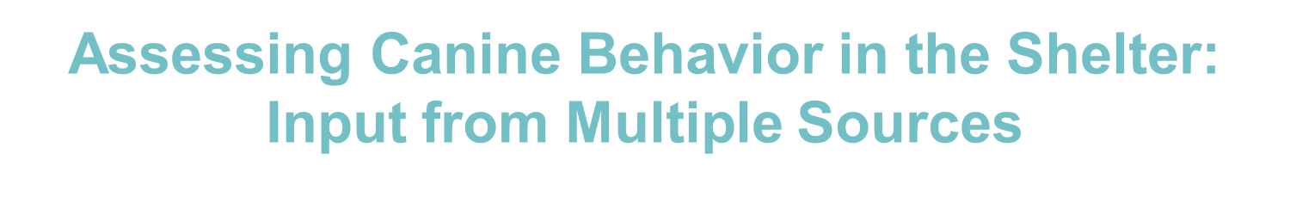

Kendra Sinclair
Strategic Partner Manager for North American Nonprofits
Facebook
Kristen Collins, MS, ACAAB
Vice President, Behavioral Rehabilitation Center
ASPCA Policy, Response & Engagement
Pamela Reid, PhD, CAAB
Vice President, Anti-Cruelty Behavior Team
ASPCA Policy, Response & Engagement

Slide 2
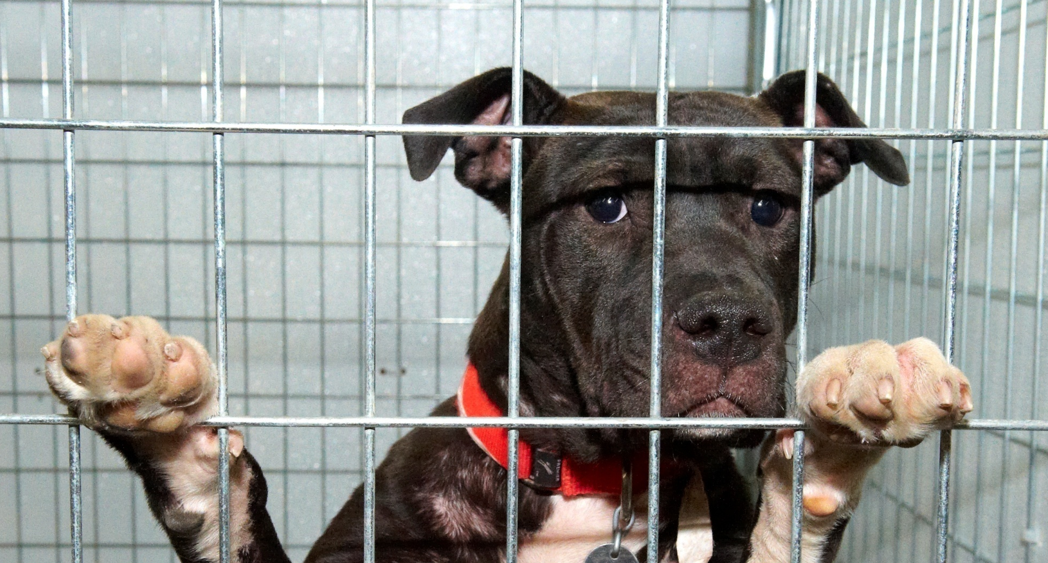

Assessing Behavior
in the Shelter: Part 2
Notes:
Hi, and welcome! Dr. Reid and I are excited to be here today to talk with you about this fascinating, complex and sometimes controversial topic. This is Part 1. We’ll be digging into the ASPCA’s new position statement on assessing canine behavior in the shelter today, including some info about animal behavior, some key points we feel are most important and what we do and don’t know when it comes to research on the topic. Next week, same time, same bat channel, we’ll talk about the how in part 2. Principles and ideas are important to discuss, but how to implement them---how to really put them into practice is a whole other can of worms.

Slide 3
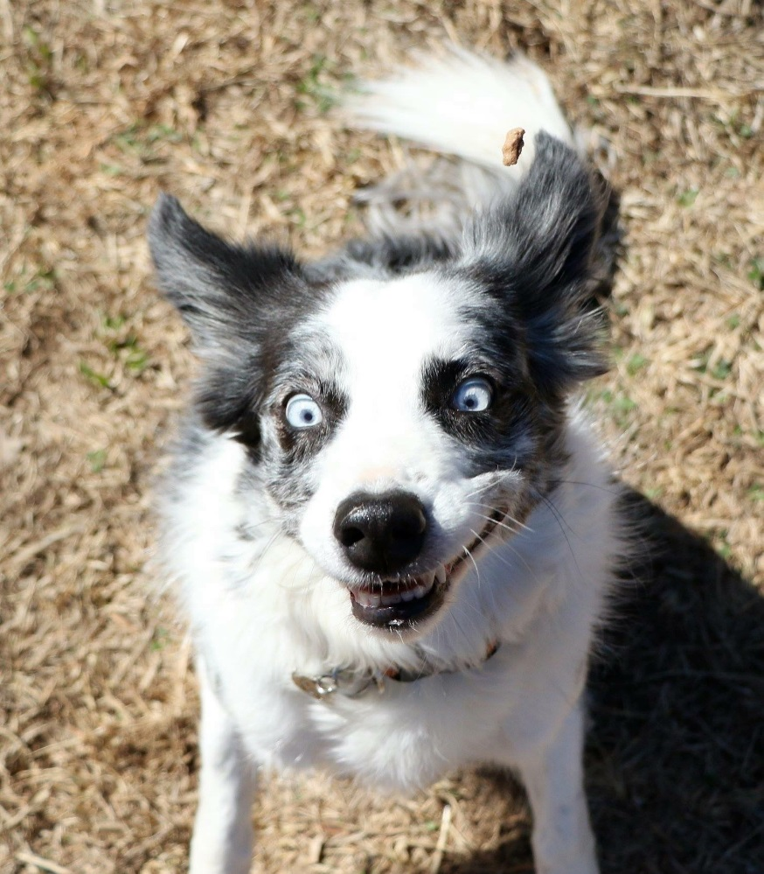
Agenda: The How
Sources:
pros and cons
How to collect info
What to do with your info
Notes:
Best source of info? Best behavior evaluation? ????
Don’t throw the baby out with the bathwater. We might not know a lot, but we should do our best to gather as much objective info as possible from as many sources as possible.
The ASPCA acknowledges that (a) it is still unknown whether any particular source of information is more predictive of future behavior in a home than any other and (b) current scientific thinking on the usefulness of behavior assessments in predicting aggressive behavior is inconclusive. Behavior assessments have not proven highly accurate or precise when used to predict aggression after adoption. It has been suggested that a significant number of dogs exhibiting aggression on an assessment do not do so in a home. For these reasons, the ASPCA maintains that euthanasia decisions should not be based solely on a dog’s behavior during an assessment or in any other single situation unless the aggression is egregious*. If a dog shows behavior that might warrant euthanasia, we recommend that organizations only make such a decision when the behavior has been reported by multiple sources.

Slide 4
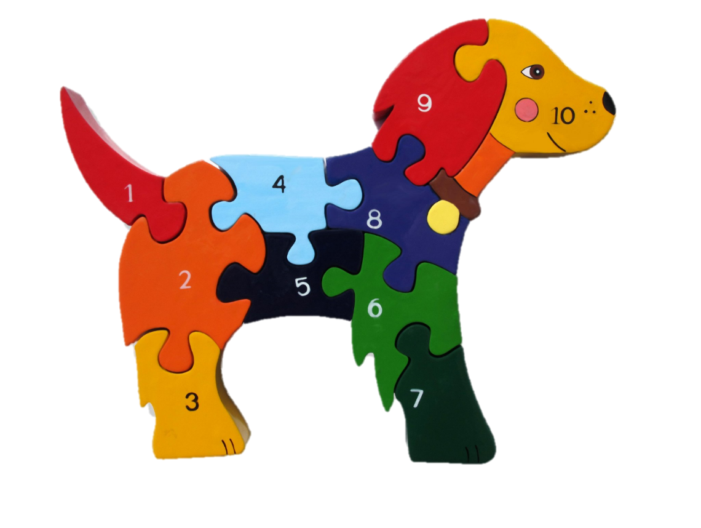
Key Points
Know what we don’t know
Strike the balance between
taking the time to gather
info and making quick
decisions
Use objective language
Plan information flow
Gather info from multiple
sources: puzzle pieces
Image COPYRIGHT © 2018. Alphabet Jigsaws Ltd. ALL RIGHTS RESERVED.
Notes:
Best source of info? Best behavior evaluation? ????
Don’t throw the baby out with the bathwater. We might not know a lot, but we should do our best to gather as much objective info as possible from as many sources as possible.
The ASPCA acknowledges that (a) it is still unknown whether any particular source of information is more predictive of future behavior in a home than any other and (b) current scientific thinking on the usefulness of behavior assessments in predicting aggressive behavior is inconclusive. Behavior assessments have not proven highly accurate or precise when used to predict aggression after adoption. It has been suggested that a significant number of dogs exhibiting aggression on an assessment do not do so in a home. For these reasons, the ASPCA maintains that euthanasia decisions should not be based solely on a dog’s behavior during an assessment or in any other single situation unless the aggression is egregious*. If a dog shows behavior that might warrant euthanasia, we recommend that organizations only make such a decision when the behavior has been reported by multiple sources.

Slide 5
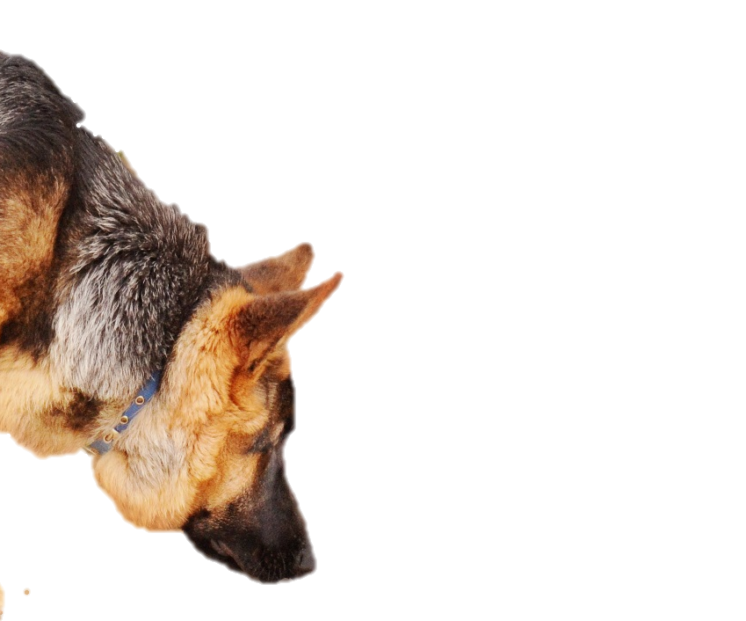
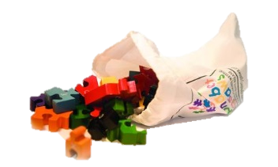
The Puzzle Pieces
Image COPYRIGHT © 2018. Alphabet Jigsaws Ltd. ALL RIGHTS RESERVED.

Slide 6



behavior team observations
foster reports
info from person who found dog
intake/
daily care staff observations
behavior evaluation(s)
info from medical team
owner reports
volunteer observations
adopter intros
playgroup
observations
Notes:
There’s A LOT of info you could collect. This is awesome. This is also overwhelming.

Slide 7
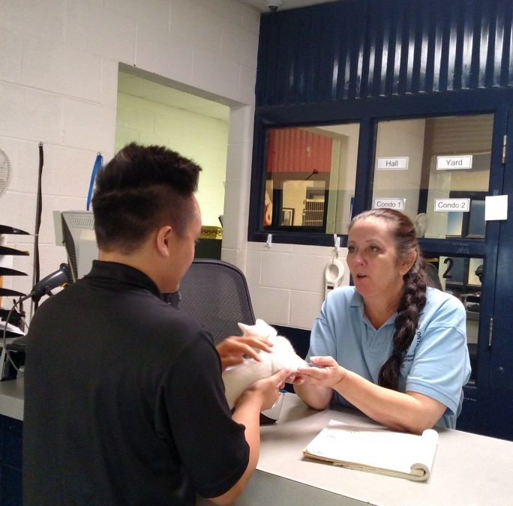
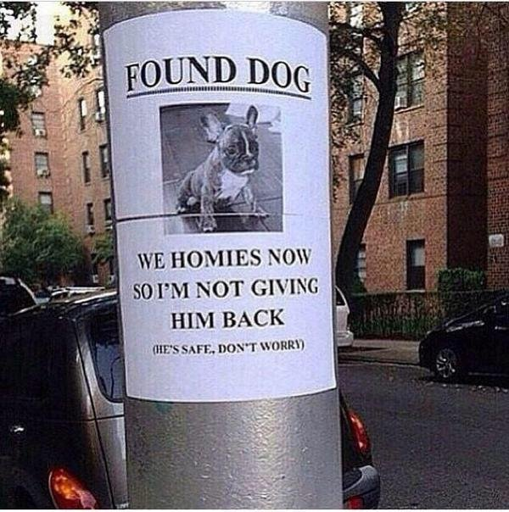
1. Info when found, relinquished or returned
Notes:
FOUND
Sometimes people who find an animal keep it for a time before bringing it to the shelter. Maybe they try to find the owner themselves or they find it during a time when the shelter is closed or it’s inconvenient for them to come or they think they might want to keep it and then change their mind.
Obviously only available for some animals. Value of this information is a function of the extent and nature of the interactions between the finder and the animal.
Presumably use the same process as for gathering info from relinquishing owner.
No research on this source of info.
OWNER
This person knows the animal better than anyone else. How best to extract that information? Informal interview or some type of questionnaire?
Obviously not available for all animals. Requires staff to spend time with relinquisher. Special type of person who can be non-judgmental.
Relevant studies: D’Arpino (maybe Segurson). Rebecca Ledger. Serpell. I believe Serpell discounted Segurson.
Ledger compared relinquisher rpts with owner rpts 2 wks and 6 wks post-adoption
Some behaviors correlated: sep anx, agg to vet, fear at vet clinic, agg to strangers, dog aggression

Slide 8

Research suggests that owners may be more truthful when completing a questionnaire like
C-BARQ (short version)
Notes:
A face-to-face interview may bias the owner toward giving answers they believe the shelter staff wants.
You can record the responses on paper or digitally. You want to make sure each animal has their own folder with all the information accumulated in one location (paper folder, digital folder, customized database)
Same if dog is being transferred from another shelter – have someone who is familiar with the dog fill out the questionnaire

Slide 9
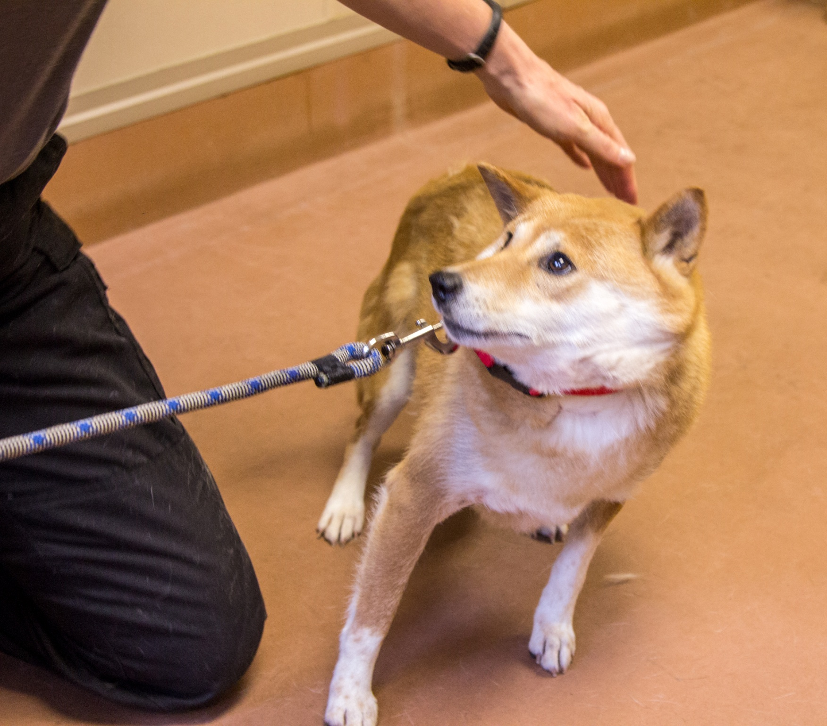
2. Intake observations
Welcome to the shelter!
Notes:
Animals undergo some form of intake process, even if it’s just taking the animal to a kennel.

Slide 10
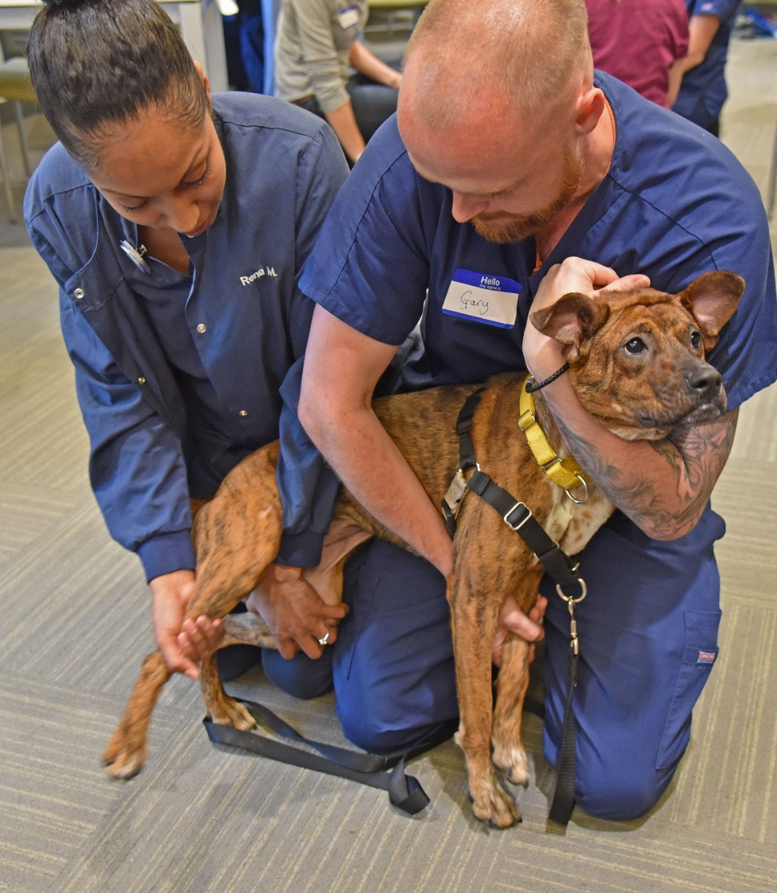
3. Medical exam observations
Notes:
Likely to happen shortly after intake anyway.
Efficient
The animal may have pre-existing bad associations with medical people/procedures.
The animal may be in pain.
The animal may react atypically to excessive restraint.
Likely to occur when animal first arrives and is highly stressed.
It is crucial to be aware that any dog’s behavior during an exam may not be very reflective of his normal behavior. How he behaves may be influenced by his discomfort with the procedures being performed during the exam and his past experience with medical procedures. Some dogs that are tolerant of people in every other situation may become defensively aggressive or extremely fearful when handled by medical personnel or when experiencing excessive restraint. Still important information to have but an aggressive or severely fearful response may by highly situation-specific.
No specific research

Slide 11
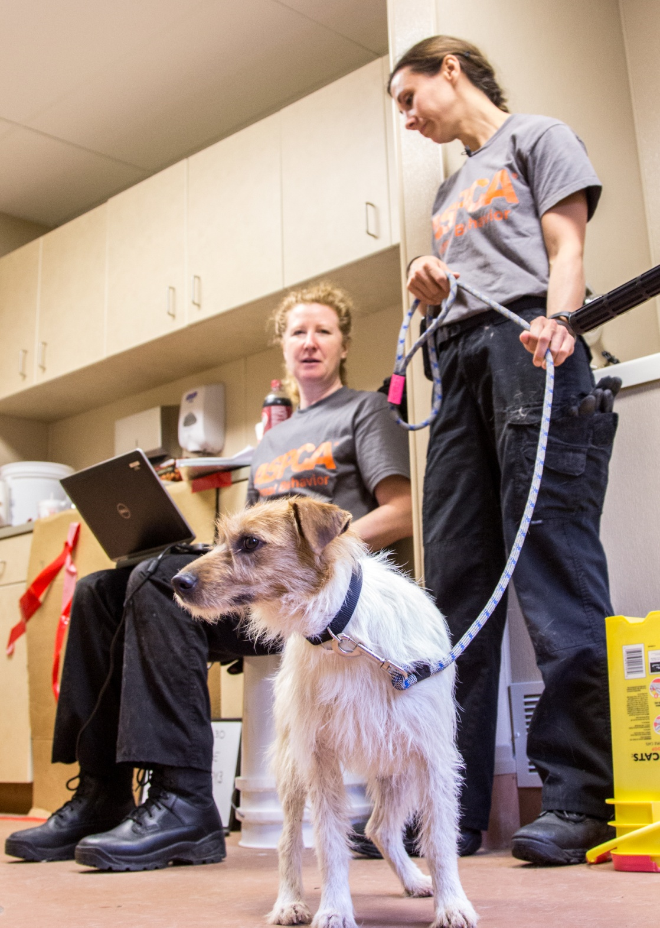
4. Behavior evaluations

Slide 12
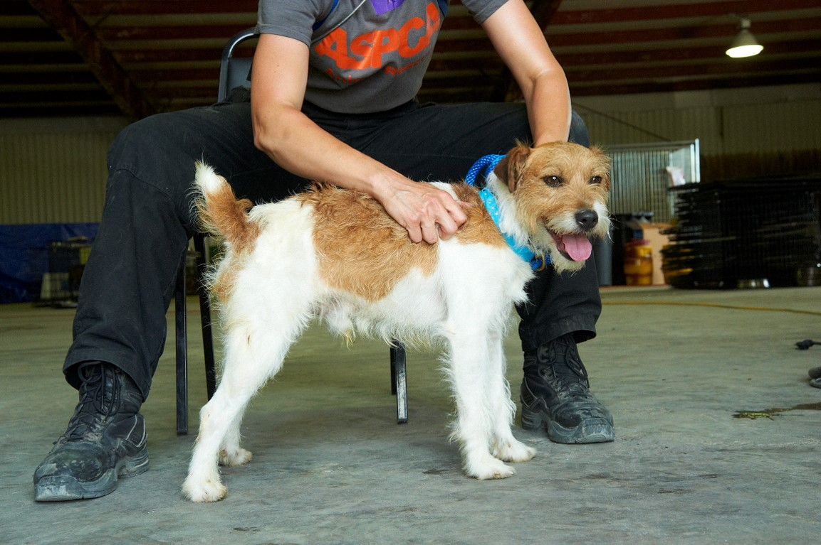
4. Behavior evaluations
Just a snapshot – and just one puzzle piece
When to evaluate?
Examples
  Fast-track cases
  More info needed
Notes:
VIDEOS HERE

Slide 13
Click to view Zeke
Notes:
VIDEOS HERE

Slide 14
Click to view Freida
Notes:
VIDEOS HERE

Slide 15
Click to view Dale
Notes:
VIDEOS HERE

Slide 16
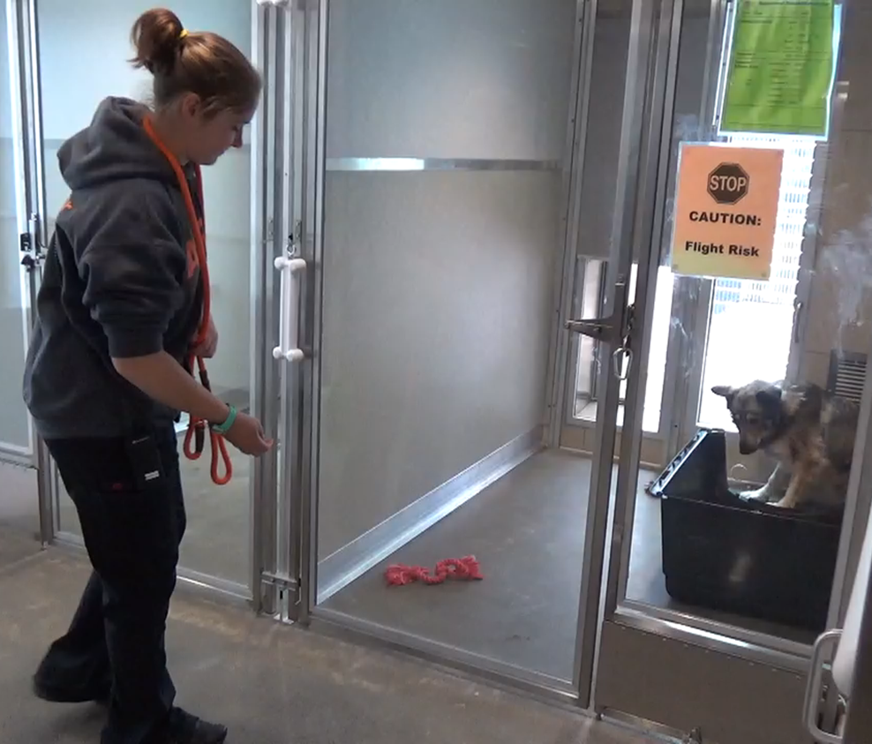
5. Daily care team observations
Notes:
Daily care staff interacts with the animal at least once a day, during routine shelter procedures, such as cleaning, feeding, & moving.
Research suggests that people are often reluctant to disclose problems with a dog because they don’t want to get a dog “in trouble.” Therefore, this source of information may be biased toward positive feedback. In addition, staff and volunteers that are untrained in animal behavior may misinterpret behaviors or be unable to recognize more subtle instances of fearful or aggressive behavior.
Van der Borg et al study. Dated study but only one I know that compared DC staff reports with something else – in their case they compared with the results of a behavior evaluation.

Slide 17
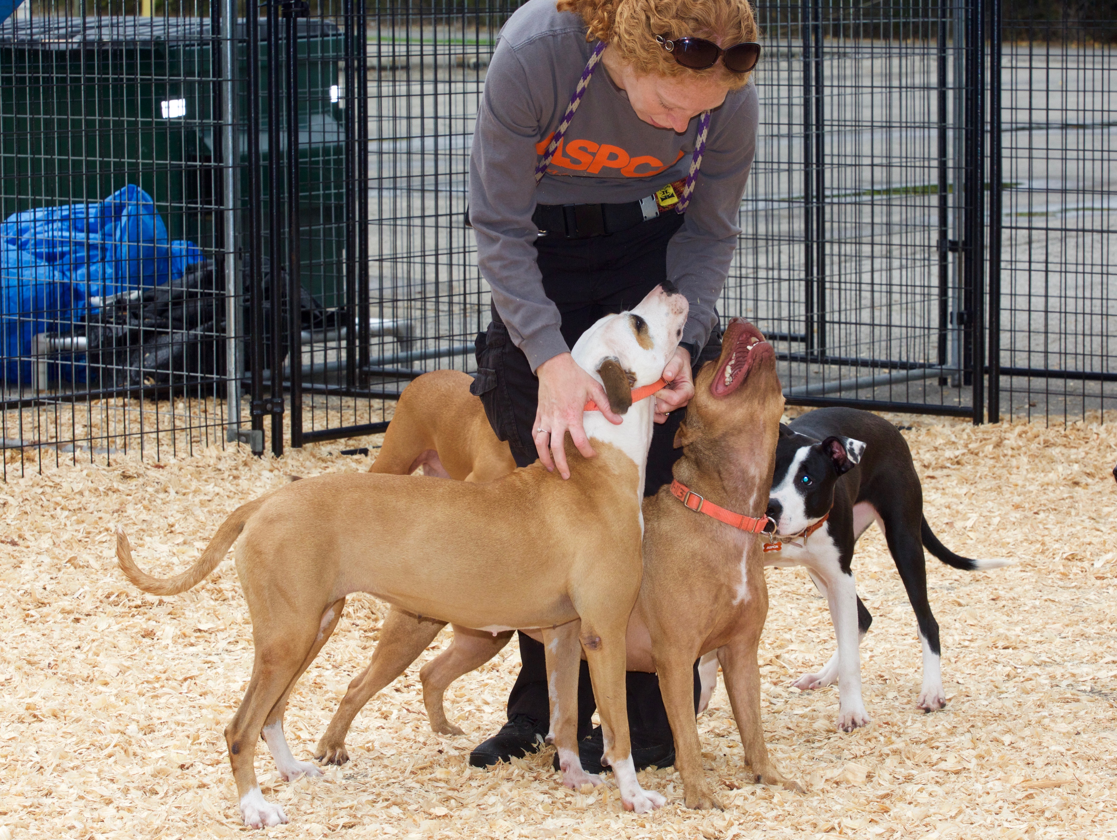
6. Playgroups
Notes:
Super valuable form of enrichment for dog-social dogs. Very efficient use of staff time (get dogs out of cages for cleaning, multiple dogs enriched by few staff, physical exercise, mental stimulation, social interaction with conspecifics and people, fresh air for dogs housed inside). Emphasize need for human supervision!!!!!!
The biggest drawback of playgroup observations is that a dog’s motivation to play with other dogs may completely overwhelm his desire to interact with people.
Some dogs’ anxiety in playgroup situations may inhibit their behavior in general. Not enjoyable for a dog that’s super anxious.

Slide 18

www.dogsplayingforlife.com
Notes:
For training on implementing playgroups, contact DPFL.
A couple of research projects exist (I don’t think peer reviewed) – pretty weak

Slide 19
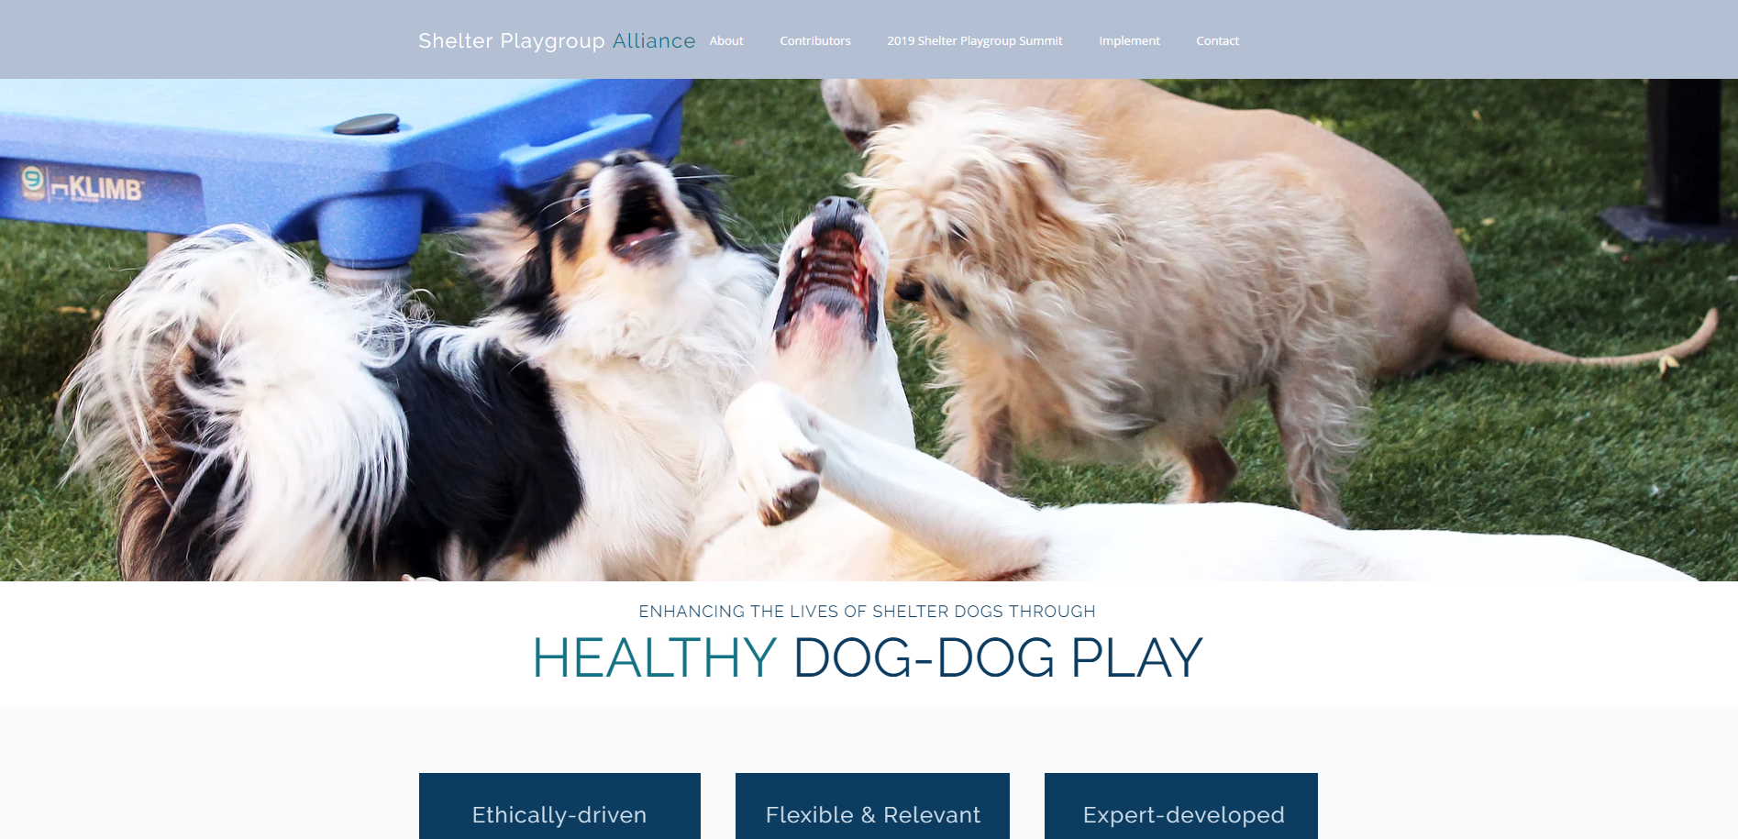
www.shelterdogplay.org

Slide 20
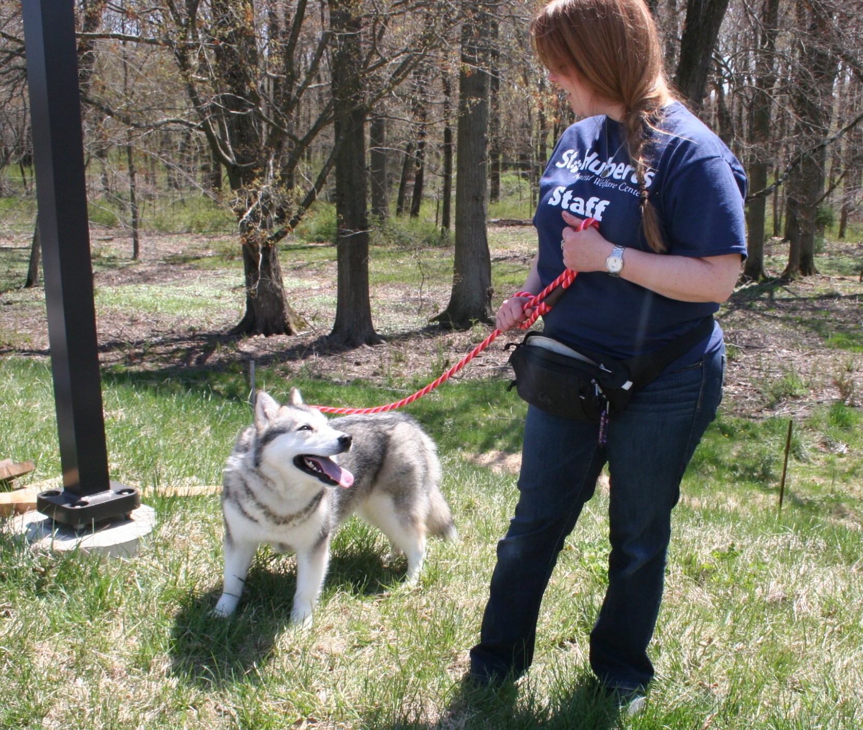
7. Walks outside
Notes:
This is an important form of enrichment for dogs (and perhaps some cats) that should be implemented in every shelter. Walks may be conducted by staff or volunteers. These are dogs that are hopefully going to live as family pets, so it’s valuable to know how they behave on walks.
Information is subject to the same limitations as mentioned previously. May be biased toward positive information. May be inaccurate due to inability of person to read subtle body language signals.
No research to my knowledge

Slide 21
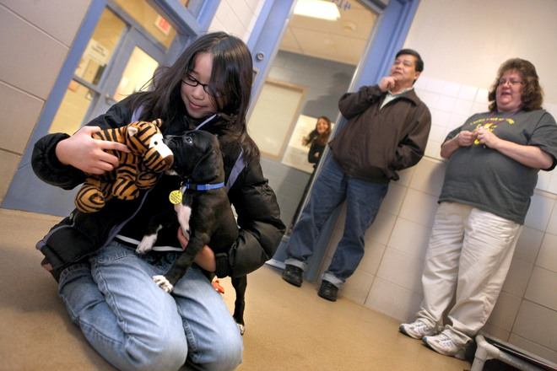
8. Adopter intros
Notes:
Also important to glean information from potential adopters who interact with the animal.
May be only way to gather info about animal’s reaction to children

Slide 22
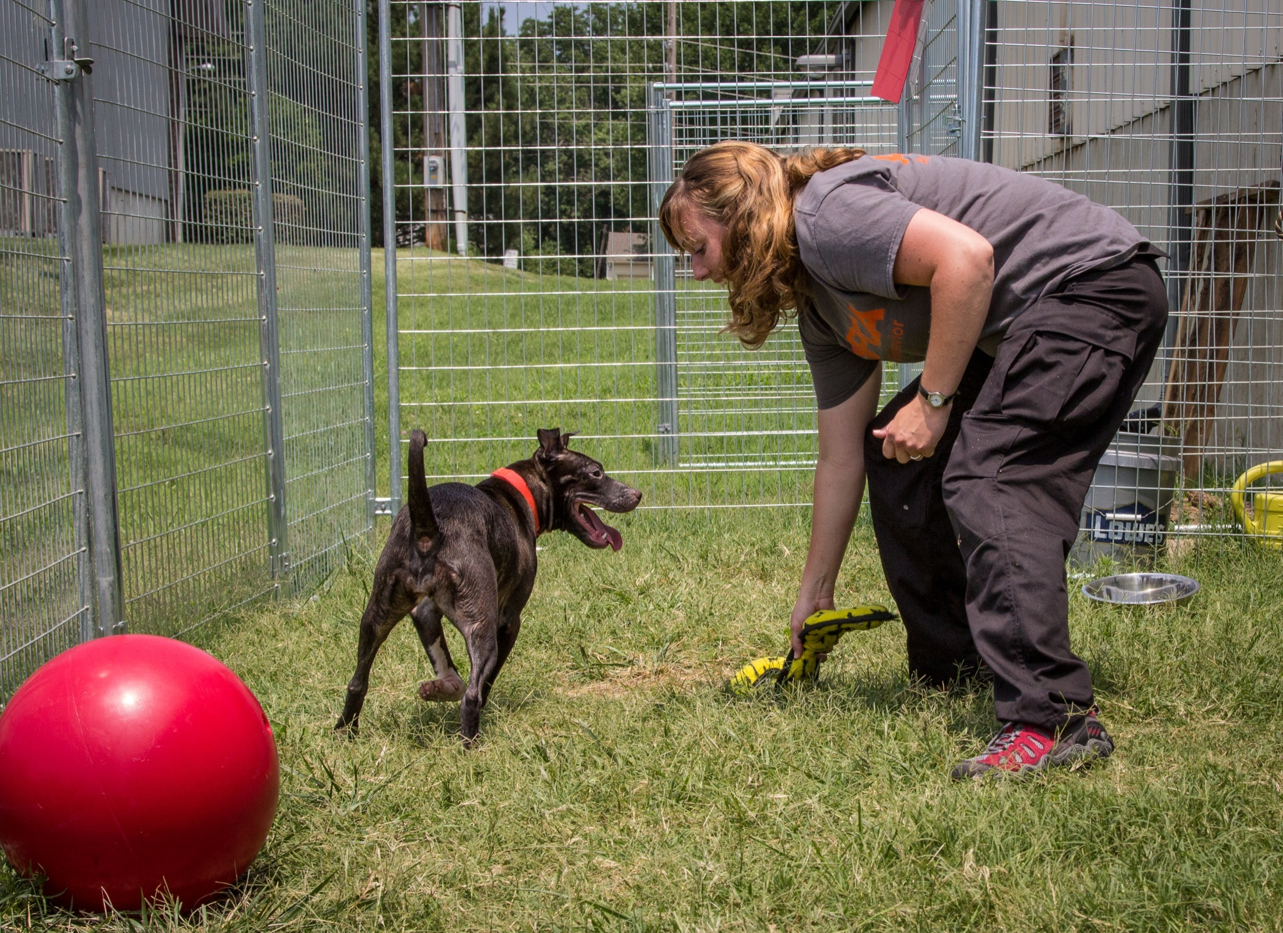
9. Socialization or b-mod sessions
Notes:
Socialization sessions are an important form of enrichment that should be implemented in every shelter. They may be conducted by staff or volunteers. These are animals that are hopefully going to live as family pets, so it’s crucial to learn if they enjoy the company of people.
Information is subject to the same limitations as mentioned previously. May be biased toward positive information. May be inaccurate due to inability of person to read subtle body language signals.
No research that I know of.

Slide 23
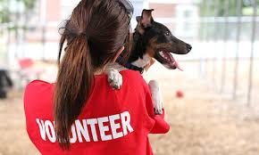
10. Volunteer interactions
Notes:
Shelters with volunteer programs may involve their volunteers in routine shelter procedures, such as cleaning, feeding, & moving---or volunteers may provide walks, playtime or socialization sessions.
Research suggests that people are often reluctant to disclose problems with a dog because they don’t want to get a dog “in trouble.” Therefore, this source of information tends to be biased toward positive feedback. In addition, staff and volunteers that are untrained in animal behavior may misinterpret behaviors or be unable to recognize more subtle instances of fearful or aggressive behavior.
Van der Borg et al study. Dated study but only one I know that compared DC staff reports with something else – in their case they compared with the results of a behavior evaluation.

Slide 24
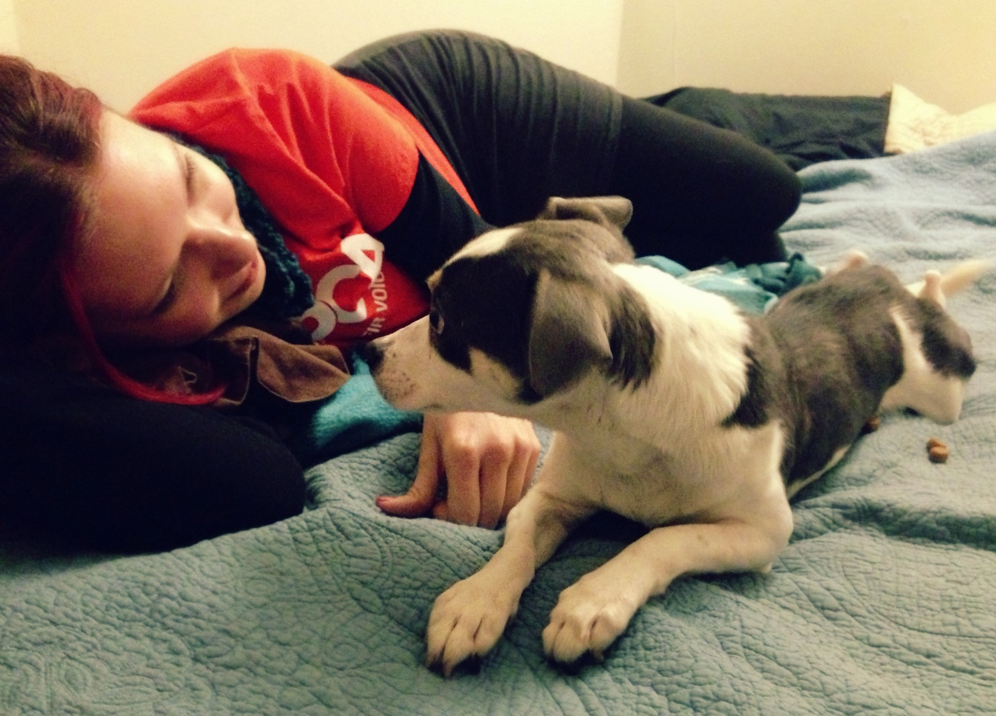
11. Foster home info
Notes:
Presumably the most predictive of the animal’s actual behavior in an adoptive home.
Value of information is a function of the length of stay in the home.
Research confirms that even a one or two-night stay improves a shelter dog’s quality of life while away from the shelter.
A stay with an experienced fosterer can be invaluable for determining if a behaviorally challenging dog is safe or can experience an acceptable quality of life in a home.
This option can be resource and time-intensive and should be considered carefully if placement in a foster home means limiting the dogs’ access to potential adopters. Dogs displaying undesirable behavior in the kennel or those with long lengths of stay may benefit the most from time away from the shelter to reduce stress and increase the chance of adoption.
Need Lisa Gunther’s research findings that cortisol levels drop during the foster stay (but resume when the dog returns to the shelter)

Slide 25
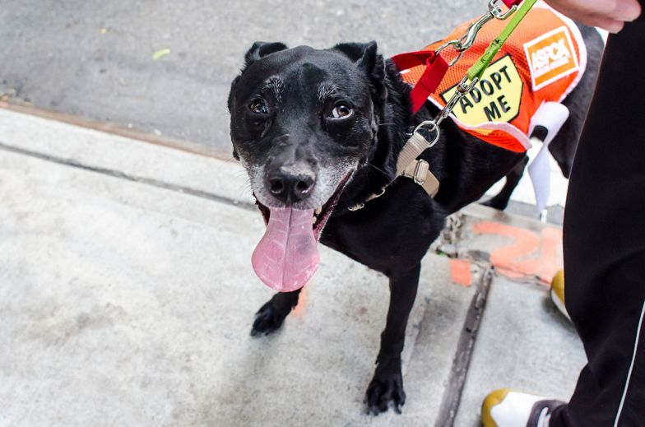
Adoption Ambassadors
Notes:
http://journals.plos.org/plosone/article?id=10.1371/journal.pone.0091959
During the study, only 7% of dogs who were adopted through the Adoption Ambassador program were returned to the shelter, compared to 17% of dogs adopted directly from the shelter.
Twenty-four percent of adopters considered information provided about their dog by the foster family when making a decision to adopt, whereas only 3% of regular shelter adopters factored information from shelter personnel in the decision. This difference could represent adopters going into relationships with more realistic expectations about their animals, resulting in fewer returns.
Results from CAS show 29% of Adoption Ambassador adopters got previous pets from a shelter or rescue. Since 93% of the adopters in the study reported they were already considering getting a dog before they adopted, it’s likely adopters who could have chosen a dog from another source—such as a breeder or pet store—adopted instead.
The Charleston research found that the majority of people adopting directly from the shelter (81%) first saw their dogs when visiting the shelter. The Adoption Ambassador adopters first learned about their dogs in these ways: Internet, including social media (54%); from a friend (18%); seeing a dog wearing an Adopt Me vest in public (15%).

Slide 26
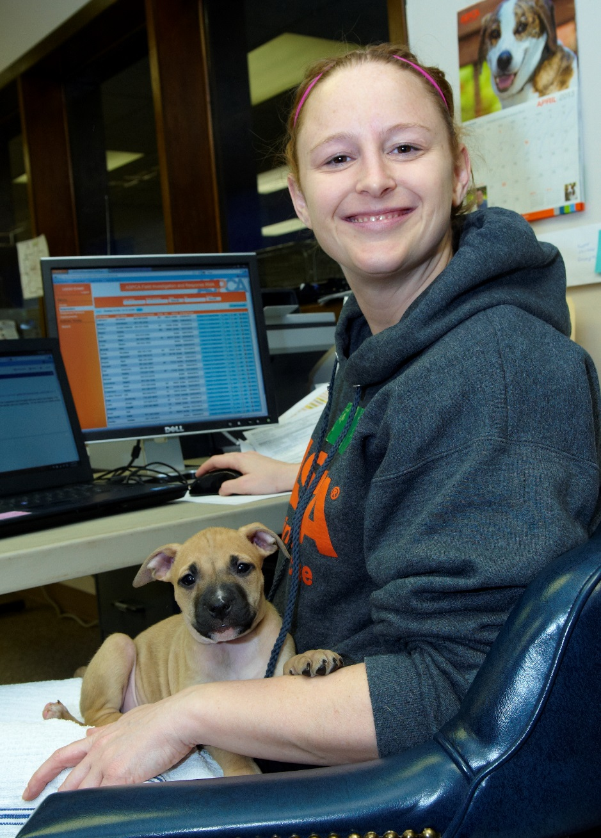
Info Collection

Slide 27
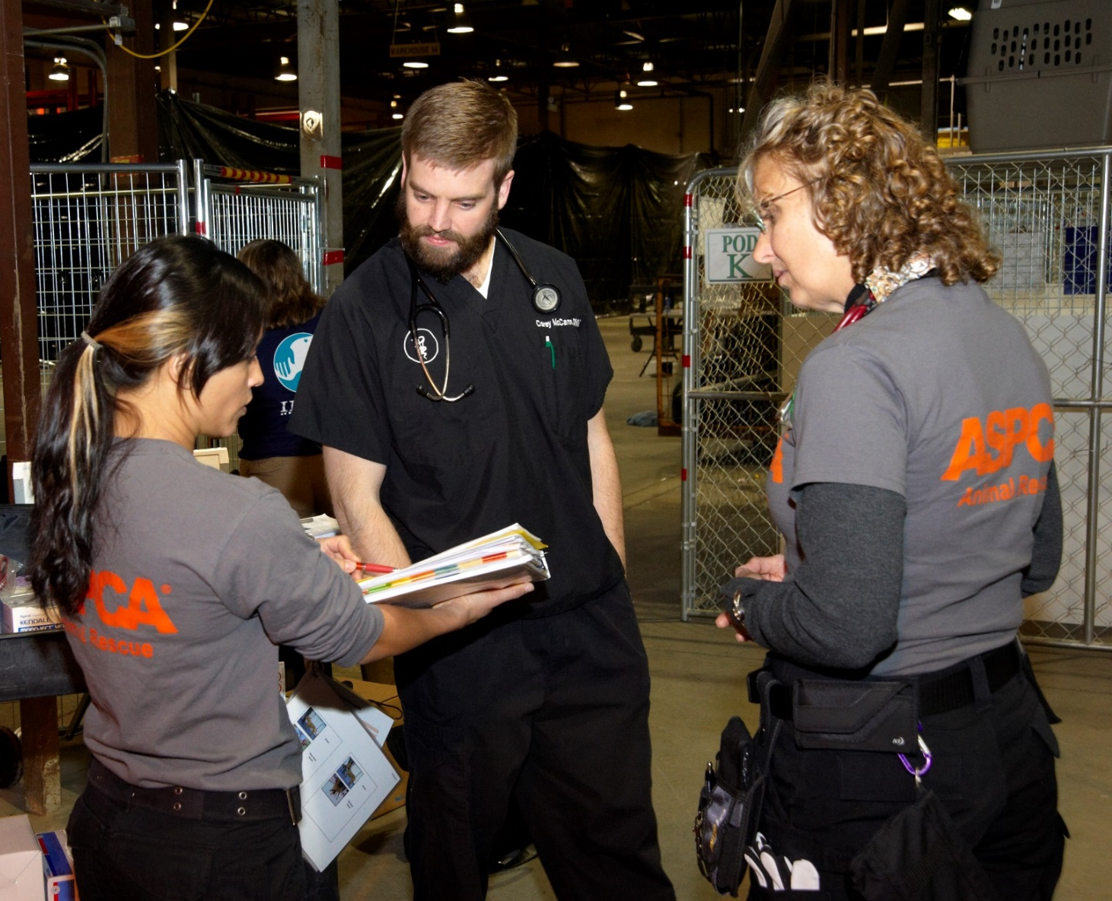
Conversation-Based Collection
Notes:
Actively seek out the information; ask vet & techs: how was the dog when you did this? Did the dog react when you opened his mouth?
Here, staff focused on behavior can guide data collection

Slide 28
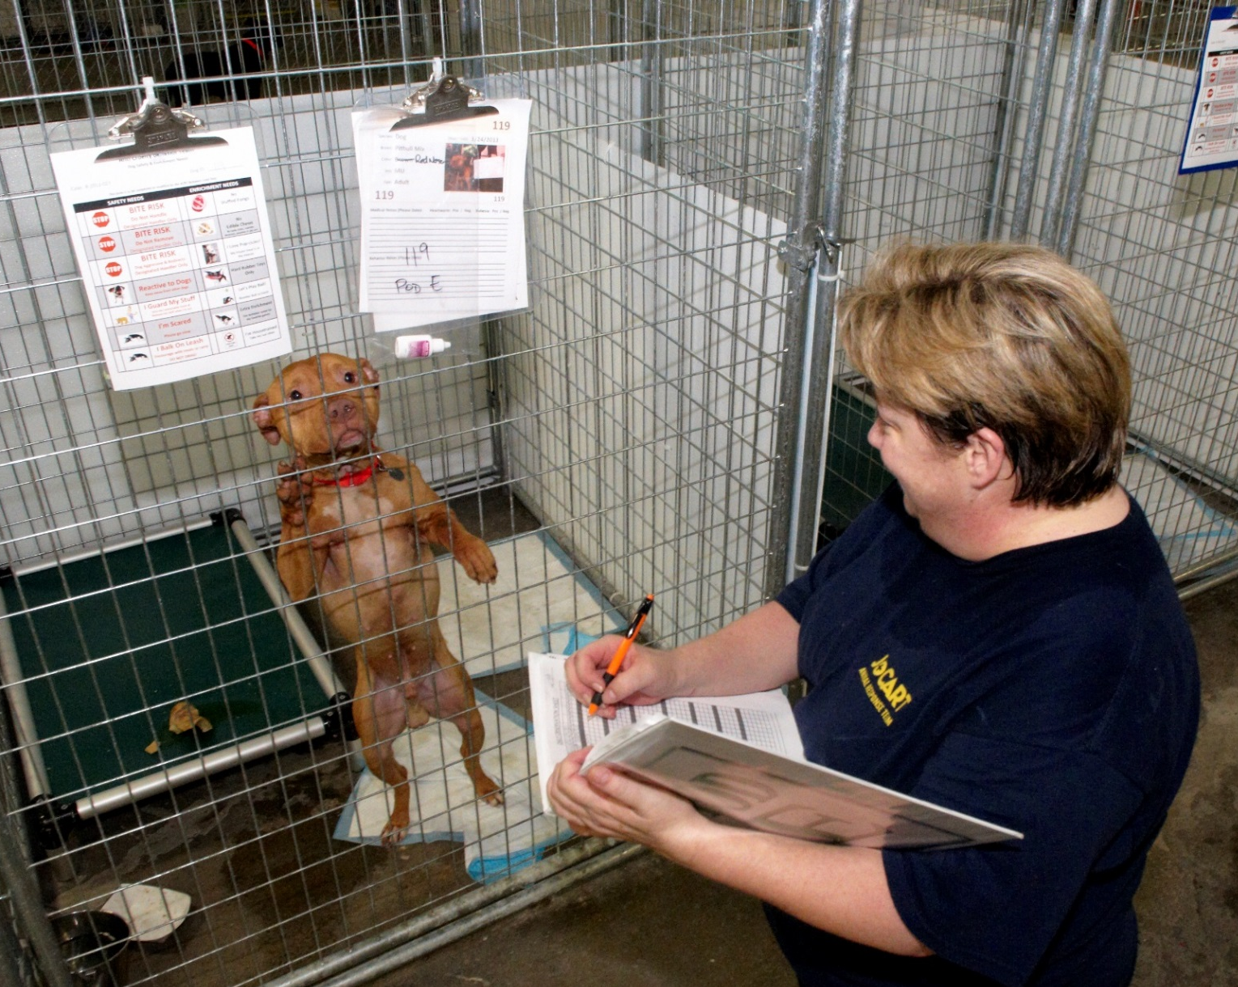
Written Logs & Forms
Notes:
Important to make it as easy as possible for people to record pertinent information
Forms on the kennel are easy but the data end up having to be transcribed by someone

Slide 29
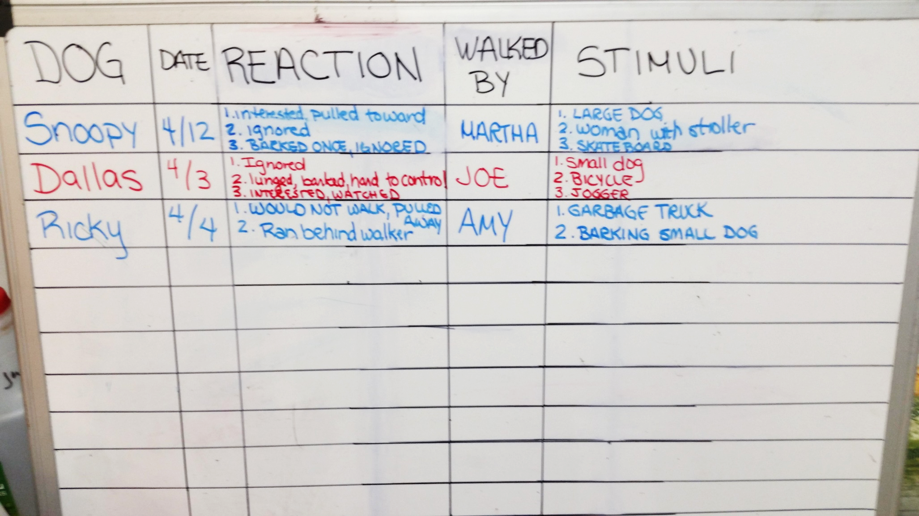
Whiteboards
Notes:
A walk can reveal much about a dog’s behavior: his enthusiasm for getting out of his kennel, his comfort with having his collar held and a leash applied, how he reacts to other dogs as he walks down the shelter aisle, his interest in interacting with the handler versus checking out the environment, his confidence in novel and outdoor environments, his inclination to pull on the leash and his willingness to return to the kennel (a place that some dogs perceive as unpleasant).
Also may be the only opportunity to observe a dog’s reaction to children, joggers, bicycles, skateboards, etc.

Slide 30
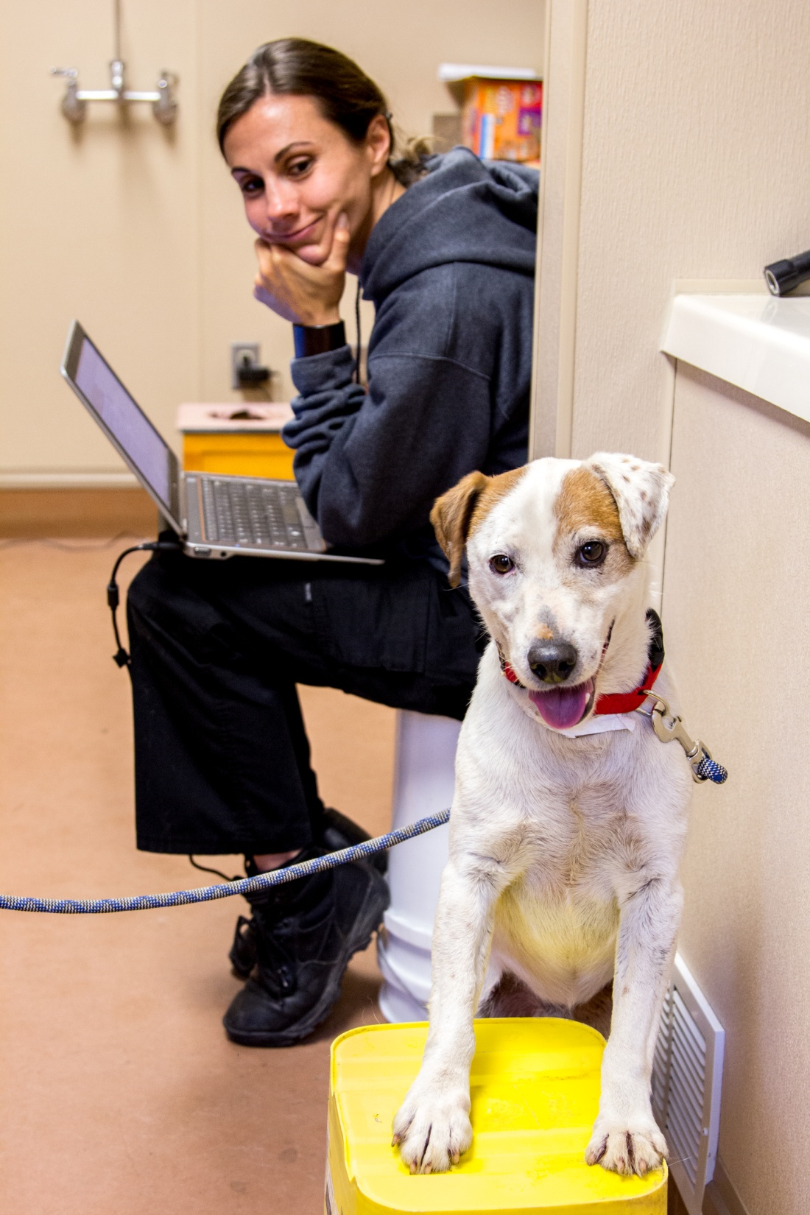
Technology
PetPoint, Shelter Buddy or other shelter software
Excel
Customized databases

Slide 31
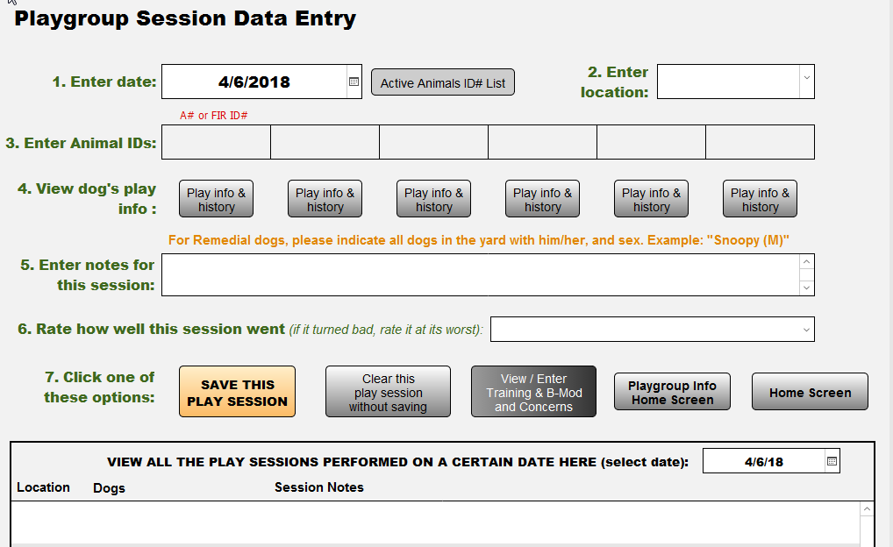
Database: Playgroup Info
Notes:
Example from our customized DB
Provides a wealth of information about how a dog responds to people and other dogs when off-leash in an enclosed area. How playful and energetic is he? How much does he interact with people or dogs instead of exploring the environment? How does the dog respond to corrections from other dogs and how appropriately does he deliver corrections to other dogs?
A dog’s behavior toward other dogs while in a playgroup is particularly valuable because it is not affected by leash-induced frustration or barrier-related aggression.
Depending on the situation, the dog may also reveal how he responds to people intervening in his interactions with other dogs (verbal corrections, physical restraint, etc.) and to punishers, should their use be necessary for the purposes of interrupting inappropriate behavior or a dogfight (water spray, shake can, compressed air, etc.).

Slide 32
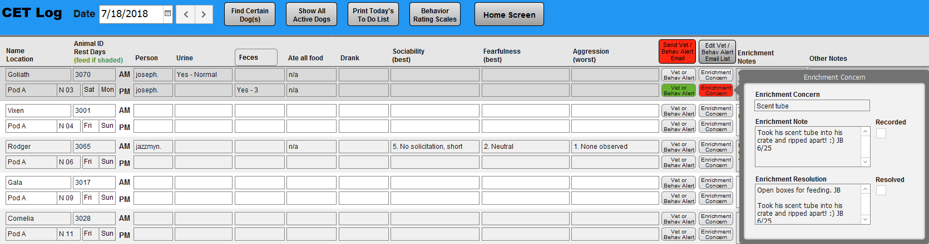
Database: BRC CET Log
Observations re: health (eating, drinking, signs of potential illness or injury)
Observations re: behavior
  Fearfulness, using a 5-point scale
  Use of enrichment items
Notes:
Example from our customized DB
Provides a wealth of information about how a dog responds to people and other dogs when off-leash in an enclosed area. How playful and energetic is he? How much does he interact with people or dogs instead of exploring the environment? How does the dog respond to corrections from other dogs and how appropriately does he deliver corrections to other dogs?
A dog’s behavior toward other dogs while in a playgroup is particularly valuable because it is not affected by leash-induced frustration or barrier-related aggression.
Depending on the situation, the dog may also reveal how he responds to people intervening in his interactions with other dogs (verbal corrections, physical restraint, etc.) and to punishers, should their use be necessary for the purposes of interrupting inappropriate behavior or a dogfight (water spray, shake can, compressed air, etc.).

Slide 33
Database: BRC CET Log
Observations re: health (eating, drinking, signs of potential illness or injury)
Observations re: behavior
  Fearfulness, using a 5-point scale
  Use of enrichment items
Notes:
Example from our customized DB
Provides a wealth of information about how a dog responds to people and other dogs when off-leash in an enclosed area. How playful and energetic is he? How much does he interact with people or dogs instead of exploring the environment? How does the dog respond to corrections from other dogs and how appropriately does he deliver corrections to other dogs?
A dog’s behavior toward other dogs while in a playgroup is particularly valuable because it is not affected by leash-induced frustration or barrier-related aggression.
Depending on the situation, the dog may also reveal how he responds to people intervening in his interactions with other dogs (verbal corrections, physical restraint, etc.) and to punishers, should their use be necessary for the purposes of interrupting inappropriate behavior or a dogfight (water spray, shake can, compressed air, etc.).

Slide 34
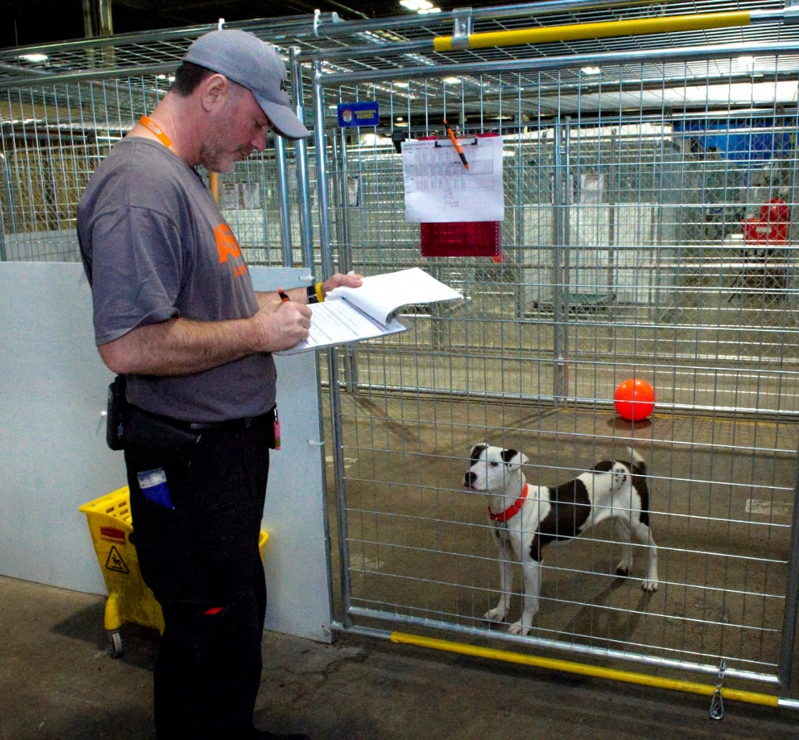
Make It Fast & Easy
Notes:
Create efficiencies.
Make it easy for people to record their observations! Provide tools: laptops, ipads, forms at the ready, pens, COWs….
Reinforce participation
Make your forms (electronic or paper) EASY: check boxes, drop-down menus
You probably want to include specific questions with additional room for comments.
Is the dog motivated to interact with people?
Does the dog enjoy petting?
Does he enjoy playing with people?
Is he content just to hang out with a person?
Does he respond to common verbal instructions, such as “Sit,” “Down,” and “Come?”
Is he eager to perform behaviors to earn treats?

Slide 35
Standardize & Use
Objective Language
Notes:
Close your eyes. Can you see what happened? I can’t.

Slide 36

Standardize & Use
Objective Language
Notes:
Forms with check boxes, etc., help in this way, too.
Do workshops with ALL teams: teach same language: behavior + body language = clear reporting
Scales and vocabulary lists = shortcuts (BRC team and fearfulness scales used by all)
Make sure you address what you want people to tell, how you want it told, when/how often you want it told (mention “Don’t you know already?”
Mention comments from Alexandra about separating out good stuff and bad stuff: make it useful for YOUR team

Slide 37
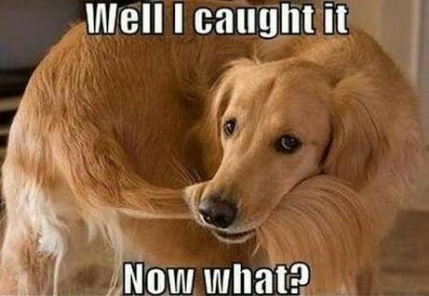
Using the Info

Slide 38
Streamline Your Process
Collect & Compile
1.
Review
2.
Act/Decide
3.
Notes:
Act means do stuff AND push info back in the other direction
And also don’t forget that once you have all the info, you need tools, like criteria, to use it consistently and efficiently

Slide 39



Info From the Many to the Few
behavior team observations
owner reports
behavior evaluation(s)
playgroup
observations
info from person who found dog
intake/
daily care staff observations
info from medical team
volunteer observations
foster reports
adopter intros

Slide 40
Info From the Many to the Few

Slide 41

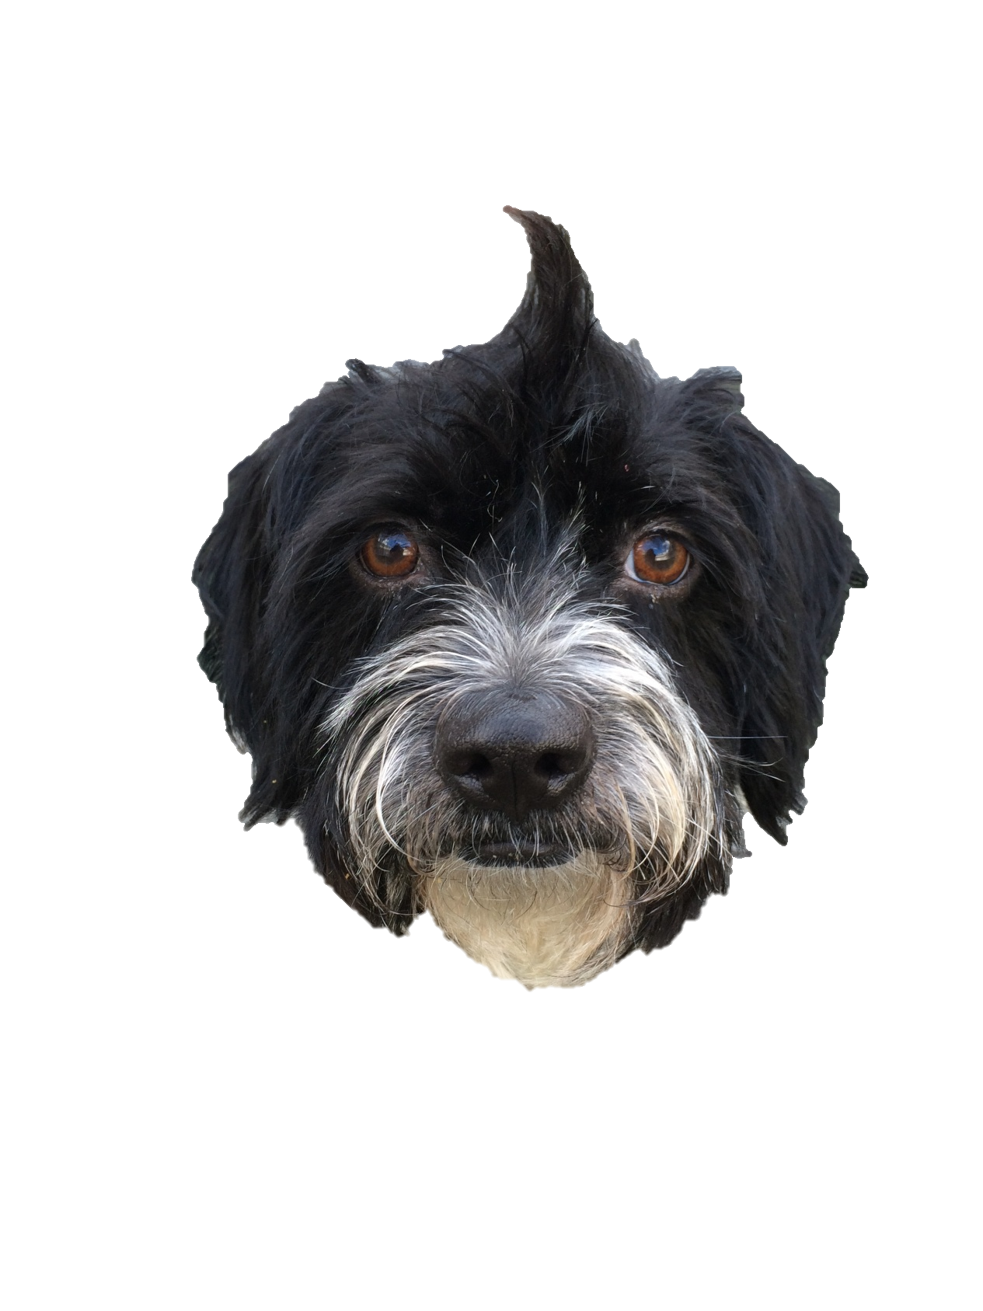
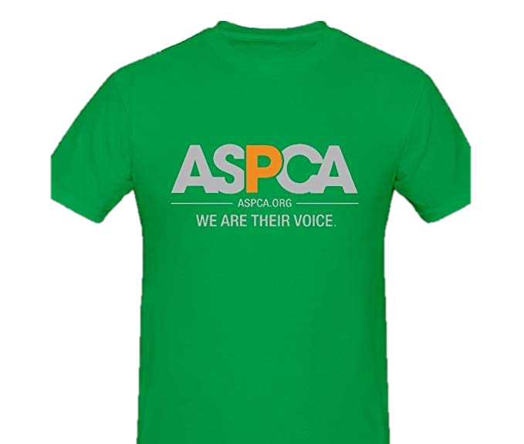

Everyone Is
The Behavior Team
Shelter
Operations
Veterinary
Medicine
Animal
Behavior

Slide 42
Example Org Chart
DIRECTOR, VETERINARY SERVICES
DIRECTOR, OPERATIONS
DIRECTOR, BEHAVIOR
Vet Techs
MANAGER, BEHAVIOR
VOLUNTEER MANAGER
MANAGER,
DAILY CARE
ADOPTIONS
MANAGER
Behavior Team
Volunteers
Daily Care Team
Adoption Counselors

Slide 43
Example Org Chart
DIRECTOR, VETERINARY SERVICES
DIRECTOR, OPERATIONS
DIRECTOR, BEHAVIOR
Vet Techs
MANAGER, BEHAVIOR
VOLUNTEER MANAGER
MANAGER,
DAILY CARE
ADOPTIONS
MANAGER
Behavior Team
Volunteers
Daily Care Team
Adoption Counselors

Slide 44
Example Org Chart
DIRECTOR, VETERINARY SERVICES
DIRECTOR, OPERATIONS
DIRECTOR, BEHAVIOR
Vet Techs
MANAGER, BEHAVIOR
VOLUNTEER MANAGER
MANAGER,
DAILY CARE
ADOPTIONS
MANAGER
Behavior Team
Volunteers
Daily Care Team
Adoption Counselors

Slide 45
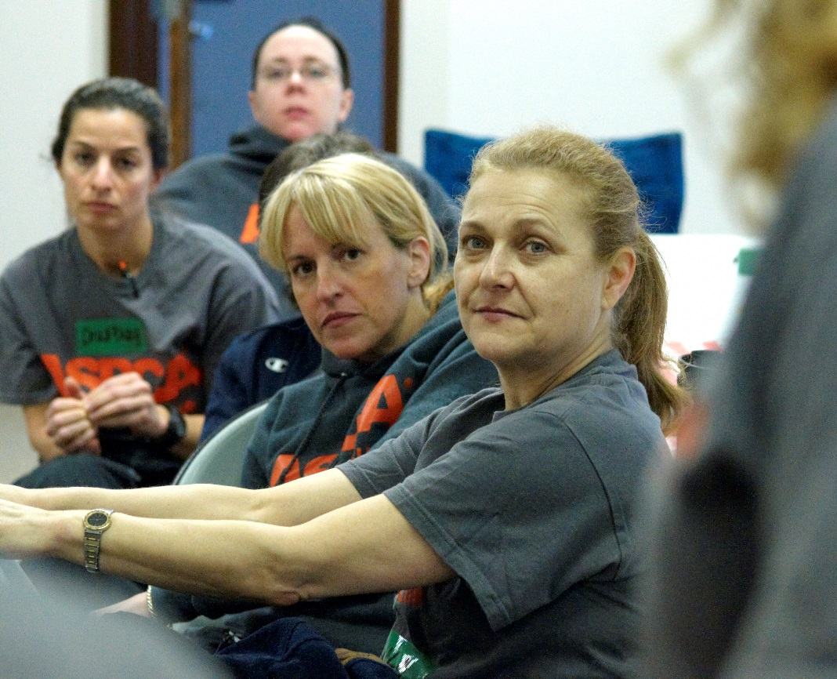
Getting the Few Together
Daily rounds with Ops, Medical, Behavior
Outcome decision meetings
Notes:
Benefits: decrease length or stay, make swift outcome decisions, improve QoL of animals while in shelter

Slide 46
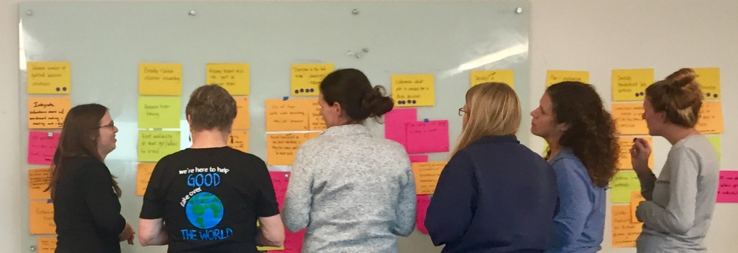
Outcome Decisions: Tools
Quality of Life Scale
Guidelines for Adoptability
Guidelines for Inclusion in Behavior Modification Program
Notes:
Benefits: decrease length or stay, make swift outcome decisions, improve QoL of animals while in shelter
One size does not fit all: if you haven't already, get your team leads together and workshop

Slide 47


Reverse Flow: Internal
Operations Teams
Medical Staff
Behavior Team
Notes:
Leadership transparent & action for animals facilitated:
All staff: outcome decisions (in teams or as group)
Ops: adoptions (info for adopters), care (cage cards)
Behavior team: treatment tweaks

Slide 48
Example Org Chart
DIRECTOR, VETERINARY SERVICES
DIRECTOR, OPERATIONS
DIRECTOR, BEHAVIOR
Vet Techs
MANAGER, BEHAVIOR
VOLUNTEER MANAGER
MANAGER,
DAILY CARE
ADOPTIONS
MANAGER
Behavior Team
Volunteers
Daily Care Team
Adoption Counselors

Slide 49
Example Org Chart
DIRECTOR, VETERINARY SERVICES
DIRECTOR, OPERATIONS
DIRECTOR, BEHAVIOR
Vet Techs
MANAGER, BEHAVIOR
VOLUNTEER MANAGER
MANAGER,
DAILY CARE
ADOPTIONS
MANAGER
Behavior Team
Volunteers
Daily Care Team
Adoption Counselors

Slide 50
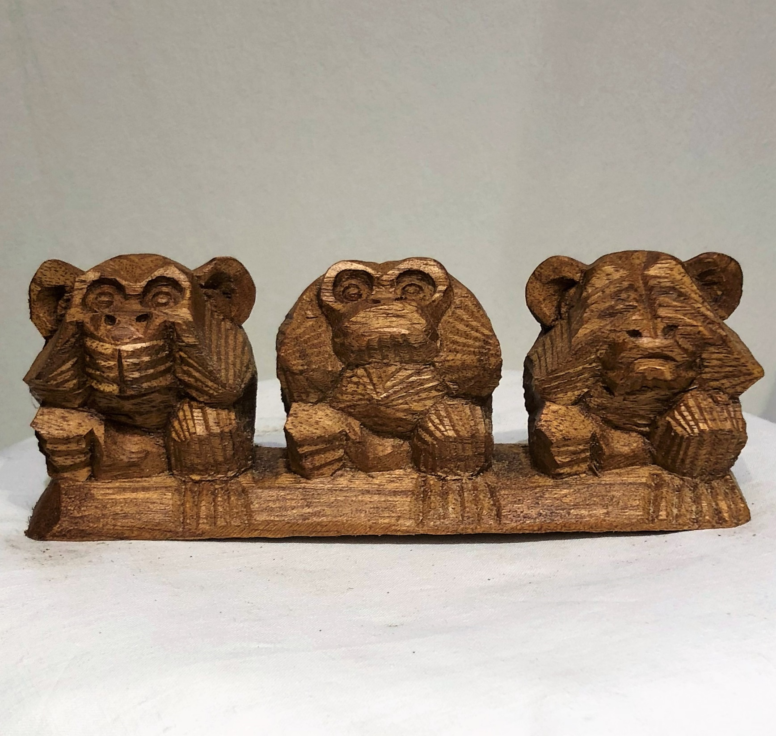
Notes:
Explain the why
Give details about those objective criteria/guidelines you made
Work on trust
Shape culture and outlook
Take care of staff
Unify: all behavior team

Slide 51
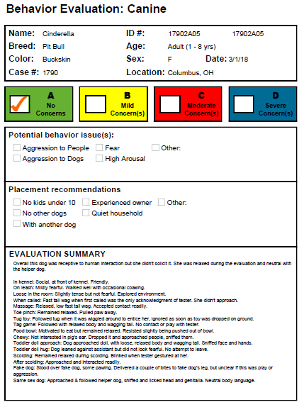
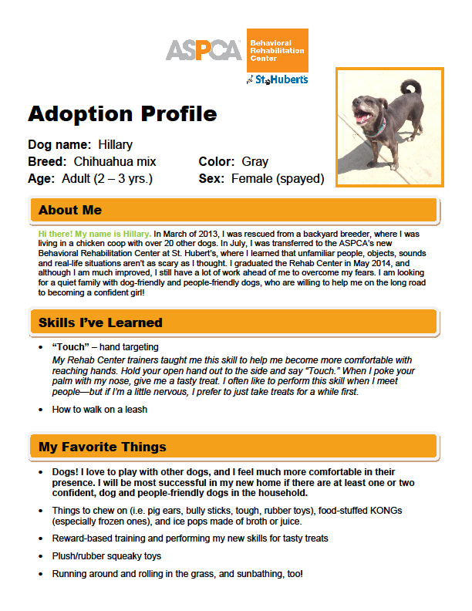
Reverse Flow: External
Notes:
More detail provided on individual subtest pages but anyone can glean important points from reading the summary page

Slide 52
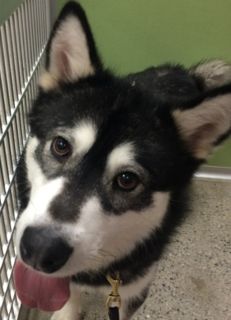
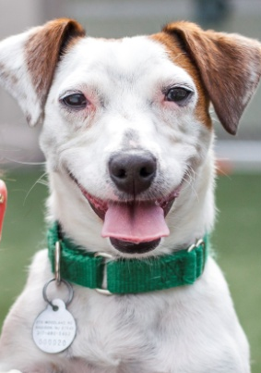
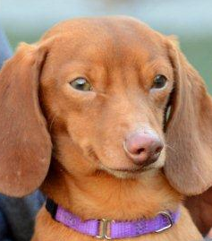
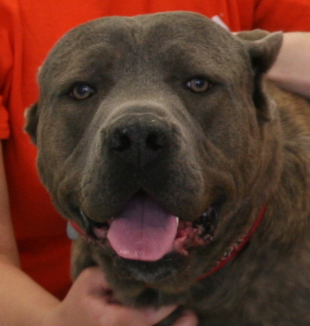
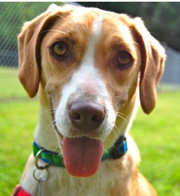
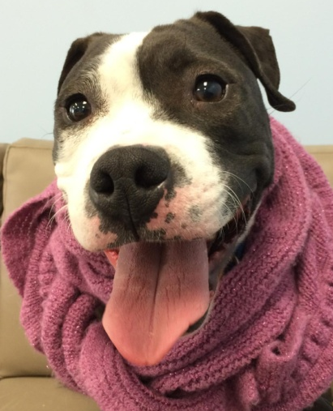
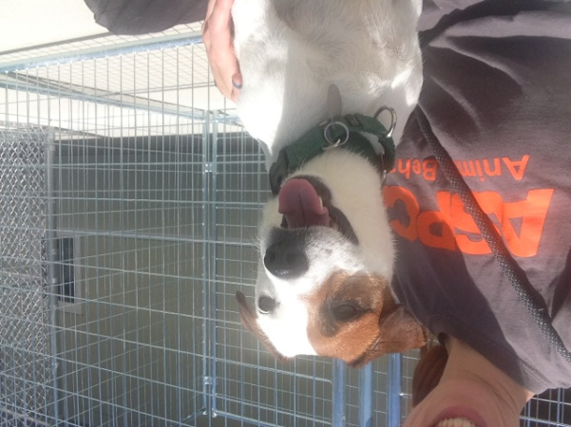
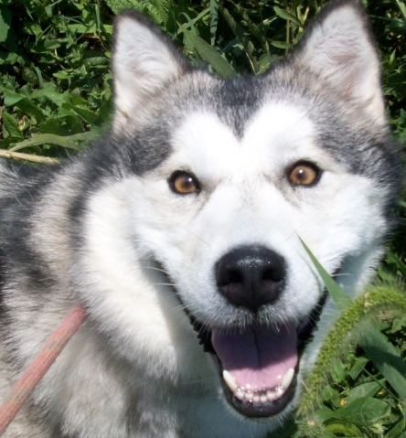
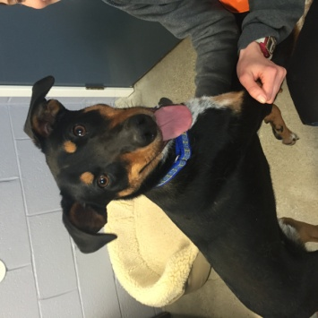
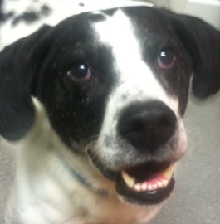
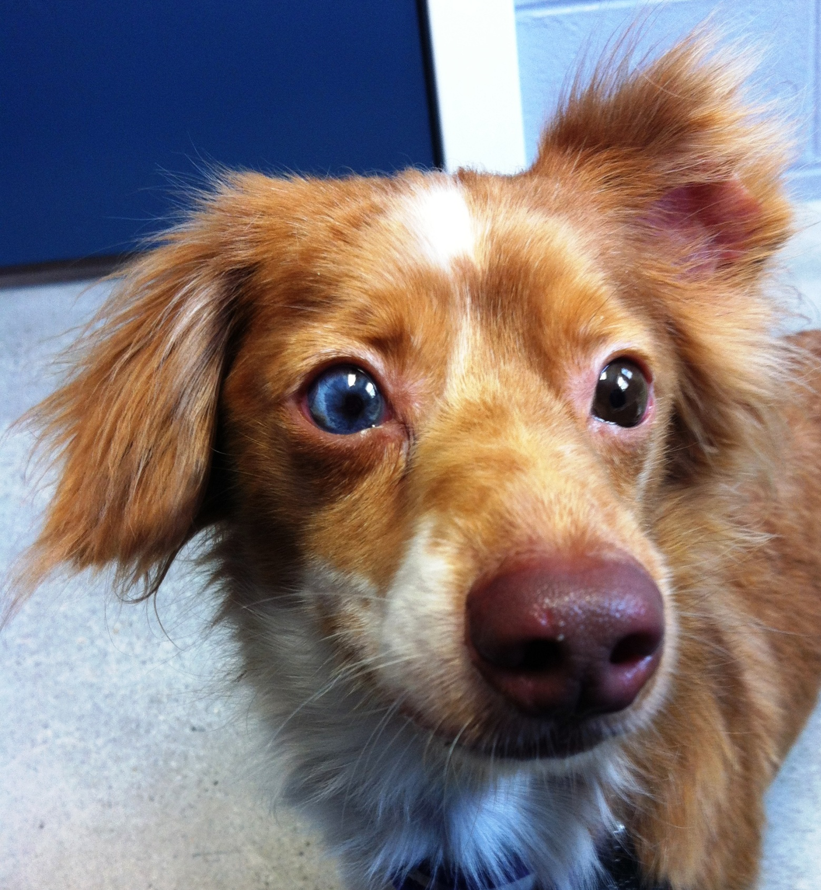
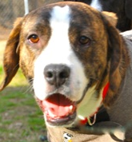
Take-Home Messages
There isn’t a foolproof way to predict shelter dog behavior in the home (yet?)
The best way to get around that is to collect multiple points of data…
  Efficiently
  Objectively
…and have a clear path for info: collect and compile, review, act
Notes:
Action = both decision-making and communication (internally and externally)

Slide 53
ASPCA Position Statement on Shelter Dog Behavior Assessments
https://www.aspca.org/about-us/aspca-policy-and-position-statements/position-statement-shelter-dog-behavior-assessments

Slide 54
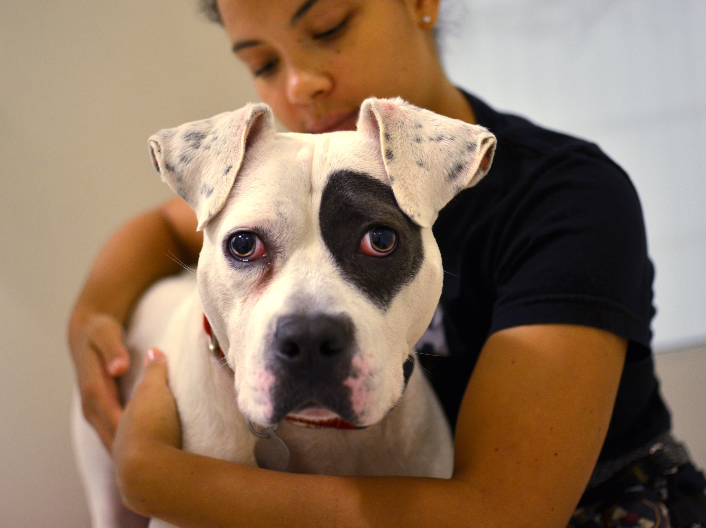
Q&A
Notes:
And now we’d like to take your questions…

