Slide 1
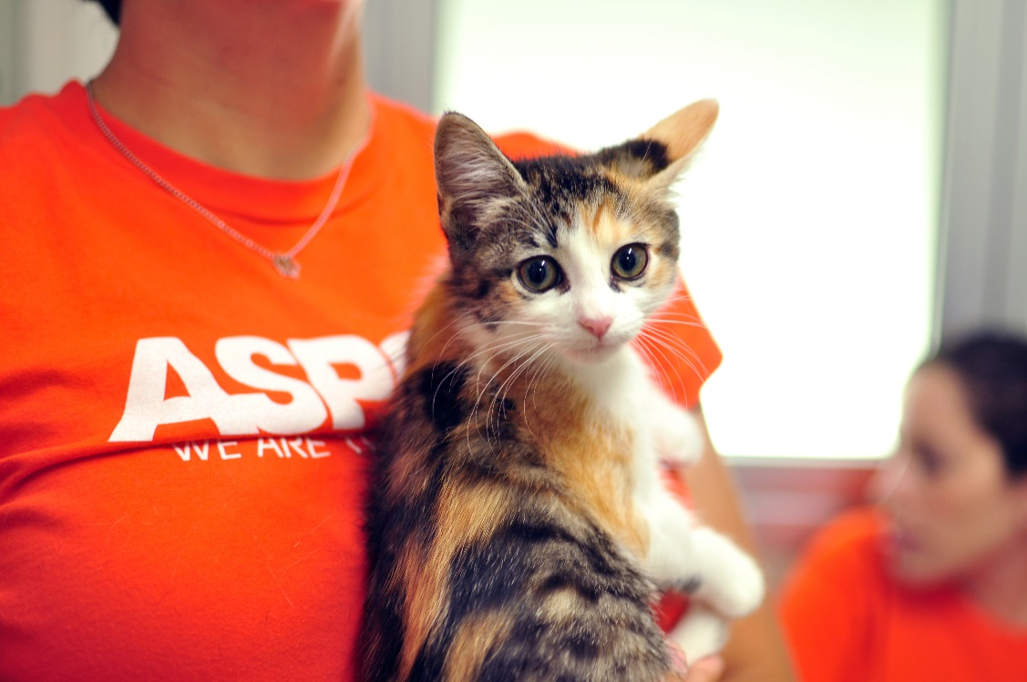
Los Angeles Foster Caregiver Information Session

Slide 2
The ASPCA was founded in 1866 as the first animal welfare organization in the western hemisphere.
Our mission is to provide effective means for the prevention of cruelty to animals throughout the United States.

Slide 4
The ASPCA Los Angeles Foster Care Program
Helping animals that are at risk of entering the shelter, or not leaving the shelter with a positive outcome
young kittens not yet ready for adoption
young kittens who are susceptible to catching disease in the shelter or need socialization
juvenile and adult cats who need help finding a home
juvenile and adult cats recovering from illness

Slide 5
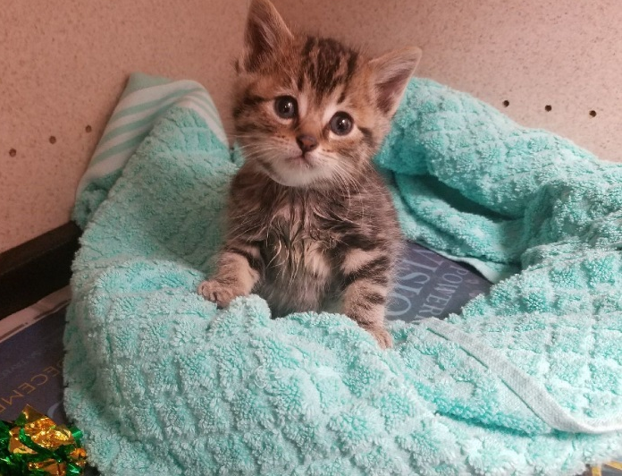
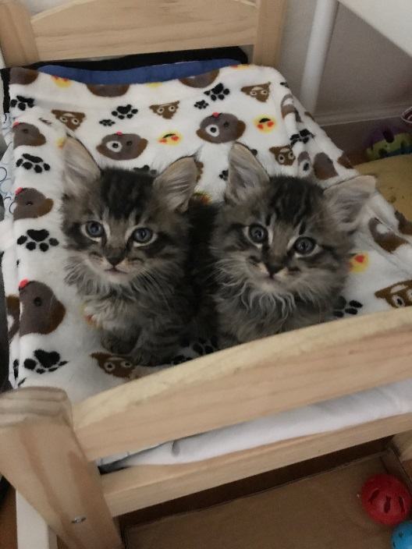
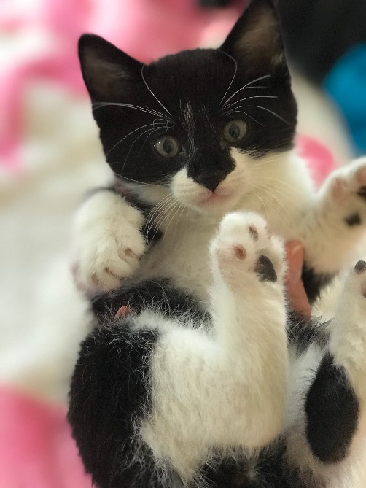
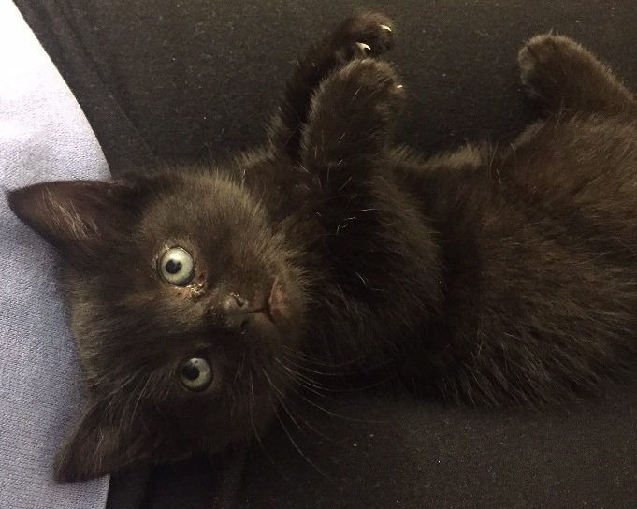
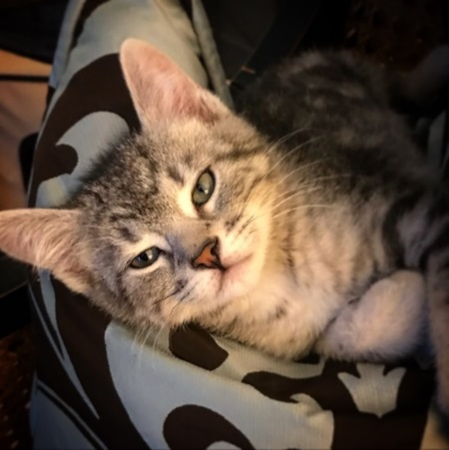
Where Our Kittens and Cats Come From
Baldwin Park Animal Care Center
More than 2,000 felines saved!

Slide 6
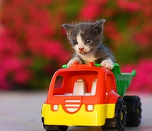
What does the ASPCA provide for fosters?
All Medical Care
Food
Supplies
Support
Cat and Kitten Delivery

Slide 7
What does a foster caregiver provide?
TLC
Safety
Medical/Behavioral observation and care
Socialization
Recheck appointments every 2-3 weeks
Taking kittens to our veterinary clinics for illness and emergency care

Slide 8
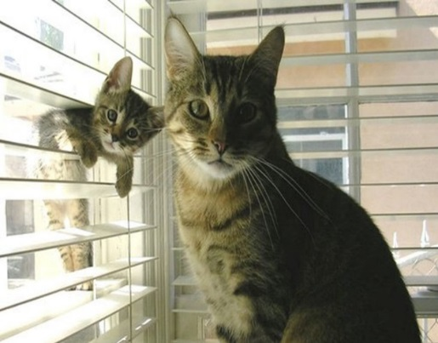
Are You Ready to Foster?
Agreement within the household
Prepare & “pet-proof” your home
Isolation room
remove hazards
block hiding spots
Attachment
Be prepared to get attached. You may
want to adopt your foster pet but the goal is to say goodbye.

Slide 9
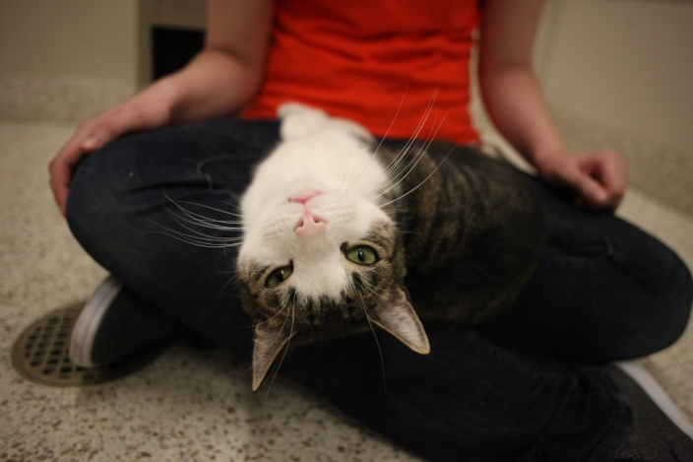
Are Your Pet and Human Household Residents Ready?
Can you separate/confine your foster pet?
Resident pets should be in good health and up-to-date on vaccinations. Consult your veterinarian.
Is anyone living in the home immune compromised, pregnant, very young or elderly?
Consult a physician
Please note: the ASPCA does not
provide medical care for resident pets
or their owners

Slide 10
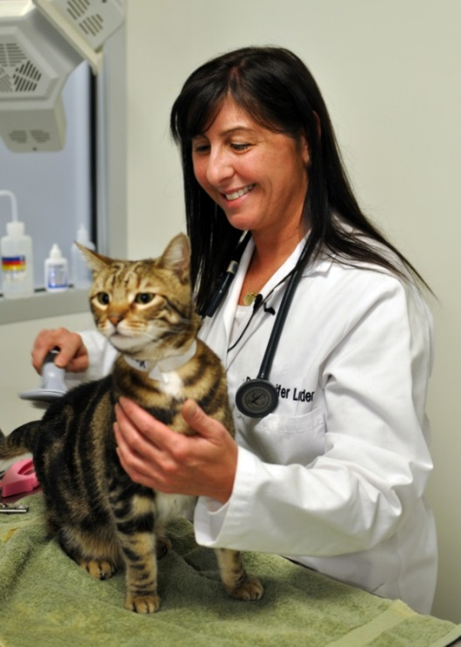
The ASPCA Prepares Foster Animals For Their Stay With You
Screening and care for common conditions:
Upper respiratory infections (URI)
Parasites
Ringworm
FeLV/FIV
Vaccinations, dewormer and flea treatment are provided if kittens are old enough
Many conditions may benefit from Foster Care!

Slide 11
Please Be Advised!
Even with thorough veterinary screening, some contagious conditions, such as ringworm and certain parasites, may not be detected prior to the start of a foster period. The ASPCA cannot guarantee the health of any foster animals.

Slide 12
On-Deck Fosters
As an ASPCA Foster Caregiver you will submit a survey each time you are ready to take on foster kittens or a foster cat
On this survey you designate how many kittens you feel comfortable fostering and what dates you are available
You can also let us know what kind of diseases you are willing to treat in your home
This means you’re up next and you can expect to get your fosters very soon! We will contact you when the next kittens or cats are ready and to schedule transportation that day.

Slide 13
Supplies We Give You
The ASPCA will provide the following supplies that are appropriate for the age of your foster. These supplies will need to be disinfected and returned at the end of your foster period.
Disposable litter boxes and litter (non-clumping only for kittens)
Playpen (if applicable)
2 cardboard carriers
Wet and dry life-stage appropriate food
Proviable (digestive aid)
Ponazuril (dewormer) for kittens
Important foster paperwork
Scale for kittens
Any necessary medications
Email XXXXXXX when you need more supplies to be delivered to you!

Slide 14
Supplies You Provide
Provided by the Foster Volunteer:
Scratchpads and other toys (use FREE items!; carpeted or wooden scratching posts should not be used)
Bedding (towels, blankets, cat beds): ensure all bedding is washable and kept clean and dry at all times
Food and water bowls
Soap/detergent for cleaning (don’t use products ending in –sol)
Bleach for disinfecting

Slide 15
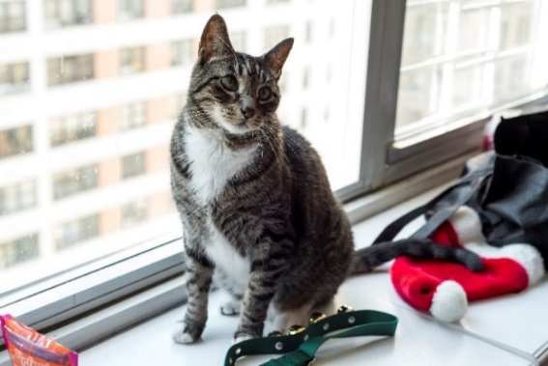
Quarantine Period and the Isolation Room
An initial quarantine period in your home is highly encouraged for 2 weeks in an isolation room such as a spare bathroom or bedroom.
Isolation room should be:
Easy to disinfect
Warm
Quiet
Spare bathroom or laundry room is ideal!
Block all hiding spots and remove dangers like cords
You might even want to have specific “cat room” clothing
If you are not able to provide a room to meet these qualifications, we will give you a playpen for the fosters to stay in during their quarantine

Slide 16
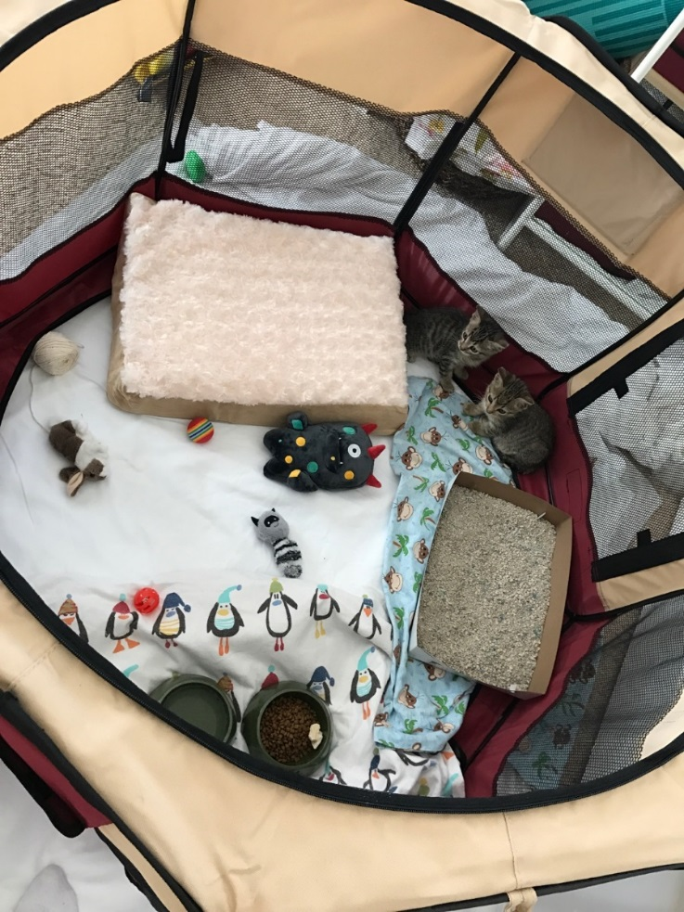
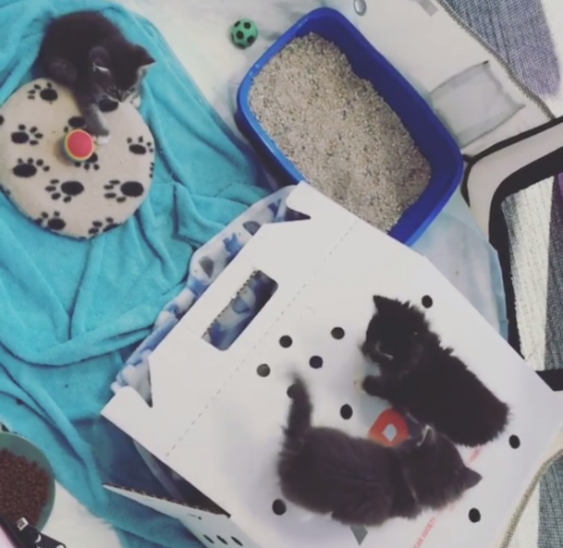
How to Set-Up Your Fosters’ Home
Litter box (clean often!)
Dishes with dry food and water (24/7 access)
Newspaper as kennel bottom in litter/food area
Cardboard carrier on its side as hiding spot/bed
Separate sleeping area, litter area and feeding area as best as possible
Clean entire space often, especially if there is illness

Slide 17
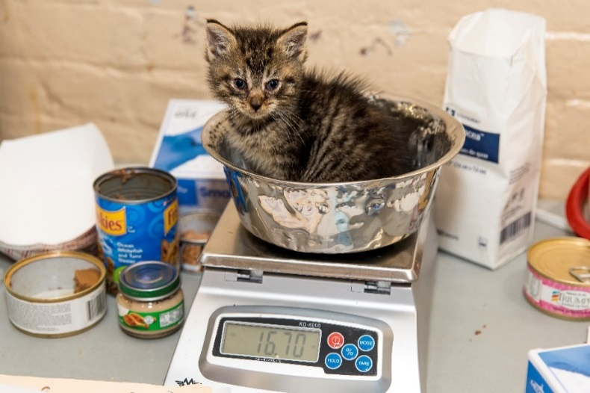
How Are They Doing?
Health Monitoring Sheet is provided in your Foster Guide
You should keep a daily log of some/all of the following:
Appetite (eating and drinking normally)
Urinating and defecating normally
Behavior notes
Loss of hair
Vomiting
Sneezing
Discharge from eyes
Gram scales to weigh kittens provided
For orphan kittens, 3 days of weight loss or of no weight gain = red flag
We want our babies to be chunky ☺ Goal is 2lbs!

Slide 18
Kitten Growth Milestones
Age | Weight | Milestones
Birth | 2 – 4 ounces | Eyes and ears are closed. Sleeps 90% of the time. Minimal handling.
4 days |  | Begins to purr.
10 – 14 days | 8 ounces | Eyes and ears should be open. Healthy kittens will be round and warm with pink skin and will rarely cry.
2 – 3 weeks | 12 ounces | Baby incisors erupt, can begin to eliminate without help. Will start crawling, standing, and playing with littermates. Begin regular handling.
4 weeks | 1 pound | Baby canine teeth erupt, beginning to walk but do not have great balance, will begin to groom themselves, able to thermoregulate. Ready for their 1st vaccine. Ready for gruel and may be ready for introduction of dry kitten food.
6 weeks | 1.5 pounds | Baby premolars erupt. Running, playing, using the litterbox, grooming themselves. Should be eating dry kitten food, supplemented with canned.
8 weeks | 2 pounds | They are now “mini” cats. Ready for surgery and adoption!

Slide 19
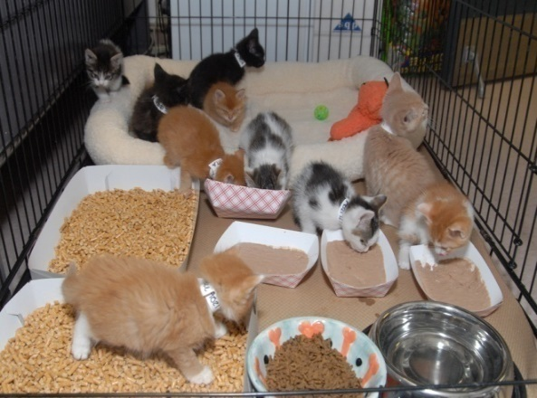
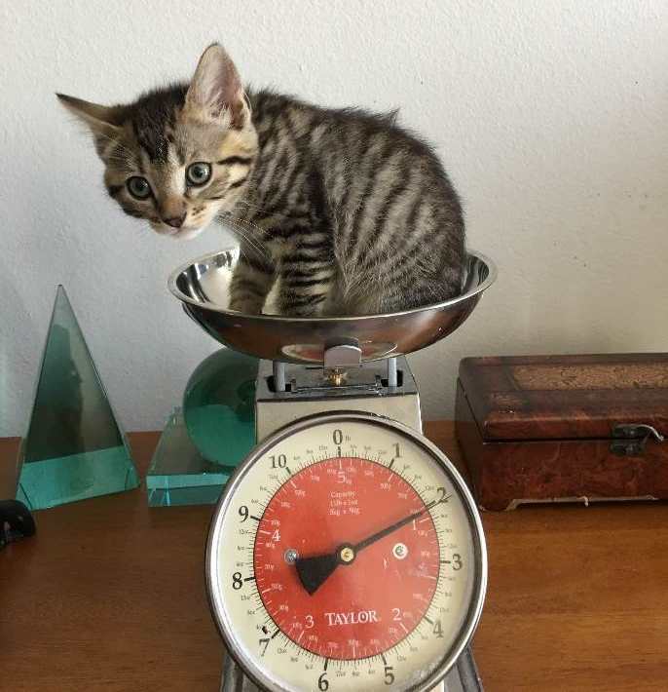
Basic Care Guidelines
Transitioning Kittens (3-5 weeks)
Start with gruel (wet food mixed with water)
Hand feeding, flat serving plates and warming the food are all helpful tactics
Bottle/syringe feeding might still be necessary
Leave dry food and water out
Leave litter box out
Eating on their own Kittens (4+ weeks)
Leave dry food and water out
Wet food 3x daily
Gaining weight (aiming for 2 lbs)
Lots of socialization!
Notes:
Remove after 2 hours if they don’t eat wet food

Slide 20
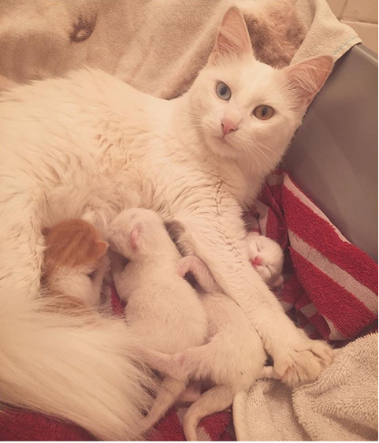
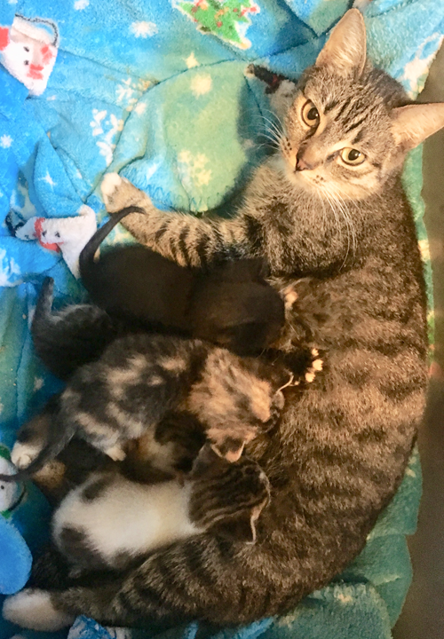
Moms with Kittens Basic Care Guidelines
Experience caring for neonates for the youngest newborns
Bottle feeding experience may be required depending on kittens ages in case supplemental feedings are needed
Mom should always have access to lots of wet/dry food and water
Monitor mom:
Behavior: is she taking care of babies?
Babies shouldn’t cry for too long
Mom should groom them
Eating/drinking habits
Litter box habits (watch out for diarrhea)
Irritated mammary glands

Slide 21
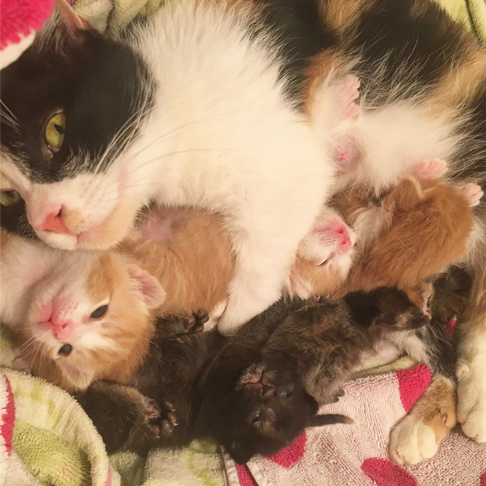
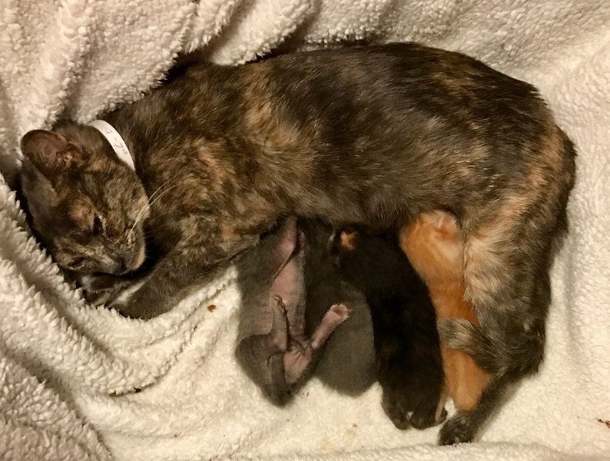
More on Moms with Kittens
Weigh babies every single day
They should gain 1/2 oz per day
Goal is 2 lbs!
Keep all babies in the nest for 3 weeks
Ensure kittens don’t separate from the rest (this is a problem!)
“Runt” needs more 1-on-1 time with mom
Minimal handling during first 2 weeks
Supplies:
Nesting box
Snuggle safe heating disc
Bottles/syringes and KMR
Larger litter box for mom
Plastic carrier

Slide 22
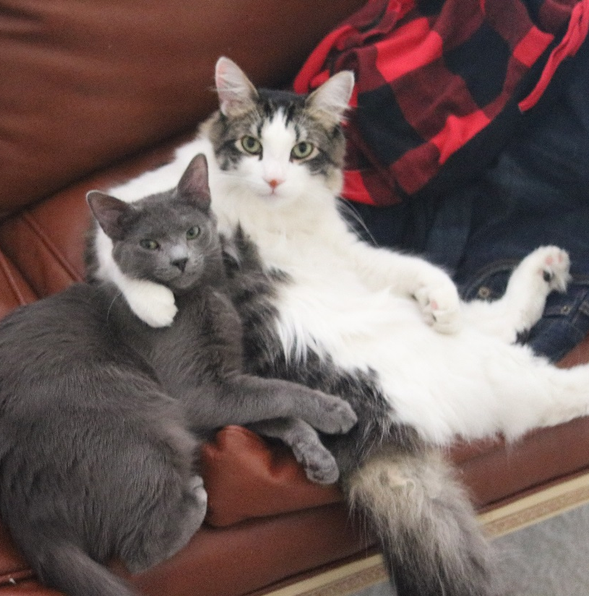
Basic Care Guidelines
Juvenile and Adult Cats (6 months +)
Plastic carrier loaner
Isolation period (can use playpen)
Feed wet food 1-2x a day
Leave water and dry food out 24/7
Lots of socialization!
Observe behavior
Larger litter boxes
Medical care as needed
URI (most common)
1 vaccination booster
Spay/Neuter surgery ASAP

Slide 23
Mortality Rates in Kittens and Difficult Decisions
Mortality rate in kittens up to 12 weeks old: 15-40%
Even if you do everything perfectly, you might still lose a kitten
Fading Kitten Syndrome can leave us with no “Why?”
We take the decision to euthanize any animal very seriously and we will never euthanize due to lack of space or time
We pursue all reasonable efforts to save an animal but there may be cases when an animal requires medical treatment that goes beyond our ability to humanely provide
Kittens who spend time nursing from their mother are generally in better health

Slide 24
Kitten Kindergarten (Critical socialization between 2-7 weeks old)
Young kittens are often under socialized
Multiple short socialization sessions (3-5 minutes) on a daily basis are best
Keep them confined in a quiet room for the first few days
Helps you observe eating and bathroom habits
Helps them adjust to the new environment
Use mealtime as a treatment for socialization
Offer food and sit with them while they eat
Create a consistent feeding schedule with wet food
Play soft/classical music intermittently (search “relaxing music for cats” on Youtube.com)
Use cat pheromone like Feliway

Slide 25
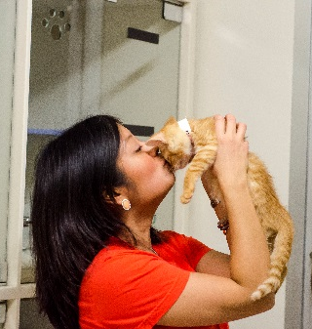
More on Kitten Kindergarten
Play time: don’t encourage biting behavior (hands aren’t toys)
Make sure kitten is comfortable every step of the way
Freezing/submission is a sign of fear
Get them used to household noises and voices by slowly introducing them
If they have a littermate, that is best! Other cats teach them how to behave and keep them occupied!
Make sure siblings do not suckle on each other! This can cause injury. Kittens will need to be separated.

Slide 26
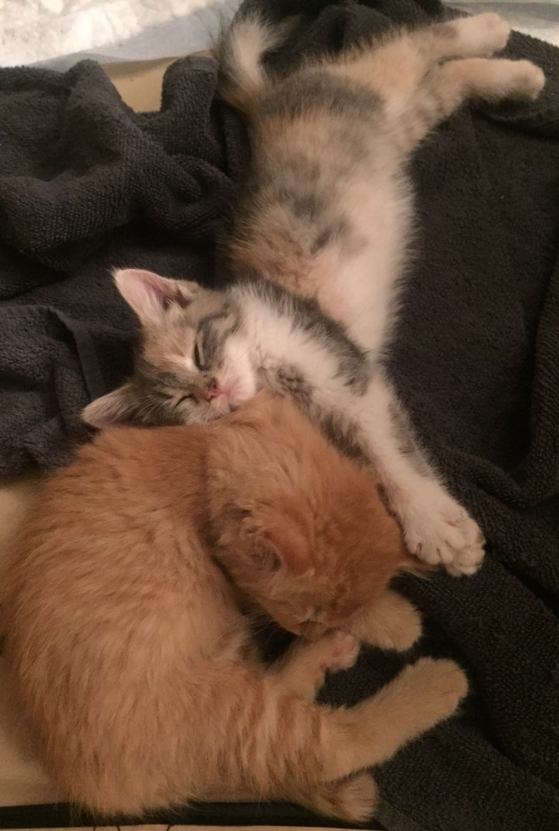
Kitten to Kitten Introductions
Gradual introduction between 2 singleton kittens close in age and size
Normal reactions:
Small hisses
Batting at each other
Rough play & some vocalizing
Signs of a serious problem:
Persistent bullying by one kitten
“Aggressor” is difficult to distract with toys
One kitten keeps the other from using the litter box or eating food
Notes:
Pairing up singletons is important for socialization
Normal reactions: usually pass in a few days
Bullying: one kitten is never the one initiating the rough play and hides or tries to get away from the aggressor
Never a good idea to pair up a healthy and sick/weak kitten

Slide 27
Upper Respiratory Infection (URI)
Viral and bacterial respiratory infections are very common in cats, especially young or stressed ones.
Symptoms include:
clear to colored discharge from eyes and/or nose
loss of appetite
depression
congestion
sneezing
coughing
fever
Common treatments include:
Rest
Hand feeding
Warm eye compress
Antibiotics
Ocular ointments
Wash your hands thoroughly after handling an animal with visible URI symptoms before contact with any other cats as URI is extremely contagious. URI is similar to a human cold, but is generally not transmittable to people or other animal species except for cats.

Slide 28
Ringworm – It’s not as scary as it sounds!
Despite its name, ringworm is a fungal infection that causes alopecia/crustiness/ redness of the skin (just like athlete’s foot)
Transmission is primarily through direct contact with an infected animal. Secondarily through fomite (objects or materials that are likely to carry infection, such as clothes, utensils, and furniture) transmission.
Treatment includes a combination of topical and oral treatments that are used to clear the infection as rapidly as possible. Typical foster length is 6 weeks.
Cleaning and disinfecting against ringworm should include thorough cleaning and disinfecting steps to remove spores from the environment or contaminated objects most effectively.
Examples of effective OTC disinfectants that are safe around kittens include:
Fantastik
Formula 409
Simple Green

Slide 29
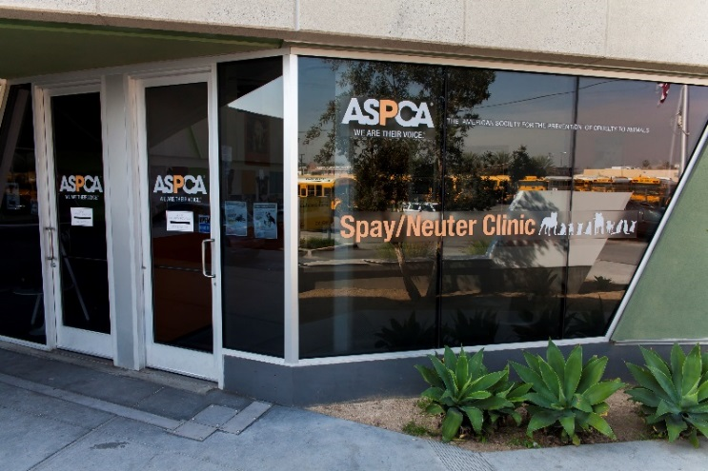
Follow-Up Veterinary Appointments
Every 2 weeks kitten will need:
Physical examination
An FVRCP vaccination booster (until 18-20 weeks of age)
Dewormer
Every 4 weeks kitten will need:
Topical Flea Treatment
At 8 weeks of age or older:
Kitten will be scheduled for their Spay/Neuter Surgery (once they are 2lbs)
At 12 weeks of age or older:
Kitten will need a rabies vaccination
Cats older than 20 weeks will only need 1 booster FVRCP after intake
Available Clinics:
-South LA
-Downey
-Baldwin Park
-Burbank
-Sherman Oaks
-Westlake Village
-Venice

Slide 30
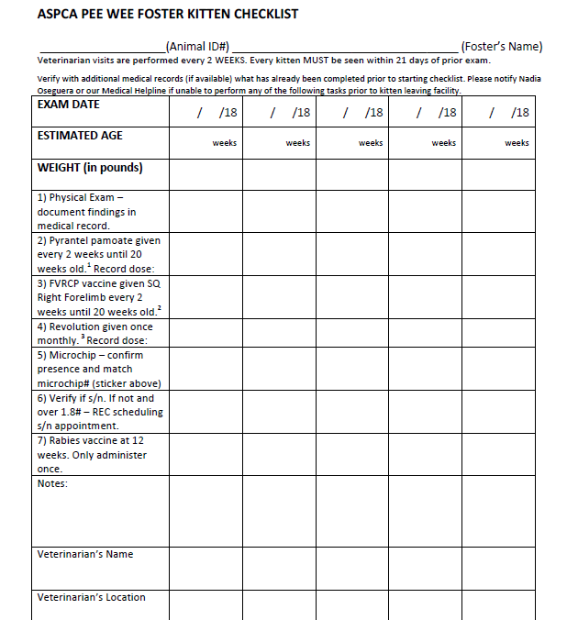
Foster Medical Checklist This form should be filled out at every check-up appointment and kept with all medical records.

Slide 31
A Fear-Free Trip to the Vet Reduces Fear, Anxiety and Stress
The carrier:
Put towel/blankie that smells like home inside
Cover the outside with a towel or blanket
Keep it elevated
Plan ahead: don’t wait till the last minute to put kittens in the carrier
Use treats (wet food, pure-chicken baby food) during and after the appointment
Play soft/classical music in the car
Give them time to come out of carrier when you get home

Slide 32
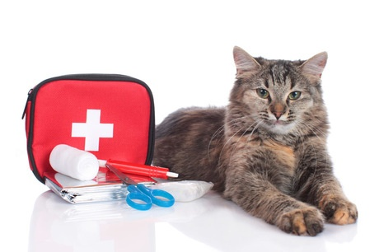
ASPCA Foster Medical Hotline
XXX-XXX-XXXX
You can call 24/7 for emergencies!
For any medical questions and concerns
Veterinary Technicians will decide if treatment can be provided at home or if they need to book you a veterinary appointment at an ASPCA-approved veterinary partner clinic.
Must get pre-approval first. Do not go to your own veterinarian.
Your Foster Guide will provide more detailed information about symptoms you might see in your kittens for common problems.
If an emergency comes up and you cannot reach the medical hotline, contact the Foster Coordinator (XXXXX) at XXX-XXX-XXXX.

Slide 33
When do I call?
Emergency Situations: Notify the Medical Hotline immediately.
If you cannot reach the Hotline, call the Foster Coordinator immediately.
Difficulty breathing, erratic breathing pattern, gasping for air
Very high or low body temperature
Very pale, blue, or grey gums
Seizures or neurologic symptoms
Accidental injury or trauma, including but not limited to cuts and fractures
Straining to urinate or not urinating for more than 24 hours
Unable to stand or walk
Call the Medical Hotline and alert the Foster Coordinator.
Failure defecate for more than 2 days
Longer than 12 hours for kittens <4 week or longer than 24 hours for kittens >4 weeks:
Not eating or drinking
Diarrhea*
Vomiting*
Sneezing or coughing
Signs of lethargy or uncharacteristic/abnormal behavior
*If repeated episodes or other signs present such as lethargy or lack of appetite, call emergency #

Slide 34
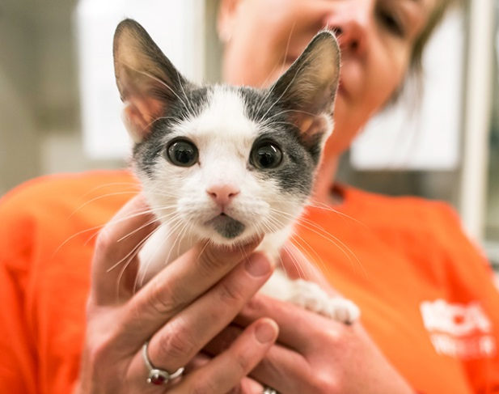
Adoption Options
Relocation
Transporting adoption-ready kittens to in-state and out-of-state partner rescues to find them their new homes!
Local Pet Stores
3 Petco locations currently:
Petco XXX
Petco XXX
Petco XXX

Slide 35
Adoption Ambassadors: Finding a home for your fosters within your network of friends, family and acquaintances
We use conversation-based adoptions with a goal of informing potential adopters about cat care and answering any questions they may have!
What questions do you have for me about cat care?
Do you have other pets in the home?
If so, the ASPCA has handouts to help make a smooth introduction
Are you able to keep this cat indoors?
Here are some reasons why we suggest keeping your cat indoors…
Do you know about the risks and harms of declawing a cat?
Notes:
Reasons to keep cat indoors:
-Indoor-only cats tend to live longer
-Indoor-only cats tend be healthier
-Prevents them from getting lost/escaping

Slide 36
Finding a home for your fosters, continued
Get Creative with finding your fosters homes…Let’s talk about ideas!
Requirements:
Must be spayed or neutered before adoption
One page adoption agreement (found in your foster guide)
No cost to adopt cats or kittens!
If adoption does not work out, the ASPCA will always take the kitten/cat back!
This will be the most rewarding part of your fostering journey!

Slide 37
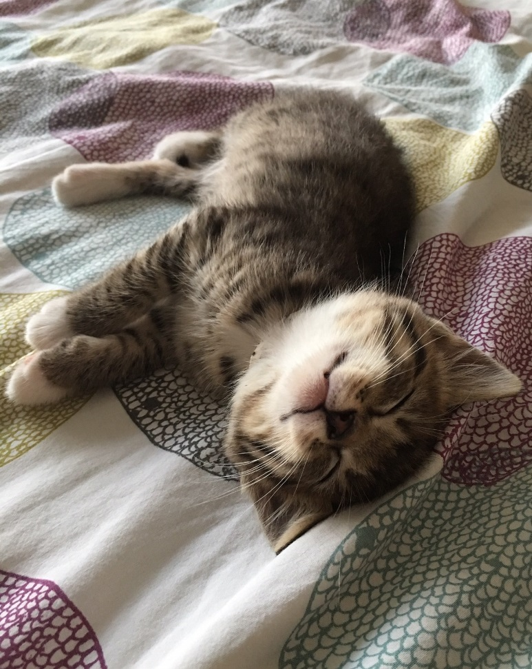
Our Top 10 Fostering Tips!
Keep the litterbox clean and welcoming!
Do not foster more than 1 litter at a time
Do not allow your foster cat outside
Use the health monitoring sheet
Provide daily interactive play sessions and safe enrichment like Cat TV!
Notify foster team ASAP if bad behaviors are starting to develop or are not going away
Please do not let you foster cat interact with resident cats during the initial quarantine period
Never physically punish your foster cat
Fatten kitties up – we want them to get to 2lbs!
Keep our medical hotline number handy at all times! XXX-XXX-XXXX

Slide 38
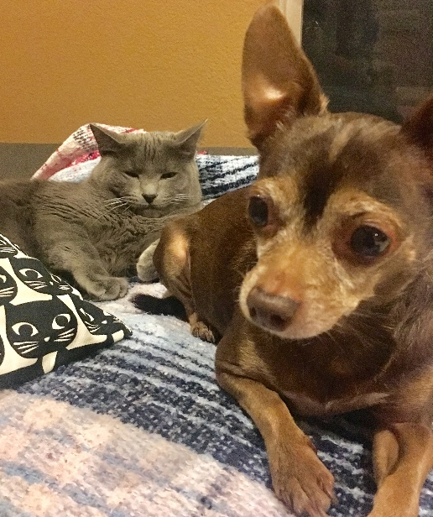
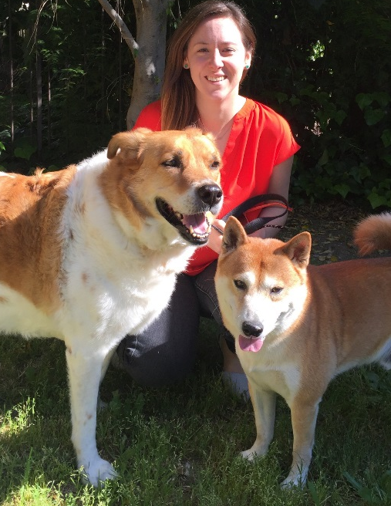
Nadia Oseguera
Los Angeles Foster Coordinator
XXX-XXX-XXXX
XXXXX@ASPCA.org
Most active hours:
Tuesday - Saturday 10:00am to 7:00pm
Tina Reddington
Los Angeles Volunteer Director
Ariel Collins
Los Angeles Animal Logistics Manager

Slide 39
Next Steps!
Check your spam folder and move my emails to the “primary tab” in Gmail
Add XXXXX@ASPCA.org to your address book
Read through our ASPCA Foster Care Guide thoroughly
Fill out the “On-Deck” foster survey each time you are ready to take home cats or kittens!
Expect a call, text or email when we have kittens/cats for you!
Join our private Facebook group to connect with all of
our LA Fosters. Share pictures, stories and receive
advice on caring for your kittens

Slide 40
THANK YOU!

