Slide 1
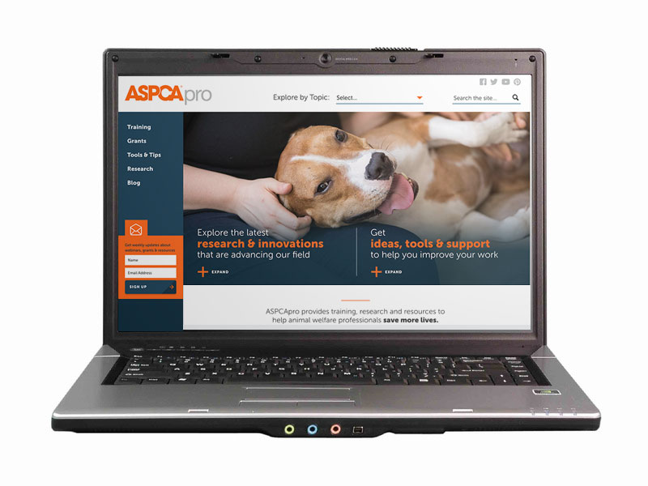

Assessing Canine Behavior in the Shelter: Input from Multiple Sources
Enjoy the music!
The webinar will begin at its scheduled time.
Join the webinar using built-in computer audio or dial
669-900-6833 or
646-558-8656
Webinar ID: 175-995-211

Slide 2

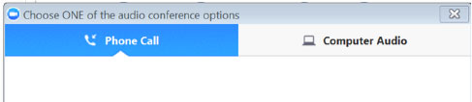
How to Adjust Your Audio
Select “Audio Settings” at the bottom of your screen.
Choose whether you’ll join using computer audio or your telephone. We recommend computer audio.

Slide 3

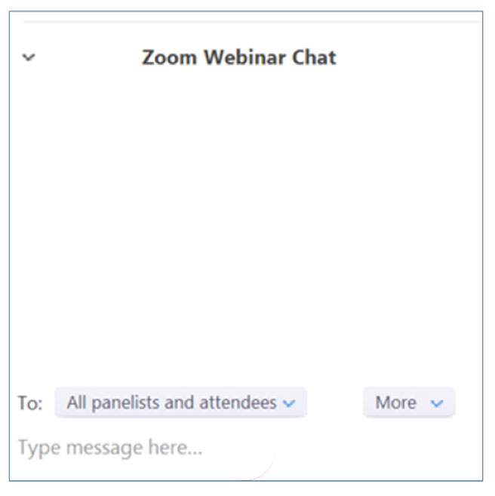
How to Chat
Select “Chat” at the bottom of
your screen
In the chat window, select “All panelists and attendees” to share your message with everyone in attendance

Slide 4
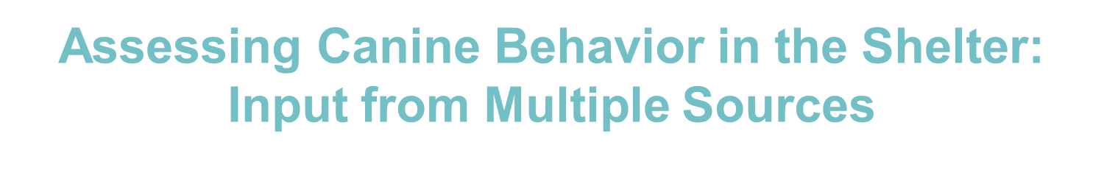
Kendra Sinclair
Strategic Partner Manager for North American Nonprofits
Facebook
Kristen Collins, MS, ACAAB
Vice President, Behavioral Rehabilitation Center
ASPCA Policy, Response & Engagement
Pam Reid, PhD, ACAAB
Vice President, Anti-Cruelty Behavior Team
ASPCA Policy, Response & Engagement

Slide 5
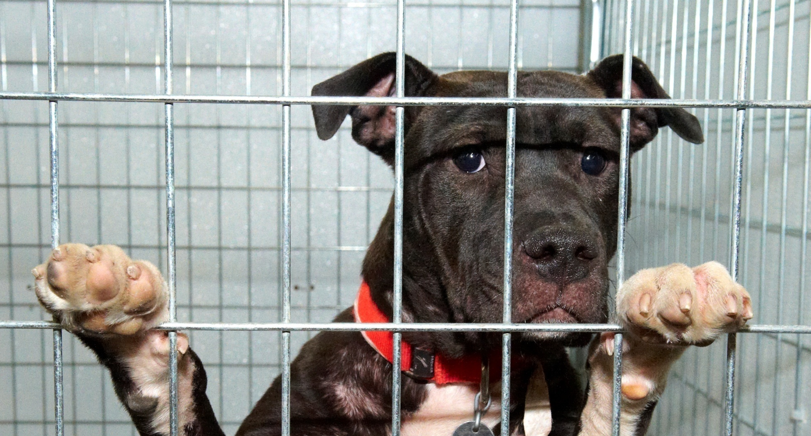

Assessing Behavior
in the Shelter

Slide 6
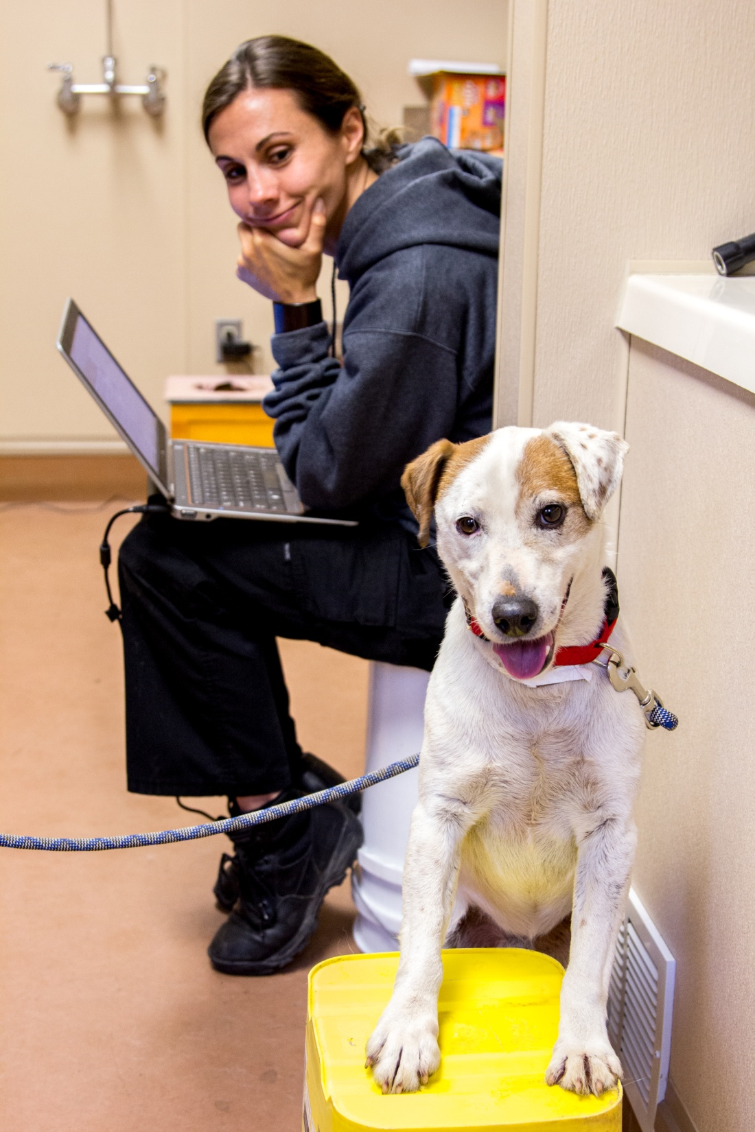
Why assess behavior?
Make outcome decisions
  Fast-track to adoption
  Appropriate for relocation
  Unsuitable for placement due to aggression or poor quality of life
Meet behavioral needs while at shelter
Make good matches

Slide 7
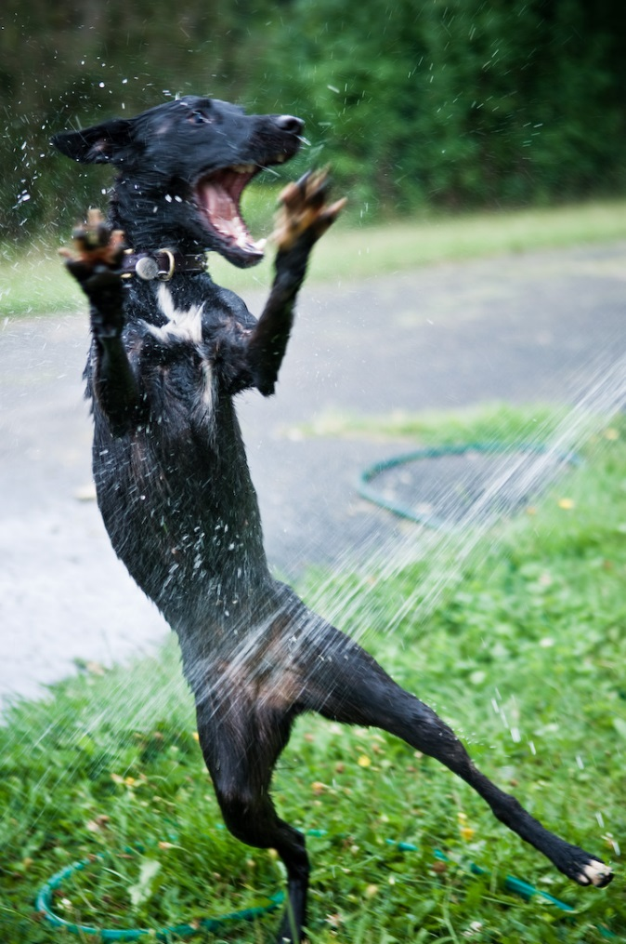
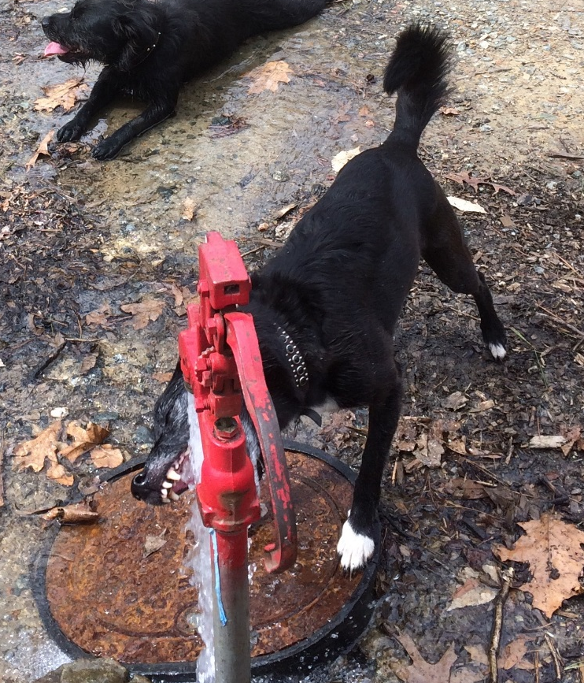
What is personality?
Personality, or temperament, describes the characteristics that account for consistent patterns of behavior.
Notes:
Broad vague definition that most psychologists can agree upon
An observation of behavior can only be considered reflective of temperament if you observe the same behavior repeatedly across time and/or across similar circumstances
This dog exhibits similar behavior toward water in different contexts – is there some personality trait that could describe her crazy enthusiasm for splashing water? Would this behavior be a reflection of a broader personality trait?
Most personality traits used to describe dogs are determined from studies that examine behavior across a variety of contexts and the tendencies that emerge are assigned descriptive labels (like for the above examples “playfulness”)
Other labels include: Boldness/Shyness, Anxiety/Nervousness, Sociability/Lack of interest in others, Aggression/Agreeableness, Fearfulness/Confidence, Excitability/Stability

Slide 8
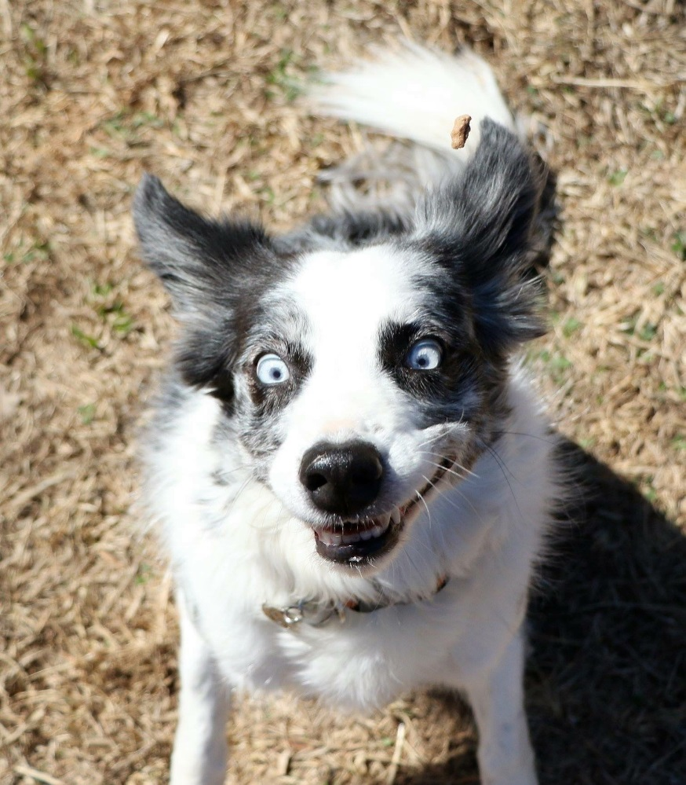
What is behavior?
A reflection of an animal’s personality
Influenced by:
Emotional state
Stress level
Environment

Slide 9

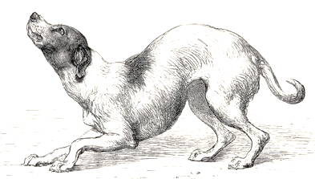
Nature or nurture?
BOTH.
Personality and behavior are influenced by a complex interplay between genetic predispositions and experience (or lack thereof).

Slide 10
ASPCA Position Statement on Shelter Dog Behavior Assessments
https://www.aspca.org/about-us/aspca-policy-and-position-statements/position-statement-shelter-dog-behavior-assessments
Notes:
Here’s where to find it. In general, we believe that one size does NOT fit all. There is no easy answer when it comes to the right way to assess animal behavior. Shelters need to consider their individual situations---their resources, their shelter population and their communities---when deciding how to behaviorally assess dogs, using their best judgement to determine how they can expediently gather as much information as possible.

Slide 11
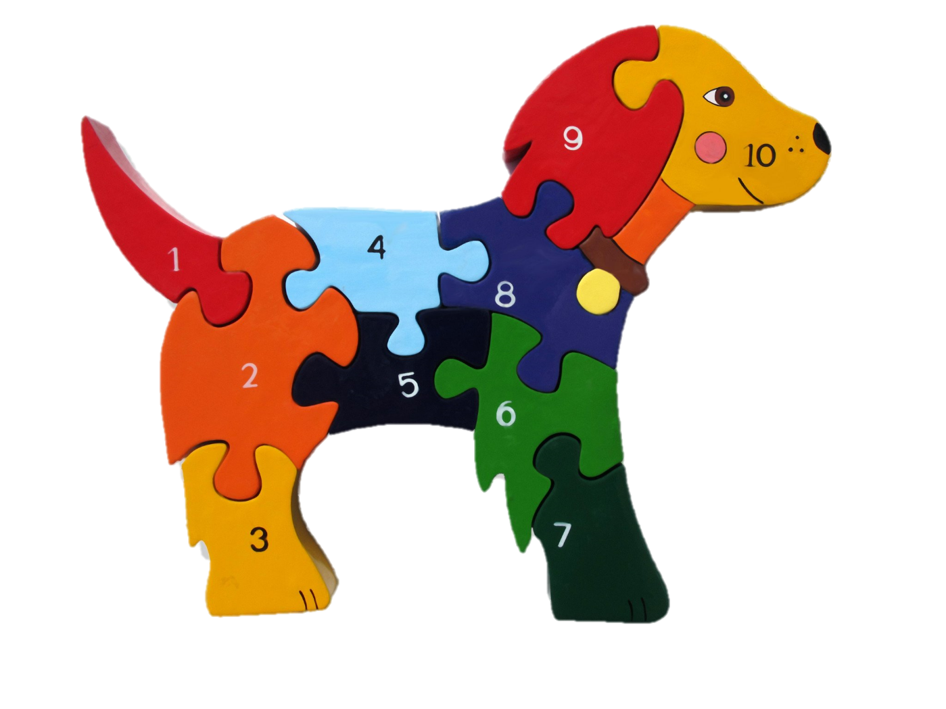
Key Points
Know what we don’t know
Gather info from multiple sources
Aim for objectivity
Consider the welfare of all animals and adopters
COPYRIGHT © 2018. Alphabet Jigsaws Ltd. ALL RIGHTS RESERVED.
Notes:
Best source of info? Best behavior evaluation? ????
Don’t throw the baby out with the bathwater. We might not know a lot, but we should do our best to gather as much objective info as possible from as many sources as possible. We’ll go into what those sources are, as well as their pros and cons, during Part 2 of this webinar series. We’ll also discuss the nitty-gritty re: how to gather info from those sources and what to do with it.
The ASPCA acknowledges that (a) it is still unknown whether any particular source of information is more predictive of future behavior in a home than any other and (b) current scientific thinking on the usefulness of behavior assessments in predicting aggressive behavior is inconclusive. Behavior assessments have not proven highly accurate or precise when used to predict aggression after adoption. It has been suggested that a significant number of dogs exhibiting aggression on an assessment do not do so in a home. For these reasons, the ASPCA maintains that euthanasia decisions should not be based solely on a dog’s behavior during an assessment or in any other single situation unless the aggression is egregious*. If a dog shows behavior that might warrant euthanasia, we recommend that organizations only make such a decision when the behavior has been reported by multiple sources.

Slide 12
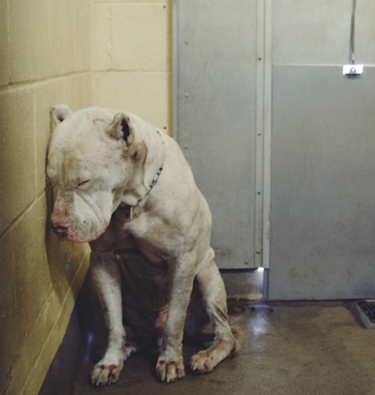
Our Goal
Strike the right balance between taking the time to gather sufficient information and making outcome decisions as quickly as possible.
Notes:
The ASPCA recommends that shelters gather as much information as possible to determine the behavioral profile of any dog in their facility that is being considered for adoption. However, this quest for information should not come at the cost of holding these dogs in the shelter for longer than necessary. A shelter’s overarching goal should be to identify dogs eligible for adoption and move them into homes or into a relocation program as quickly as possible.

Slide 13

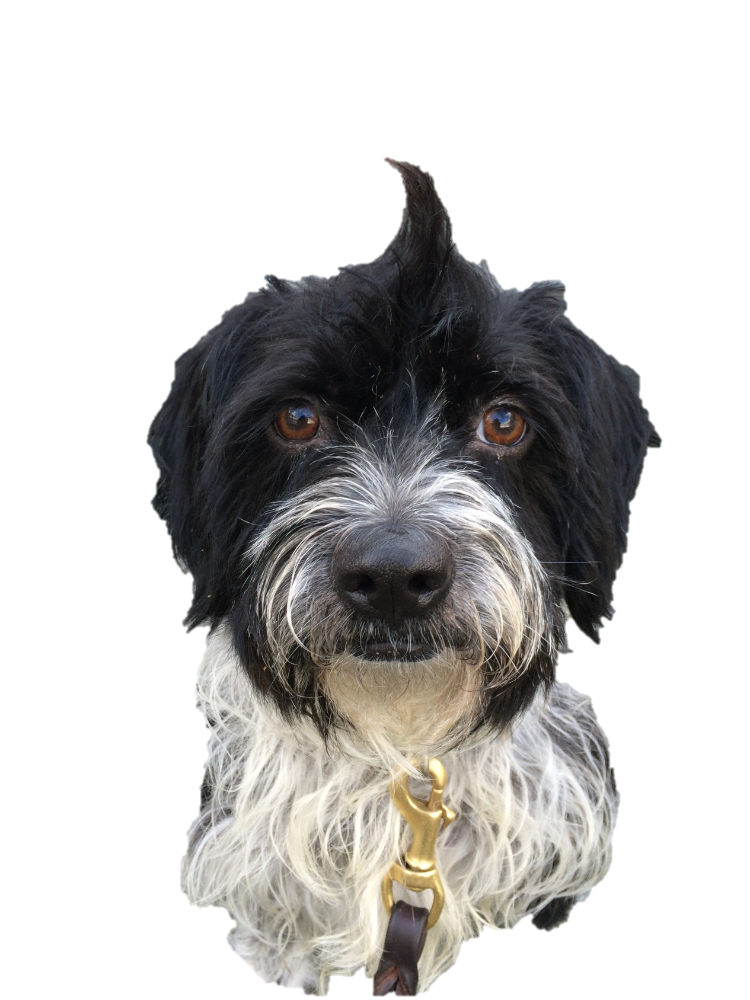
Behavior/Decision Spectrum
Super social, no issues
Severe/egregious behaviors
Notes:
There are no-brainer decisions on both ends of the spectrum
A dog is turned in by the owner for reasons that have nothing to do with the dog’s behavior. Owner reports no concerns. Dog is super social and relaxed with people and dogs. Put the dog up for adoption asap.
A dog comes in that has exhibited confirmed severe aggression: *”Egregious” aggression should be defined by the individual shelter, but some defining characteristics could be (a) a bite that requires medical treatment, (b) an injurious bite that the dog could have avoided inflicting but opted to bite rather than retreat, (c) an injurious bite delivered without obvious warning, or (c) an attack in which repeated injurious bites are delivered. A euthanasia decision should be made asap.
For everyone else in between these two extremes, gather more information asap.

Slide 14
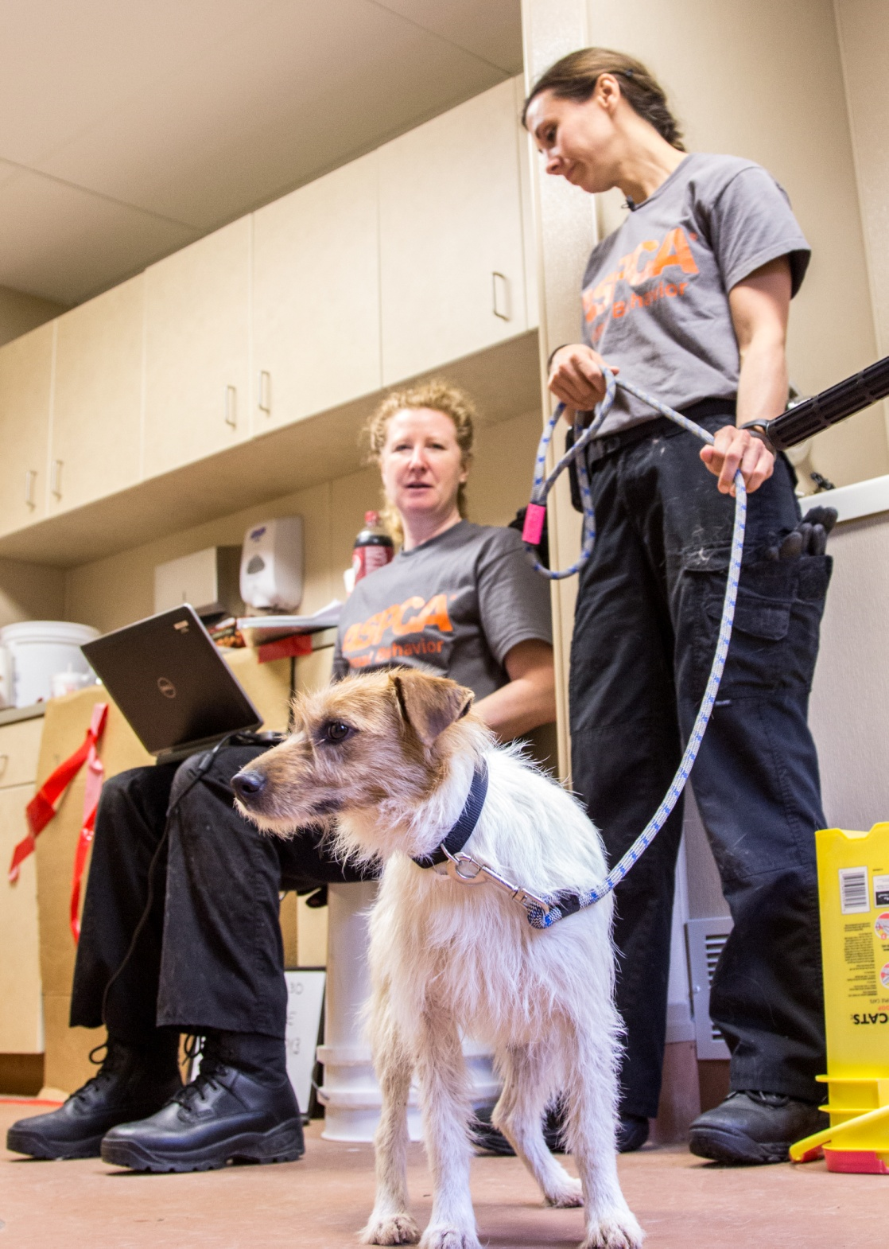
Standardized Behavior Evaluations

Slide 15
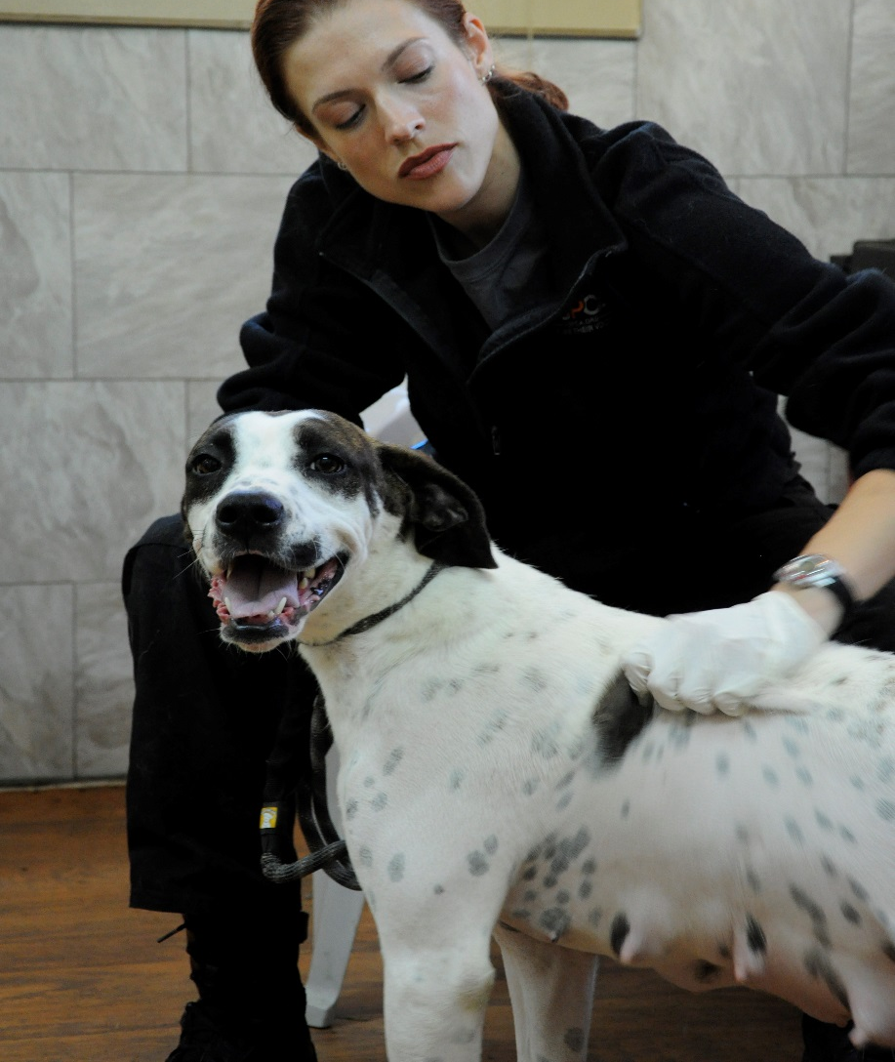
Three Commonly Used Behavior Evaluations
Assess-a-Pet
ASPCA SAFER
Center for Shelter Dogs Match-Up II
Notes:
Three tests in most common use in the US – in order of development
Sue Sternberg developed Assess-a-Pet
Emily Weiss developed SAFER
Amy Marder developed Match-up and Match-up II

Slide 16
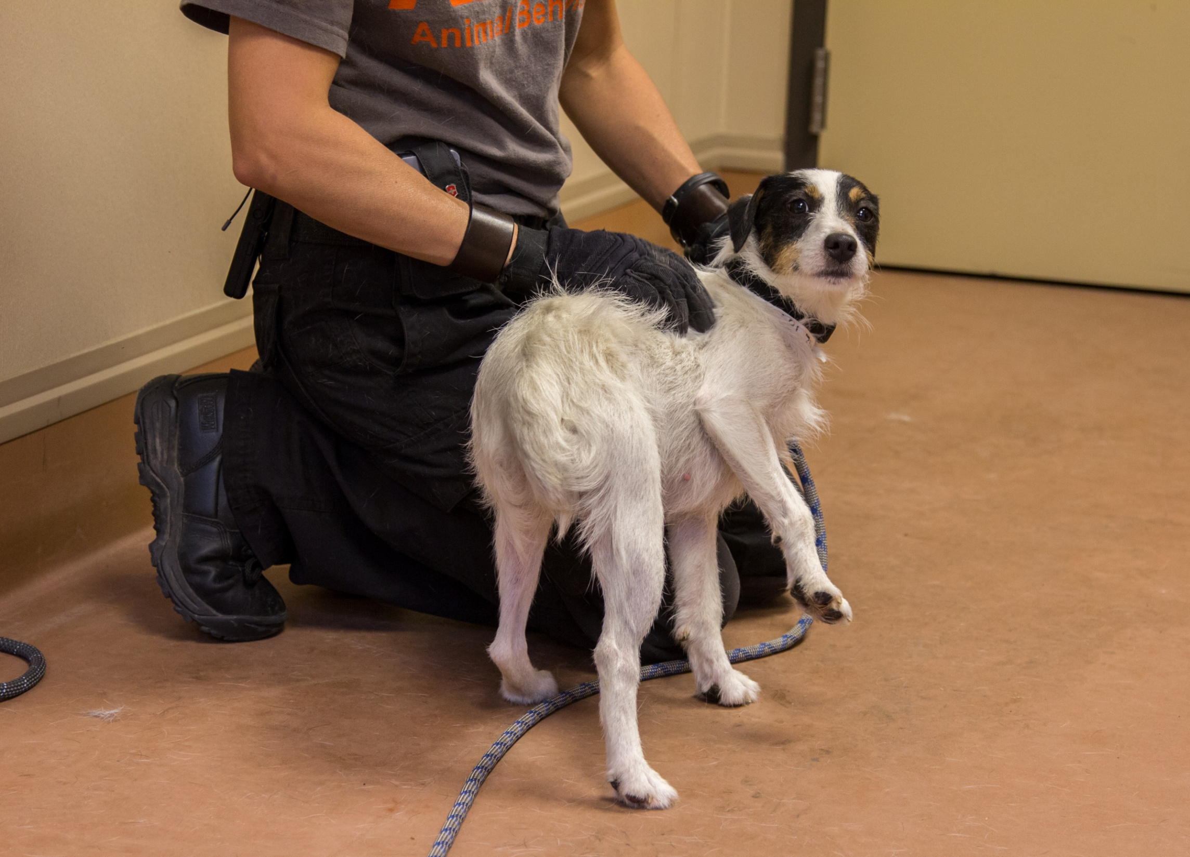
Sociability toward people
New environment
Handling
Playfulness
Notes:
Based on simulated everyday real-life experiences – common sense sorts of things

Slide 17
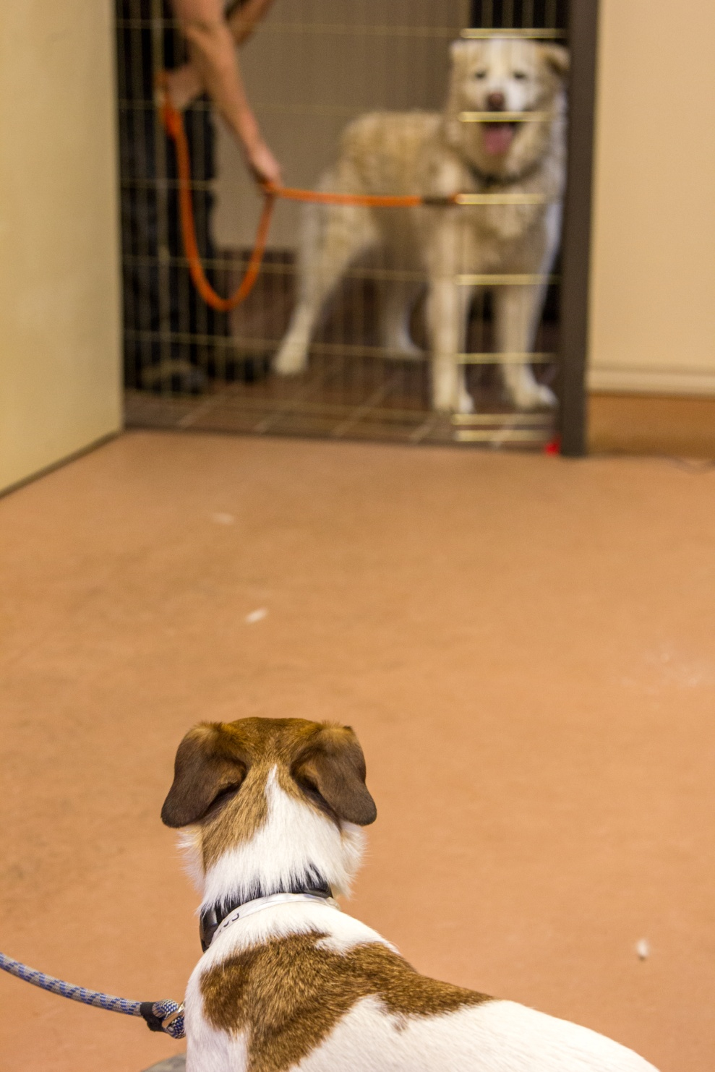
Resource guarding
Toddler doll
Dog sociability

Slide 18
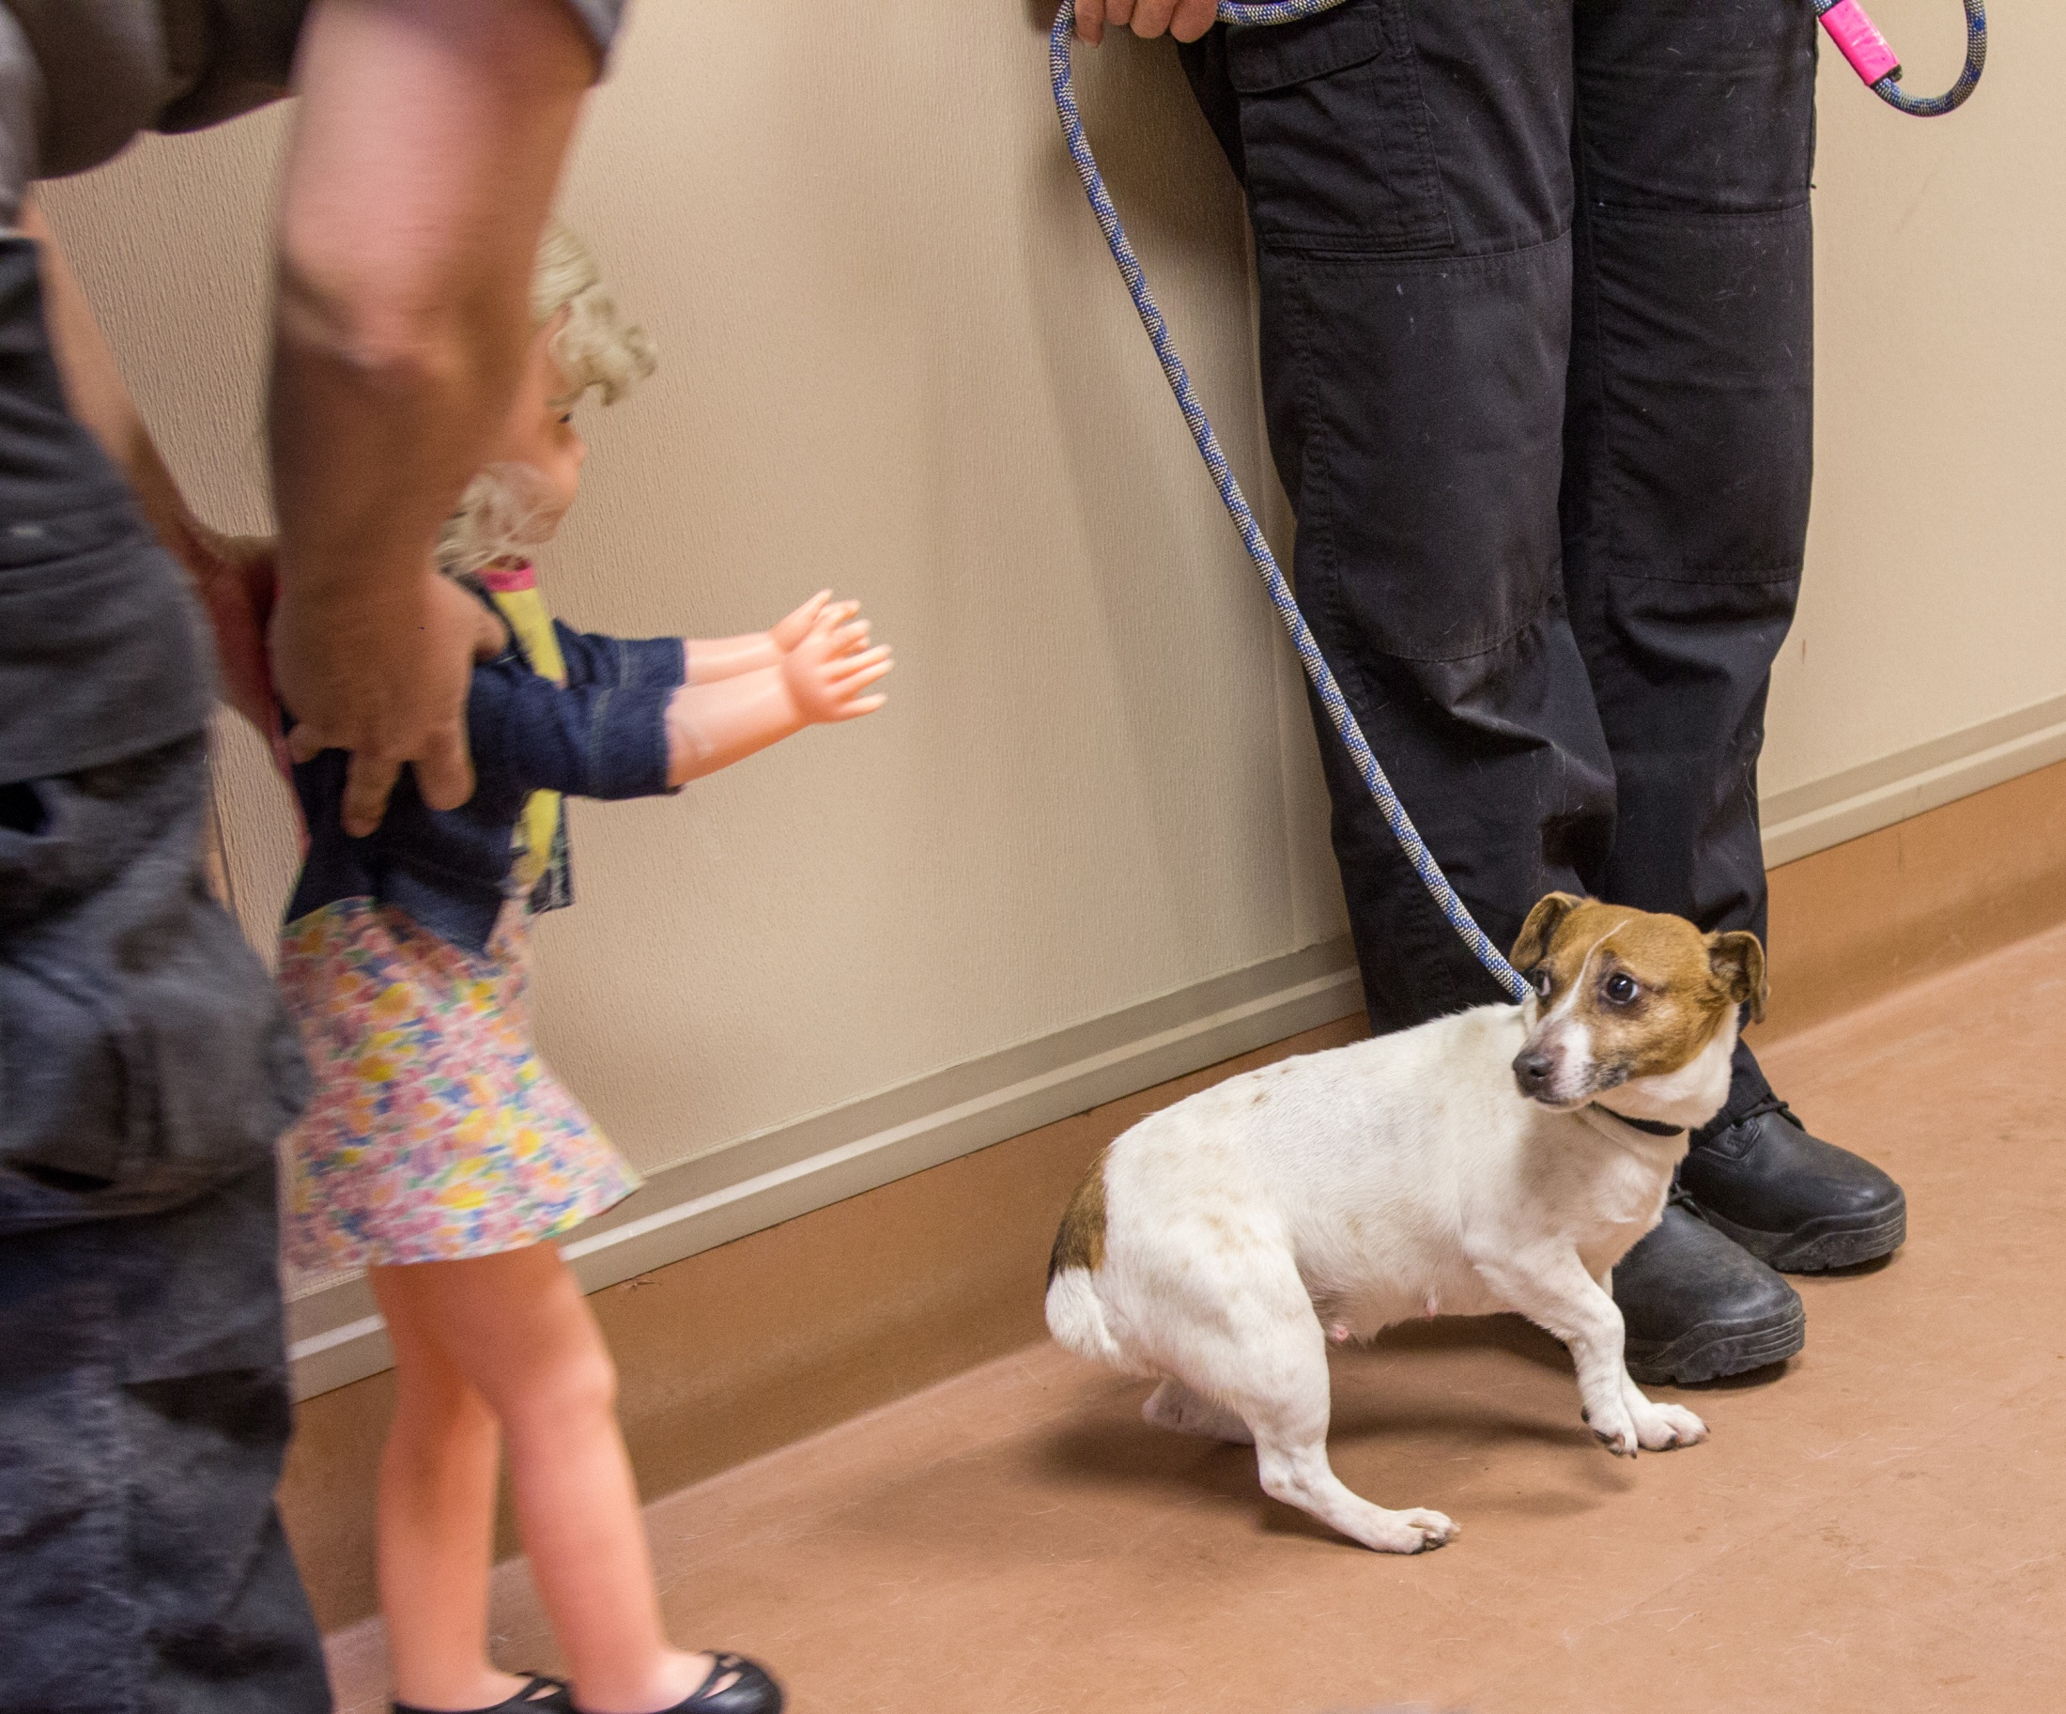
Fear tests
Training & problem solving
Notes:
Potentially stressful and provocative

Slide 19

What does the Science say?

Slide 20
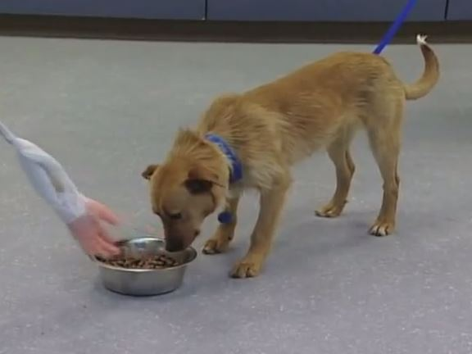
Food Guarding Studies
Notes:
First explain value of validating specific subtests (not tied to entire evaluation)

Slide 21
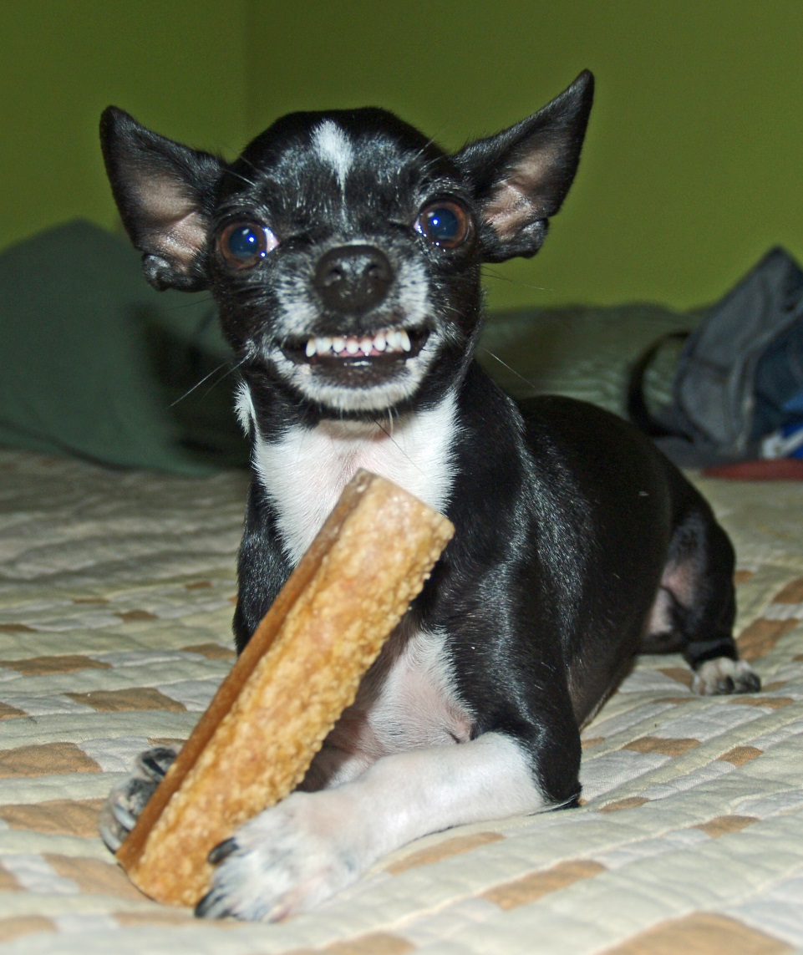
Of dogs that guarded food in the evaluation, only 50% did so in the home.
Of dogs that did NOT guard food in the evaluation, 25% did show it in the home.
Very few adopters reported concern about food guarding.
Notes:
These results from Marder et al. (they adopted out all dogs exhibiting food aggression, regardless of severity)
Also Mohan-Gibbons et al.
Useful finding from both studies – adopters don’t care about food guarding.

Slide 22
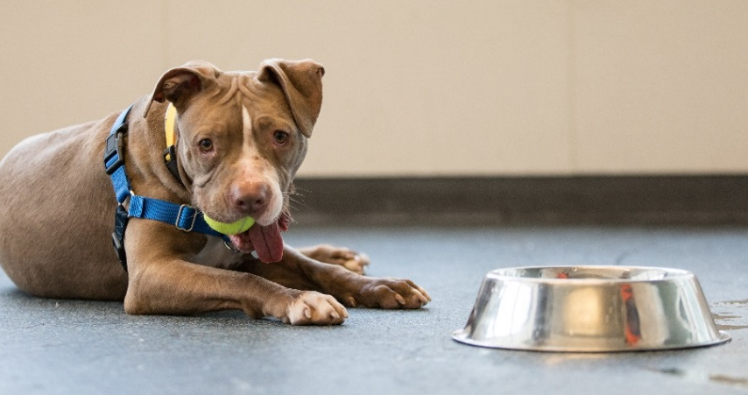
Impact of Omitting Food Guarding Subtest from Behavior Evaluations
14,180 dogs taken in during the four months of the study
Food guarders:
  Less likely to be adopted
  Longer shelter stay
  More likely to be euthanized
Notes:
Recent ASPCA study to examine impacts of omitting food guarding component
These shelters adopted out most food guarders in both baseline & pilot phases (except for very severe)
In baseline, food guarders were identified by owner reports, behavior in shelter, or evaluation
In pilot phase, food guarders were identified by owner reports or behavior in shelter
In “The Impact of Excluding Food Guarding from a Standardized Behavioral Canine Assessment in Animal Shelters,” published Feb. 8, 2018, in the peer-reviewed journal Animals, researchers worked in nine shelters for four months. During the first two months, they established a baseline for assessing the dogs for food guarding. During this period, dogs who exhibited food guarding:
Were less likely to be adopted
Had a longer shelter stay
Were more likely to be euthanized

Slide 23
Returns (Within 1 Month) for Any Reason
379
326
COPYRIGHT © 2018. ASPCA®. ALL RIGHTS RESERVED.
Notes:
Dogs identified as food guarders but still adopted out in the pilot phase were rarely returned by the adopter
Dogs identified as food guarders during baseline were more likely to be returned (not clear why – power of negative label?)
Severe food guarding was seen in only 17 percent of the dogs, and was easily identified by shelter staff without a formal assessment.

Slide 24
Number of Bites or Injuries to Staff
Note: Percent is not shown as it is less than 1% in each group
COPYRIGHT © 2018. ASPCA®. ALL RIGHTS RESERVED.
Notes:
Surprisingly few bites to staff, whether among food guarding dogs or ALL 14,180 dogs
104 incidents from a total of 14,180 dogs (less than 1% of dogs)
There was no change to number of injuries, including all bites and injuries, not just those involving food.
Clearly no difference between baseline and pilot stages of study
Obviously fewer dogs identified as food guarders during pilot phase

Slide 25
Number of Bites or Injuries to Adopters
Note: Percent is not shown as it is less than 1% in each group
COPYRIGHT © 2018. ASPCA®. ALL RIGHTS RESERVED.
Notes:
Owner reports of bites (for any reason, not just over food)
So impact?
No increase in injuries to staff, volunteers or adopters
No increase in returns
If FA is severe, you will find out anyway

Slide 26
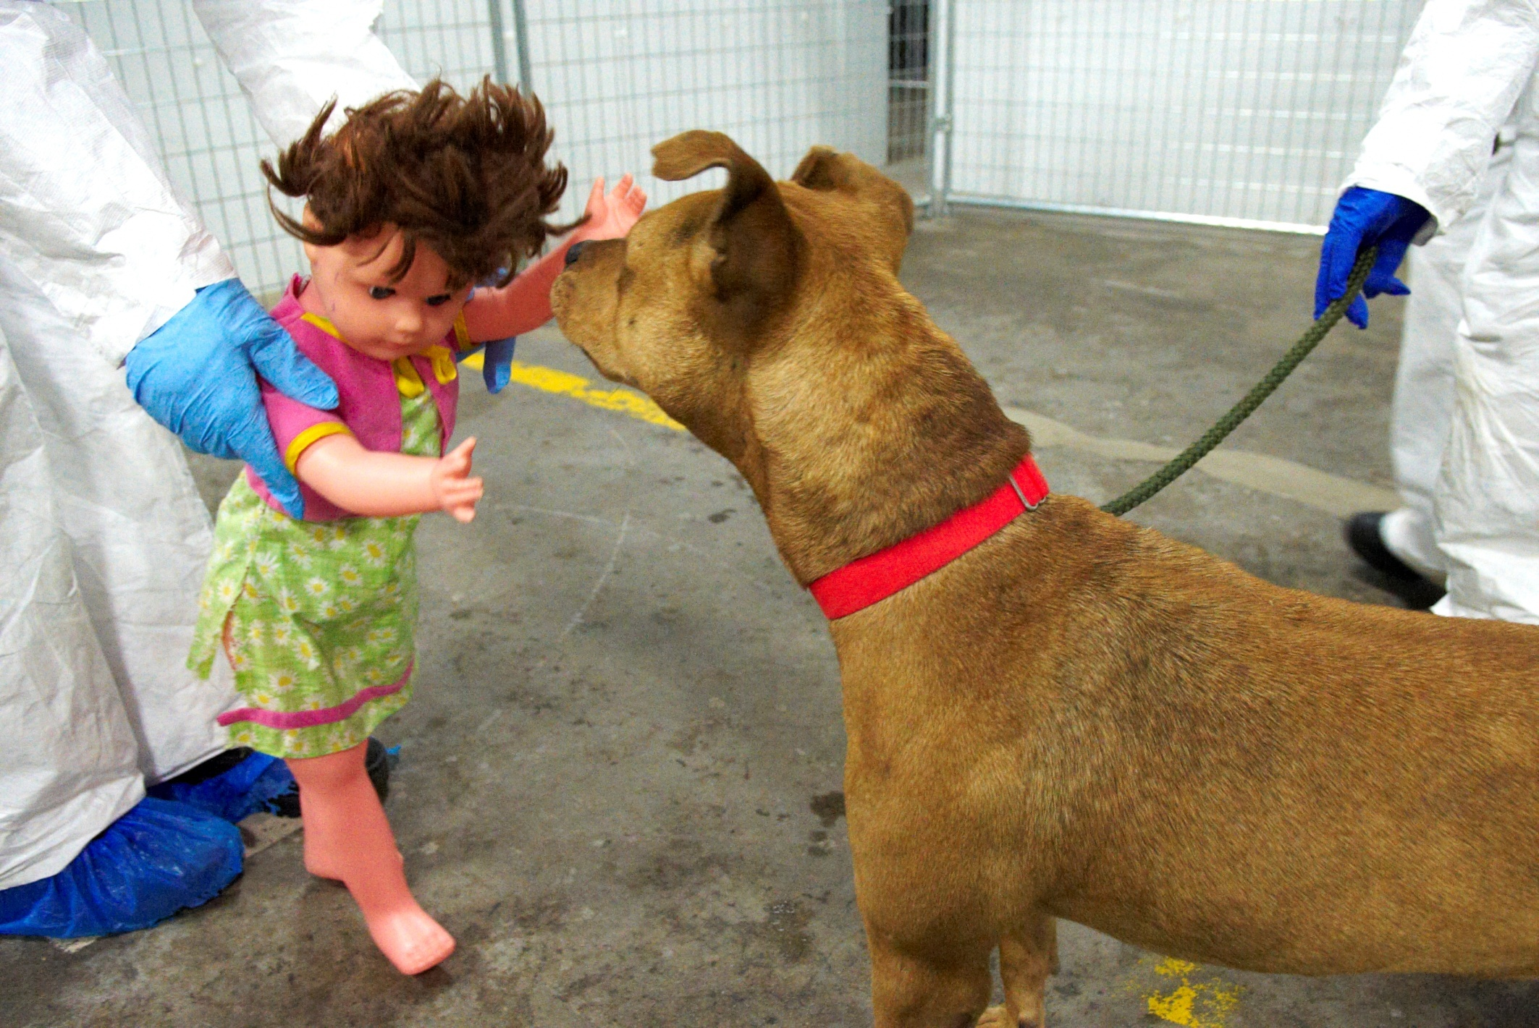
Testing Sociability Toward Children
Notes:
Kathy Houpt study
In an unpublished study by Reid at U of Guelph, a dog’s reaction toward a doll is more reflective of its reaction toward an unusual stimulus than its reaction toward children

Slide 27
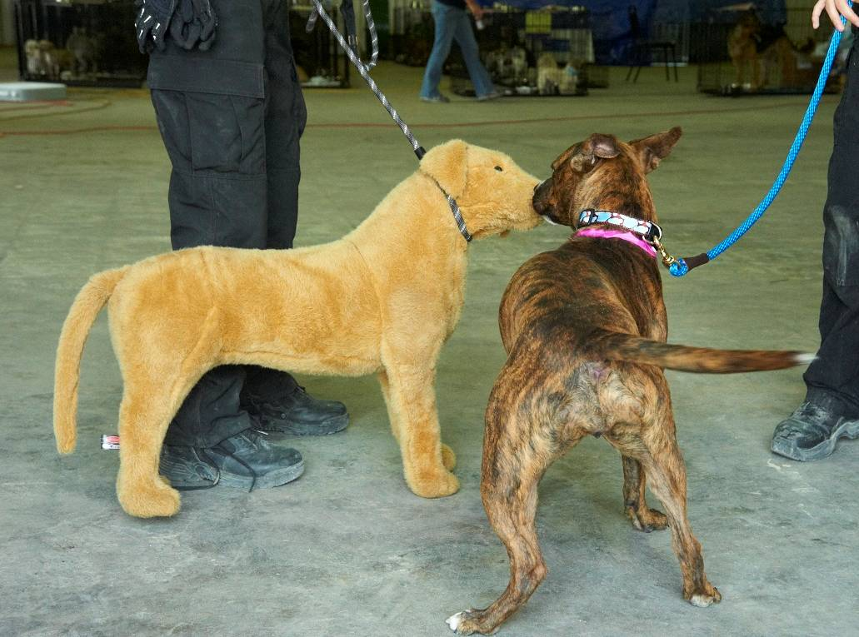
Testing Sociability Toward Dogs

Slide 28
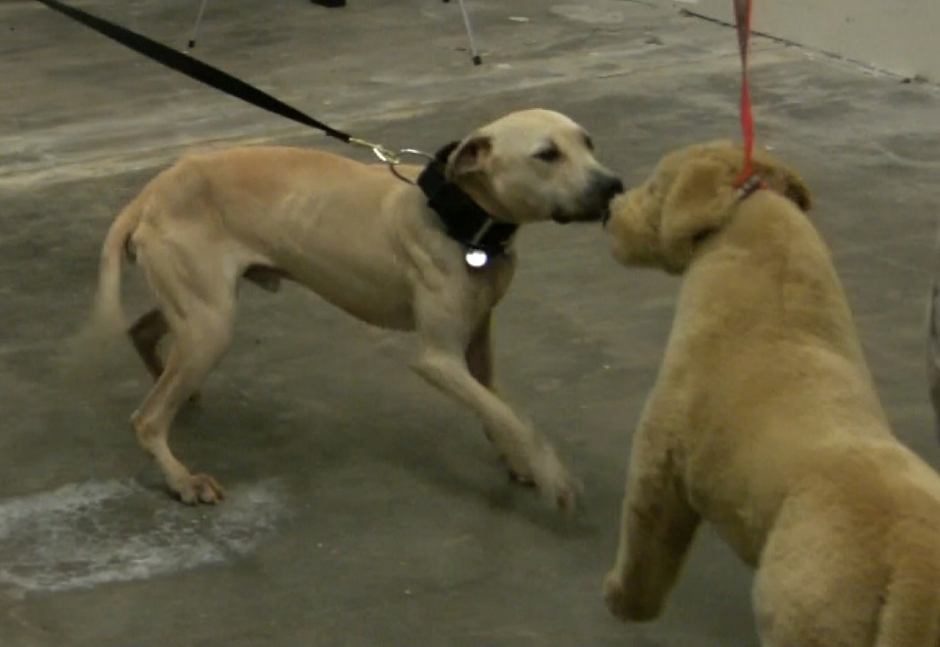
Shelter Dogs
Behavior | Degree of Agreement
Aggression | Poor
Friendliness | Substantial
Fearfulness | Moderate
Notes:
Shabelansky et al (2015)

Slide 29
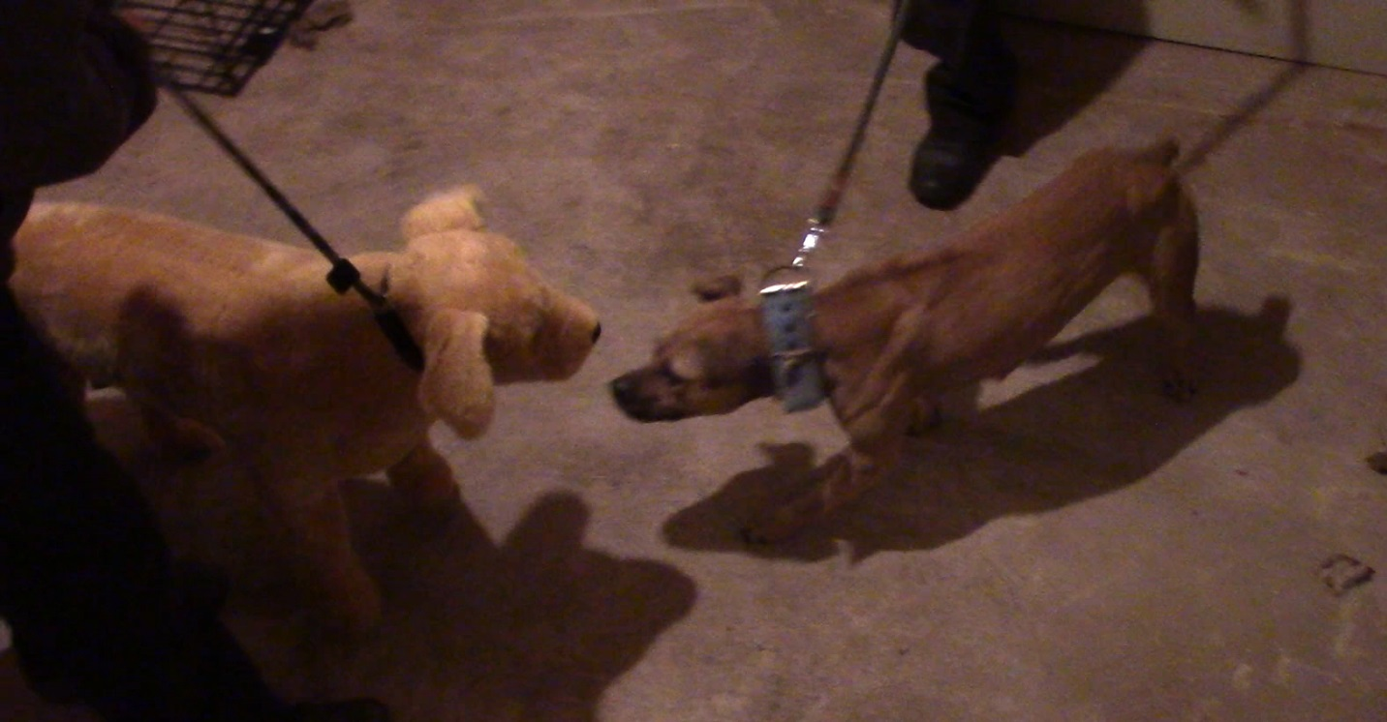
Sanctuary Dogs
Behavior | Degree of Agreement
Aggression | Poor
Friendliness | Fair
Fearfulness | Moderate
COPYRIGHT © 2018. ASPCA®. ALL RIGHTS RESERVED.
Notes:
ASPCA Study (as yet unpublished)
N=156
71 females (69 intact)
83 males (50 intact)
Mostly mixed breeds
89% adult (remainder juveniles) 11% 8+ yrs

Slide 30
Fake Dog: Poor Tool for Identifying Aggressive Dogs

Slide 31
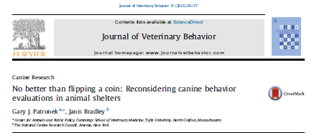
Notes:
Explain Patronek & Bradley study and findings

Slide 32

Notes:
Don’t throw out the baby with the bathwater!

Slide 33
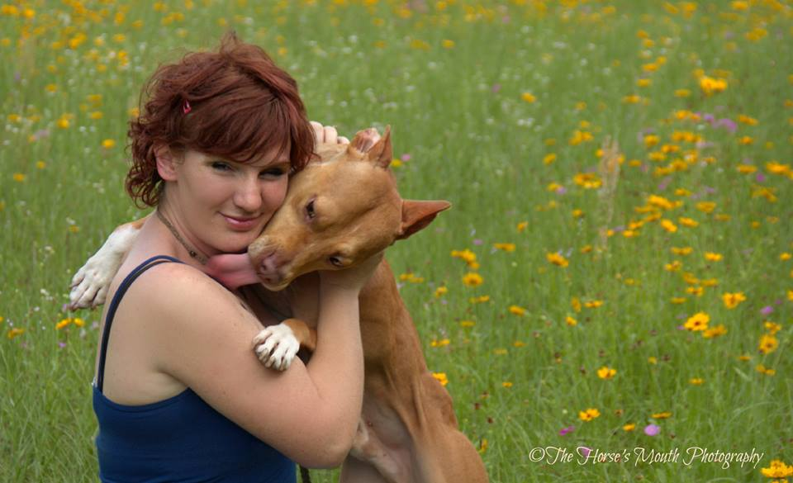
Our ultimate goal is to reduce length of stay while putting safe, happy dogs into our communities.

Slide 34
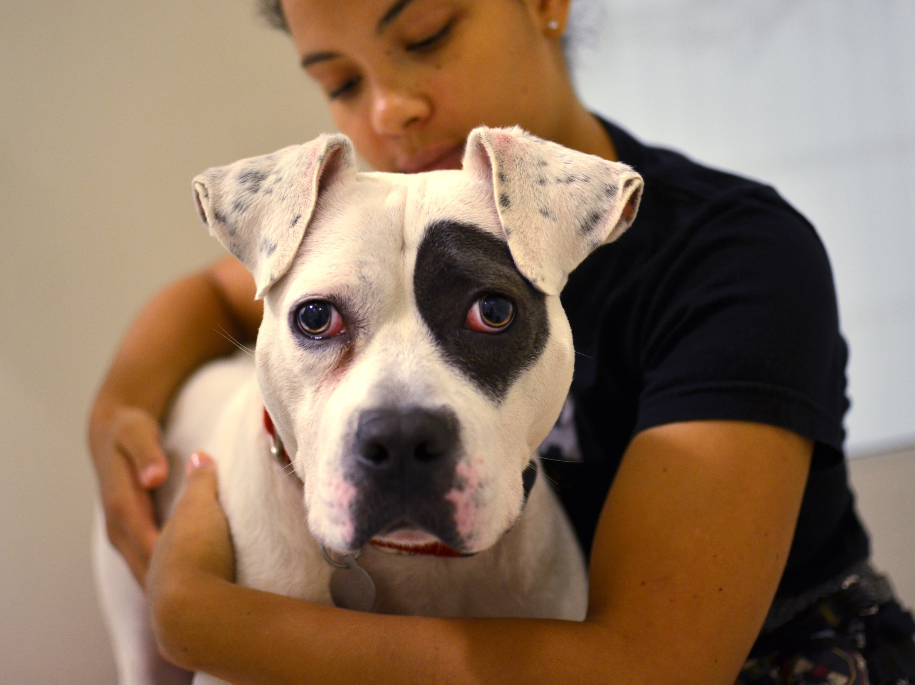
Q&A
Notes:
And now we’d like to take your questions…

