Slide 1
ENJOY THE MUSIC
The webinar begins at the top of the hour
Join the webinar using
COMPUTER AUDIO
or
CALL IN with your phone:
669-900-6833 or 646-558-8656
Webinar ID: 868-872-649

Slide 2
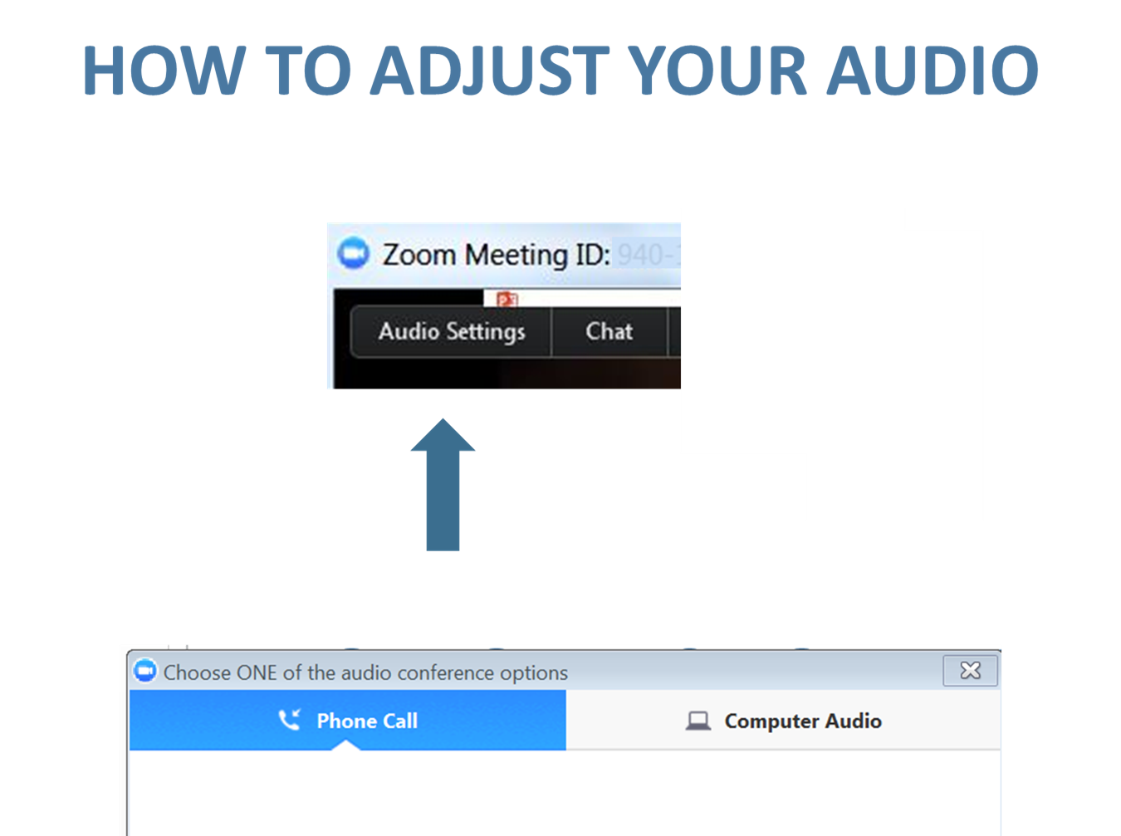

Slide 3
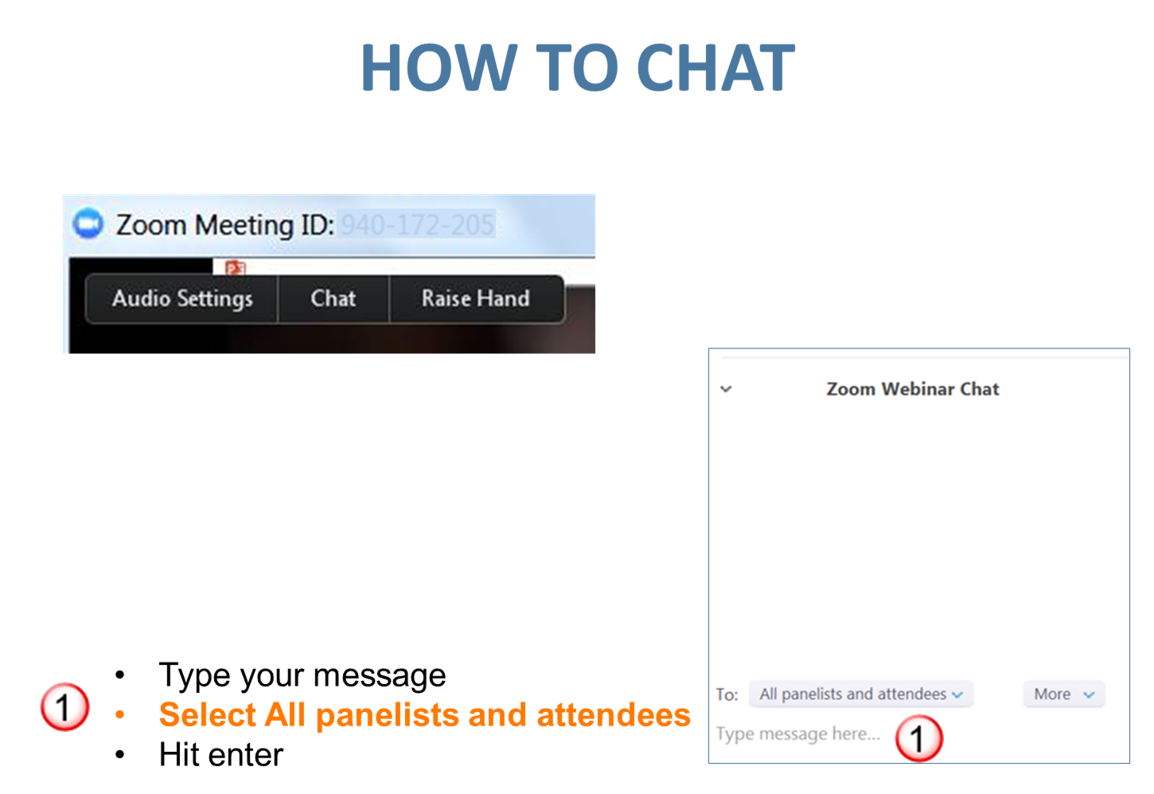

Slide 4
Is Your Adoption Process Really Working?
Your Presenter
Susan Cosby
Director of Lifesaving Programs and Partnerships
Petco Foundation

Slide 5
Adoptions
#allthecats

Slide 6


Slide 7


Slide 8


Slide 9


Slide 10


Slide 11
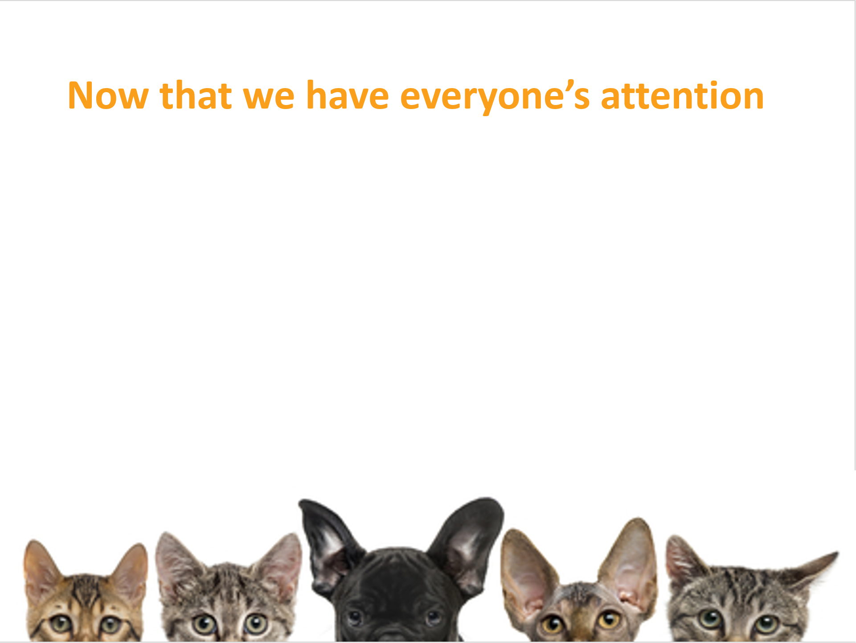

Slide 12


Slide 13


Slide 14
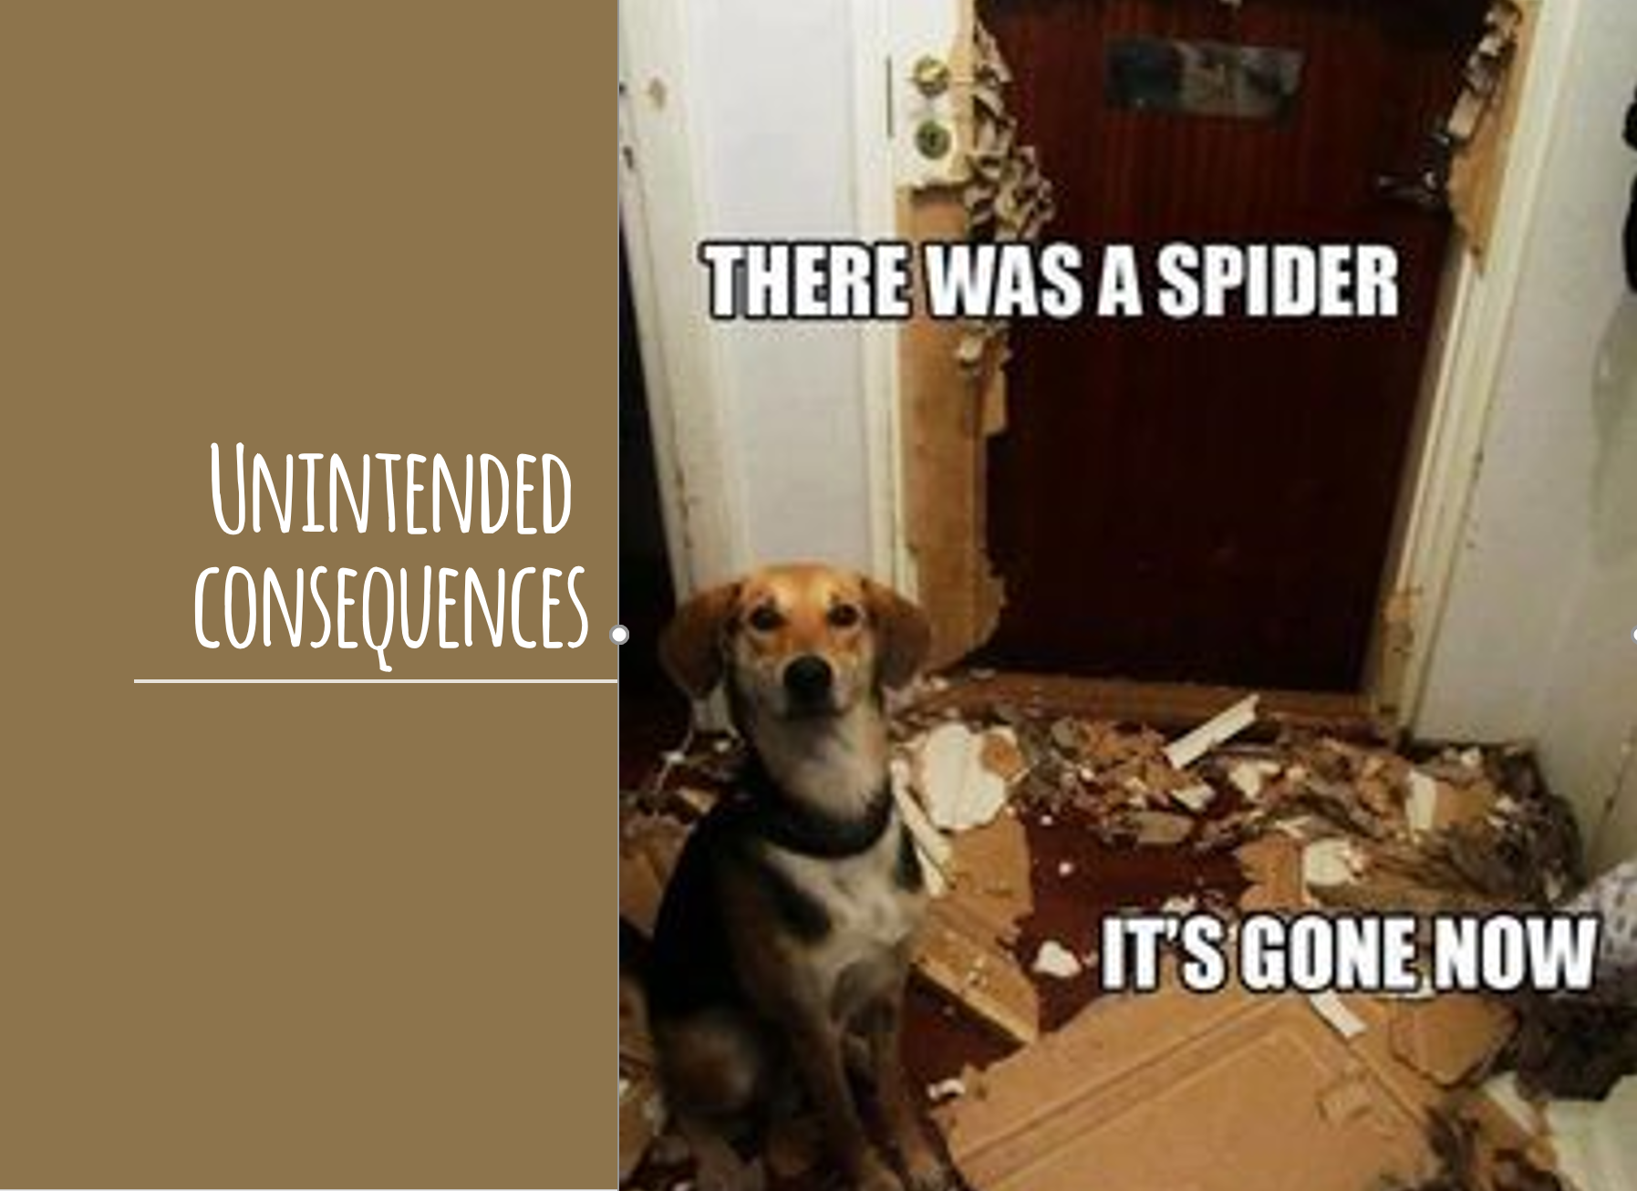

Slide 15
Rescues & shelters both rated low on:
Too much paperwork
Lengthy application process
Strict requirements
High fees
No response
Lack of follow up
*Best Friends Animal Society Adoption Barriers Research, 2016

Slide 16
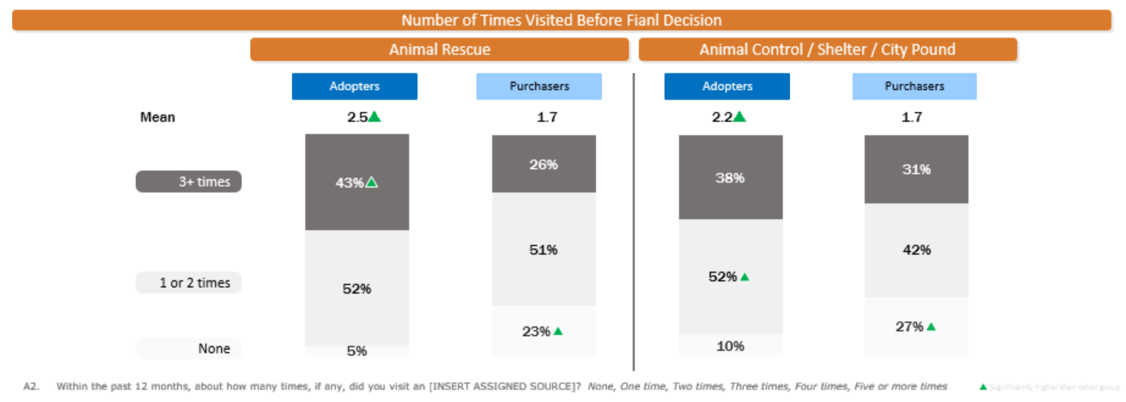
Most (73-77%) of purchasers visited a shelter or rescue prior to purchasing a pet
*Best Friends Animal Society Adoption Barriers Research, 2016

Slide 17
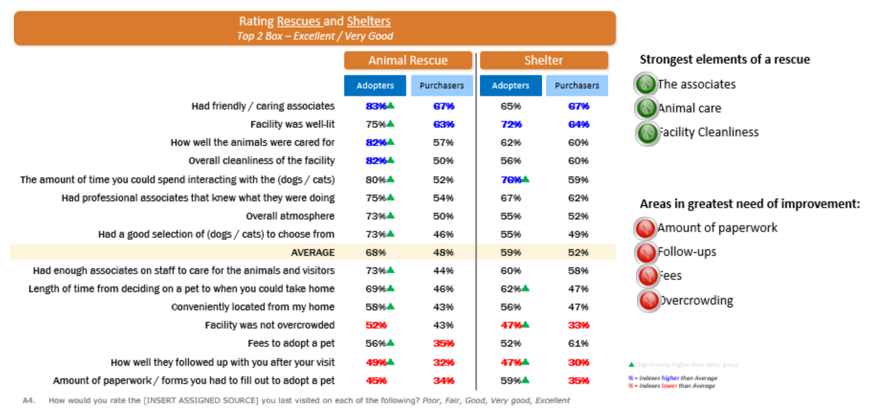
*Best Friends Animal Society Adoption Barriers Research, 2016

Slide 18
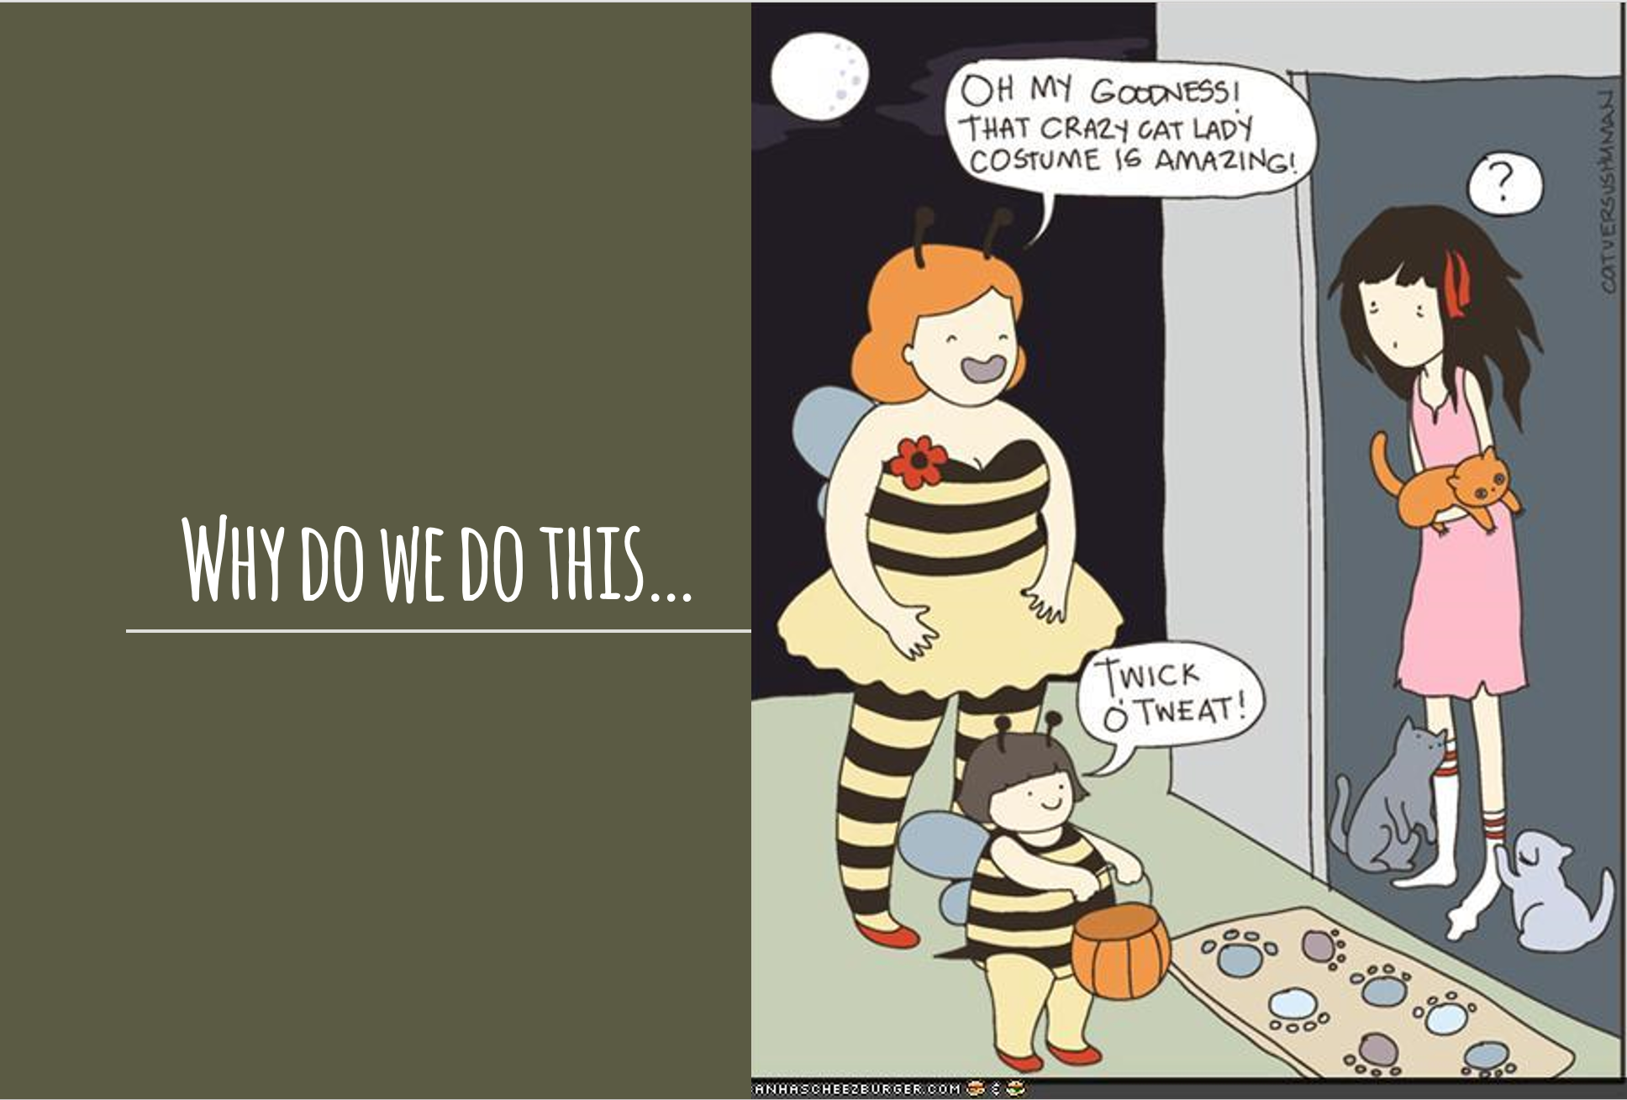

Slide 19


Slide 20
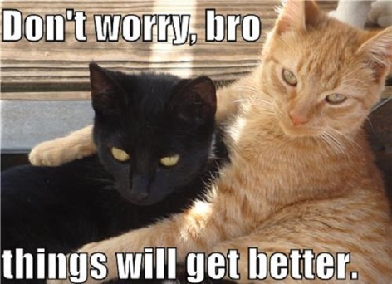

Slide 21


Slide 22
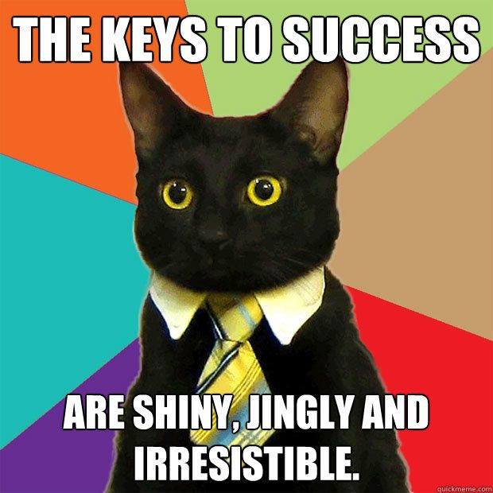

Slide 23


Slide 24
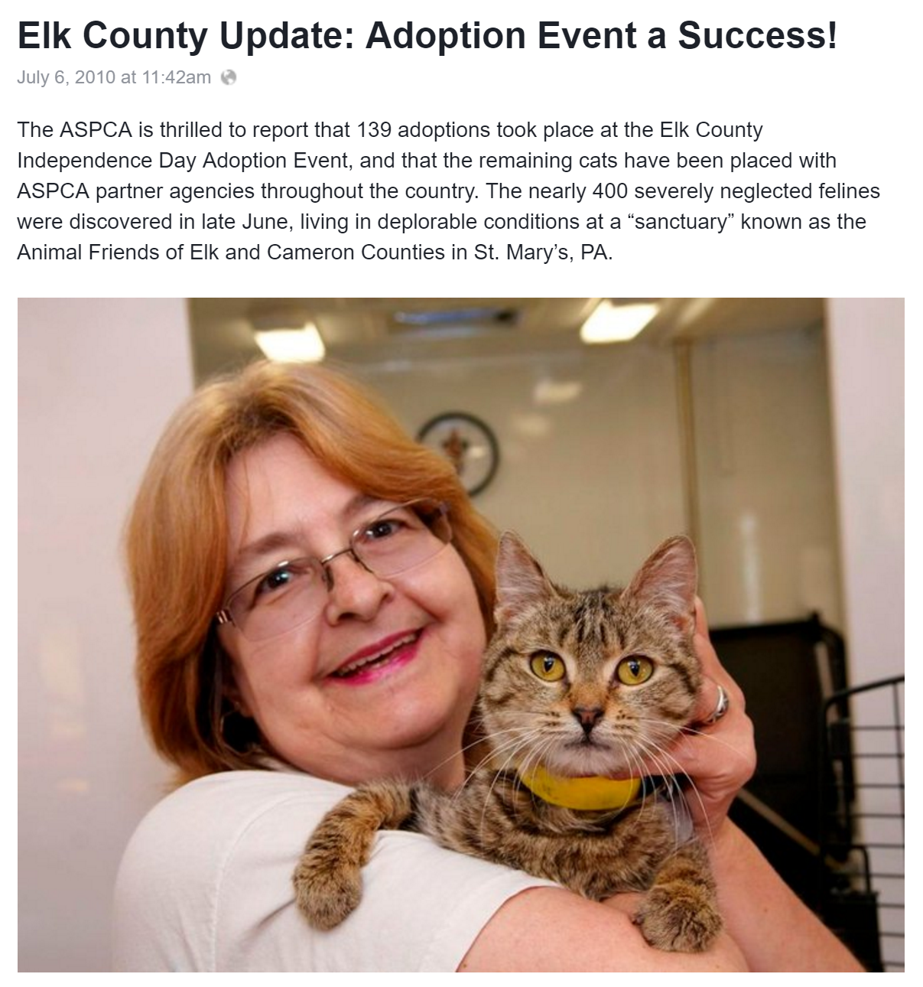

Slide 25


Slide 26


Slide 27


Slide 28


Slide 29
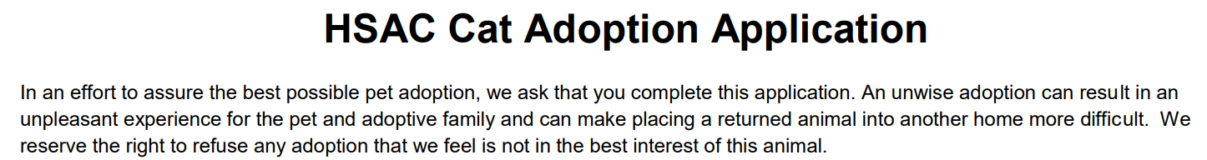

Slide 30


Slide 31
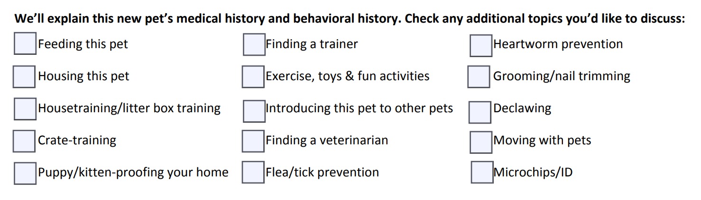


Slide 32
Creating your adoption experience
Gather your people
Bring your materials (adoption related materials)
Do a language check – are you friendly? Are you thankful? Are you grateful?
Look for telltale words like “must” and “required”
See PDF worksheet: “Creating your adoption experience”

Slide 33
Creating your adoption experience
Evaluate each item on your application
  Why do we ask this question?
  Is it important to know?
  Is it something we can control?
  Is there a better way to get or give information that can address this issue?
See PDF worksheet: “Creating your adoption experience”

Slide 34
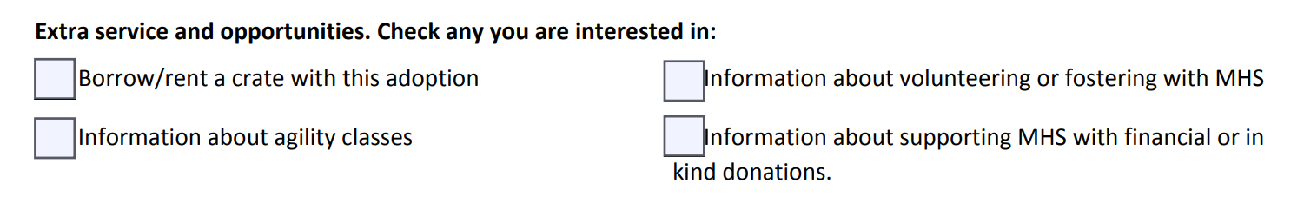
Creating your adoption experience
Discuss what is most important for your organization? It might surprise you…
See PDF worksheet: “Creating your adoption experience”

Slide 35
Creating your adoption experience
Take a hard look at each question.
Do you really need to ask it?
What information are you trying to get?
Is there a better way to ask the question?
See PDF worksheet: “Creating your adoption experience”

Slide 36
Tricky situations
When do you decline?
Why do you decline?
How can you get to yes?
See PDF worksheet: “Creating your adoption experience”

Slide 37


Slide 38


Slide 39
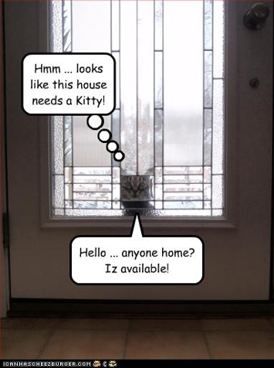

Slide 40


Slide 41
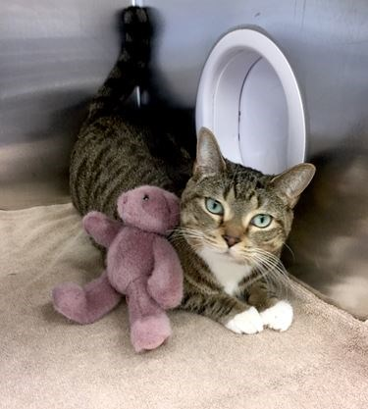
Join the Million Cat Challenge today! https://millioncatchallenge.org/
THANK YOU!

