Slide 1

How to Use Animal Resource Typing
to Improve Disaster Response
Enjoy the music!
The webinar will begin at its scheduled time.
Join the webinar using built-in computer audio or dial
669-900-6833 or
646-558-8656
Webinar ID: 897-847-654

Slide 2
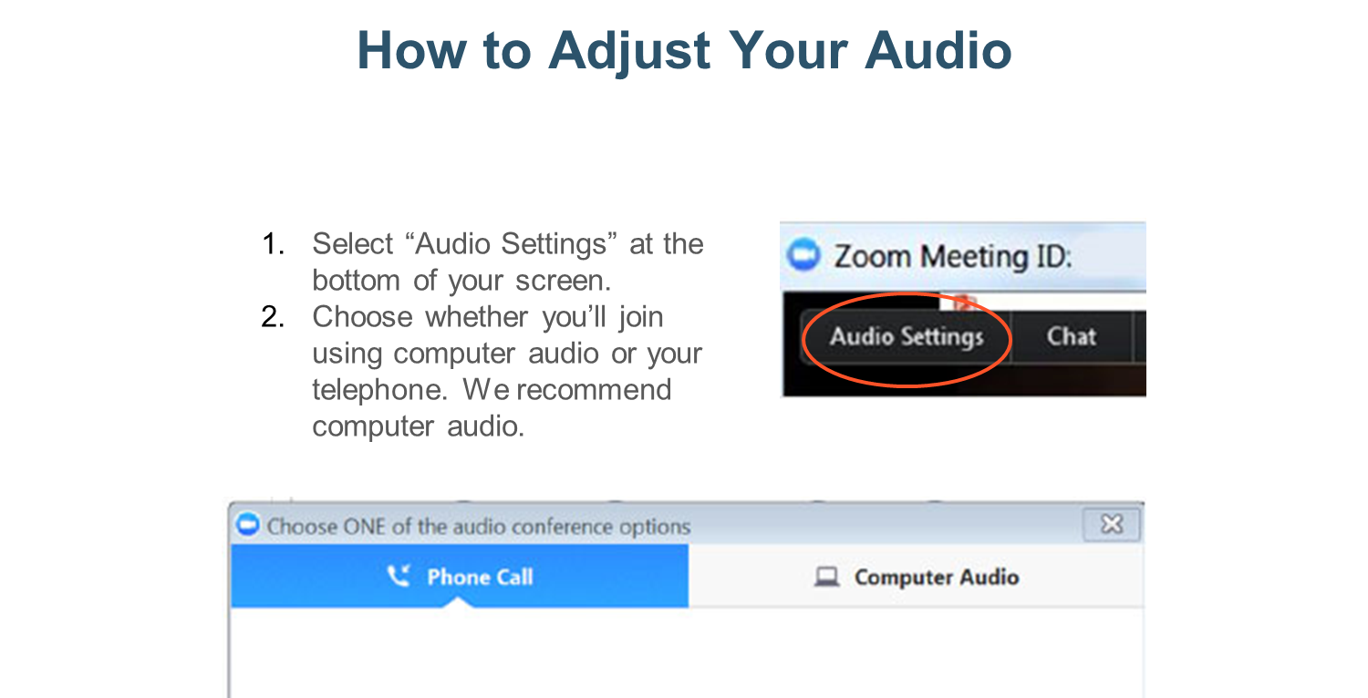

Slide 3
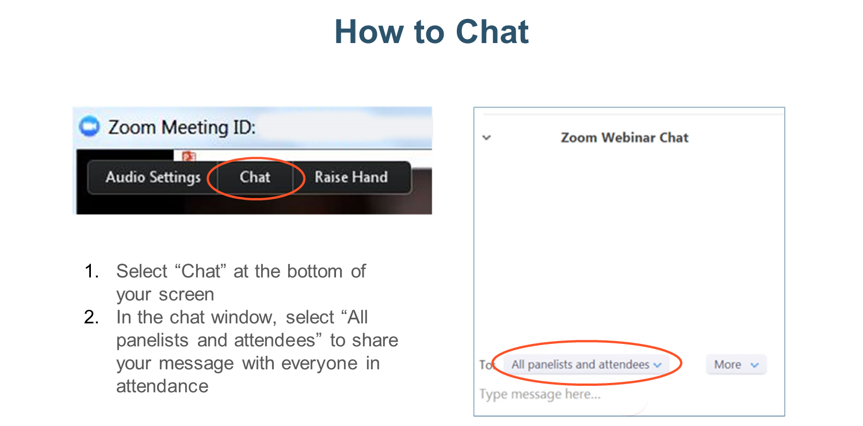

Slide 4


Animal Emergency Response
Resource Typing
Dick Green, EdD
ASPCA Director
Disaster Response
Type 3 Puppy Adorableness

Slide 5
Agenda
Introduction to Emergency Animal Resource Typing
  Kind and Type of resources
  Team and Individual typing
  Recent Examples (H. Maria, Camp Fire)
Credentialing
National Qualification System (NQS)
Emergency Management Assistance Compact (EMAC)
Mission Ready Packages (MRP)

Slide 6
History
2007 - FEMA’s National Integration Center (NIC) formed the Animal Emergency Response Working Group.
  Resource typing and credentialing framework.
2013 - Southern Agricultural and Animal Disaster Response Alliance (SAADRA) developed Animal Emergency Response Typing Guidelines.
2015 - NARSC and SAADRA revised guidelines, and shortly thereafter, they were accepted by NASAAEP.
  2014 and 2017 vetted in regional exercise and served as basis for the most recent guidelines

Slide 7

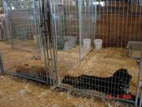


Resource Typing 101
A common language for the movement of resources.
Defines a resource’s (equipment, teams, and units)
minimum capabilities.
  Type 1 resource is generally considered to be more capable than Types 2, 3, or 4, respectively, because of
  size, capacity, experience, or qualifications.

Slide 8
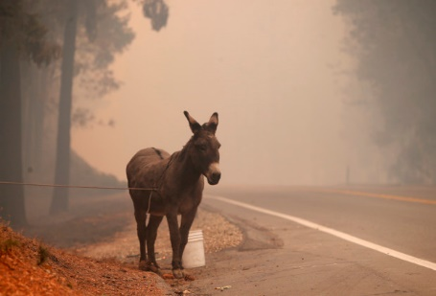
Why is Resource Typing Important?
The effectiveness of a response is directly dependent upon the availability of resources
Resource typing expedites resource ordering and delivery thereby effectiveness of response
Butte Co Fire 2018

Slide 9
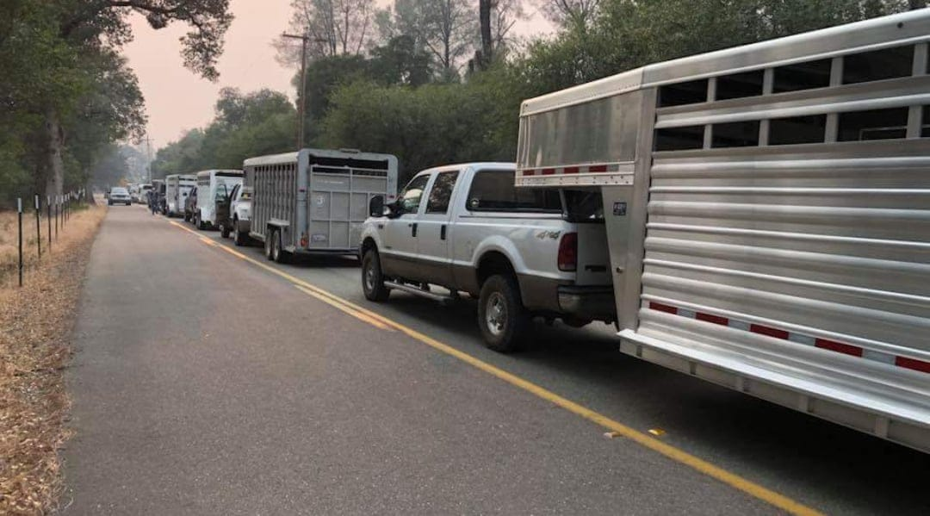


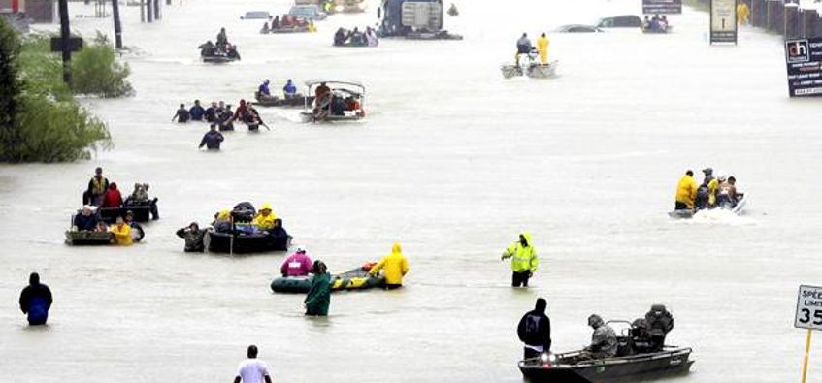
Rogue or Misguided Capabilities?

Slide 10
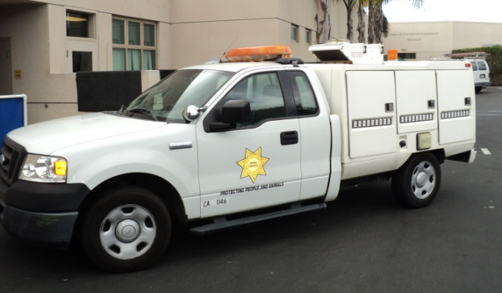
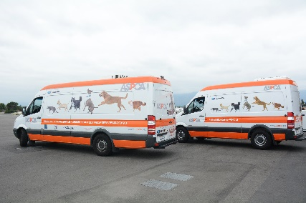
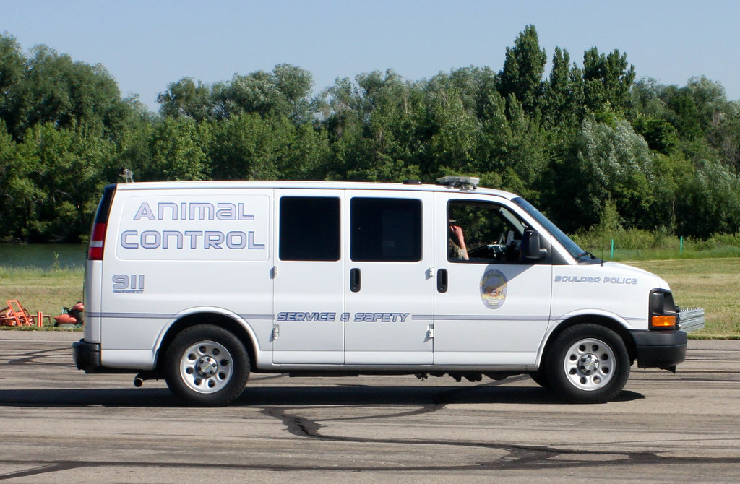
Kind and Type
Kind of resource describes what the resource is.
  Animal control vehicle, veterinary medical staff, portable X-ray machine, boat, and kennel cage
  Kinds of resources can be as broad as necessary to suit the incident application.
Type of resource describes a capability for that kind of resource.

Slide 11
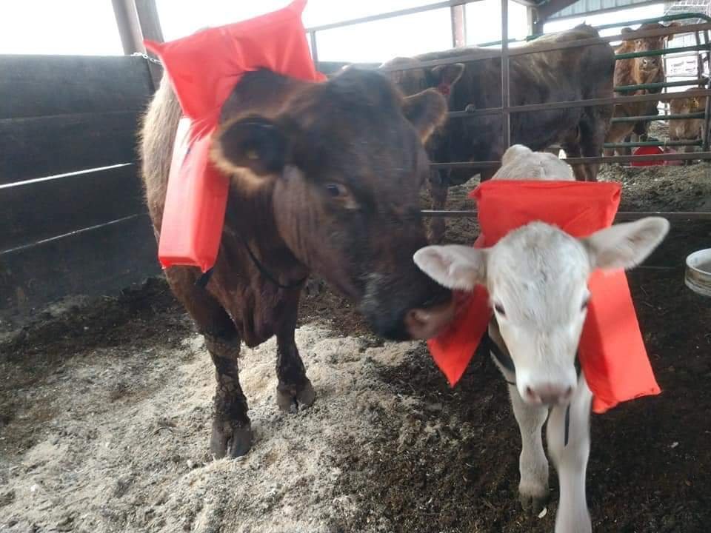
Lessons Learned
All resources may be typed; prioritize those resources you plan to share or can deploy
FEMA’s animal resource typing includes 9 animal response teams and 11 typed positions.
Animal response equipment has not yet been typed.
USCG Type 1 Cow PFD

Slide 12

FEMA Emergency Animal
Resource Typing (2018)
Chris Darlington
Carlene Hastings
Shep Willner
Anne McCann
Kevin Dennison
Brigid Elchos
Dick Green
Kelly Coladarci
Renee Poirrier
Ty Vannieuwenhoven

Slide 13
NIMS 508: Resource Typing Definitions
Used to categorize, by capability, the resources requested, deployed, and used in incidents. Measurable standards.
Veterinary Medical Team (Types 1-4)
Animal Shelter Team – Cohabitated (Types 1-4)
Animal Shelter Team – Collocated (Types 1-4)
Animal Shelter Team – Animal Only (Types 1-4)
Animal Evacuation, Transport, and Re-entry Team (Types 1-2)
Animal and Agriculture Damage Assessment Team (Types 1-2)
Animal Search and Rescue Team (Types 1-3)
Companion Animal Decontamination Team (Types 1-3)
Animal Depopulation Team (Type1)

Slide 14
NIMS 509: Position Qualifications
Inventorying, credentialing, and qualifying of personnel.
Validating identity and attributes
Veterinarian
Vet Assistant
Animal Behaviorist
Animal Response Shelter Manager
Animal Care and Handling Specialist
Animal Reunification, Tracking, and Identification Specialist
Animal Emergency Response Team Leader
Animal Control/Humane Officer
Animal Search and Rescue Technician
Animal Decontamination Specialist
Animal Depopulation Specialist

Slide 15

Animal Control/Humane Officer
RESOURCE CATEGORY | Animal Emergency Response
RESOURCE KIND | Personnel
OVERALL FUNCTION | The Animal Control/Humane Officer maintains public safety by enforcing animal-related laws and providing safe and humane capture and containment of animals in one or more of the following competency areas: 1. Companion animals, including pets, service animals, and assistance animals 2. Livestock, including food or fiber animals and domesticated equine species 3. Wildlife animals, captive wildlife, and zoo animals 4. Laboratory animals
COMPOSITION AND ORDERING SPECIFICATIONS | This position can be ordered as a single resource or in conjunction with a NIMS typed team (Animal Search and Rescue Team). Discuss logistics for deploying this position, such as security, lodging, transportation, and meals, prior to deployment This position typically works 12 hours per shift, is self-sustainable for 72 hours, and is deployable for up to 14 days Requestor specifies competency areas necessary based on the animal population the position will serve Requestor specifies specialty skills or certifications necessary, such as euthanasia or chemical capture Requestor specifies whether Animal Control/Humane Officer should bring animal control vehicle and specialized equipment

Slide 16
COMPONENT | SINGLE TYPE | NOTES
DESCRIPTION | The Animal Control/Humane Officer: 1. Provides case management of animals involved in human bite cases 2. Provides safe and humane capture and containment of stray, abandoned, unattended, diseased, or injured animals 3. Assists with emergency euthanasia, as the Authority Having Jurisdiction (AHJ) authorizes 4. Ensures safety precautions for the public and animals when working in potentially dangerous situations with unfamiliar and unpredictable animals | Not Specified
EDUCATION | Not Specified | Not Specified
TRAINING | Completion of the following: 1. IS-100: Introduction to the Incident Command System 2. IS-200: Incident Command System for Single Resources and Initial Action Incidents 3. IS-700: National Incident Management System, An Introduction 4. IS-800: National Response Framework, An Introduction 5. National Animal Care & Control Association (NACA) certification training or equivalent formal training | Not Specified
EXPERIENCE | Two years of experience as an animal control officer, commensurate with the mission | Not Specified
PHYSICAL/MEDICAL FITNESS | 1. Performs duties under arduous circumstances characterized by working consecutive 12-hour days under physical and emotional stress for sustained periods of time 2. Is able to work while wearing appropriate Personal Protective Equipment (PPE) 3. Keeps immunizations up to date and commensurate with mission | PPE is mission specific and may vary by work environment; it includes protective footwear, protective clothing for skin exposure, eye and ear protection, respirators, gloves, and masks.
CURRENCY | Routinely provides animal control services commensurate with the mission | Not Specified
PROFESSIONAL AND TECHNICAL LICENSES AND CERTIFICATIONS | NACA certification or equivalent animal control certification | Not Specified

Slide 17
Animal-Only Sheltering Team
DESCRIPTION | The Animal Sheltering Team – Animal-Only Shelter manages the oversight, setup, operations, communication, and demobilization of a temporary animal shelter. The team provides a safe and protected environment for displaced animal populations and meets their basic needs.
RESOURCE CATEGORY | Animal Emergency Response
RESOURCE KIND | Team
OVERALL FUNCTION | This team: 1. Establishes and manages a temporary shelter for the safe and humane handling, care/husbandry, and housing of one of the following animal populations: a. Companion animals, including pets, service animals, and assistance animals b. Livestock, including food or fiber animals and domesticated equine species 2. Meets animals' basic welfare needs 3. Ensures proper animal identification, tracking, reunification, and reporting 4. Coordinates with incident command; coordinates all facets of the animal response and intersecting components of the human response 5. Maintains safety, biosecurity, and sanitation of the facility and equipment 6. Provides appropriate security
COMPOSITION AND ORDERING SPECIFICATIONS | 1. Discuss logistics for deploying this team, such as security, lodging, transportation, and meals, prior to deployment 2. This team works 12 hours per shift, is self-sustainable for 72 hours, and is deployable for up to 14 days 3. Requestor may order any combination of Veterinarian, Veterinary Assistant, and Veterinary Medical Team to support this team’s activities, if necessary 4. Requestor may order a Shelter Facilities Support Team Leader to support shelter operations, if necessary 5. In an animal-only shelter, shelter staff provide full care of animals, which may be either stray (owner unknown) or temporarily away from their owners 6. Though owners may visit, they do not provide daily animal care 7. Average ordering ratio for Animal Care and Handling Specialists is one person to 15 animals; this ratio varies by species and shelter conditions 8. Requestor considers sheltering requirements for animals that are not medically or behaviorally suited for congregate sheltering 9. Requestor considers species-specific management needs

Slide 18
COMPONENT | TYPE 1 | TYPE 2 | TYPE 3 | TYPE 4 | NOTES
PERSONNEL PER TEAM MINIMUM | 43 | 26 | 11 | 9 | Not Specified
PERSONNEL PER TEAM MANAGEMENT AND OVERSIGHT | Same as Type 2, PLUS: 1 – National Incident Management System (NIMS) Type 1 Animal Emergency Response Team Leader 1 – Administrative Support | Same as Type 3, PLUS: 1 – NIMS Type 1 Animal Emergency Response Team Leader | Same as Type 4, PLUS: 1 – NIMS Type 2 Animal Emergency Response Shelter Manager | 1 – NIMS Type 1 Animal Emergency Response Team Leader | 1. Order one or more NIMS Type 1 Animal Emergency Response Shelter Manager if shelter planning, site selection, design, and setup are necessary to establish shelter. 2. Animal Emergency Response Team Leaders provide technical expertise for operations, planning, logistics, safety, finance, and administration of shelter operations. 3. Order additional Animal Emergency Response Team Leaders as appropriate based on scope and scale of shelter operations. 4. The Administrative Support position is not a NIMS typed position.

Slide 19
COMPONENT | TYPE 1 | TYPE 2 | TYPE 3 | TYPE 4 | NOTES
PERSONNEL PER TEAM SUPPORT | Same as Type 2, PLUS: 13 – NIMS Type 2 Animal Care and Handling Specialist 2 – Animal Intake and Reunification Specialist | Same as Type 3, PLUS: 13 – NIMS Type 2 Animal Care and Handling Specialist 1 – NIMS Type 2 Animal Intake and Reunification Specialist | Same as Type 4, PLUS: 1 – NIMS Type 2 Animal Intake and Reunification Specialist | 2 – NIMS Type 1 Animal Care and Handling Specialist 5 – NIMS Type 2 Animal Care and Handling Specialist 1 – NIMS Type 2 Animal Intake and Reunification Specialist | Order additional Animal Care and Handling Specialists and Animal Intake and Reunification Specialists as appropriate based on scope and scale of shelter operations; for example: 1. To help with animal intake as shelter opens 2. If operating hours exceed 12 hours per day 3. If number of animals in shelter exceeds 500
CAPACITY PER TEAM SHELTERING | Up to 500 animals | Up to 300 animals | Same as Type 4 | Up to 100 animals | Not Specified

Slide 20
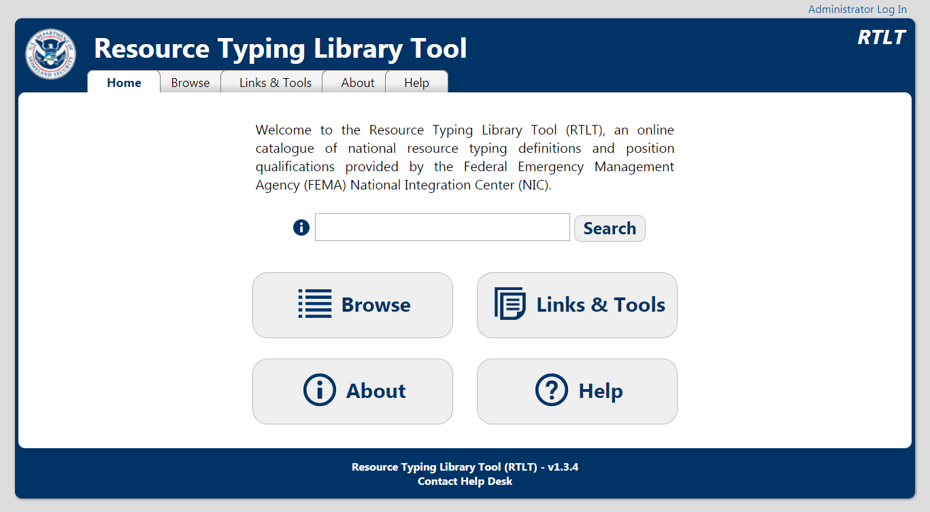

Slide 21
Hurricane Maria (Sep 2017)
10th most intense Atlantic hurricane in history
The most intense storm the world saw in 2017.
Third of a trio of storms to hit the states and territories— following hurricanes Harvey and Irma.
3rd costliest hurricane on record (~$100 B); only Katrina (2005) and Harvey inflicted more damage.
Sep 20, Maria struck Puerto Rico as a Cat 4 hurricane. Death toll likely higher than 1000 people in Puerto Rico.

Slide 22

Maria
21 Sep the ASPCA received a request from FEMA through the USDA to provide an assessment team for St. Croix.
26 Sep, team arrived on the island
31 Sep, meeting with major stakeholders and interest groups, they provided their recommendations to the commissioner for the Virgin Islands Department of Agriculture (VIDOA).
Recommendations were based on the animal resource typing

Slide 23
St Croix
Type 3 Companion Animal Sheltering Team
Type 3 Large Animal Sheltering Team
Type 3 Companion ASAR Team
Type 3 Large Animal SAR Team
2 - Type 1 Animal Behavior Specialists
Type 4 Companion Animal Veterinary Team
Type 4 Large Animal Veterinary Team

Slide 24
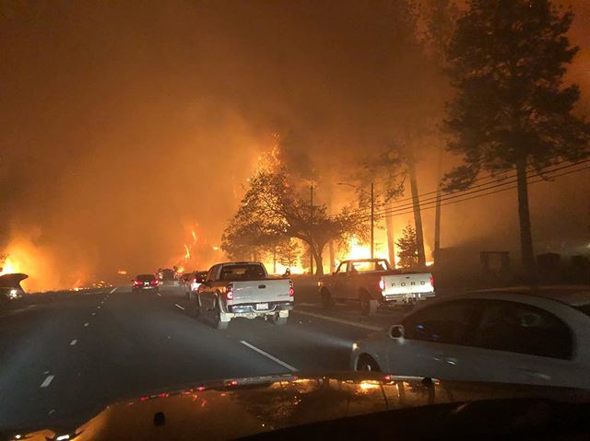
Butte Co, CA Camp Fire
11/08/18 - 11/25/18; Evacs Lifted 12/12/18
~27,000 people evacuated
  ~ 24,015 dogs, cats, birds, horses
153,336 Acres
18,804 Structures
Reached Paradise by 0800
  7.9 miles in 1hr 30 minutes
Reached Chico by end of the first day (19.7 mi)

Slide 25
More on Camp Fire
    4000 Animals Sheltered total
    Peak number in shelters - 2300
    30 Species of animals cared for
  Estimated 6000 Animals cared for in Evac Area
  4221 request for evac response
  Average of 20T feed provided in the field/ day
  Peak 80 evac teams

Slide 26
Butte County (Camp Fire)
Type 3 Companion Animal Sheltering Team
Type 3 Large Animal Sheltering Team
2 - Type 1 Animal Behavior Specialists
Type 4 Companion Animal Veterinary Team
Type 4 Large Animal Veterinary Team
Animal Care and Handling Specialist
Animal Control/Humane Officer

Slide 27
Credentialing
Process whereby the identity and attributes of individuals or members of teams are validated against an established set of minimum criteria and qualifications for specific job titles.
ASAR Credential AR Flooding June, 2019

Slide 28
Hole
Photo here
Qualification Card
National Animal Rescue & Shelter Coalition
www.NARSC.net
Issued by:
Organization logo/contact info here
Name here
ID # 478-08-
Creating/modifying credentials to reflect new Emergency Animal Resource Typing
Expires: 01/25/2010
Emergency Information: Blood Type:
Allergies:
ICE Contact:
Qualified at the XXXXXXX Level for Shelter Work
Qualified at the XXXXXXX Level for Field/Rescue Work
Level
Shelter Work
Field/Rescue Work
A
AWARENESS
IS 10 & IS 100, 200, 700, 800
IS 10 & IS 100, 200, 700, 800
O
OPERATIONS
Awareness prerequisites plus Approved Sheltering Course (AES), Basic First Aid/CPR
Awareness prerequisites plus Approved Sheltering Course, AHE, Haz-mat Awareness Certificate
T
TECHNICAL
Operations prerequisites plus Animal Handling Experience (AHE), Animal Sheltering Experience (ASE)
Operations prerequisites plus Technical Animal Rescue and Large Animal Rescue training and experience, S-130,10, SAR TECH III, Basic boat Handling/safety, Advanced AHE
S
SPECIALIST
Technical prerequisites plus ICS 300, Advanced AHE, Haz-mat awareness Cert.
Technical prerequisites plus High/Low angle rescue, SRT, confined space, trench rescue, First Responder, ICS 300, S290
experience
Approved by:
Name, contact info & signature here

Slide 29
National Qualification System (NQS)
FEMA system to provide a foundational guideline on the typing of personnel resources within the NIMS framework.
  Describes components of a qualification and certification system;
  Defines a process for certifying the qualifications of incident personnel;
  Describes how to stand up and implement a peer review process; and
  Provides an introduction to the process of credentialing personnel.

Slide 30
NQS
FEMA has established the NIMS Job Titles/Position Qualifications
  Defines minimum qualification criteria for personnel serving in defined incident management and support positions.
  Next step in the animal resource typing process will be to establish the minimum qualifications for all of the positions.
  Position Task Books: experiences logged and recognized for advancement.

Slide 31
Emergency Management Assistance Compact (EMAC)
Resource typing will allow for states to better define what animal resources they need.
EMAC is a process for states to borrow resources from other states.
All hazard-all discipline mutual aid compact signed into law with all 50 states, DC, Puerto Rico, Guam, and USVI.
Offers assistance during governor-declared states of emergency that allows states to send personnel, equipment, and commodities to assist with response and recovery efforts in other states.

Slide 32
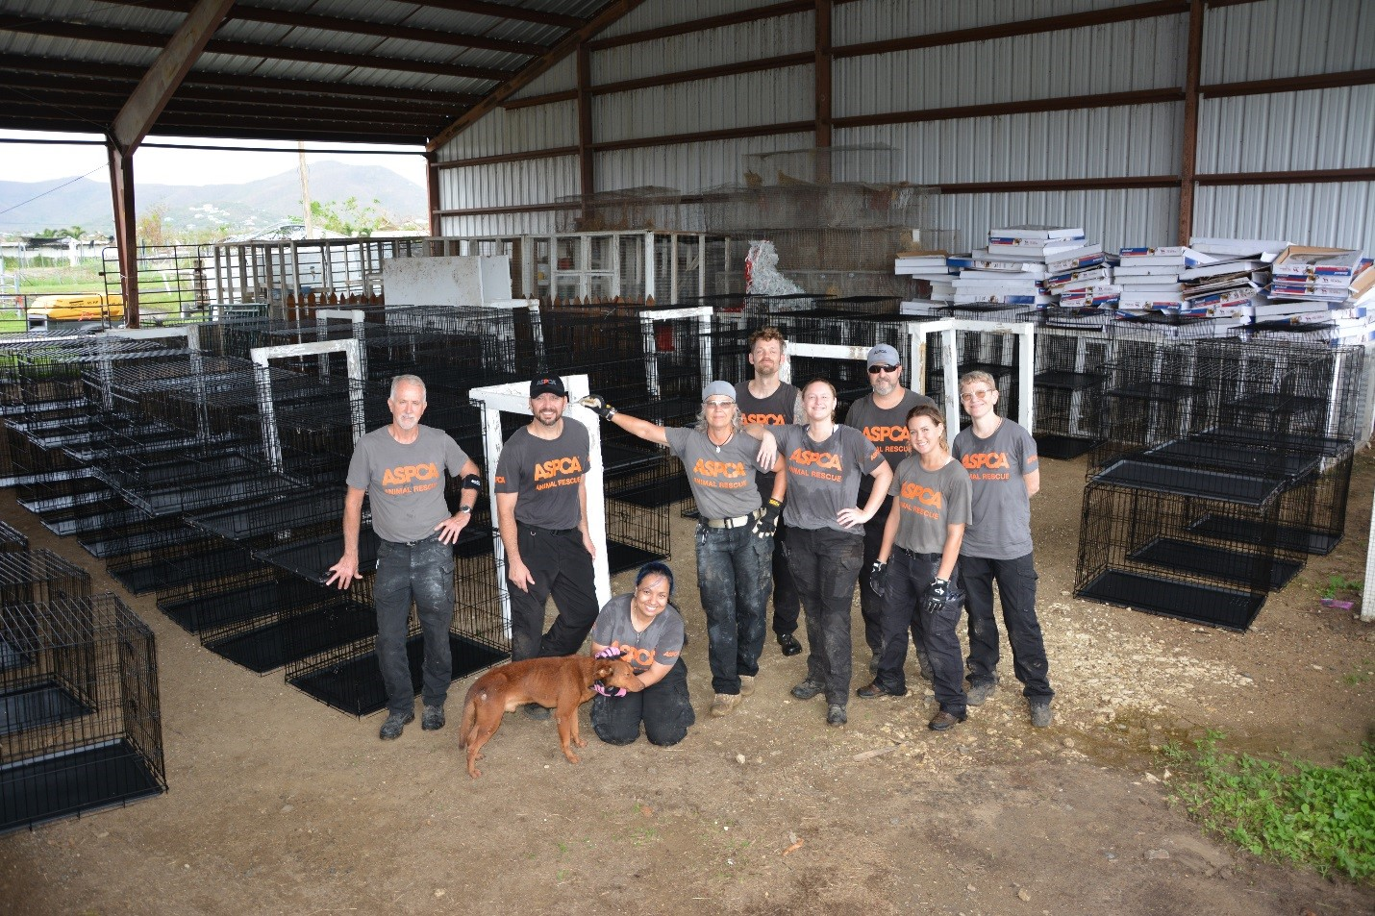
EMAC
States can also transfer services (such as shipping blood from a disaster-impacted lab to a lab in another state) and conduct virtual missions (such as GIS mapping).
The cost for borrowing resources falls on the borrowing state or territory.
A number of EMAC requests were made following Hurricane Maria.

Slide 33
Mission Ready Packages (MRP)
Pre-identifying specific response and recovery capabilities that are organized, developed, trained, and exercised prior to an emergency or disaster.
Based on NIMS resource typing but also consider the mission, limitations that might impact the mission, required support, space needed to stage and complete the mission, personnel assigned to the mission, and estimated cost.
A major component of EMAC. States can request or deploy equipment, personnel (including volunteers), and other resources through MRPs to assist in disaster recovery efforts.

Slide 34
MRPs
Under EMAC, typed resources can be classified under one of the following categories:
  Animal health
  Medical and PH
  EMS
  Human services
  Fire and haz-mat
  Incident management
  Law enforcement
  Mass care
  Public works
  Search and rescue
  National guard
  Telecommunicator emergency response

Slide 35
MRPs
State emergency management agency oversees the development of potential MRPs that fit stated categories or meet specific capabilities.
Each MRP includes additional information on the costs, limitations, space requirements, and more associated with the deployment and subsequent use of the MRP.
This information allows requesting states to select the MRP that best fits their budgets, needs, and limitations

Slide 37

Questions?

Slide 38

Thank-you!!
dick.green@aspca.org
Andybob

