Slide 1
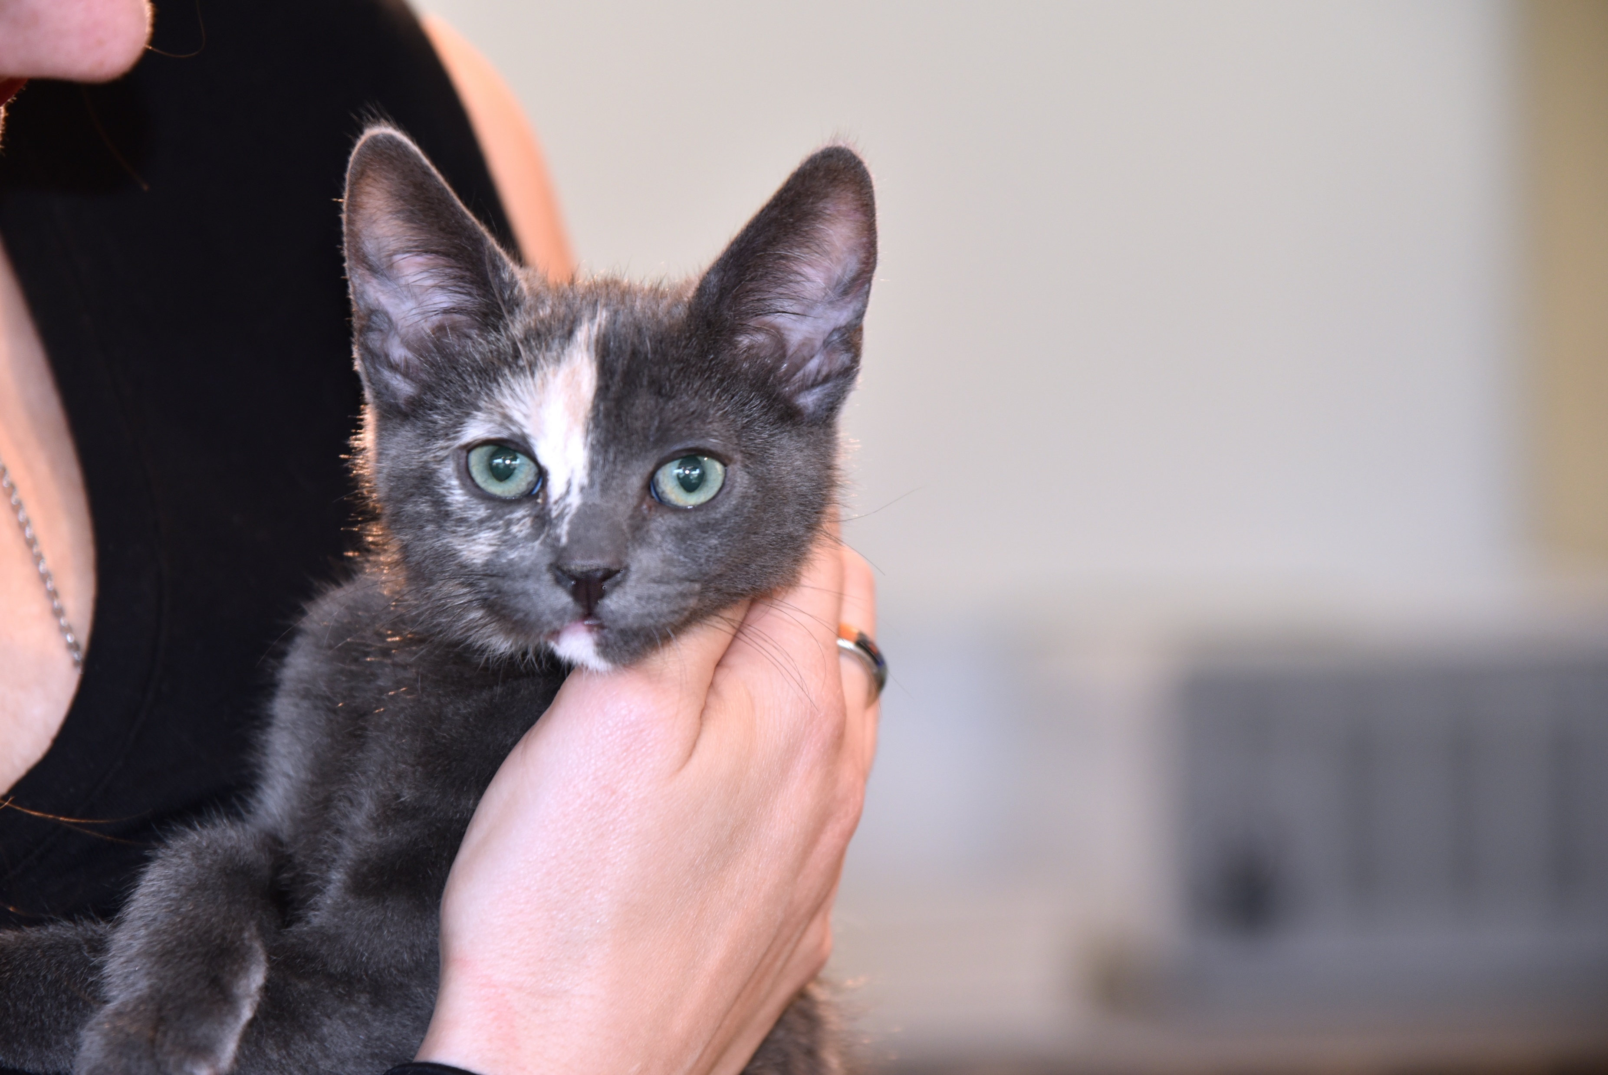

Adoption Ambassador Program
Training Session -
Presented by:
Nicole Marquez - Coordinator, Placement & Logistics
© 2020 ASPCA®. All Rights Reserved.
Notes:
“Hi fosters! My name is Nicole and I’m our Pee Wee program’s Coordinator of Animal Placement and Logistics. Thank you so much for your interest in becoming a member of our Adoption Ambassador team! Our fosters have been doing a fantastic job at finding wonderful homes - in 2019 alone they adopted out 459 kittens! With the expansion of our program, and the growing number of foster volunteers becoming involved in our adoption efforts, we want to ensure everyone is provided the tools necessary to conduct successful adoptions. This training session will detail our Adoption Ambassador adoption process, and discuss what you’ll need to do to be a successful adoption counselor. After reviewing this powerpoint you will be "certified" as an ASPCA Adoption Ambassador. If you have any questions after reviewing this information please reach out to us at LAAdoptions@aspca.org.”

Slide 2
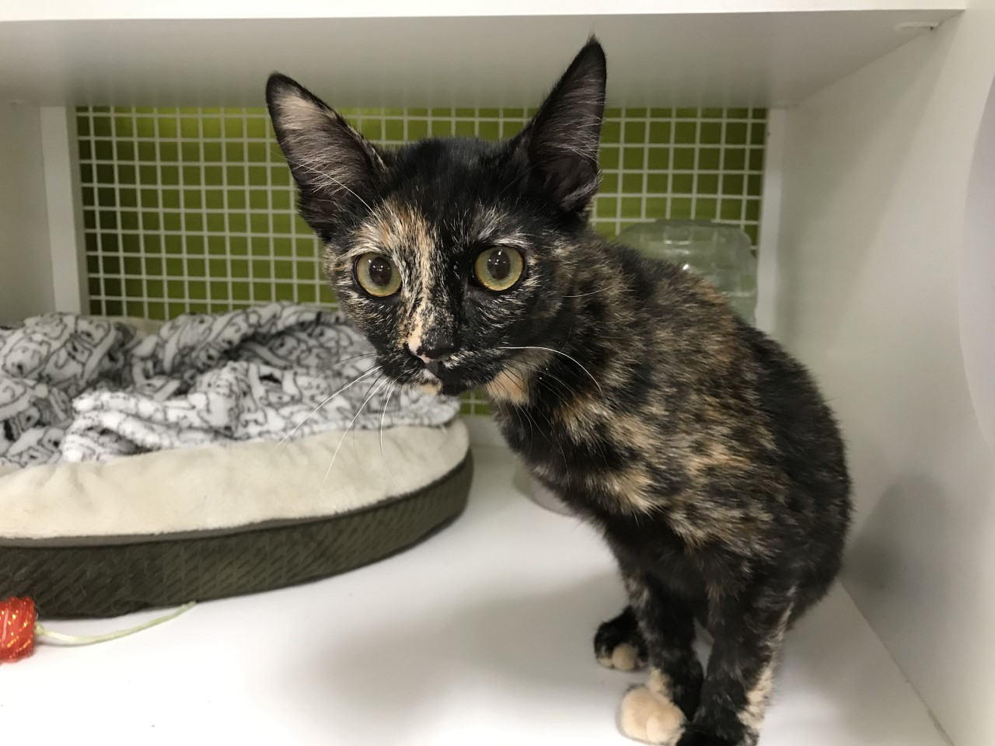
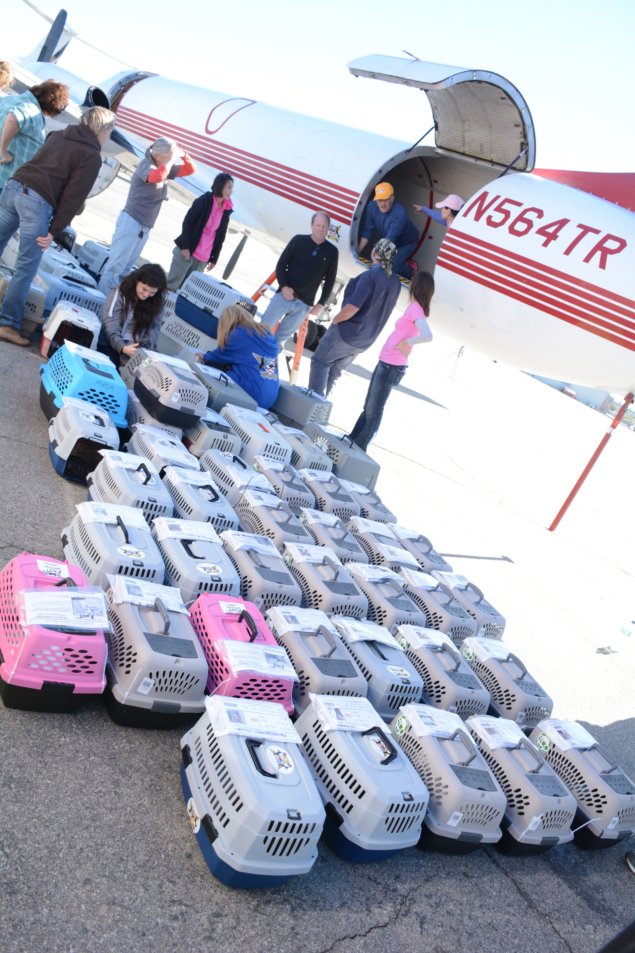
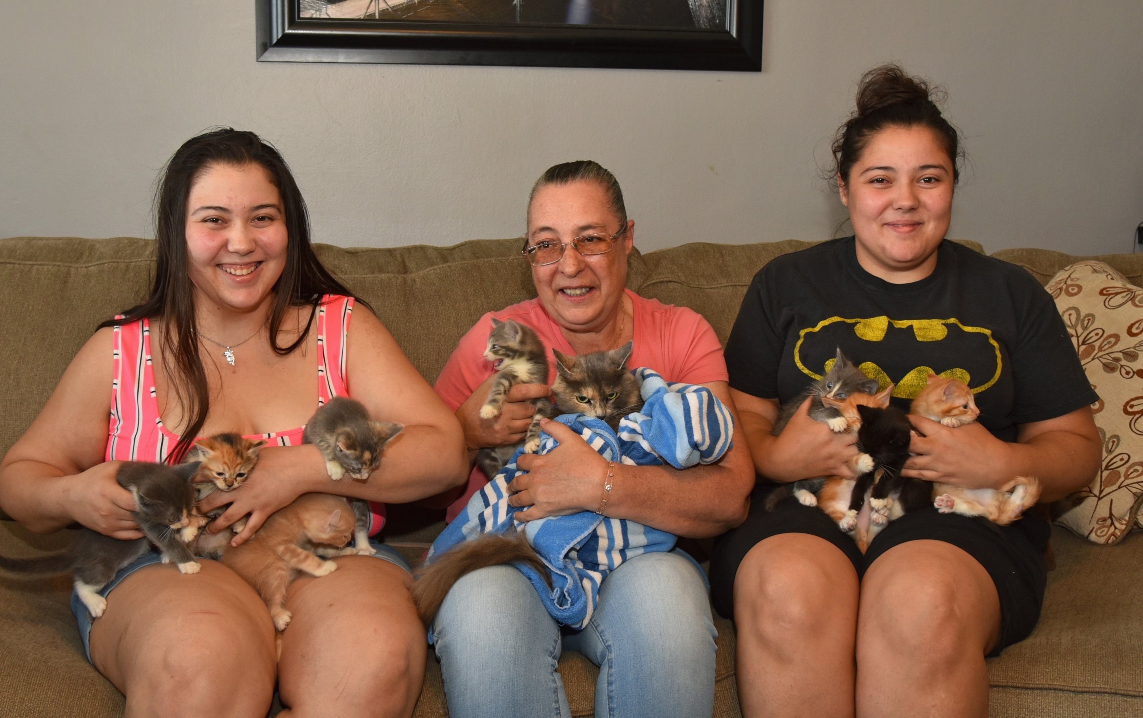
Placement Flow
Foster to adoption via:
Local Petco adoption center
Relocation to an ASPCA approved adoption partner through the Way Station
Adoption Ambassador Program
Early adoptions are important!
Adoption Ambassador goal: solidify adopter by the time of the spay or neuter appointment
Finding an adopter is NOT required. No adopter? No problem!
  Altered adoption ready kittens without adopters will be placed in Petco or relocated through the Way Station.
Notes:
“Finding homes for our foster kittens is done through any of the following three ways: via placement in one of our local Petco adoption centers, relocation to an ASPCA approved adoption partner via the Way Station in Burbank, or with the help of you, our Adoption Ambassador fosters. Kittens are ready for their new homes as soon as they undergo their spay or neuter surgery, and are healthy enough for adoption. With many factors contributing to the importance of early adoptions (including the greater appeal of very young kittens), an Adoption Ambassadors goal is to secure an adopter before their kitten has their spay or neuter surgery. However, finding an adopter for all of your kittens is not required! Any altered, adoption ready kittens can instead be scheduled for placement at one of our local Petco locations, or can travel to one of the many fantastic ASPCA adoption partners located throughout California and the Pacific Northwest.”

Slide 3

Adoption Ambassador Adoption Flow
KEEP THIS AREA CLEAR
FOR ZOOM VIDEO
Search for a potential adopter
Notify Placement Team
Hold an open-ended conversation
Unite kitten and adopter
Schedule Spay/Neuter appointment
Follow their journey!
Notes:
“Here is an overview of the adoption process through our Adoption Ambassador program. A typical Adoption Ambassador adoption will follow this pathway. Search for people interested in adopting one (or maybe even two!) of your kittens. Once a potential adopter has been found, set aside a time that works for both of you to have a conversation, this can be in person or over the phone. Once an adoption is solidified, alert our Placement team with the good news. You’ll then schedule your kitten’s spay or neuter appointment, the final step before they’re ready for their new home. Once they’ve recovered from their surgery it’s time to unite them with their adopter! Lastly, you’ll get to follow their journey by occasionally checking in. Let’s dive deeper into each of these checkpoints. ”

Slide 4
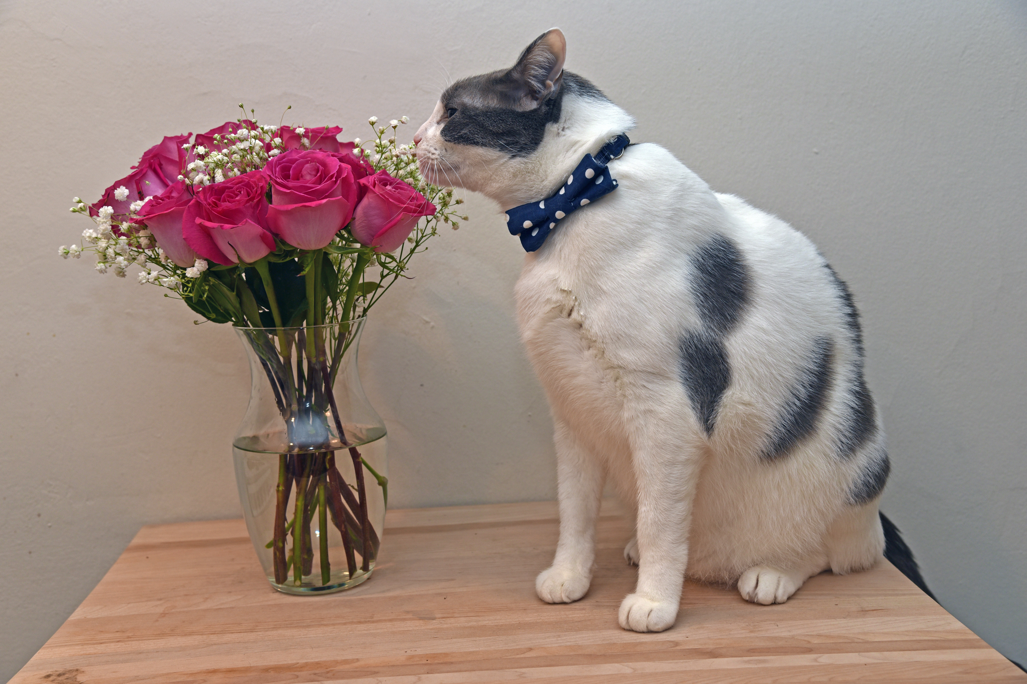
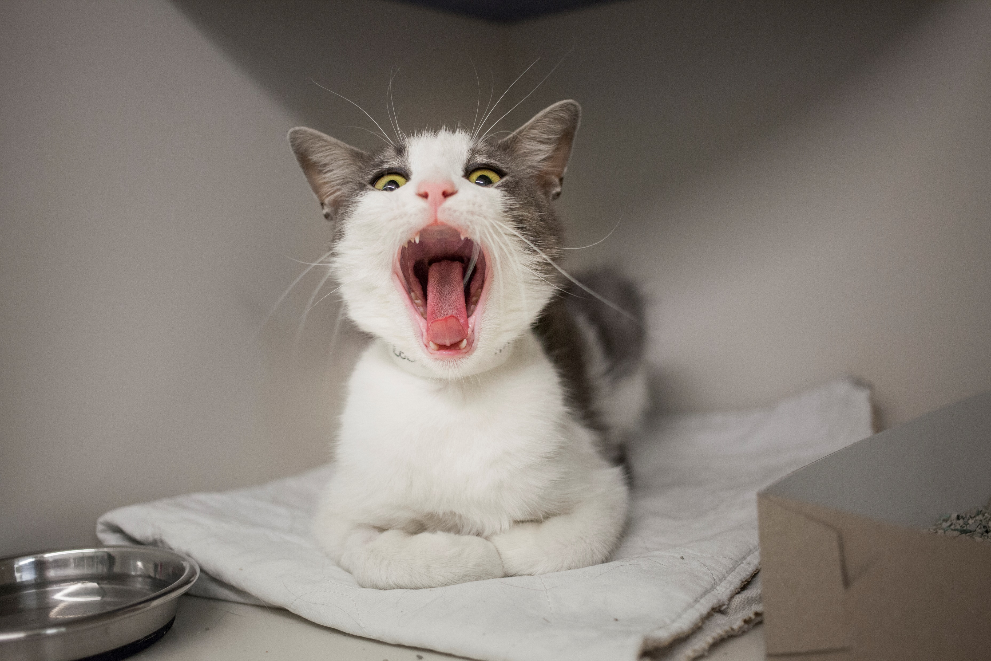
Search for a Potential Adopter
Ways to look:
Word of mouth: utilize network of friends, family, and acquaintances
Social Media: Share, share, share!
In the community: Post flyers in popular gathering areas
Ways to attract adopters:
Be CREATIVE!
Post eye-catching pictures and videos.
Use cute clothes or collars.
Write informative bios that highlight quirky characteristics – get silly!
Adopt me MEOW!
Email laadoptions@aspca.org
Notes:
“Adopters are out there, but how can you reach them? You can begin by utilizing your network of friends, family, or acquaintances to spread the word on your foster kittens, or maybe they will become adopters themselves! Social media is definitely one of the best modern tools to have a message travel far and fast. Take advantage of multiple social media platforms, and encourage your connections to share, share, share. Keep an eye out for active local Facebook groups that allow postings of adoptable pets, and share popular groups with your fellow Adoption Ambassador fosters in our ASPCA LA foster Facebook network. If you are not social media savvy, ask a family member or friend to help you out. They can use their social networking for you, or help you get started on your own. In addition to social media, consider posting flyers around your community. Seek out areas where people gather such as coffee or tea shops, or recreational centers.
When attempting to attract these adopters, get creative! Provide your social media audience with an abundance of pictures and videos - and post them constantly! Decorate pictures with eye-catching components such as funny dialogue bubbles, or dress them in clothes, bows, or cute collars. Videos are especially useful because it allows potential adopters to gain insight on how your kittens behave in a comfortable home setting. A good tip when decorating your pictures is to include your contact information. Most of the time, people just share pictures, so having your contact information readily available will ensure that adopters can reach you. Consider creating an email dedicated to communicating with potential adopters. You can also create bios that are informative and highlight particular personality traits that make each kitten stand out. Don’t be afraid to get silly or weird with these bios, maybe one of your chatty kittens enjoys ‘serenading you the song of her people.’ And maybe her extra snuggly sister enjoys ‘cuddling under the moonlight, while watching her favorite movie, Ratatouille.’
The ASPCA also posts adoptable cats on our website at aspca.org/LAAdoptions. We mostly use this website to advertise adult cats (including mama cats in foster) and harder to place cats (such as shy or special needs). The Placement Team can work with you to create an adoption profile of your foster cat to post on our website if needed.​”

Slide 5
Hold an “Open-ended” Conversation
KEEP THIS AREA CLEAR
FOR ZOOM VIDEO
The ASPCA uses a conversation-based adoption process with a goal of informing adopters about cat care and answering any questions they may have. Here are the main talking points to discuss with a potential adopter:
"What have your past experiences with cats been like?"
"What kind of cat are you interested in adopting?"
"Veterinary care is important in maintaining a happy, healthy life."
"What kind of pets do you have at home?"
  If the potential adopter does have pets at home, we have tips on how to conduct successful introductions.
  If the potential adopter has no resident cats, explain the benefits of adopting a pair.
  Adopting in pairs is not required. Kittens bond well to new feline companions!
Notes:
“The ASPCA’s adoption process uses a conversation-based approach, where we ask open-ended questions to gain insight on the potential adopter's experience in pet care and what information we need to provide to establish a well-informed pet guardian. Here we will go over the main talking points to discuss with adopters, and appropriate ways to handle responses.
‘What have your past experiences with cats been like?’ Use this question to establish a baseline on the potential adopter’s knowledge in pet care. If the adopter has no experience with cats (or needs a refresher in cat care), this is a great opportunity to discuss the basics of what a kitten will need, and what they will need to prepare for before bringing home a new pet. If they wish to adopt a kitten as a surprise gift, be sure the person speaking for the adopter feels comfortable being the best representative of the person receiving the kitten. Remember, the goal is to help potential adopters become prepared and informed pet guardians.
‘What kind of cat are you interested in adopting?’ Time to play match-maker! The great part about our fosters becoming our adoption counselors is only YOU know your kittens best! This is the perfect opportunity to match the potential adopter with the type of cat they are looking for, whether it is a reserved lap kitty, or a rambunctious playful friend for their young resident cat.
‘Veterinary care is important in maintaining a happy, healthy life.’ The ASPCA recommends that kittens are vaccinated for FVRCP every 2-3 weeks until 5 months of age and receive a follow-up veterinary exam soon after adoption. Review with the potential adopter all services your foster kitties have received. This medical history is important to keep and adopters should bring records along with them to their first veterinary appointment. Encourage the potential adopter to proactively think of a Veterinarian for their cat, if they do not have one already. If any of your foster kittens are required to have a medical waiver completed due to a health issue, be sure that a member of the Placement Team has discussed this with the potential adopter.
The ASPCA also recommends adopters speak with a veterinarian if they'd like to get their new cat/kitten tested for FeLV/FIV after adoption. FeLV and FIV are not common diseases in the cat population; therefore, interpreting test results can be complex and a single test result may not be a true indicator of an individual cat’s infection status. For this reason, only cats with clinical signs of infection and/or significant risk factors for infection are tested in our foster program.
‘What kind of pets do you have at home?’ If the potential adopter has any resident pets, ensure that they are up-to-date on their vaccinations and altered. If they have unaltered pets, inform them on the many benefits of spaying and neutering. While owning an unaltered pet is not an automatic “no” for adopting, if may serve as a “not right now.” The interested adopter may want to consider spaying or neutering their resident pets first before deciding to bring home a new pet, as it can cause unwanted behavioral issues. You can also guide them to aspca.org/LAFAQ for information on spay and neuter services, including low-cost options.
You’ll also want to take this time to provide helpful tips on introducing a cat or kitten to their resident pet. The ASPCA’s adoption packet includes an in depth look at the best methods for pet introductions that the adopter can refer to before and after adoption. You may proactively share this packet to the potential adopter to review in preparation. In the meantime, here are some helpful tips you can briefly touch upon:
If the potential adopter has a resident cat, they’ll need to begin slowly and introduce gradually. Allow for the new kitten to first become familiar with their new environment by setting them up in an area separated from their resident cat. Then, both cats can slowly become familiarized with one another's scent by having their bedding swapped. When it’s time to physically introduce the cats, utilize a barrier that only lets them sniff each other, such as a door or a baby gate. During this time, create positive associations by offering treats or meals to both cats.
If the potential adopter has a resident dog, begin by asking how their dog normally behaves around cats. If their dog has never been around a cat, the adopter should first gain an understanding of their behavior by having supervised visits with a friend or family members cat. This will also let the potential adopter know what obedience skills they will need to teach their dog in preparation for a feline addition. In this case, it may be best to reconnect with them in the future to see if their dog is ready for a cat companion. If they have a dog who is cat friendly, great! They will still want to approach the introduction process in a slow and gradual way, similar to how we discussed introducing cats to each other. First have the new kitten become accustomed to their new environment, then slowly physically introduce one another with a barrier and with the resident dog on a leash.
If the potential adopter does not have any resident cats, take the time to explain the benefits adopting a pair. Feline companionship is important in development and overall well-being throughout a cats lifetime. Cats teach each other appropriate feline manners, and keep each other company and entertained when their adopter isn’t home or even asleep! However, it is not required to adopt your foster kittens in two’s. It may seem like your kittens are bonded (especially if you only have a litter of two), but at such an early age a kitten will bond to any feline companion! Do not hold back the opportunity of a great home in fear of splitting up a pair. “

Slide 6
"The ASPCA strongly recommends that the adopter keep their new cat or kitten indoors, how do you feel about that?”
"If scratching becomes an issue, please reach out to the ASPCA. They have many safe and humane methods to help as an alternative to declawing, including different types of scratching pads, soft paws and regular nail trimmings”
"Have you considered the allergies of yourself and others in the home? Or the lease regulations for your home?"
"There is no adoption fee for any of the cats or kittens!"
"I will be checking in to see how your new cat/kitten is doing. We would love to get pictures and updates to make sure everyone is doing well."
  Send pictures and videos to laadoptions@aspca.org.
KEEP THIS AREA CLEAR
FOR ZOOM VIDEO
Notes:
“‘The ASPCA strongly recommends that the adopter keep their new cat or kitten indoors, how do you feel about that?’ Indoor cats generally live longer, healthier lives. Even if the potential adopter is on board with keeping their new kitten indoors, use this time to inform them on the enrichment your foster kitten enjoy at home.”
‘If scratching becomes an issue, please reach out to the ASPCA. They have many safe and humane methods to help as an alternative to declawing, including different types of scratching pads, soft paws, and regular nail trimmings.’ The best tactic to tackle scratching is to provide appropriate areas to scratch. Provide scratching posts with various materials, and encourage the cat to utilize them by adding toys or scenting with catnip.
’Have you considered the allergies of yourself and others in the home? Or the lease regulations for your home?’ Allergies do not have to be a barrier for owning cats, and many people with allergies live peacefully with their furry friends. Non-life threatening allergies can be maintained by weekly baths or air purifiers that remove pet dander. You'll also want to confirm with the potential adopter that they have considered any fees in their lease or rental agreement.
'There is no adoption fee for any of the cats or kittens!' With supported research, the ASPCA strongly believes in waiving adoption fees. Guardians are just as attached to their cat companions, and see no decrease in value of their cat.
‘I will be checking in to see how your new kitten is doing. We will want pictures and updates to make sure everyone is doing well.’ Unless prompted by a specific circumstance, the ASPCA does not perform regular home checks. We do, however, love to develop a lasting relationship with our adopters by checking in with a phone call, email, or even a quick text. Discuss with the adopter that you will be reaching out to them occasionally in the near future, and encourage them to reach out to you should they need support for any issues. Adopters may send their picture or video updates directly to you, or they may email us at laadoptions@aspca.org.”

Slide 7
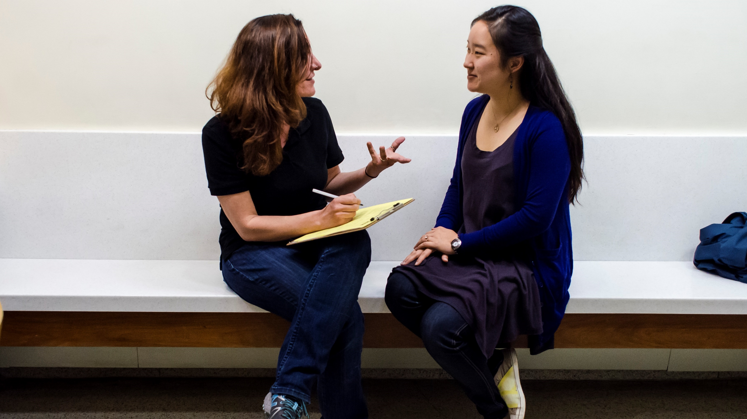
Conversation Tips
Develop a trusting and open relationship
  Positive interactions encourage honest answers
  Opens doorway for future post-adoption questions
Be objective, remove judgements
  Search for the first qualified home, not the “best” home
Turn “no” into “not yet”
  If it doesn’t seem like the best time to adopt, explore what they can do in the future to prepare for a new addition
  “It sounds like it may not be the best time for adoption. How do you feel about…”
Notes:
“The way we approach a potential adopter is just as essential as the information we discuss with them. It is important to consider that an adopter may feel nervous or intimidated because they might expect a lengthy, interrogative adoption application. They may feel worried they will be judged because they have never owned a kitten before, or their last cat met tragedy from being kept outside. We want adopters to feel that we understand them and we are not here to judge, but here to teach and help everyone be the best pet guardian we know they can be. It is important that a trusting and open relationship is developed, allowing the potential adopter to feel comfortable with you during and even after the adoption process. Encourage them to provide honest answers by keeping interactions positive. If someone is not familiar with veterinary care, take the time to happily educate them and avoid speaking in a condescending tone. This can also open a doorway for adopters to reach out in the future for guidance should any issues begin to arise - instead of resorting to giving up their companion. Whether they end up adopting or not, their experience can lead them to spread awareness on our mission and the importance of adoption.
When talking to potential adopters, be objective, remove judgements and search for the first qualified home, not the “best” home. Qualified homes come in all sizes, colors, ages, and even income levels. If you find yourself ready to decline an adopter, ask yourself if you’re being objective, or if you’re leading your search based off your judgments on what you perceive the best home should look like.
If you’ve objectively determined that it is not the best time for adoption, explore what they can do to become prepared for a new addition in the future. Turn “no” into “not yet” by saying something along the lines of: “It sounds like it may not be the best time for adoption (in this case we will use a potential adopter with an intact resident cat). How do you feel about preparing your current cat for a new friend by having him undergo his neuter surgery first? Having an intact pet can potentially cause unwanted behavioral issues when bringing home a new addition.”

Slide 8
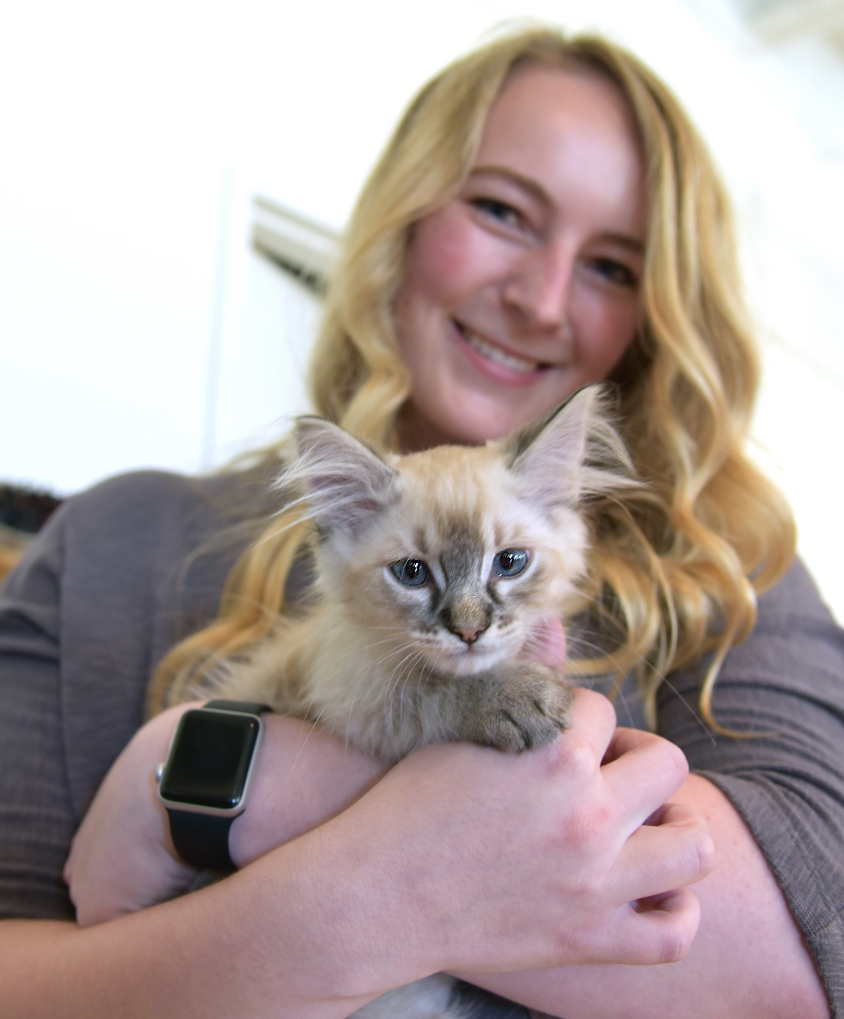
Purrfect match found?
Alert the Placement team!
Notify the Placement team by completing the “Interested Adopter Form” at the following link:
www.ASPCA.org/LAAdoptionAmbassador
Collect information for the Adoption Agreement and Microchip Registration
Adoption agreements are sent via email, with the subject titled: “Please DocuSign: ASPCA Adoption Agreement”
Agreements are sent 24-48 hours within the scheduled spay/neuter appointment date
Included in the adoption agreement email is a link to the adoption packet titled “Welcome Home Kitty! Adoption Packet”
The adopter information provided will also be used for their kittens microchip registration
Notes:
“Once you’ve determined you’ve found the perfect match, alert the Placement team as soon as possible. Complete the “Interested Adopter Form” by visiting the following link: www.aspca.org/laadoptionambassador.
To complete this form, you’ll need to collect information from the adopter for the adoption agreement and microchip registration. Once we receive the adopter’s information, the ASPCA will send the adoption agreement via email, with the subject titled ‘Please DocuSign: ASPCA Adoption Agreement.’ Agreements are sent 24-48 hours within the scheduled spay/neuter date. Be sure to keep the adopter updated on when their kittens’ spay or neuter appointment has been scheduled, and plan for a time for their kitten to come to their new home after 24-48 hours of recovery. In that same adoption agreement email, there will be a link to our adoption packet titled ‘Welcome Home Kitty! Adoption Packet’ filled with helpful information on cat care.
Additionally in the Interested Adopter Form will be a section for you to input the adopters contact information they would like linked to their new kitten’s microchip number. Inform the adopter that a microchip is the most important factor in ensuring their cat makes it back to them should they ever become lost. It is not a tracking device, but a small implant with a number unique to every pet used to identify and unite them with the adopter. The ASPCA will link this unique number to the adopters contact information after the adoption agreement has been completed. Have them review the Microchip Registry Instructions ahead of time found in the Adoption Ambassador Resource section. I’ll go over where to find that shortly.”

Slide 9
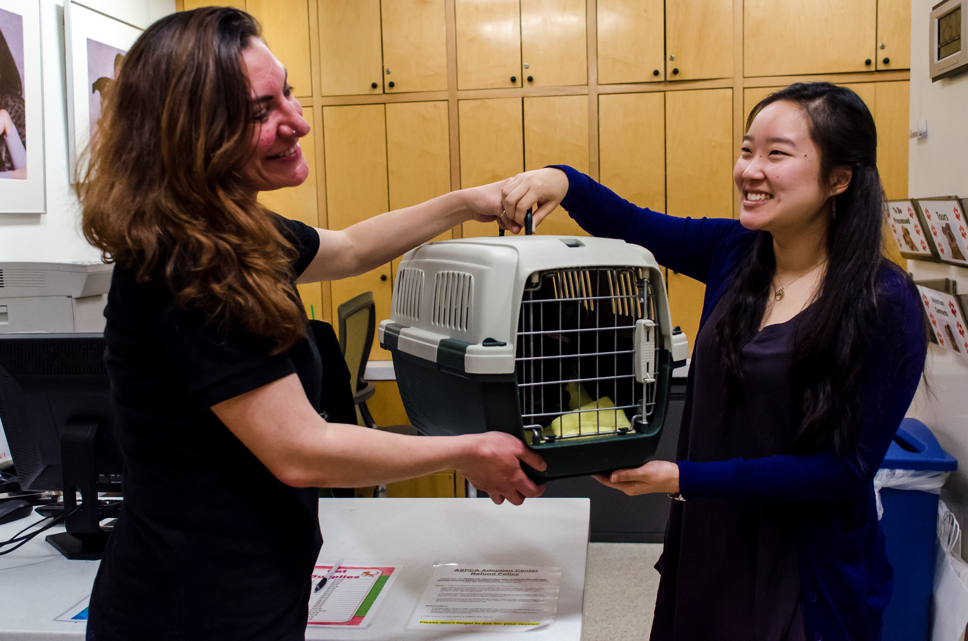
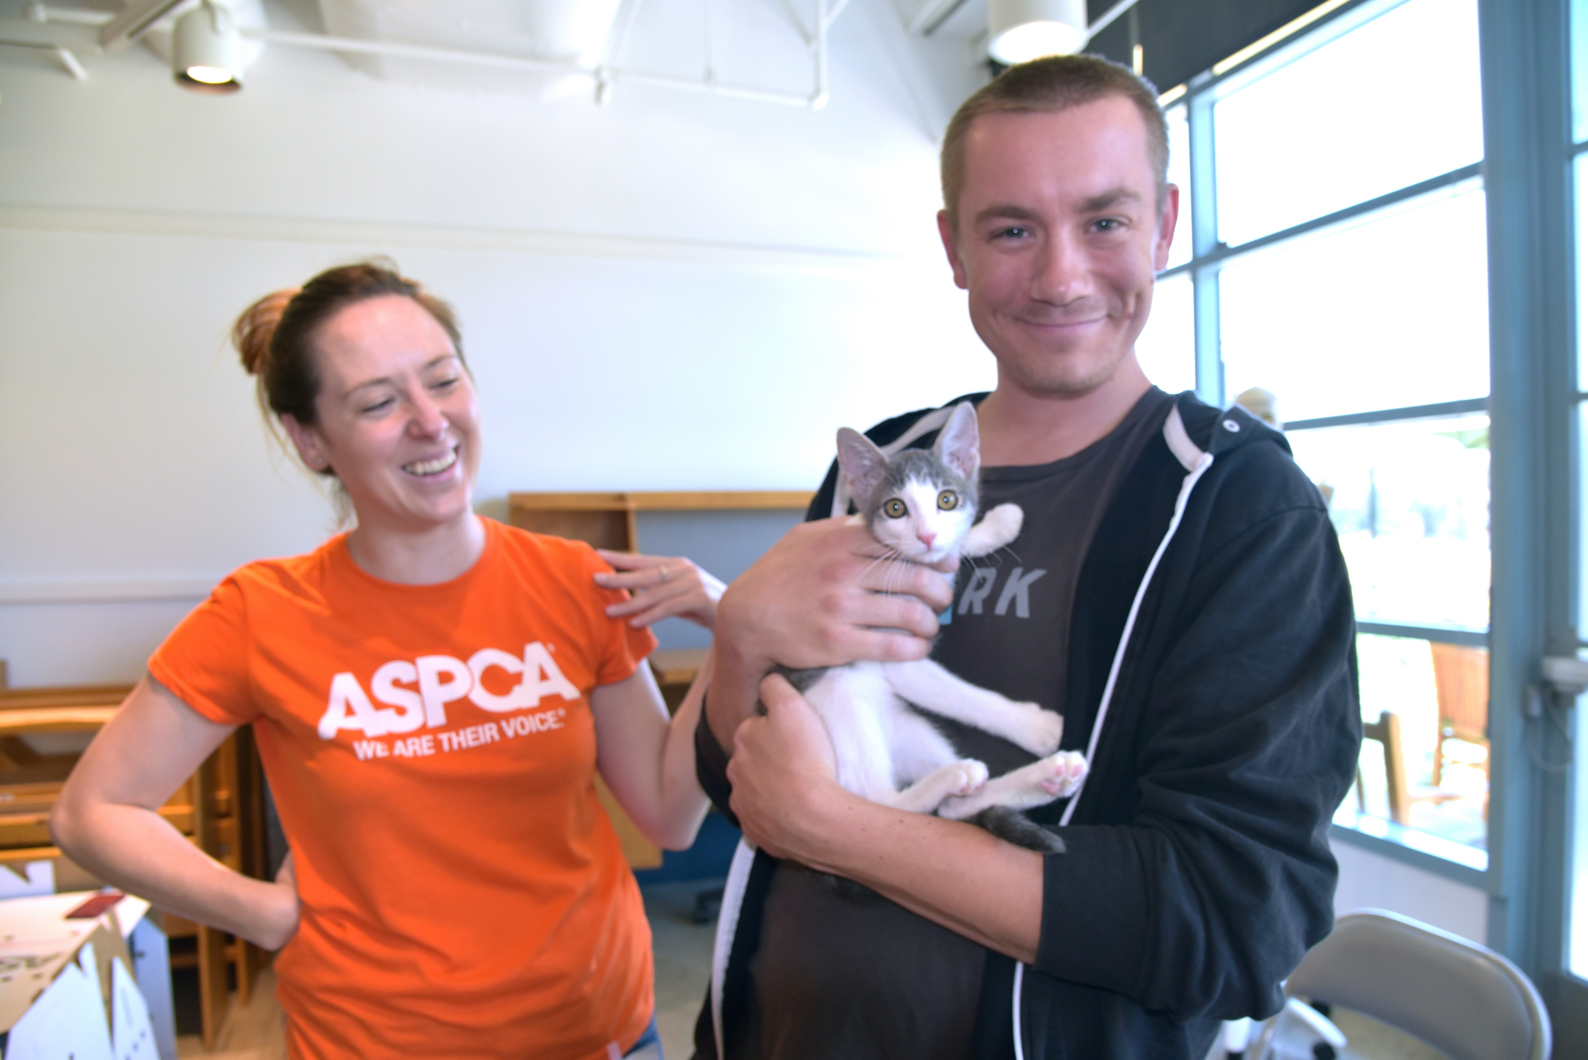
Schedule Spay or Neuter surgery at lafoster@aspca.org
When your foster kittens are healthy and close to 32oz (2lbs), contact our Foster team to schedule a surgery appointment.
If your surgery appointment has already been scheduled, ensure the Placement Team has a 48 hour notice prior to surgery or prior to the day you will be handing over the kitten.
Unite kitten and adopter!
If possible, have the kitten recover from surgery for at least 24-48 hours before moving them to their new home
IMPORTANT! Verify with the placement team that the adopter has completed the adoption agreement
Be sure to supply all medical documentation to the adopter. Missing records can be requested at laadoptions@aspca.org
Notes:
“Once all your foster kittens are close to 32oz/2lbs and are displaying no medical concerns, contact our Foster Team at lafoster@aspca.org to schedule their spay and neuter surgery appointment. Be sure to schedule your kittens surgery as soon as they are ready, even if an adopter has not been found. Alert adopters with the date of their kittens surgery, when they will be ready to go home, and remind them to complete the adoption agreement once it is received. Remember, adoption agreements are sent within 24-48 hours of the surgery date. If your surgery appointment has already been scheduled, ensure the Placement Team has at least a 48 hour notice prior to surgery or prior to the day you will be handing over the kitten. This ensures that we have enough time to send the adoption agreement, and the adopter has enough time to complete it.”
Once your kitten has recovered for at least 24-48 hours after surgery (if possible), they are ready to go home! By now, you should have scheduled a date and time to meet with their adopter and bring them their new family member. Be sure to verify with the adopter and the placement team that they have completed the adoption agreement before uniting them with their new kitten – this is a very important step! If they cannot locate the agreement, remind them to check their spam/junk section. When handing over their new kitten, remember to supply them with all their related medical documentation. Any missing records can be requested by contacting us at laadoptions@aspca.org.”

Slide 10
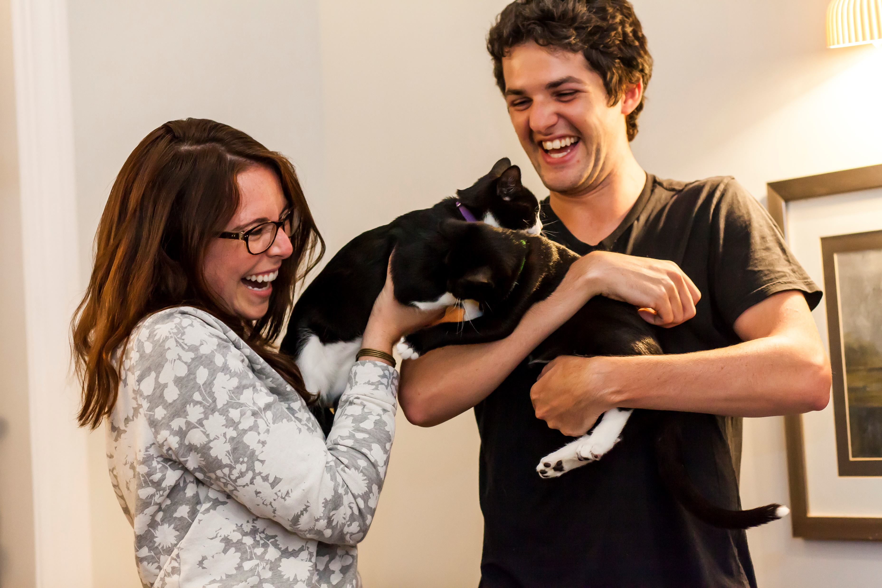
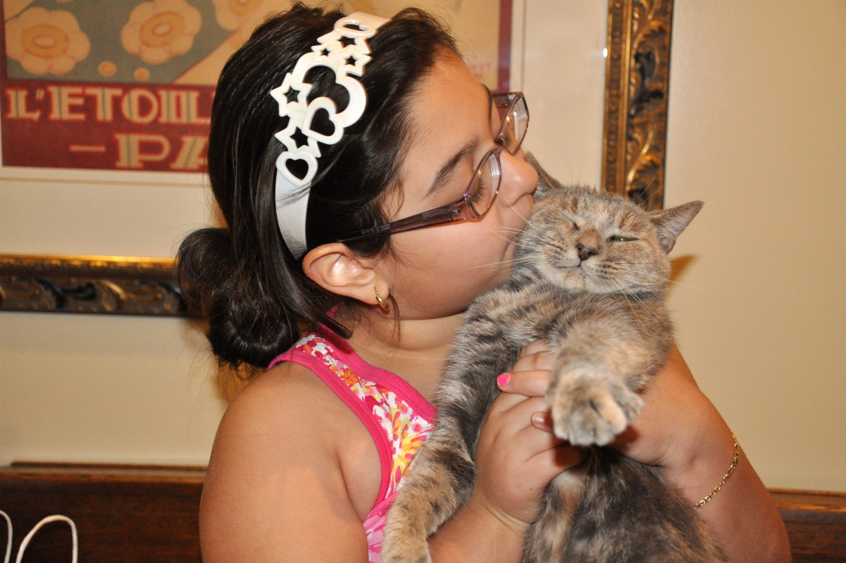
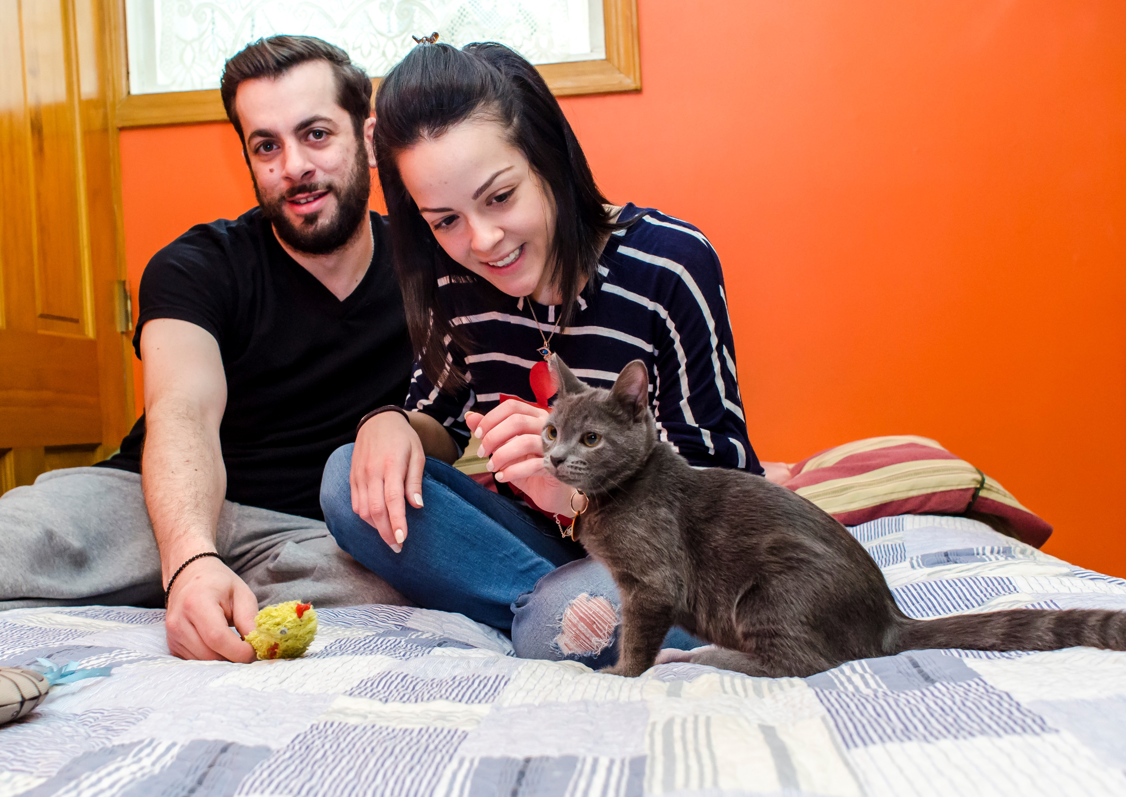
Follow their Journey!
Check in at 2 weeks
  Microchip registration profile verified?
  Have they visited a vet recently?
  Is everyone getting along?
  Pictures and videos please!
Check in at 1 month, then 6 months
  Revisit the 2 week check-in topics
  Pictures and videos please!
  The ASPCA is here to help! If adopters need assistance they may contact the ASPCA at laadoptions@aspca.org
Notes:
“Now, for one of the most fulfilling moments of being an Adoption Ambassador foster – following their happy ever after story! One of the best feelings is confirmation that all of your hard work and dedication has paid off, and your foster kittens are happy and loved. Check in with the adopter around 2 weeks after they’ve brought their new kitten home and discuss the following:
Have they verified that their Found Animals microchip registry profile is set-up and up-to-date with the correct contact information? If not, resend them our information sheet detailing the microchip registration process.
Have they visited a veterinarian recently? If not, remind them that we highly encourage scheduling a check-up appointment. This is especially important for younger kittens who need follow up vaccinations.
Is everyone getting along with their new addition to the family? If they have resident pets, then hopefully everyone has settled in well by the end of the first two weeks. If not, guide them to our introduction instructions and verify if they have been following those steps. We also have feline behavioral experts on staff if additional assistance is needed. Direct them to email laadoptions@aspca.org if they are still experiencing issues despite following our introduction methods.
Then, ask for updated pictures and/or videos. Send any received pictures or videos at laadoptions@aspca.org, we’d love to see as well!
The next check-ins will happen at around 1 month and 6 months after adoption. You’ll want to revisit the topics discussed at the 2 week check-in mark, focusing on how the transition period has been going. We would also love updated pictures and/or videos to see how everyone has grown! Lastly, remind them that the ASPCA is here to help even after adoption, and they may contact us at LAAdoptions@aspca.org”

Slide 11
KEEP THIS AREA CLEAR
FOR ZOOM VIDEO
If they are not able to keep their cat/kitten for any reason, please advise the adopter to contact the ASPCA and we will arrange to take them back into our program. Email laadoptions@aspca.org for any adoption returns.
If they are experiencing any behavioral issues, please advise the adotper to contact the ASPCA at laadoptions@aspca.org. Feline behavior specialists are on staff who can help with common issues such as not getting along with resident pets or litter box issues.
Notes:
“Be sure to emphasize that if they are unable to keep their kitten for any reason, the ASPCA will arrange to take them back. Email laadoptions@aspca.org for any adoption returns. Similarly, contact the ASPCA at the same email if they are experiencing any behavioral issues or have questions about anything. The ASPCA has feline behavior specialists on staff who can help with common problems such as not getting along with resident pets or litter box issues.”

Slide 12
Tools and Resources
For adoption resources: www.aspca.org/AdoptionAmbassadorResources
“Welcome Home Kitty” Adoption Packet
Microchip Registry Instructions
Tips on issues such as litter box problems
Remember!
Interested Adopter Form: www.aspca.org/LAAdoptionAmbassador
For any questions, contact us at LAAdoptions@aspca.org
Notes:
“All Adoption Ambassador resources will be easily accessible at aspca.org/AdoptionAmbassadorResources. You’ll find important information to assist you on your adoption journey including handouts on important topics and our adoption packet to proactively share with adopters.
Remember, when you’ve confirmed an adopter, notify us via the Interested Adopter Form at www.aspca.org/LAAdoptionAmbassador, and for any questions contact us at LAAdoptions@aspca.org.”

Slide 13
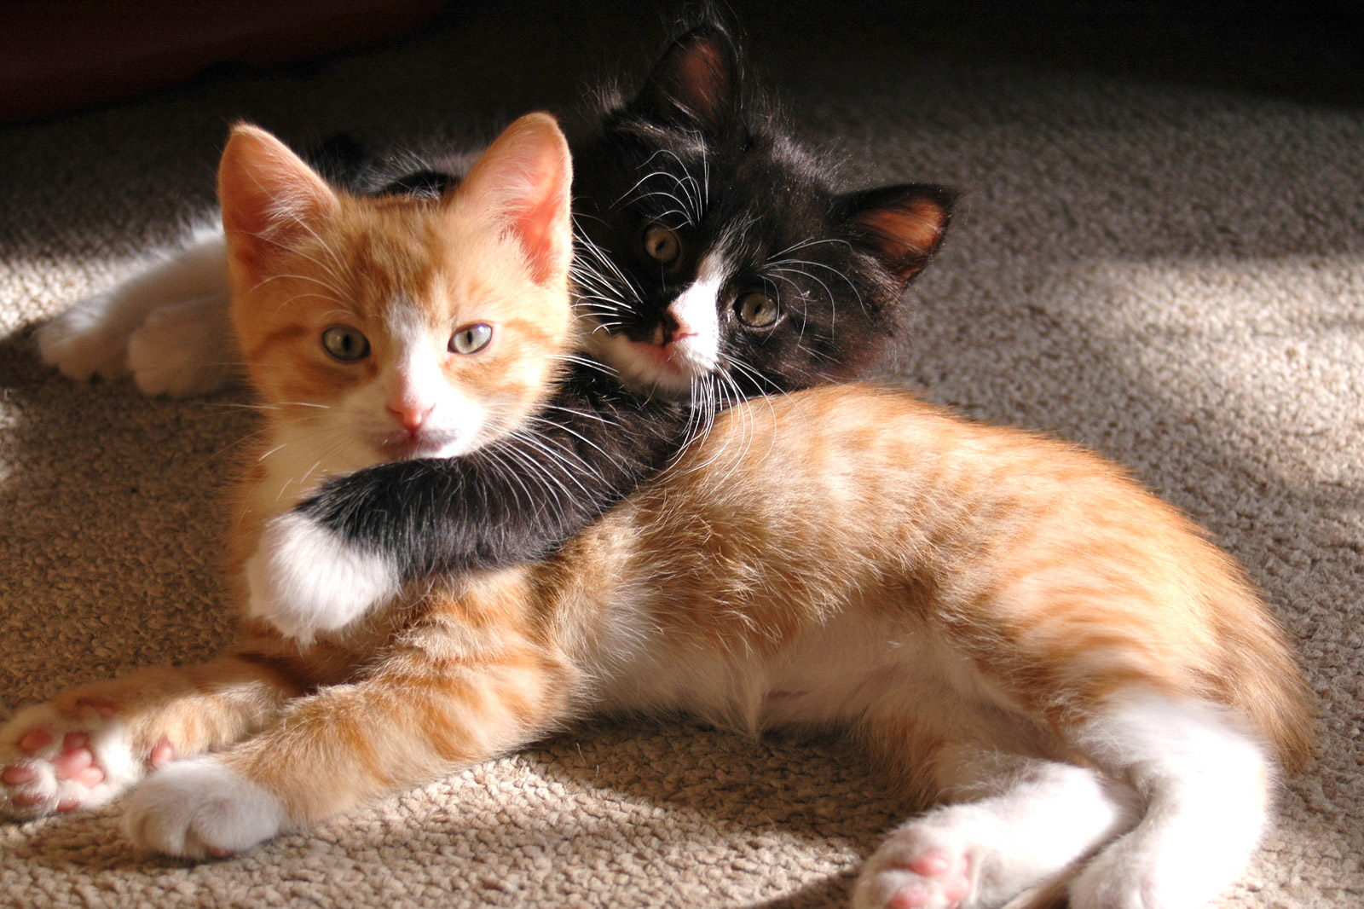
Thank you!
Let us know you’ve completed this session at: www.aspca.org/JoinAdoptionTeam
Notes:
“This concludes our training session! Let us know that you’re ready for matchmaking by completing the form found at www.aspca.org/JoinAdoptionTeam. You will also have a chance to submit any questions you may have. On behalf of everyone at the ASPCA, thank you for your continuous participation in our life saving efforts and becoming a member of our Adoption Ambassador team!”

