Slide 1
Animal Relocation in the COVID-19 Era
Brian A. DiGangi, DVM, MS, DABVP
Senior Director, ASPCA Shelter Medicine Services
Karen S. Walsh, CAWA, LVMT, CFE
Senior Director, ASPCA Animal Relocation
Kevin O’Neill
Vice President, ASPCA Government Relations, State Affairs

Slide 2
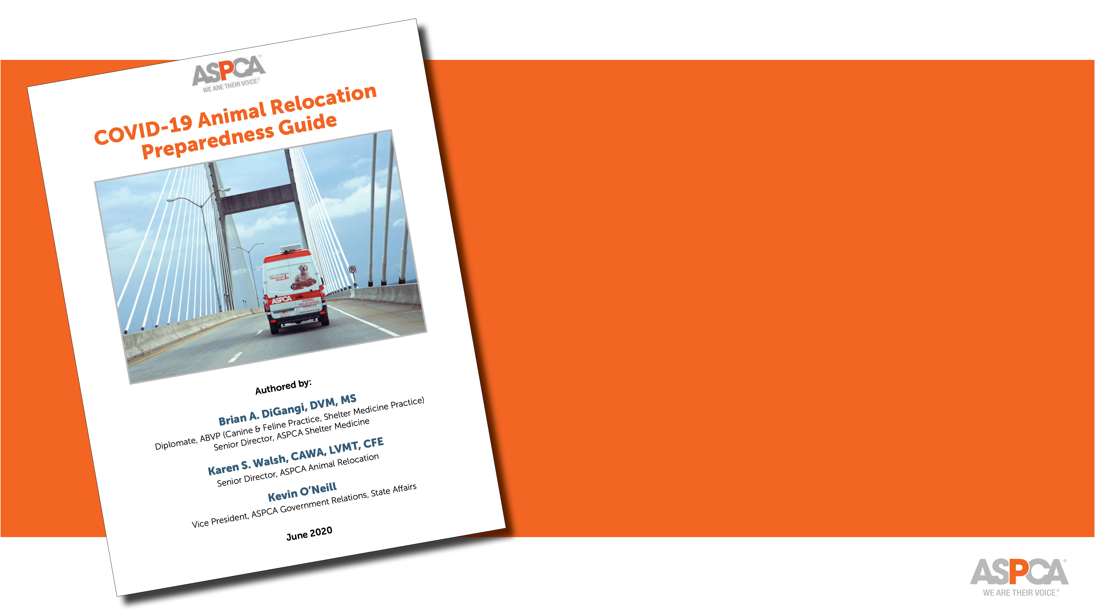
Community Preparedness
Decision-Making to Control Disease Transmission
Program Readiness
Prioritizing Relocation Candidates
Capacity for Care
Communication Considerations
Operational Protocols & Social Distancing
Paperwork and Record-Keeping
Post-Transport Concerns
Sample Frameworks

Slide 3
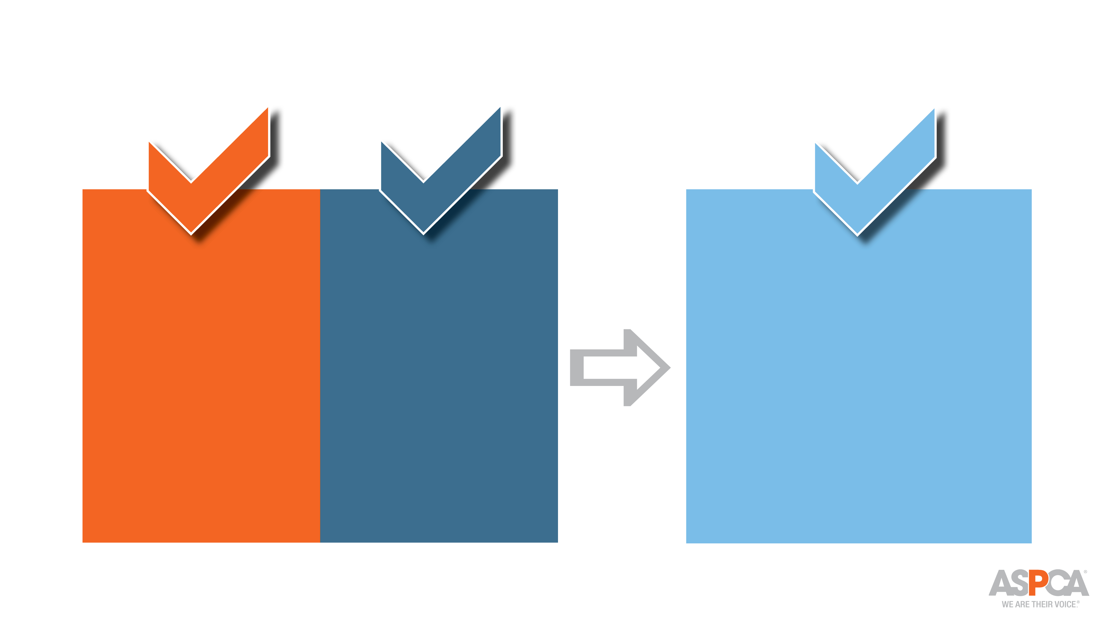
Preparedness Checklist
Can we resume relocation?
Should we resume relocation?
Choose the most appropriate model
Develop, review, or modify SOPs
Assess SOPs for capacity, feasibility, resource needs

Slide 4
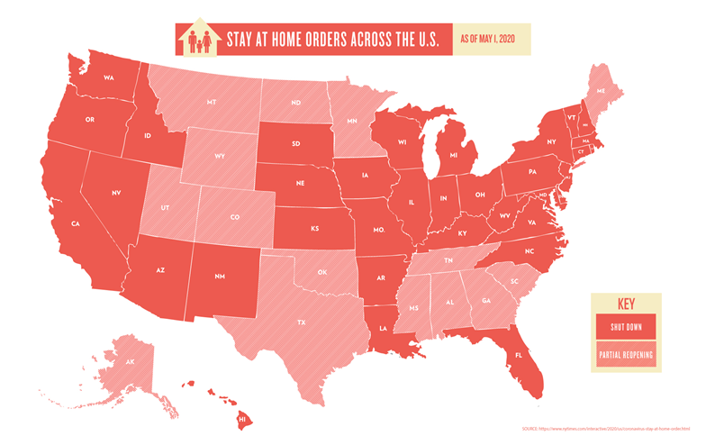
Community Preparedness: CAN We Resume Relocation?
Assessing Source Communities
Assessing the Destination
Are states allowing imports?
Are there restrictions on veterinary services?
Are there quarantine requirements?
Assessing your route

Slide 5
Community Preparedness: CAN We Resume Relocation?
Are existing state import requirements suspended?
Are destinations located in new/emerging hotspots?
Are states seeking new import regulations?

Slide 6
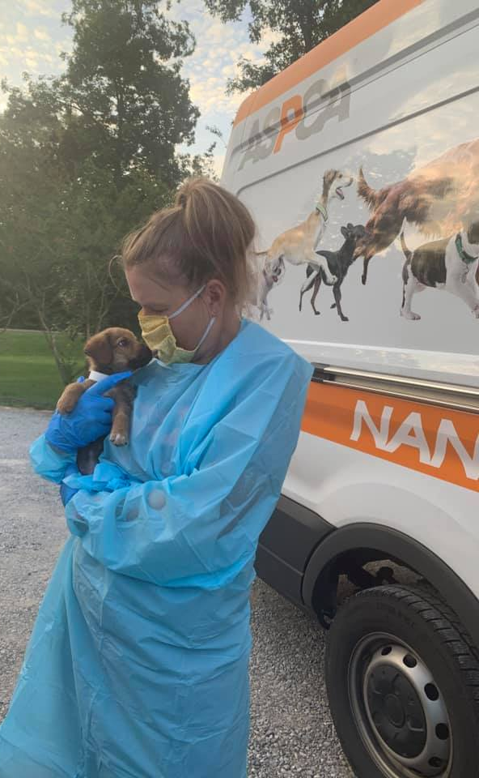
Programmatic Considerations: SHOULD we resume relocation?
Local available source outcomes
Capacity for destination community
Local adoption capacity – S & D
Veterinary services
Social distancing/PPE - impact
Operational Changes
Exposure risk – staff, foster, volunteer

Slide 7
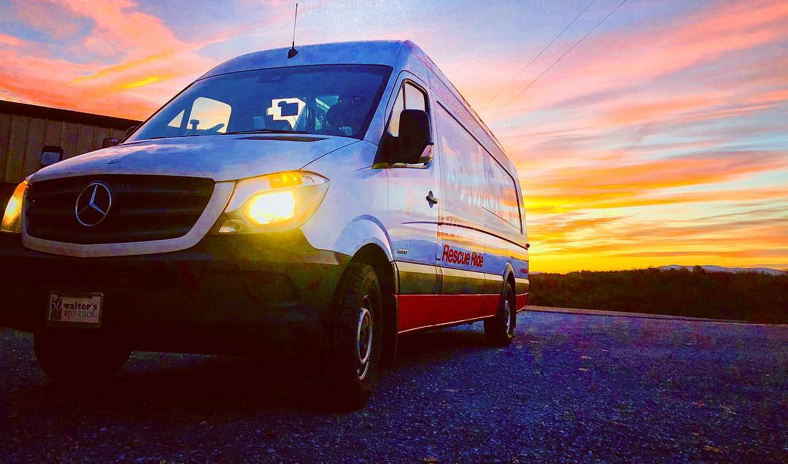
Ready to Resume Relocation?

Slide 8
Which works for your organization?

Slide 9
Develop, Review, or Modify SOP’s
Personnel Safety & Support
Handling SARS-CoV-2 positive personnel
Handling COVID-exposed animals
At this time, there is no evidence that pets can spread COVID-19.
Training staff and volunteers
Notes:
Personnel safety and support
Testing, self-monitoring, quarantine guidelines
Team Check-In
Contingency planning
Handling SARS-CoV-2 positive personnel
Planning!
Handling COVID-exposed animals
At this time, there is no evidence that pets can spread COVID-19.
Hold for 14 days prior to release
Training staff and volunteers

Slide 10
Develop, Review, or Modify SOP’s
Program Operations
Communication
Social Distancing
Notes:
Program operations
Frequency and volume of transports
Animal and personnel selection
Communication
Partners, personnel, public
Social distancing
Animal selection
Loading/unloading
Driver biosecurity
Paperwork

Slide 11
Q & A
Do you often hear resistance from locals who live in cities that are receiving out of state cats and kittens?
Do you know of any states that are restricting animals from coming into the state?
Notes:
Karen and Kevin

Slide 12
Q & A
How have organizations begun utilizing electronic forms of document transfer for important paperwork, such as CVIs?
Notes:
Karen and Kevin

Slide 13
Q & A
In the face of COVID-19, how should we handle disaster transports differently for both animals and staff?
Notes:
Karen and Kevin

Slide 14
Q & A
We are new to relocation, what is your most important advice for newbies, especially now?
How do we prepare a shelter for a relocation program?
Notes:
Karen and Kevin

Slide 15
Q & A
Open Q & A

Slide 16
sheltermedicine@aspca.org
relocation@aspca.org
government_relations@aspca.org

