Slide 1

Caring for Kittens During COVID-19 and Beyond: Old Strategies and New Lessons
Enjoy the music!
The webinar will begin at its scheduled time.
Join the webinar using built-in computer audio or dial 669-900-6833 or 646-558-8656
Webinar ID: 100-939-689

Slide 2
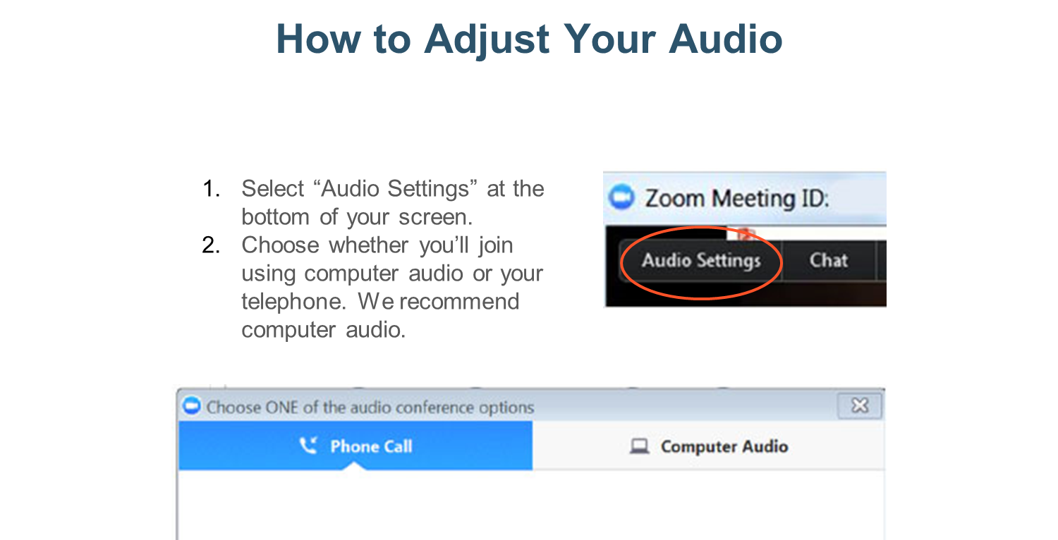

Slide 3
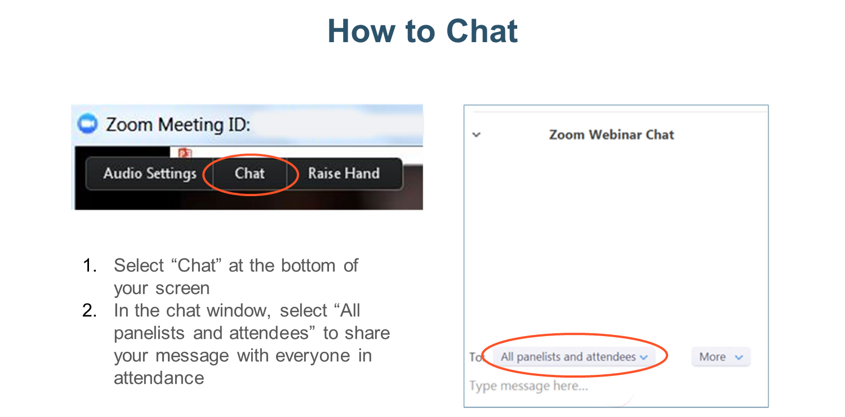

Slide 4

Your Presenter
Erin Doyle, DVM, DABVP (Shelter Medicine Practice)
Senior Director, Shelter Medicine and Residency Programs
ASPCA
Immediate past-president, Association of Shelter Veterinarians
erin.doyle@aspca.org

Slide 5
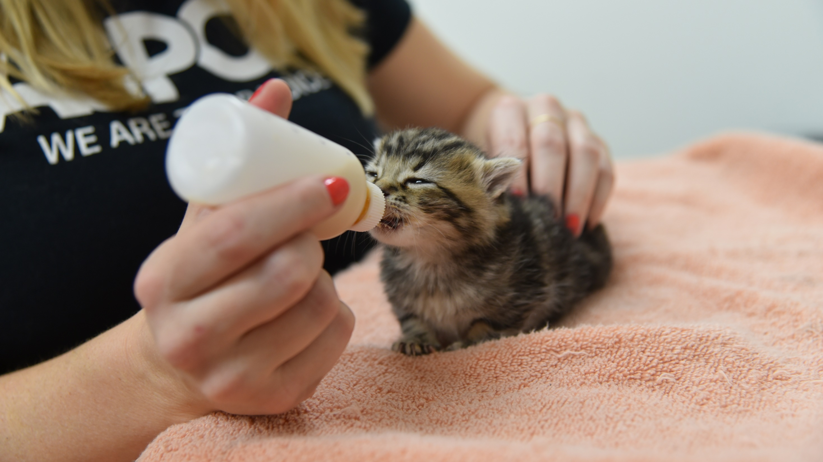

Caring for Kittens During COVID-19 and Beyond: Old Strategies and New Lessons.

Slide 6


Learn five core best practices for underage kitten care
Learn how our COVID-19 response has allowed us to look at these practices in a new way
Learning Objectives

Slide 7
Question for the group
Did you change your intake policy for underage kittens and nursing queens due to COVID-19? If so, how?

Slide 8

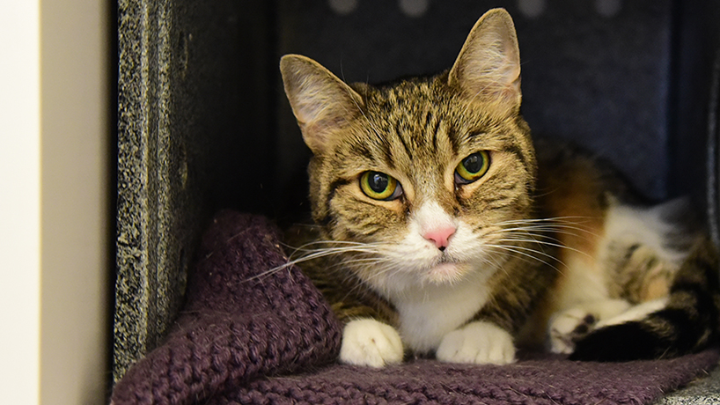
Tried and true strategies for success in kitten care

Slide 9
#1 – Manage the foster population
Intake processing capacity
Foster home capacity
Capacity to support ongoing care
Potential intake
Placement capacity

Slide 10
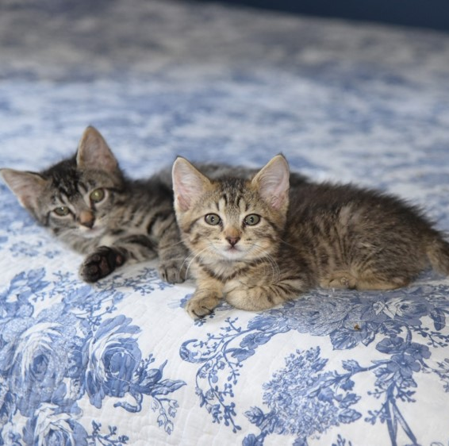
#2 – Don’t mix and mingle litters
Balance risk versus benefit
Make sure it’s a “long-term” relationship
Assess medical risk
Assess behavioral benefit

Slide 11
#3 – Infection control
Prevent the spread of disease
House in an easily cleaned area
Hand hygiene after handling
Monitor for disease
Toys and bedding that can’t be cleaned travels with them
Sanitize between litters

Slide 12
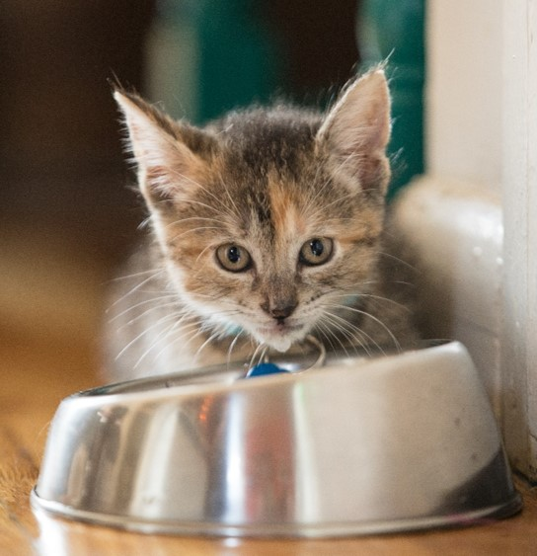
#4 – Create clear monitoring parameters
Monitor trends
Appetite
Weight
Identify key concerns
Lethargy
Inappetence
Activity level
Weight loss
Respiratory signs
Diarrhea
Vomiting
Ocular signs

Slide 13
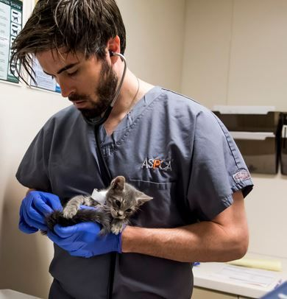
#5 – Preventive medicine
Vaccination
Parasite treatment
Modified-live FVRCP every 2 weeks starting at 4 weeks of age
Flea treatment
Treatment for roundworms and hookworms every 2 weeks
Treatment for coccidia
Intake examination
Physical exam
Wood’s lamp screening

Slide 14
Question for the group
Did you change your management of underage kittens in your care due to COVID-19? If so, what was the biggest change?

Slide 15
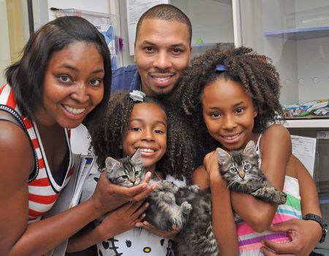
Population management – reconsidering the shelter’s role
Are we stepping in too quickly?
Can we ask more of the finder?
Provide information and resources
Foster to surrender
Help with placement and spay-neuter

Slide 16
Avoid mixing and mingling – all the more important
COVID-19 transmission…
Is human to human
But…
The potential for transmission to and between cats highlights the need to follow best practices
And stresses the importance of…
Avoiding overcrowding
Thoughtful cat-cat interactions

Slide 17
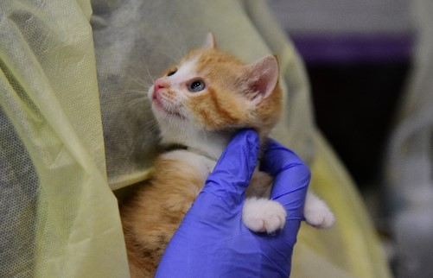
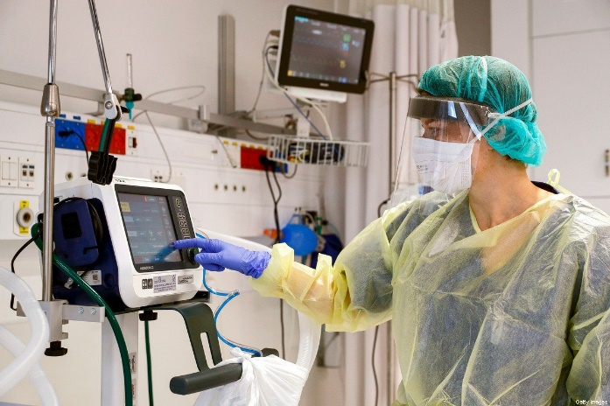
Infection control practices – less is (sometimes) more
PPE and disinfectants should always be used for a thoughtfully defined reason.
Their efficacy is only as good as the protocols and processes in place.
Appropriately used spot cleaning, hand hygiene, reusable protective garments and conscientious animal handling can be equally effective.

Slide 18
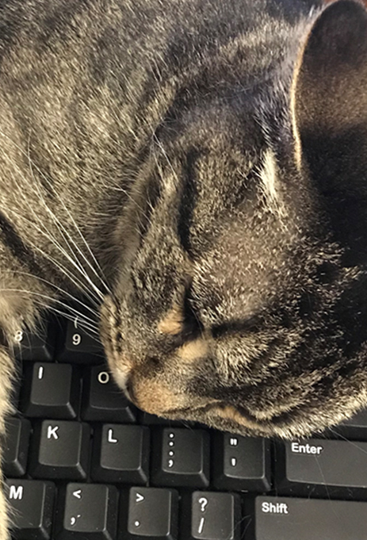
How do we follow-up on foster monitoring parameters?
Telemedicine
Availability is based on individual state practice acts
Requires VCPR – typically readily established for foster animals
Streamlines the process for straightforward medical concerns

Slide 19
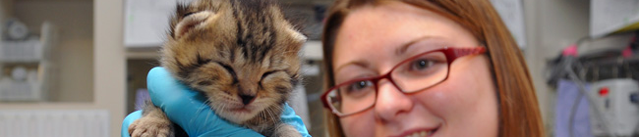
Preventive medicine protocols
Still a vital component of foster programs
Veterinarians should base protocols on guidelines and assessment of risk
Consider how to balance this with intake diversion programs

Slide 20
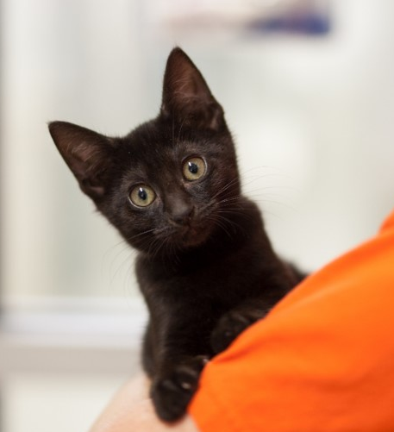
COVID-19 has caused us to reassess our protocols and procedures in a way that can have lasting positive impact.

Slide 21
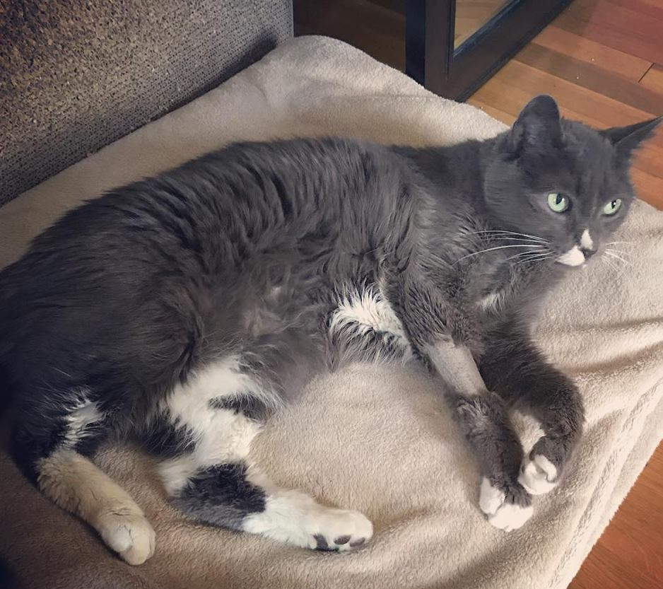
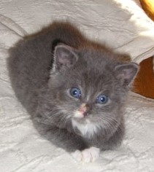
Questions?
erin.doyle@aspca.org
sheltermedicine@aspca.org

Slide 22

Join APCC for our next webinar:
June 17, 2020 at 6PM EST
The Nose Knows: Or Does It? How Drugs Affect Scenting Ability in Dogs
Presented by Dr. Karla Smith, DVM, Consulting Veterinarian in Clinical Toxicology

