Slide 1
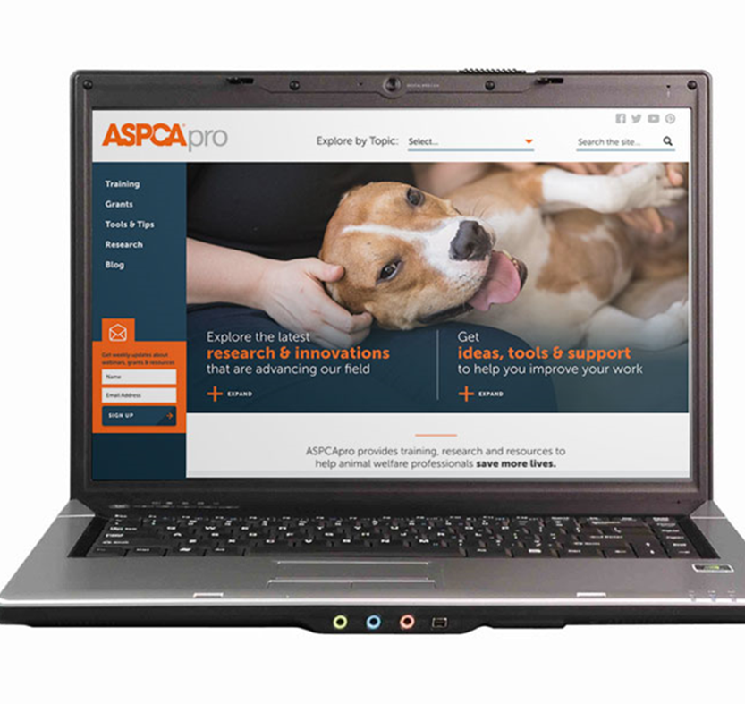
Reopening Clinics: Refreshers For Your Staff
Enjoy the music!
The webinar will begin at its scheduled time.
Join the webinar using built-in computer audio or dial 669-900-6833 or 646-558-8656
Webinar ID: 956-5308-6998

Slide 2
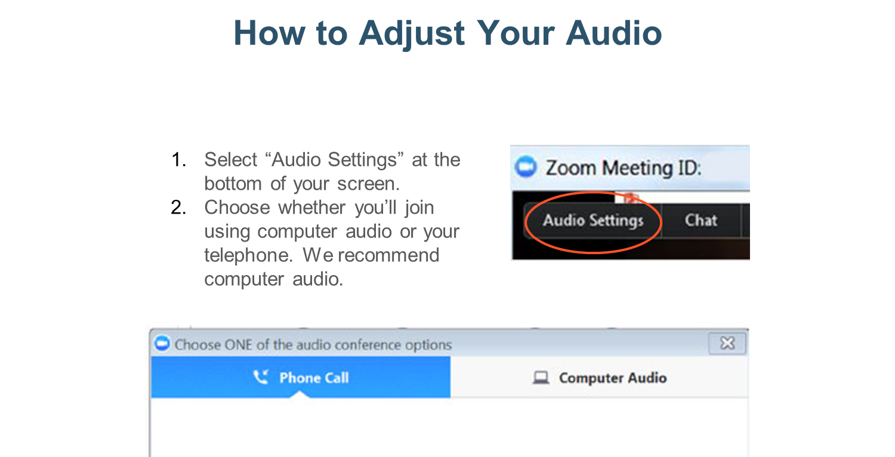

Slide 3
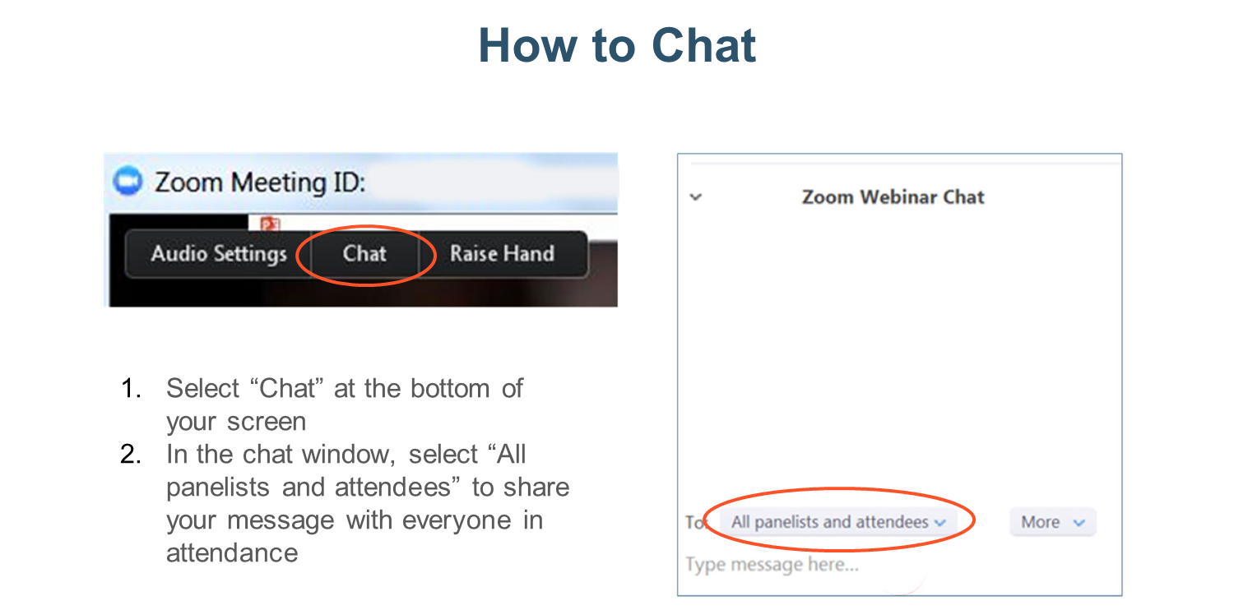

Slide 4
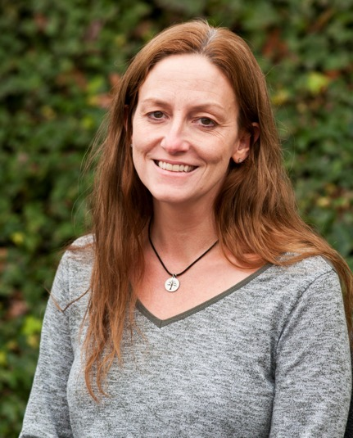
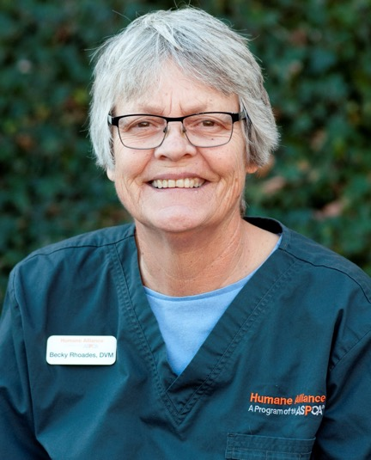
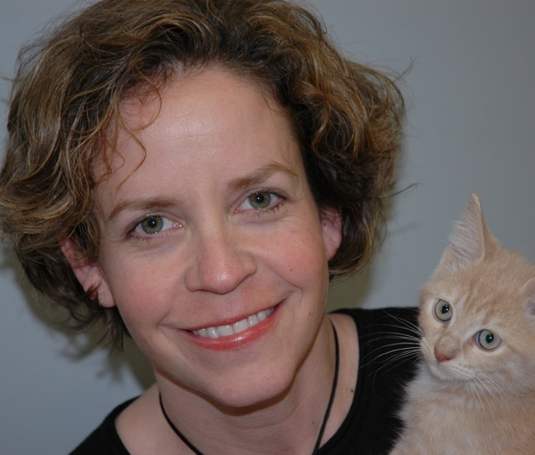
Presented by
Sarah Hess
Director, Programs
ASPCA Spay/Neuter Alliance
Darcie Harrell, RVT
Rebecca Rhoades, DVM

Slide 5
Just-in-Time Onboarding of Veterinary Support Staff
May 7, 2020
Rebecca Rhoades, DVM
Darcie Harrell, RVT
Sarah Hess
Brian DiGangi, DVM, MS
© 2020 ASPCA®. All Rights Reserved.

Slide 6
ASNA Update
ASPCA Statement Concerning ​
Spay and Neuter of Shelter Animals ​
During the COVID-19 Crisis​
​
Pandemic Creates Operational and Legal Challenges for Shelter, Veterinary Services​
​
Temporary Suspension of Spay Neuter Will Save Lives During the Pandemic​
​
​
https://www.aspcapro.org/resource/aspca-statement-concerning-spay-and-neuter-shelter-animals-during-covid-19-crisis​
​ ​
ASNA stopped surgeries on 3/26
We have repurposed our campus to distribute free pet food and offer free primary pet care to WNC​
​
We are in planning mode. Training programs target re-open on August 31; surgery to open first but no specific date yet.

Slide 7
Purpose
Provide tools to onboard new veterinary support staff or to onboard volunteers – "Just-in-Time" Training
Provide a quick refresher for existing veterinary support staff
Allow you to have enough staff to accomplish your surgical goals while also maintaining social distancing, split shifts & other COVID precautions
© 2020 ASPCA®. All Rights Reserved.

Slide 8
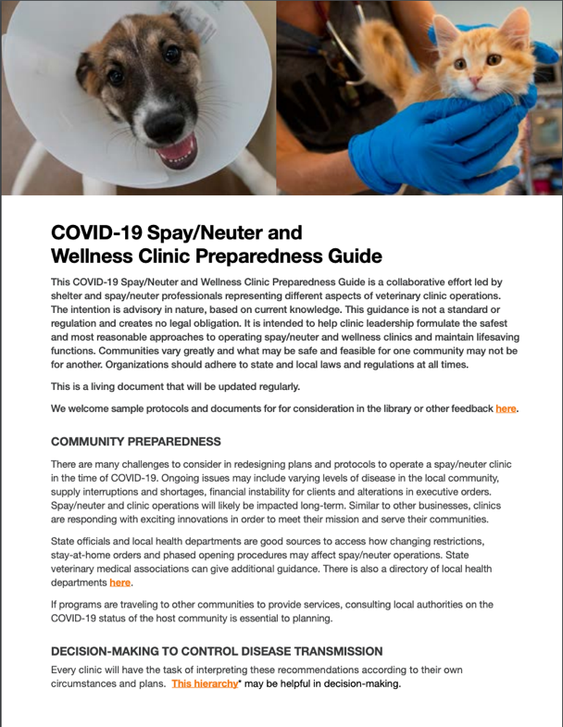
Toolkit Highlights
AVMA chart on how to change workflow & staffing levels to protect your staff​
​
Assessing capacity for social distancing and PPE requirements​
​
Curbside Check in/Discharge​
​
Alternative Drug Protocols ​
​
Telemedicine rechecks​
https://network.bestfriends.org/covid-19-sn-clinic-guide

Slide 9
Background
In non-COVID world, ASNA recommends staffing:
Vet + 2 (VT + VA) = up to 20 sx
Vet + 3 (VT + 2 VA) = 21-40 sx
Staffing patterns in non-COVID times are based on efficiently & safely reaching a high-volume of surgeries
COVID precautions will change your staffing dynamics & efficiency; but should not affect your patient safety
© 2020 ASPCA®. All Rights Reserved.

Slide 10
Takeaways
Regardless of how many support staff on a shift, each person needs well-defined responsibilities
Each person, in their defined role, should be trained to accomplish their tasks for both patient & human safety
The roles of each team member weave together for a cohesive unit
© 2020 ASPCA®. All Rights Reserved.

Slide 11
Veterinarian Role
Drug protocols/pain management
Exams/premeds
High-risk waivers
Surgeries
Rechecks
Follow-up calls
Walk-throughs
© 2020 ASPCA®. All Rights Reserved.

Slide 12
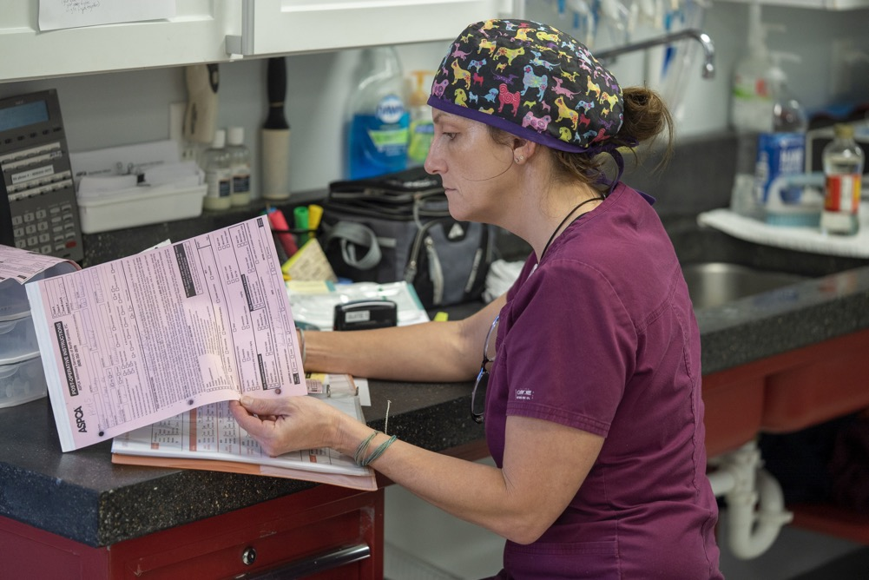
Lead Veterinary Technician Role
Surgical lead & flow director
Management of controlled substances
Drug log maintenance
Drug drawing
Induction/intubation
Monitoring (2-min loop cycles)
Completes paperwork
Walk throughs
© 2020 ASPCA®. All Rights Reserved.

Slide 13
Veterinary Assistant Role
Gentle animal handling & restraint for exams & induction
Patient care
Transporting awake & anesthetized animals
Surgical patient prep
Thorough anesthetic monitoring with 2-minute loop manual checks
Recovery
Suite set-up/break-down
Feeding/watering
End-of-day cleaning
© 2020 ASPCA®. All Rights Reserved.

Slide 14
Just-in-Time Onboarding Manual
The manual contains information, video links and tests​
​
Designed for Technicians to work through Assistant course first then Technician course ​
​
You have the opportunity to set up a custom 1-hour call with ASNA after the webinar​
Our content & photos are pre-COVID. While we have provided some generalized suggestions for COVID; your clinic/program is responsible to implement COVID precautions necessary for your state requirements & clinic operations​.

Slide 15
Patient Intake
Online check-in with electronic payment​
​
Prioritizing patients in greatest need ​
​
Curbside check-in to maintain social distancing​
© 2020 ASPCA®. All Rights Reserved.

Slide 16
Gentle Animal Handling & Restraint
Helps minimize stress on patients
Should be incorporated into all aspects of patient care, handling, & housing
When staff recognizes & addresses fear in cats & dogs, you save time & minimize staff injuries
Gentle Handling Techniques for Cats:
https://www.aspcaonline.org/#/dashboard
© 2020 ASPCA®. All Rights Reserved.

Slide 17
Disease Prevention
Critical for staff to understand & follow strict rules to help prevent the spread of disease
Provide adequate supplies in all parts of your clinic to allow for easy compliance
© 2020 ASPCA®. All Rights Reserved.

Slide 18
Hypothermia Prevention Care
Preventing hypothermia is critical for anesthetized patients to avoid slow recovery
Remember to utilize tools to prevent hypothermia at all points during their stay in the clinic
© 2020 ASPCA®. All Rights Reserved.

Slide 19
Goals of Safe Anesthesia
Decrease stress
Produce unconsciousness
Provide analgesia
Foster amnesia
Maintain immobilization & muscle relaxation
Incorporate potentially reversible agents
Well-known drugs, reliable & cost-effective for HQHVSN environments
© 2020 ASPCA®. All Rights Reserved.
© 2020 ASPCA®. All Rights Reserved.

Slide 20
Pre-op
Opioid
Local Block
Balanced
Analgesic
Protocol
Pre-op
Sedative/
Anxiolytic *
Pre-op
NSAID**
*Anxiety has been shown to contribute to pain wind-up
** NSAID non-steroidal anti-inflammatory drug
* Anxiety has been shown to contribute to pain wind-up
** Non-steroidal anti-inflammatory drug

Slide 21
Flow & Time Management
The lead technician is key to good flow!
Good flow during surgery is
Always knowing what is going on in the prep & surgery suite,
Knowing your doctor & having the next patient ready
High-quality patient care throughout the whole day
© 2020 ASPCA®. All Rights Reserved.

Slide 22
Communication
Practice closed-loop communications
Utilize non-verbal communications to signal tasks
Good communication is key to good patient care & preventing emergencies
© 2020 ASPCA®. All Rights Reserved.
Notes:
V tray set upright on prep table indicates table cleaned and closed surgical pack placed on mayo stand means surgery table cleaned

Slide 23
Efficiency & Accuracy When Drawing Drugs
Making up drugs for all patients first thing in the morning allows for more drug security & efficient surgery flow
© 2020 ASPCA®. All Rights Reserved.

Slide 24
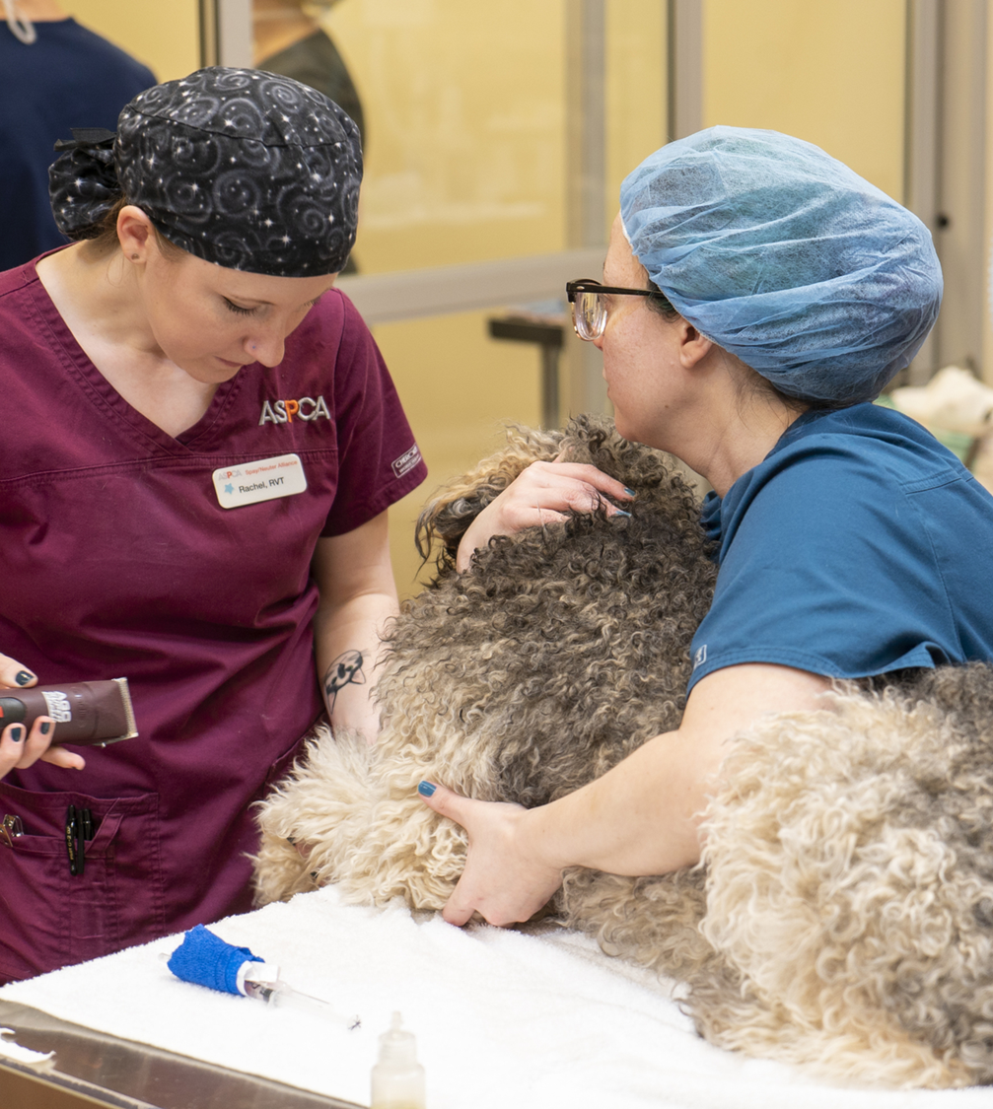
Induction
Smooth induction of patients for spay/ neuter surgery requires proper planning & good technique
Start surgery with puppies & toy breeds as they are most susceptible to developing hypoglycemia & hypothermia
© 2020 ASPCA®. All Rights Reserved.

Slide 25
Handling Anesthetized Patients
Anesthetized patients must be carried to fully support the alignment of their neck & back to prevent injury
Always move or adjust a patient from underneath, instead of pulling on limbs
© 2020 ASPCA®. All Rights Reserved.

Slide 26
Patient Prep
We recommend close monitoring to ensure proper sterile preparation of the surgical field
© 2020 ASPCA®. All Rights Reserved.

Slide 27
Patient Monitoring
Continuous monitoring requires alarmed pulse oximeters on every patient under anesthesia
Surgical team must perform manual checks on their patients at regular intervals (2-3-minute loops)
Closed-loop communications
© 2020 ASPCA®. All Rights Reserved.
Notes:
Always respond to pulse-ox alarms, assess patient status and communicate to team.

Slide 28
Recovery
Have all animals on the recovery mat facing the same direction with their tongues visible
​
Smaller groupings to limit exposure and maintain social distance ​
© 2020 ASPCA®. All Rights Reserved.

Slide 29
Emergency CPR
Have a plan & keep practicing with your whole team
© 2020 ASPCA®. All Rights Reserved.

Slide 30
Release
Curbside discharge to avoid people in the lobby​
​
Remote discharge instructions ​
​
Electronic receipt, record and discharge instructions with contact information for post-op concerns​
© 2020 ASPCA®. All Rights Reserved.
Notes:
With after hours emergency numbers and what to do if need recheck - telemedicine

Slide 31
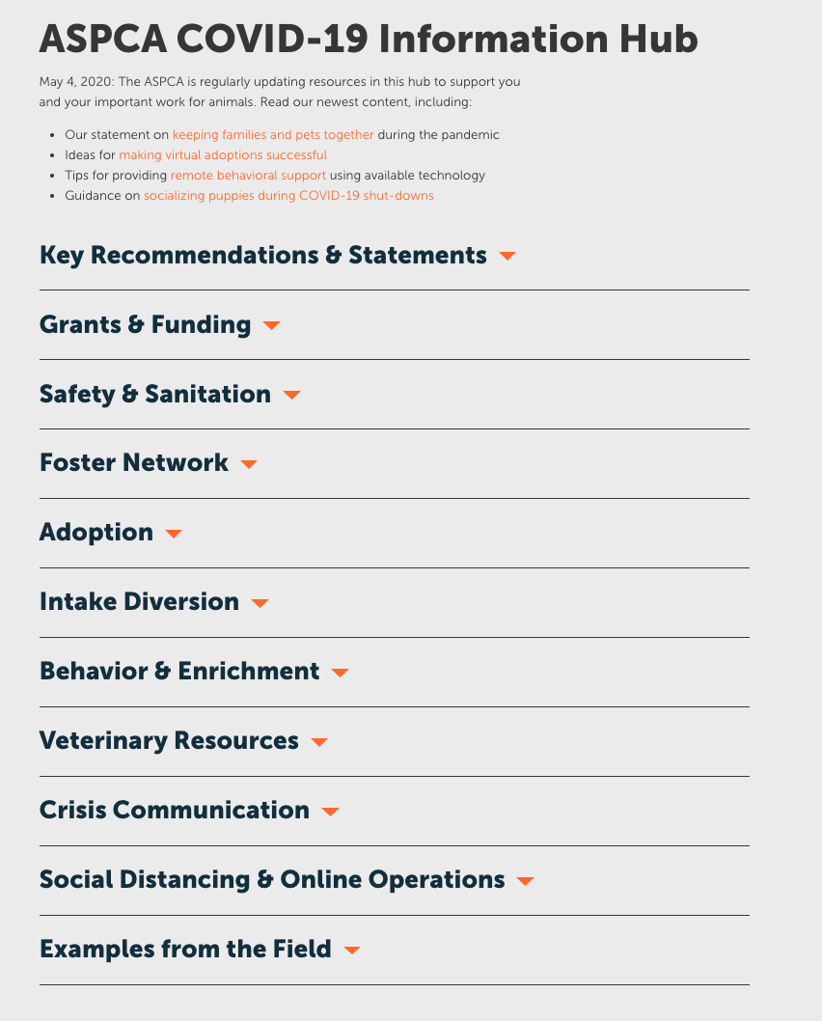
Ask ASNA and Ask The Experts ASPCA COVID-19 Info Hub
If you have follow-up questions about this onboarding resource: 1 hour “Ask ASNA”
ASPCA is offering “Ask the Experts” for sheltering, behavior & equine:
https://www.aspcapro.org/ask-ASPCA-expert
Request your 1-hour zoom consultation HERE
Notes:
Ask asna and the covid tool kit link
https://docs.google.com/forms/d/e/1FAIpQLSfIPaP9zYznZufMtWHobK-bLYfNuKEWZURJXvKvtL1rB0h9Vg/viewform

Slide 32
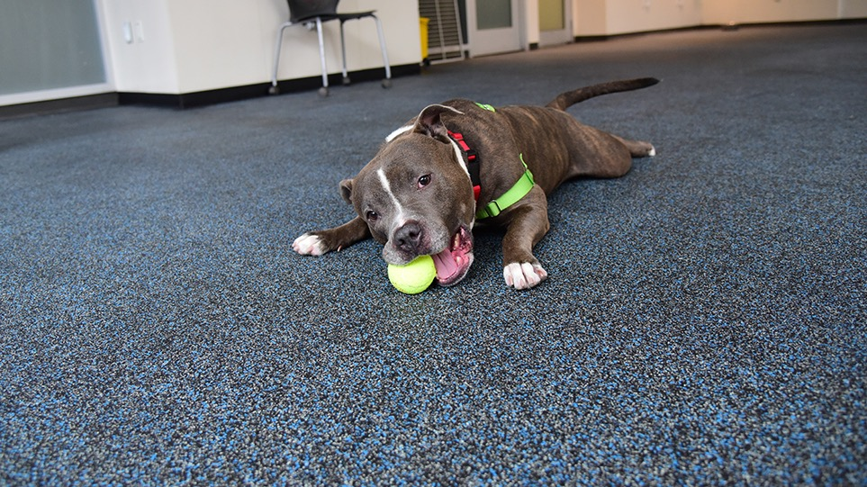
We’d love your feedback! Please fill out our anonymous survey!
Questions?
© 2020 ASPCA®. All Rights Reserved.

Slide 33
Join us for our next webinar: May 20, 2020 at 3PM EDT
Caring for Kittens During COVID-19 and Beyond: Old Strategies and New Lessons
Presented by Dr. Erin Doyle
DVM, DABVP, Senior Director of Shelter Medicine, ASPCA

